Slide 1
Ecotourism
Ecotourism is not just a marketing gimmick. It is increasingly recognized as a tool for sustainable development.
Achieving genuine ecotourism is a challenge, as high standards have to be met. But when it is achieved, communities and natural environments are the immediate beneficiaries.

Slide 2
A short definition put forward by The Ecotourism Society in 1991 describes it as 'responsible travel to natural areas that conserves the environment and sustains the well-being of local people.'

Slide 3
Professionals working within the field of ecotourism generally agree that it is characterized by:
- Travel to a natural area.
Travel that supports the conservation of biodiversity.
Travel that brings benefits to local host communities.
Travel that leads to greater understanding of the natural or cultural environment visited.

Slide 4
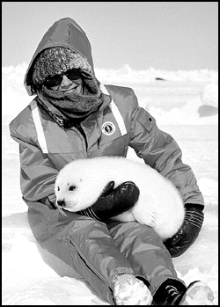
Including these four components in a travel package significantly restricts the number of products that can genuinely be labelled ecotourism. Many confuse the term with nature tourism or adventure travel, but they are not the same. Rather, ecotourism is one niche market within the larger, and rapidly expanding, nature tourism market. By some estimates, nature-based tourism now comprises 20 per cent of the world travel market, and ecotourism 7 per cent.

Slide 5
Ecotourism is not just visits to the rainforest. It can be activities in a traveller's home country, as long as these visits are responsible and benefit conservation efforts and local communities - and the visitor has participated in some learning experience. One example might be camping at a national park, paying an entry fee, following park rules of conduct, buying supplies at a gateway community outside the park, and participating in a natural history lesson.

Slide 6
- award winning responsible tourism

Slide 7
Safari adventure in Masai Mara, Kenya
Take a walk on the wild side - in lion country. Stay at Kenya’s most legendary safari camp Basecamp Masai Mara, preferred by politicians and dignitaries because of our the commitment to fight climate change, to nature conservation and local development. Leave a positive footprint and enjoy Basecamp’s speciality, walking safari with your own Masai guides - or you can enjoy traditional game drives in classic safari jeeps on the open savannah of Masai Mara. At Basecamp Masai Mara, you will get closer to nature than you have ever been before.

Slide 8
But is it ecotourism?

Slide 9
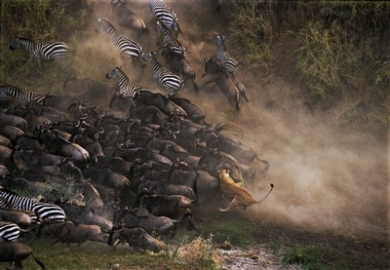
- Travel to a natural area
Masai Mara National Game Reserve
The magic of the Masai Mara, the jewel of Africa’s wildlife areas hosting more than 95 different big mammals and 550 different birds.
Drive across the impressive Great Rift Valley; spend the nights at Basecamp – a small tented camp embedded by trees at the very edge of savannah.
Prepare to meet the wild.

Slide 10
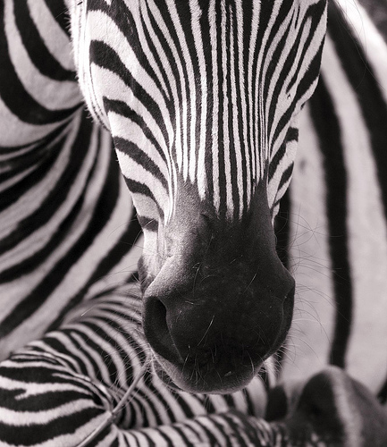
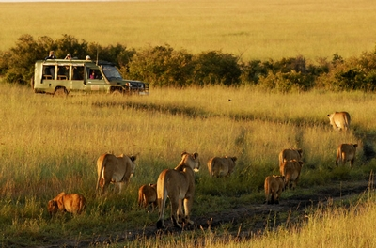
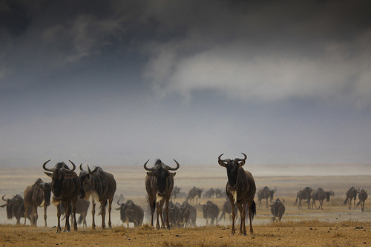
Maasai Mara, Africa`s greatest wildlife reserve (Kenya) is without a doubt Africa’s most famous safari destination. The Maasai Mara Ecosystem holds one of the highest lion densities in the world and this is where over TWO MILLION wildebeest and zebra migrate annually.

Slide 11
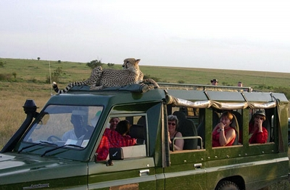
- Travel that supports the conservation of biodiversity

Slide 12
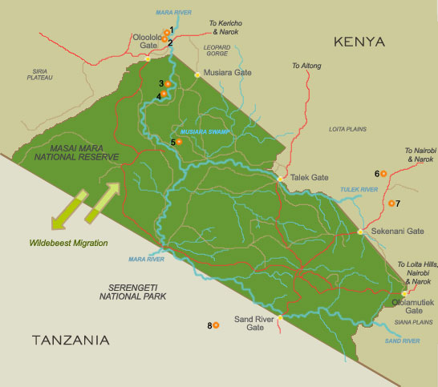
40,000 acres of land secured for wildlife and conservation

Slide 13
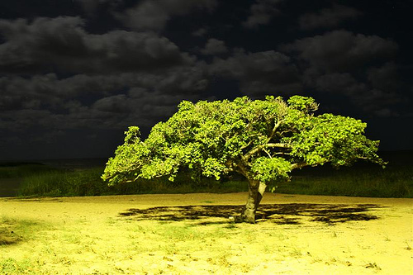
More than 50,000 trees planted in 10 years

Slide 14
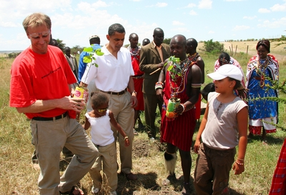
Established one of the largest indigenous tree nurseries in Mara
Has supported the planting of an estimated 50,000 trees since 2000, as part of restoring vegetation along the river near Basecamp. This has been done jointly with the local community.

Slide 15
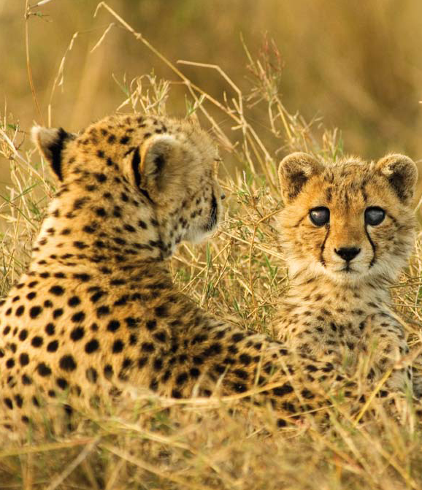
The only private sector supported cheetah conservation project in Masai Mara

Slide 16
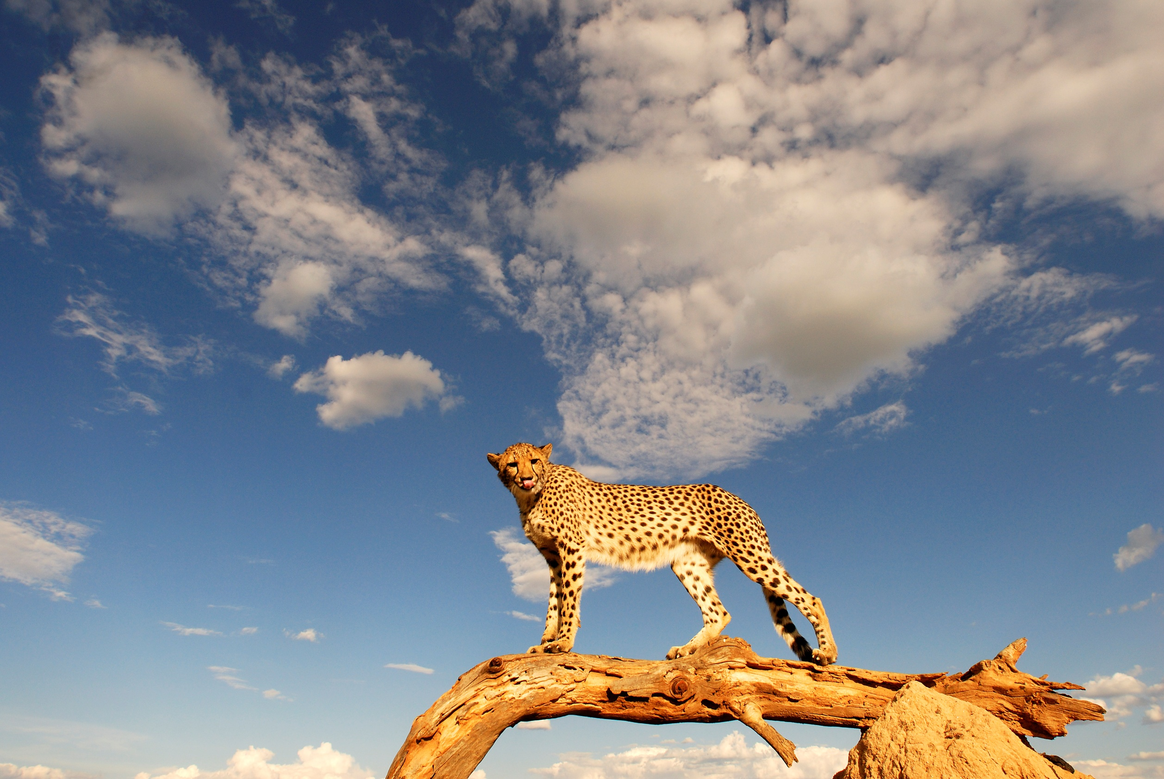

Slide 17
25% of profit is used to finance Basecamp Big Five partnership programs

Slide 18
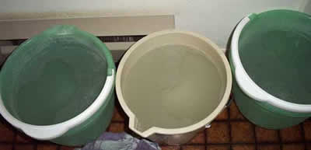
Practices garbage separation and composting. Has clean and well-fenced garbage disposal and composting areas.
Grey water from every tent is collected and re-used to water plants in the compound
Use of dry toilets

Slide 19
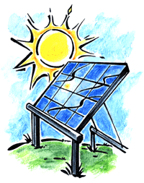
Extensive use of solar energy and use of energy saving LED bulbs. The solar water heaters are ISO-certified and have been chosen because of their energy efficiency character. Even the communication system is powered by solar energy.
Have a solar cooker at the kitchen area, as a demonstration to the local community on efficient technologies available.

Slide 20
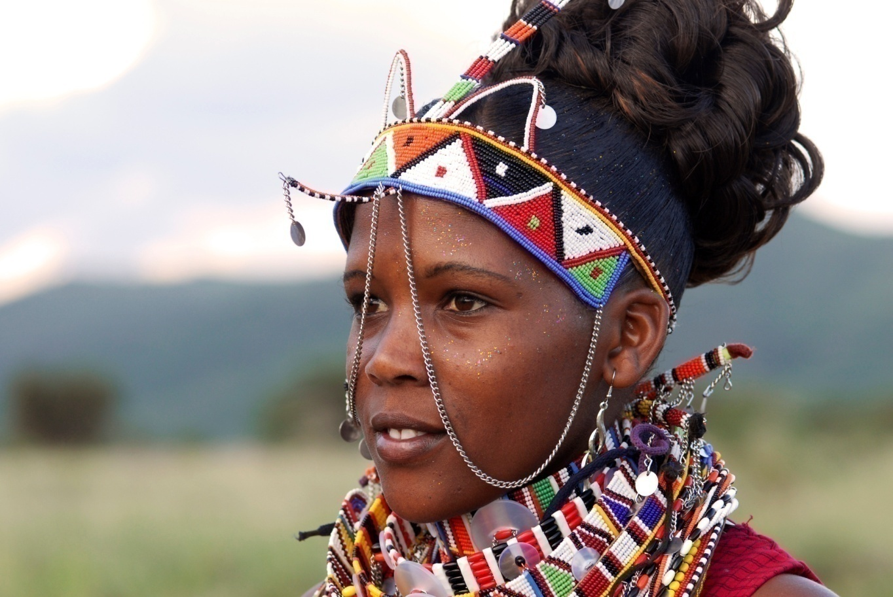
- Travel that brings benefits to local host communities

Slide 21
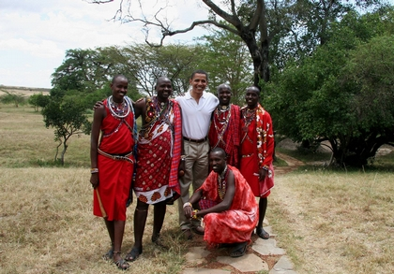
Of the 43 staff, 95% are Maasai,
including 10 women.

Slide 22
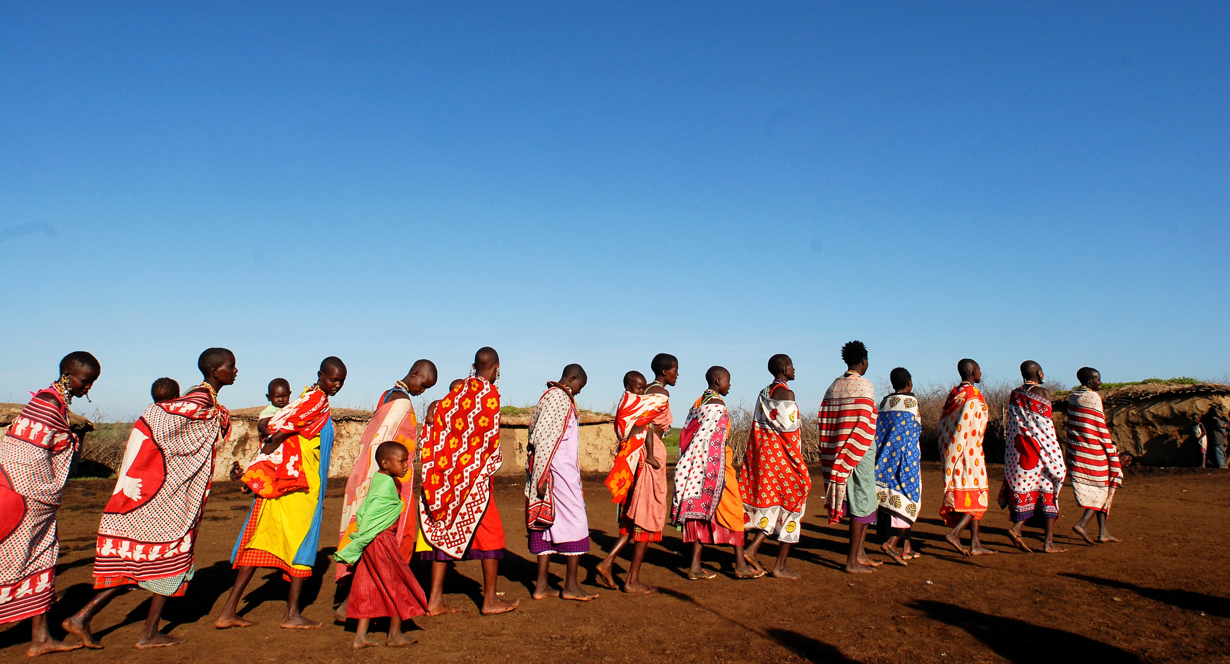
Scholarships for girls
70 students are supported. Local communities benefit. Basecamp focuses on girls education and encourage their families to keep them in school through primary and secondary school.

Slide 23
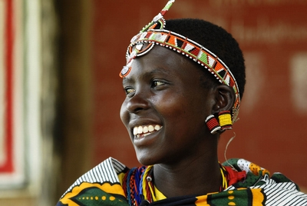
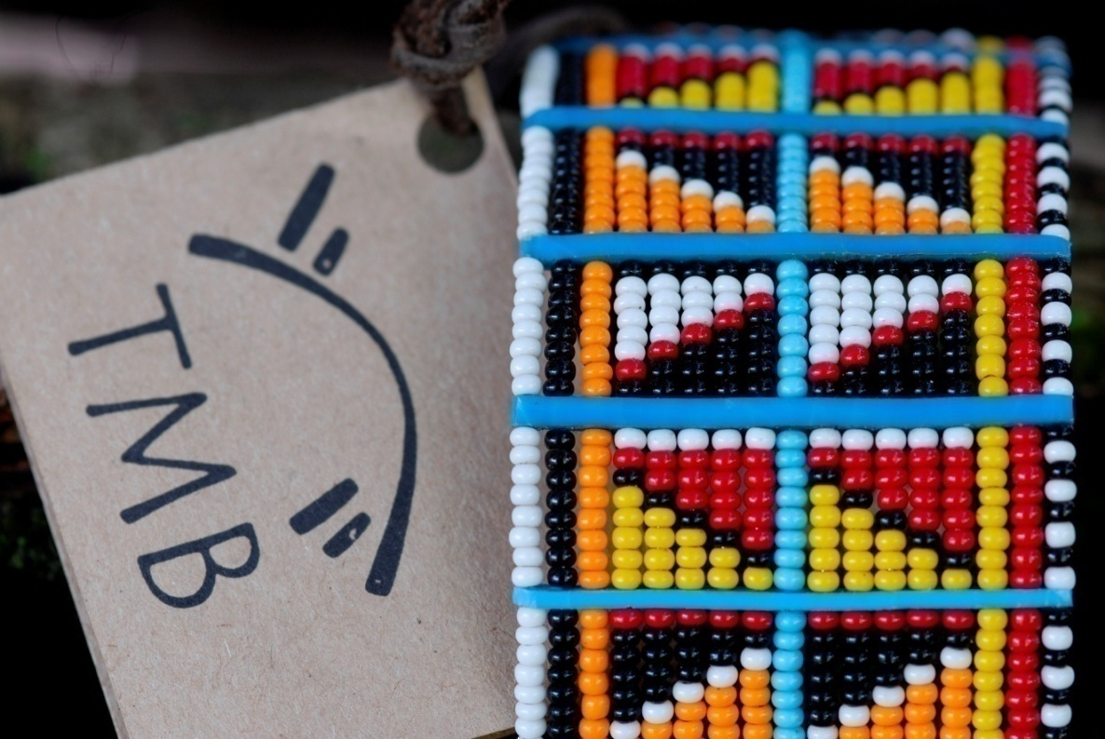
113 women earning an income from the Maasai Brand (TMB) - an innovation of Basecamp Explorer to conserve Maasai culture

Slide 24
Investing in people "Education is the new Maasai weapon. It helps us protect ourselves, and secures our future." Ole Sayalel (Big Moses)
A percentage of bed night goes to an education fund that mainly supports girl-child education.
Basecamp is also supporting a masters student at Moi University.

Slide 25
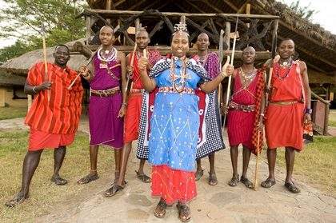
Camp Manager Basecamp Masai Mara
Grace Osoi started in the reception and is now the only Maasai woman working as camp manager in Kenya.

Slide 26
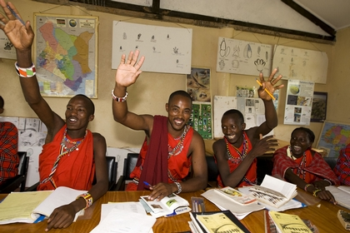
Magazine features an article about the Koiyaki Guide School, which is run by Basecamp in partnership with the local community. "I took care of cattle on the Mara when I was a boy," says Jackson Tinka, 21. Tinka and his companion are what was until recently a rarity in Kenya's biggest-drawing game park: tour guides working in the land of their fathers. Though the vast stretch of savanna lies in territory owned by the Masai, until a few years ago the red-robed pastoralists made up less than 20% of those employed in its camps and lodges. Those who could find work did so mostly as low-paid camp guards. Yet there's a growing realization that the Masai and the 1,530 sq km national reserve share a common future. The tribe's fortunes will most likely be found in the tourists who provide Kenya with the bulk of its foreign exchange — and in the wildlife those tourists pay to see.

Slide 27
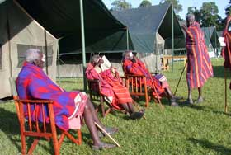
Financial support for construction of local clinic and provision of water

Slide 28
HIV/Aids awareness at destination

Slide 29
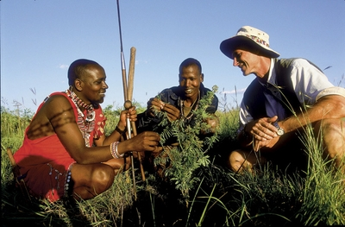
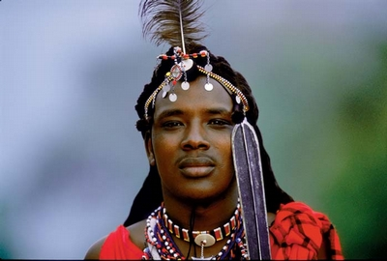
Travel that leads to greater understanding
of the natural
or cultural environment
visited

Slide 30
Through use of local design and material in lodge construction, campfire cultural talks and dance performances, movie on Maasai life produced by Basecamp and sold to guests at camp, CD on Maasai songs produced by Basecamp and sold to guests at camp, the Maasai brand made by local women is sold at camp. The Maasai brand workshop is located at the camp and guests can see, feel and touch culture at the centre. Visitors can regularly enjoy lectures on ecotourism, Maasai culture, Travellers Philanthropy by our local guides, and researchers in the Masai Mara are often invited to give talks on Hyenas, Cheetah, and other research topics.

Slide 31
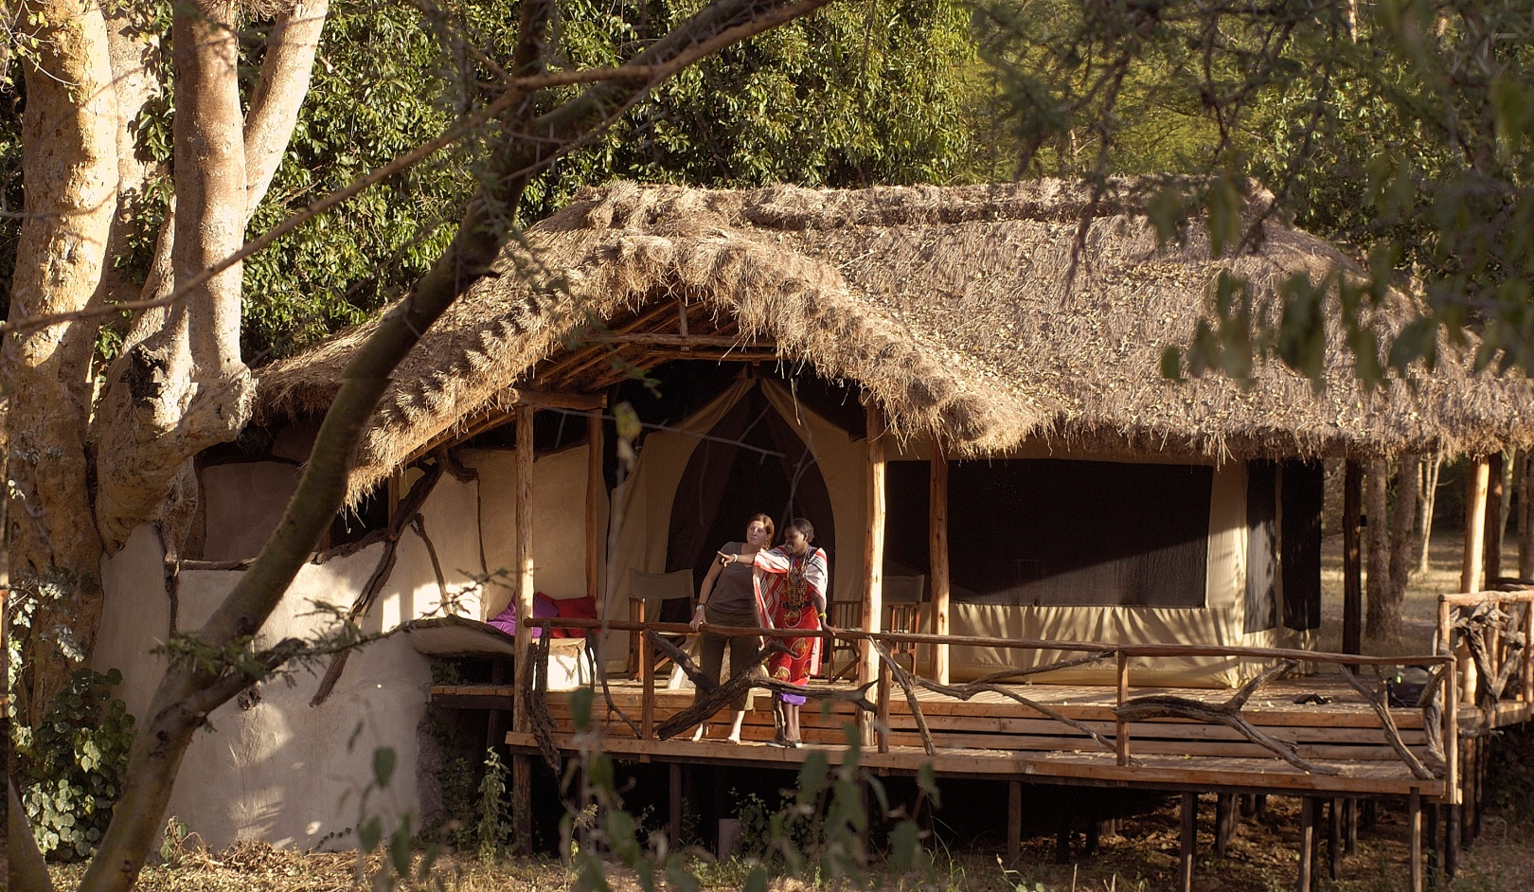
Extensive use of local material, including deadwood, and labour for construction. Most structures are constructed in a way that they can be dismantled and taken away safely, leaving no footprint.

Slide 32
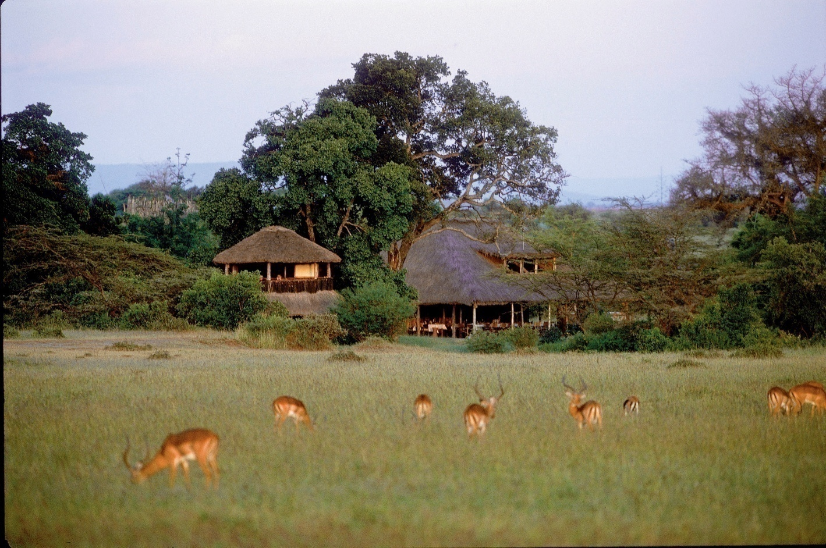
Use of a tree-top wildlife viewing post has reduced the need for game drives.

Slide 33
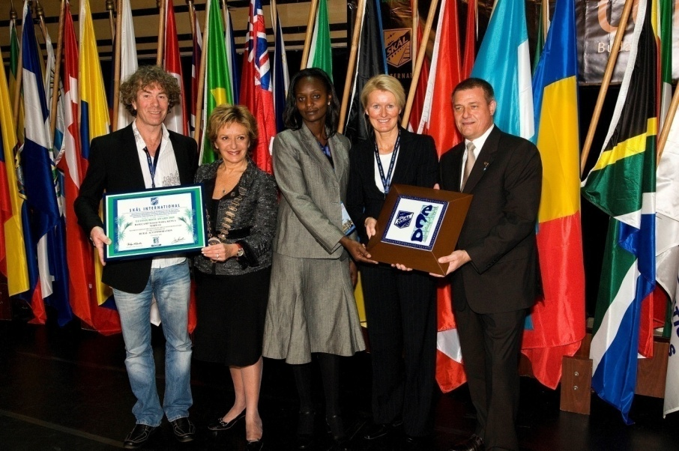
PRESS RELEASE
5TH NOVEMBER 2009
Basecamp Masai Mara – the world's best ecotourism hotel
Basecamp was declared the world’s best ‘Ecotourism
hotel’ by Skål International. Skål is the world’s largest association for professionals
within the tourism industry, with 20 000 members in 90 countries.
“Look to Basecamp”, says Jack Soifer. “In the opinion of the jury Basecamp won this
prestigious international award because they are taking in the best of Africa,
highlighting the importance of education, and combining high quality trips with a
strong commitment towards sustainability, conservation of nature and support of local
cultures. We want to highlight best practises within ecotourism, and Skål believes
that Basecamp represents the future of the tourism industry”.

Slide 34
Basecamp’s commitment to sustainable tourism has already won the company several awards. has has recognized Basecamp Masai Mara as one of the 10 best safari experiences in the world. In 2005 Basecamp received “The Responsible Tourism Award” at the World Travel Market in London, and in Kenya Basecamp Masai Mara has a “Gold Eco Rated” status as the best ecocamp in Kenya.

Slide 35
Each year Basecamp Masai Mara receives more than 1000 educational visits from universities, government departments and aspiring ecotourism operators. These visits are an endorsement of the model.

