Slide 1
China
It’s a one child policy
Camilla, Noor, & Rebecca

Slide 2
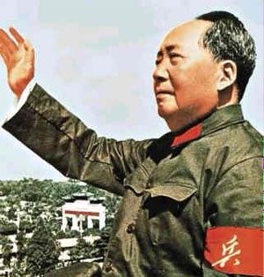
Why?
1949- Communist Party
1958- The Great Leap Forward
1976- Mao’s death & Malthusian logic

Slide 3
One Child Policy
1979- Introduction
Propaganda
Benefits
Punishments
Exceptions

Slide 4
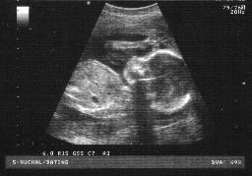
The 1991 Decision
Tightened guidelines
Ultrasounds
Excess bachelors

Slide 5
Figures

Slide 6
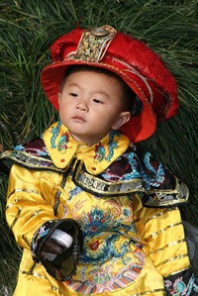
Consequences
1983- the peak year
Sterilisations
IUD insertions
Abortions
Only child

