Slide 1
Drought
Alice, Jeremy & Thomas

Slide 2
AUSTRALIA
MEDC
Oceania
Population:20,294,082
Average life expectancy at birth: 78 years
Infant mortality rate: 5
Average annual population growth: 1.2%

Slide 3
AUSTRALIA
The summer of 2009, was one of Australia’s driest summers.
The amount of precipitation had decreased about 25-30% compared to the summer of 2008.

Slide 4
AUSTRALIA
Drought is occuring in Australia due to climate changes and extreme changes in average temperatures.

Slide 5
AUSTRALIA
This results in:
Fires
Since Australias population is growing quite rapidly and the amount of water sources are decreasing, lack of water will be eventually become a serious issue.

Slide 6
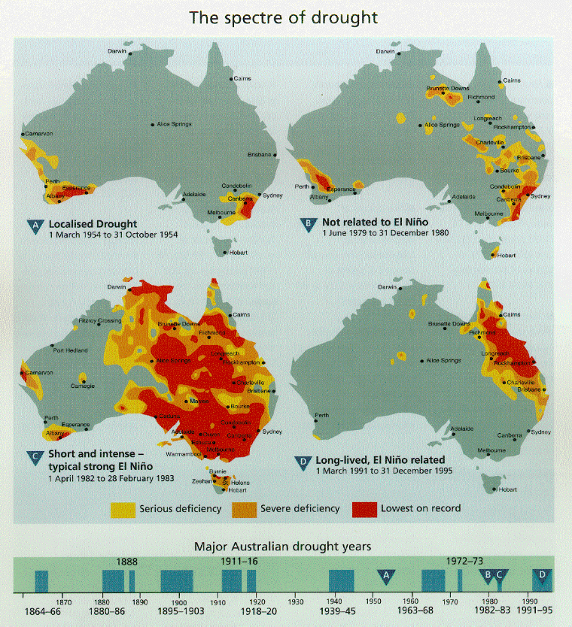

Slide 7
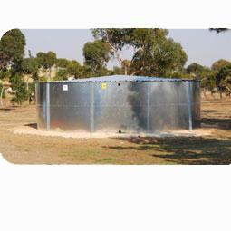
AUSTRALIA
The government have decided to collect and save rain water as well as recycle water and protect underground water resources.

Slide 8
Botswana
LEDC
Africa
Population:1,576,000
Average life expectancy at birth: 47 years
Infant mortality rate: 58
Average annual population growth: 2.6%

Slide 9
Botswana
Botswana is a generally dry country with a low and variable rainfall which averages 250mm in the extreme south west and 650mm in the extreme north.
More than three-quarters of Botswana is covered with the Kgalagadi (Kalahari) desert. This desert absorbs all of the rainfall without any run-off.

Slide 10
Botswana
Drought makes existing problems even worse. Such problems include a scarcity of water, limited employment opportunities, poverty and low crop production. It impacts on just about every aspect of people's lives, but especially those people living in rural communities. About half the population live in the rural areas.

