Slide 1
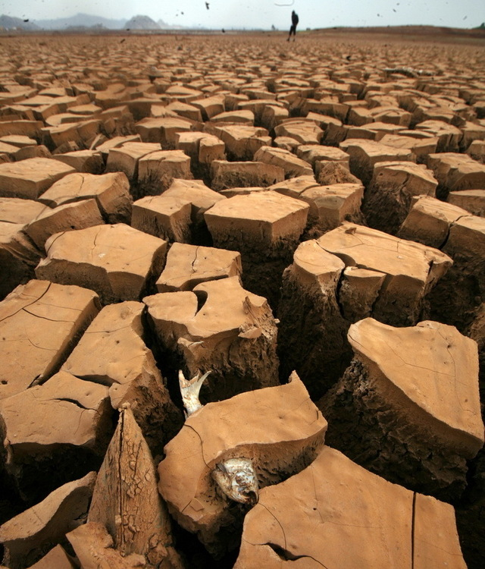
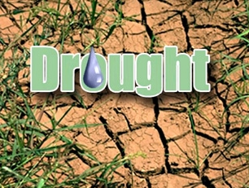

Slide 2
Drought
A drought is an extended period of dry weather leading to extremely dry conditions.
The definition of drought depends on the culture defining it.

Slide 3
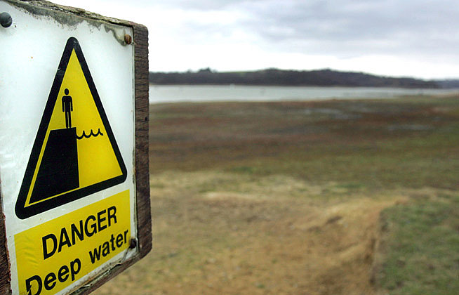
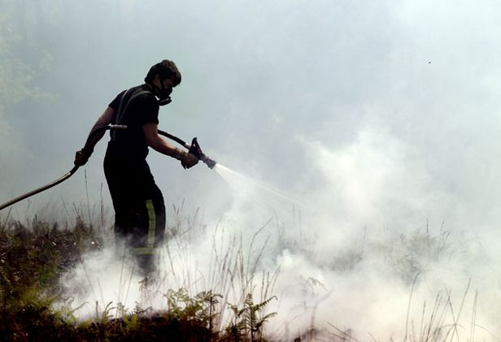
In the UK
Absolute drought: A period of at least 15 consecutive days with less than 0.2 mm of rainfall.
Partial drought: A period of at least 29 consecutive days with less than 0.2 mm days during which the average daily rainfall does not exceed 0.2 mm.

Slide 4
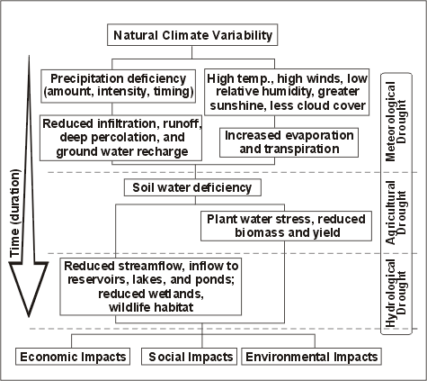

Slide 5
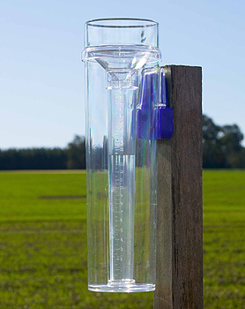
Global Drought Monitor

Slide 6
Arid conditions are caused by a number of factors:

Slide 7
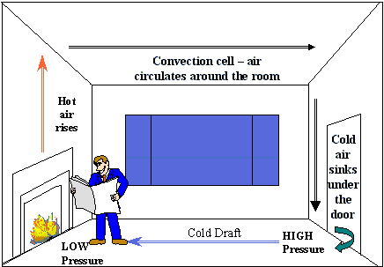
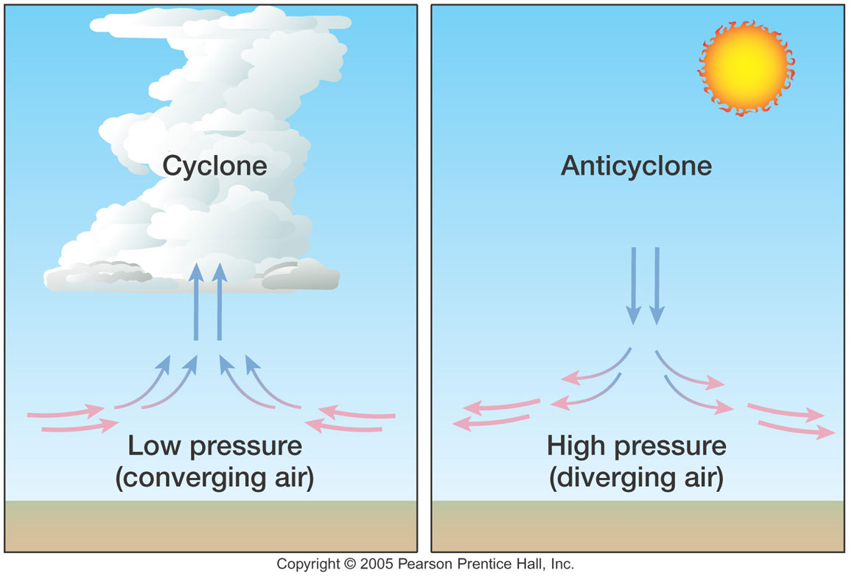

Slide 8
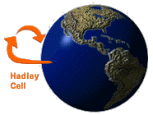
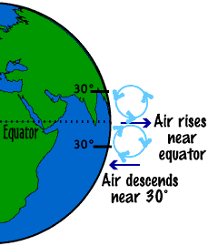
Subtropical high-pressure belt

Slide 9
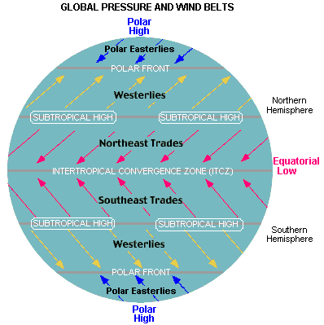

Slide 10
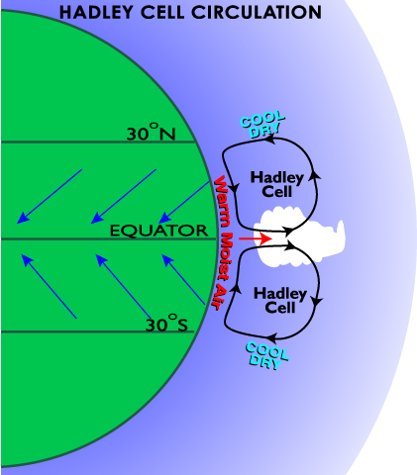

Slide 11
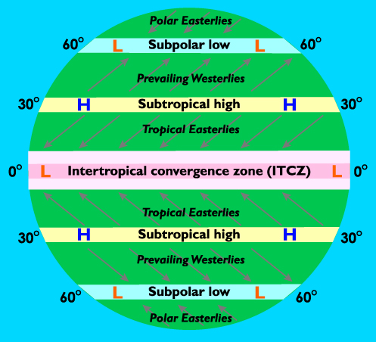
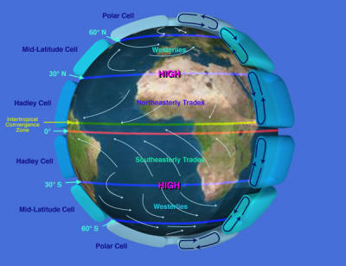
20-30°N

Slide 12
effects

Slide 13
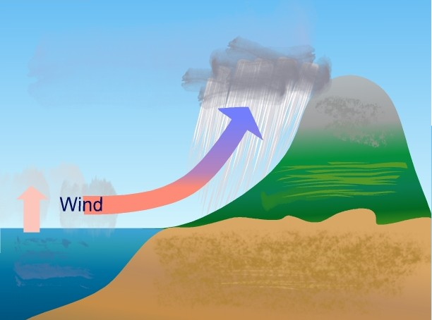

Slide 14
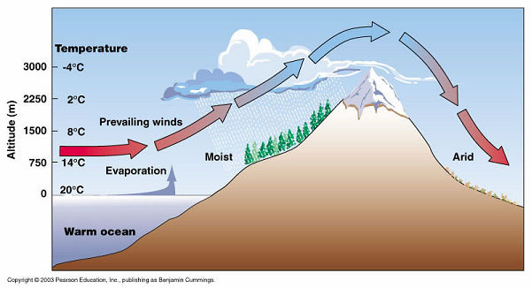

Slide 15
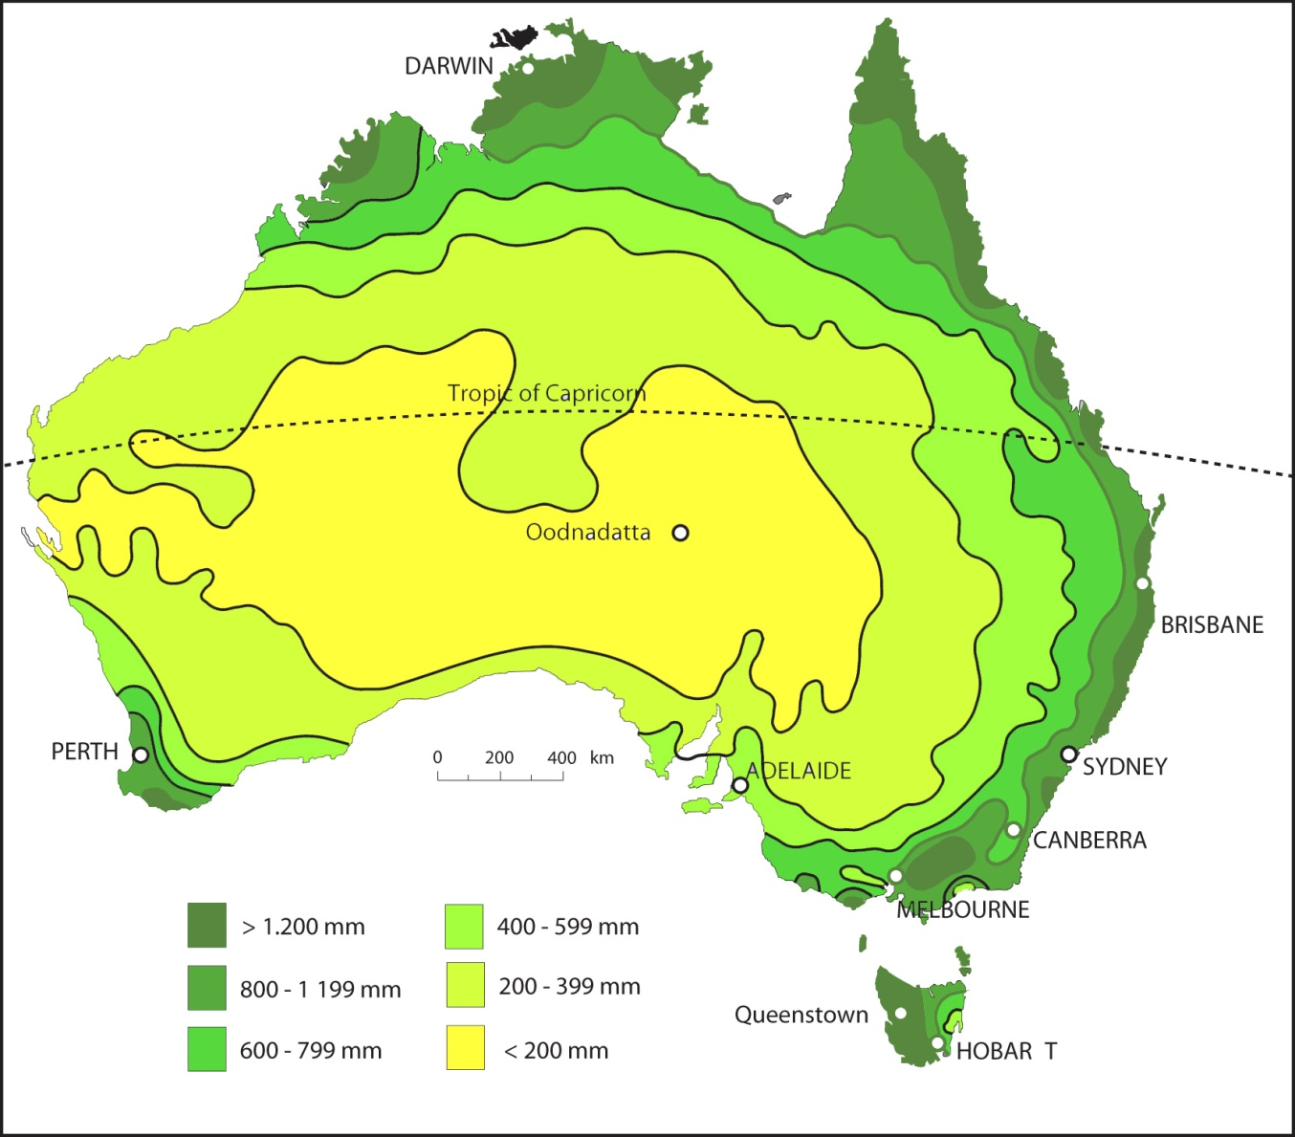
Continentality (distance from the sea)

Slide 16
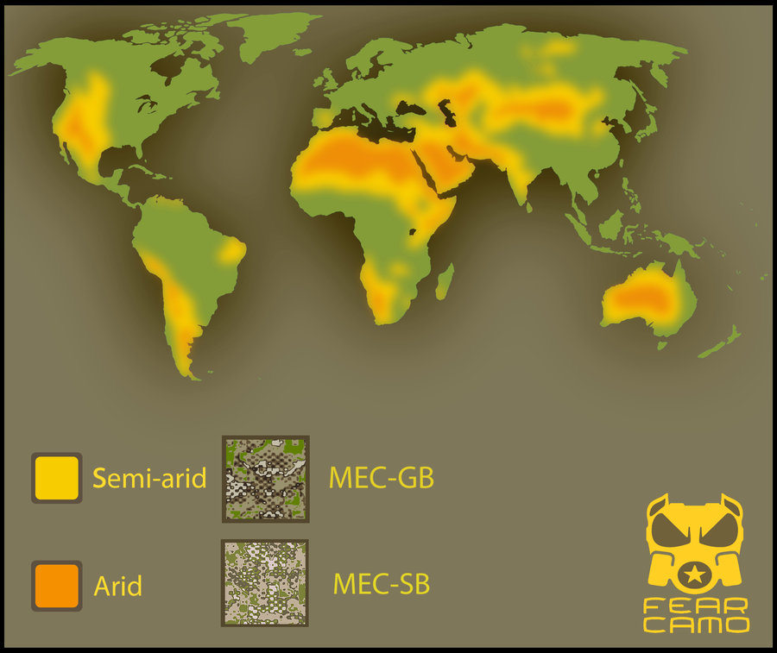

Slide 17
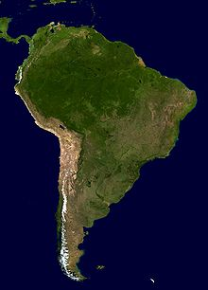
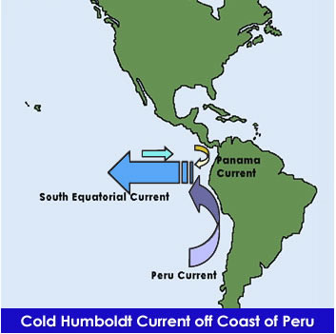
Cold offshore currents

Slide 18
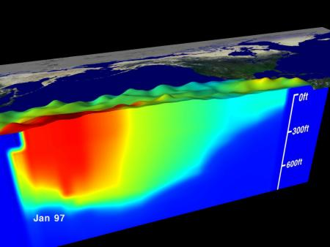

Slide 19
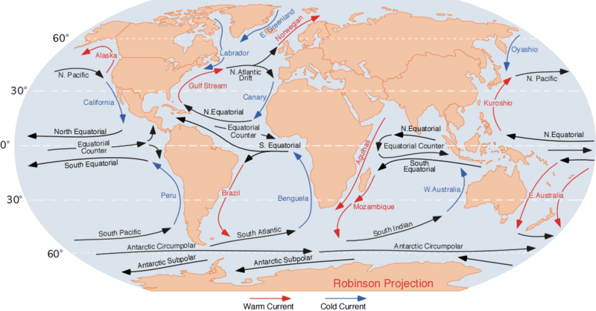

Slide 20
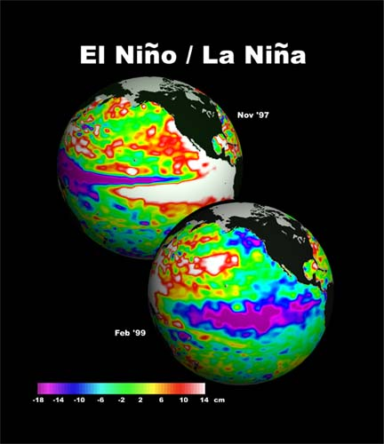

Slide 21
 | El Niño is characterized by unusually warm ocean temperatues in the equatorial Pacific Ocean.
La Niña is characterized by unusually cold ocean temperatures in the equatorial Pacific Ocean.

Slide 22
What causes these fluctuations?
They are connected with the climate phenomenon called the Southern Oscillation, a major air pressure shift between the Asian and east Pacific regions whose best-known extremes are El Niño events. The Southern Oscillation (strength and direction) is measured by a simple index, the SOI.
What causes the Southern Oscillation cycle, which has a direct relationship to the El Nino - La Nina event cycle is still unknown.

Slide 23
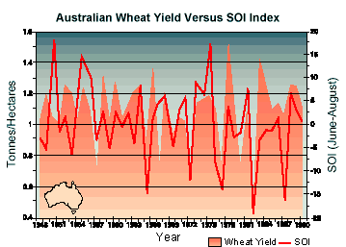
Rural productivity, especially in Queensland and New South Wales, is linked to the behaviour of the Southern Oscillation. The graph opposite shows how Australia's wheat yield, (with the trend over time removed), has fluctuated with variations in the Southern Oscillation. Negative phases in the oscillation (drier periods) tend to have been linked with reduced wheat crops, and vice versa.
Tourism is another industry vulnerable to large swings in seasonal climate.
What causes the Southern Oscillation cycle, which has a direct relationship to the El Nino - La Nina event cycle is still unknown.

Slide 24
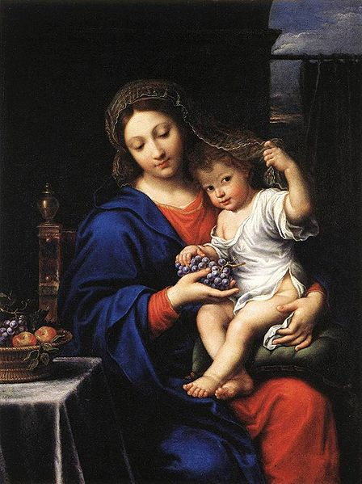
El Niño

Slide 25
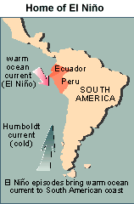
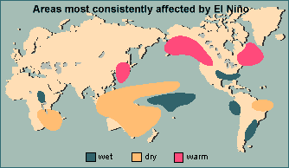

Slide 26
El Niño refers to the irregular warming in the sea surface temperatures from the coasts of Peru and Ecuador to the equatorial central Pacific. This causes a disruption of the ocean-atmosphere system in the tropical Pacific having important consequences for weather around the globe. This phenomenon is not totally predictable but on average occurs once every four years. It usually lasts for about 18 months after it begins.

Slide 27
Among these consequences are increased rainfall across the southern tier of the US and in Peru, which has caused destructive flooding, and drought in the West Pacific, sometimes associated with devastating brush fires in Australia.
Observations of conditions in the tropical Pacific are considered essential for the prediction of short term (a few months to 1 year) climate variations.

Slide 28
A network of buoys which measure temperature, currents and winds in the equatorial band provide necessary data. These buoys daily transmit data which are available to researchers and forecasters around the world in real time.

Slide 29
The El Niño of 1982-83 was responsible for the loss of nearly 2,000 lives and displacement of hundreds of thousands from their homes.
The losses were caused by droughts and fires in Australia, Southern Africa, Central America, Indonesia, the Philippines, South America and India.
There were floods in the USA, Gulf of Mexico, Peru, Ecuador, Bolivia and Cuba.
More hurricanes than usual affected Hawaii and Tahiti.

Slide 30
Drought in the Horn of Africa

Slide 31
Horn of Africa Drought
Drought exists as a chronic long-term problem within the Horn of Africa. Countries such as Ethiopia, Kenya, and Somalia, have severed from regular and repeated drought for the last 30 years. As a result many suffer from hunger and malnutrition and up to 17 million rely on daily food aid just to survive. Regular famine disasters hit the area affecting millions. The persistent drought also contributes significantly to the lack of development and poverty within the region, but the picture is complex with many interconnected factors.

Slide 32
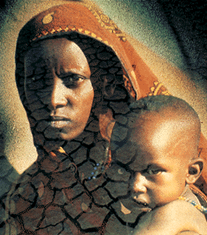
The Horn of Africa drought is a good example the consequences of a natural event can be exacerbated by the inability of a people and region to cope; the people of the Horn of Africa are among the most vulnerable in the world. In addition, we can also see how human actions, particularly those linked to climate change, can worsen the magnitude of natural disasters.

Slide 33
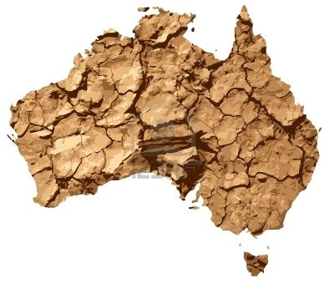
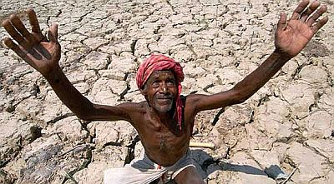
The MDB case study provides a good contrast to drought in the Horn of Africa because, whilst the effects are undeniably significant, the widespread famine disasters associated with the Horn of Africa are not a problem in Australia. Basically the people are less vulnerable and much better able to manage the risks. However, through the attempts made to manage water resources within the MDB people have frequently exacerbated the problems.

Slide 34
Australian drought hits food bowl (the Murray-Darling Basin)

Slide 35
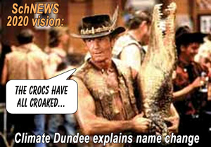
Australian officials have warned the El Nino weather pattern could worsen the drought in an area known as the country's food bowl. The Murray Darling basin, which produces 40 per cent of Australia's food, has suffered from a drought for nine years.

Slide 36
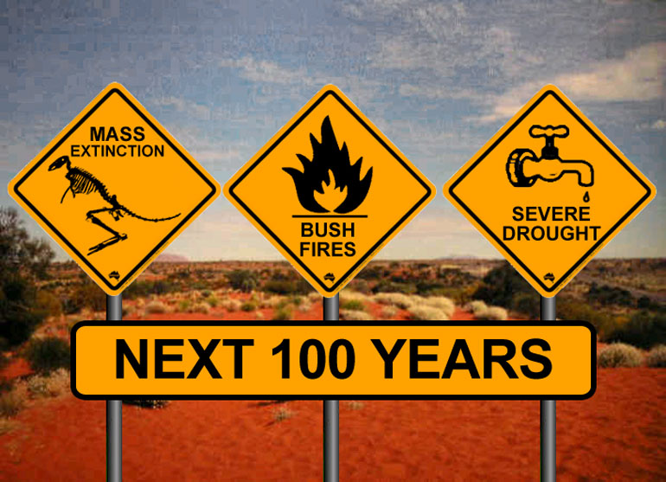
Murray-Darling Basin Drought
By mid 2008 the BBC were describing the drought in the Murray-Darling Basin (known as Australias food-bowl) as the worst in 100 years. The issues are complex with climate change cited as a major cause. However decades of mismanagement mean that the water within the rivers is over-allocated at 130%, even in a good year. The impacts are evident, with farming communities devastated, frequent wildfires and valuable ecosystems on the brink of environmental collapse.

Slide 37
Is climate change to blame?
According to the Bureau of Meteorology “Australia and the globe are experiencing rapid climate change. Since the middle of the 20th century, Australian temperatures have, on average, risen by about 1°C with an increase in the frequency of heatwaves and a decrease in the numbers of frosts and cold days. Rainfall patterns have also changed — the northwest has seen an increase in rainfall over the last 50 years while much of eastern Australia and the far southwest have experienced a decline.”
It should be noted, however, that inflows in the first half of the twentieth century were generally less than in the second half and average inflows to the Murray in the last decade have been similar to the Federation and 1940’s droughts.
The Murray-Darling Basin Commission is collaborating with the Bureau and other agencies in a three year $7 million project looking at the potential impacts of climate change on the Murray-Darling Basin.

Slide 38
What are some of the reasons for and consequences of these droughts? Summarise the two case studies.
http://www.waterforgood.sa.gov.au/rivers-reservoirs-aquifers/river-murray/drought-in-the-murray-darling-basin/
http://www.environment.gov.au/water/locations/murray-darling-basin/index.html
http://www.earthtimes.org/climate/predicted-long-term-drought-horn-africa/276/
http://articles.latimes.com/2009/oct/25/world/fg-climate-refugees25

Slide 39
