Slide 1
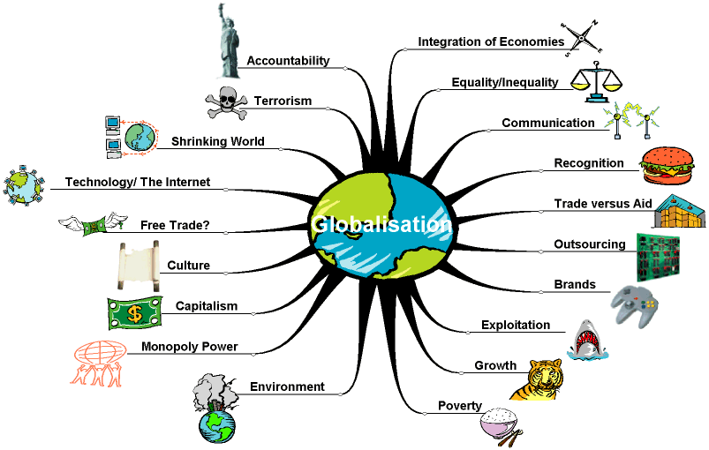

Slide 2
What is globalisation?
There are many different definitions of globalisation, but most acknowledge the greater movement of people, goods, capital and ideas due to increased economic integration which in turn is propelled by increased trade and investment.
It is like moving towards living in a borderless world.

Slide 3
There has always been a sharing of goods, services, knowledge and cultures between people and countries, but in recent years improved technologies and a reduction of barriers means the speed of exchange is much faster.
Globalisation provides opportunities and challenges
Bigger markets can mean bigger profits which leads to greater wealth for investing in development and reducing poverty in many countries. Weak domestic policies, institutions and infrastructure and trade barriers can restrict a country's ability to take advantages of the changes.
Each country makes decisions and policies that position them to maximise the benefits and minimise the challenges presented by globalisation.

Slide 4
The issues and perceived effects of globalisation excite strong feelings, tempting people to regard it in terms of black and white, when in fact globalisation is an extremely complex web of many things.

Slide 5
Globalization – the removal of barriers to free trade and the closer integration of national economies – can be a force for good that has the potential to enrich everyone in the world, particularly the poor, but the way it has been managed (especially the international trade agreements) needs to be rethought.
Joseph Stiglitz
Globalization has been “misgoverned”.
John K. Galbraith

Slide 6
Facts
Global income is more than $31 trillion a year, but 1.2 billion people of the world's population earn less than $1 a day.
80% of the global population earns only 20% of global income, and within many countries there is a large gap between rich and poor.
The 3 billion people living in the 24 developing countries that increased their integration into the world economy enjoyed an average 5% growth rate in income per capita, longer life expectancy and better schooling.
Two billion people, living in countries in sub-Saharan Africa, the Middle East, and the former Soviet Union, have been unable to increase their integration into the world economy, and their economies have contracted, poverty has risen, and education levels have risen less rapidly than in the more globalised countries.
Sea level rise, warming temperatures, uncertain effects on forest and agricultural systems, and increased variability and volatility in weather patterns are expected to have a significant and disproportionate impact in the developing world, where the world's poor remain most susceptible to the potential damages and uncertainties inherent in a changing climate.
The digital and information revolution has changed the way the world learns, communicates, does business and treats illnesses. In 2002, there were 364 people per 1000 using the internet in high income countries, while there were only 10 per 1000 in low income countries.
Source: The World Bank, 2004 United Nations Development Programme, 2004

Slide 7
Define the term globalization. [2 marks]
Globalization might be defined as “the flow of capital, and goods, money, culture, ideas and people between countries resulting in the increasing interconnectedness of the world economically, culturally and politically”.
Other similar and comprehensive definitions would be acceptable.

Slide 8
Referring to examples, discuss the ways in which globalization decreases the differences between countries. [10 marks]
Responses should show an understanding of the process of globalization and include a discussion of a variety of ways in which it decreases the differences between countries. Evidence for decreasing difference might include references to culture; globalization has resulted in the adoption of common language, cultural traits and patterns of consumption. Globalization also makes a significant impact through economic activity resulting in environmental similarities in the form of homogenous rural and urban landscapes. Economic and political convergence encouraged by the global institutions may also be a product of globalization.
There may be other equally valid approaches to this essay which emphasize other aspects of globalization. Overall, the response should be discursive rather than descriptive to access band F and above.
The marks should be allocated according to the markbands.

Slide 9
Essay Analyse the effects of the growth of global tourism on the culture and environment of indigenous people, referring to examples. [20 marks]
A clear understanding of “indigenous people” (meaning native) should be evident if not
actually defined. “Culture” has a wide interpretation and includes customs, beliefs,
religion, dress, morals, manners, music, art, food and many other traits. A good
response will select examples which demonstrate distinct cultural contrasts between
tourists and indigenous people so the effects are significant. However, the indigenous
population need not be remote and an urban tourist destination in a LEDC may be used.
The growth in international tourist demand, the expansion of the global communications
network and tourist-related TNCs, have exposed remote and less developed parts of the
world. These regions may be explored and exploited for their cultural contrasts,
“otherness” or pristine environments sometimes under the disguise of ecotourism. The
impacts of tourism upon indigenous people and their culture may be negative and
include the commercialization and dilution of culture and moral degradation. Other
impacts such as loss of grazing rights in the Maasai game reserves have had both
cultural and environmental repercussions. Environmental impacts are diverse, mainly
negative and may include the destruction of local vegetation for the building of hotels,
roads and airports, loss of plant and animal species and breeding grounds, water, traffic
and noise pollution, soil erosion and land degradation through the overburden of solid
waste. Responses should cite local environmental impacts which are directly related to
the indigenous population living there.

Slide 10
Although some general observations are necessary, the focus of the response should be on examples and more than one is expected.
Both cultural and environmental impacts should be covered, but not necessarily in each example used. Very good analytical responses will recognize the breadth of the question and include the positive as well as negative effects of growing tourism.
Discussion of sustainable tourist projects involving local people and minimizing damage to their cultural traditions and environments would access markband F and above.
Economic aspects may be mentioned, but only in connection with cultural and environmental impacts.
The marks should be allocated according to the markbands.

Slide 11
Essay Discuss the extent to which the process of globalization has reduced physical and cultural diversity on an international scale. [20 marks]
Responses should address three elements in the question: the process of globalization, the development of homogenized landscapes and convergence of culture. To move beyond band F responses should include discussion of all three elements although it need not be balanced.
The key points of discussion should include most of the following:
The process of globalization has involved the flow of people, money, goods, ideas and culture between nations. This diffusion has been encouraged by the breaking down of international barriers and liberalization of trade and the expansion of international tourism, which may have resulted in loss of national distinctiveness.

Slide 12
In some rural areas, physical diversity has been reduced by the activities of agribusiness resulting in monocultural landscapes and ecological losses.
In many urban areas the influence of TNCs has also been important resulting in the adoption of common styles and structures.
Cultural diversity has also been reduced by universal adoption of common languages, customs, morals, dress and food.

Slide 13
The counter-argument might recognize that the impact of globalization varies.
It may be most intense in countries that can most easily adopt a different culture and less so where countries are less accessible or adaptable.
There may be some resistance to the cultural effects of globalization and efforts made to emphasize and redefine national identity. These might include political movements against the processes of Americanization or McDonaldization of culture and the possible rise of religious fundamentalism. Thus, there may be a tendency towards more diversity.

Slide 14
The discussion should recognize variations in the impact of globalization.
Stronger responses should be well supported by examples to illustrate both the physical and cultural aspects under review.
Responses may not move beyond band F where there is no attempt to argue the case.
Marks should be allocated according to the markbands.

Slide 15
To what extent do transnational corporations benefit LEDCs? [10 marks]
The benefits include employment opportunities, improved technology, improved business expertise and linguistic skills, infrastructural development, financial support and taxes, inward investment, improved national balance of payments and local economic growth through the multiplier effect.
The drawbacks include: exploitation of the local labour force, foreign instead of local decision-making, leakage of profits back to the country of origin, redirection of local funds and grants towards TNCs, poor health and safety standards, competition with local industries, increased urbanization leading to overcrowding, and undesirable changes in culture and consumption levels.
Responses may also recognize that TNCs can originate in LEDCs.

Slide 16
A very good response would address the benefits and drawbacks covering several of the points given, but the treatment of one may be more detailed than the other.
A balanced argument is likely to be credited at band D or above.
The marks should be allocated according to the markbands.

Slide 17
Essay question
Explain how world economic activity has become increasingly integrated.
Refer to examples in your answer. [20 marks]
The essay needs to focus on economic activity on a global scale and the nature of integration.
The broad interpretation of ‘how’ should include a description of the means by which it has been occurring. A clear understanding of the terms ‘economic activity’ and ‘integrated’ should
be shown and accompanied by valid examples.

Slide 18
The features of economic integration include the free flow of people, goods and capital between nations. This is dominated by the integrated global production systems of TNCs, global markets and global finance. International organizations such as the IMF, World Bank and World Trade Organization contribute to the integration of economies by encouraging the liberalization of trade and the free movement of capital.
The process of integration has also been facilitated by development of trading blocs, international trade agreements and the
technological improvements in transport and communications.
Good responses achieving band F and above should be able to explain the majority of these features citing specific cases of types of economic activity involved. Essays lacking examples and case studies should not
move beyond band E.
The marks should be allocated according to the markbands.
Examiners should be aware that candidates may take a different approach which, if appropriate, should be fully rewarded.

