Slide 1
DIPLOMA PROGRAMME
GEOGRAPHY

Slide 2
“There has never been a greater need for young people to study Geography”
“Geography provides the ideal, integrated framework to understand contemporary world issues, and more importantly, it provides an effective framework of problem solving. If we understand the causes of problems, we are well on the way to finding an effective solution. And the reality is that we live in a world today that desperately needs young people equipped with the skills and insights to make our world a better place!”
Stephen Codrington

Slide 3
Standard Level
Divided into parts:
Geographic Skills—integrated throughout the course
Core Theme
Optional Themes (2)
Fieldwork

Slide 4
Higher Level
Divided into parts:
Geographic Skills—integrated throughout the course
Core Theme
Optional Themes (3)
HL Extension—Global Interactions
Fieldwork

Slide 5
Geographical skills
Maps
Graphs
Statistical calculations
Quantitative techniques
Investigation
Produce written material

Slide 6
Core theme
Patterns and Change (SL/HL)
There are four compulsory topics in this core theme:
1. Populations in transition
2. Disparities in wealth and development
3. Patterns in environmental quality and sustainability
4. Patterns in resource consumption

Slide 7
Optional themes SL
Leisure, Sport and Tourism
The Geography of
Food and Health

Slide 8
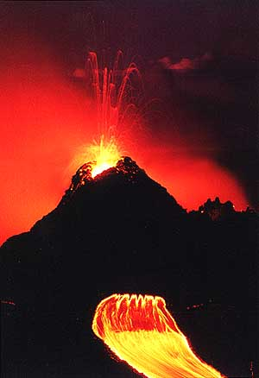
HL = SL +
Optional Theme: Hazards and Disasters Risk Assessment and Response
Part 3: HL Extension:
Global interactions

Slide 9
ASSESSMENT OUTLINE SL
External assessment 75%
Internal assessment 25%

Slide 10
ASSESSMENT OUTLINE HL
External assessment 80%
Internal assessment 20%

Slide 11
External Assessment SL
Paper 1 (1 hour 30 minutes)
Section A: Students answer all short-answer questions. Some
include data.
Section B: Students answer one extended response question.
Paper 2 (1 hour 20 minutes)
Students answer two structured questions based on stimulus material, each selected from a different optional theme. For each theme there is a choice of two questions.

Slide 12
External Assessment HL
Paper 1 (1 hour 30 minutes)
Section A: Students answer all short-answer questions. Some
include data.
Section B: Students answer one extended response question.
Paper 2 (2 hours)
Students answer three structured questions based on stimulus material, each selected from a different theme. For each theme there is a choice of two questions. (20 marks per question).
Some stimulus material is included in the resources booklet.

Slide 13
(HL only)
Paper 3 (1 hour)
Syllabus content: Higher level extension.
Students answer one of three essay questions.

Slide 14
Internal Assessment
Internal Assessment
Written report based on fieldwork. Maximum 2,500 words
This component is internally assessed by the teacher and externally moderated by the IB at the end of the course.
Syllabus content: Any topic from the syllabus.

Slide 15
Population growth

Slide 16
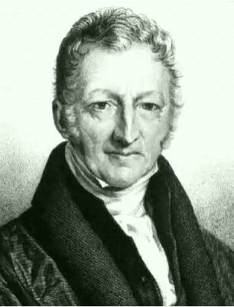
Thomas Robert Malthus (1766-1834)

Slide 17
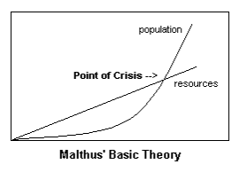
What many know, at least those with an elementary knowledge of economics or politics, is that Malthus is the surname of a man, who, a couple of hundred years back, said that man, sooner or later, universally, will run up against himself; that the population of mankind will eventually outstrip man's ability to supply himself with the necessities of life.
Peter Landry

Slide 18
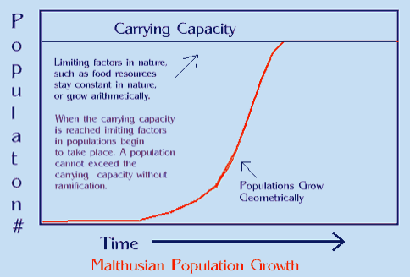
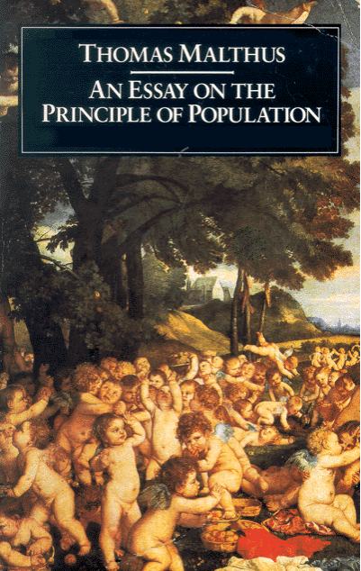
The Malthusian doctrine, as stated in "Essay on the Principle of Population," was expressed as follows: "population increases in a geometric ratio (1, 2, 4, 8), while the means of subsistence increases in an arithmetic ratio (1, 2, 3, 4)”."Well, that seems plain enough, and perfectly understandable -- if there are too many people and not enough food, then, certainly, there are going to be problems.

Slide 19
Malthus developed his theory, at least to this extent: that left alone, no matter all the problems short of world wide catastrophe, humankind will survive, as, nature has a natural way to cut population levels: "crime, disease, war, and vice," being, the necessary checks on population." This proposition, as was made by Malthus in 1798, was to cause quite a public stir, then, and yet today. Peter Landry Malthus had a strong influence on Charles Darwin in his evolutionary thought, in that he was the first to realize that population growth and surpluses were kept in check by mortality.

