Slide 1
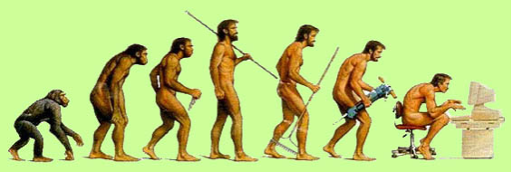
Chapter 5
Development Geography

Slide 2
The syllabus says:
Identify and explain the changing patterns and trends of regional and global disparities of life expectancy, education and income.

Slide 3
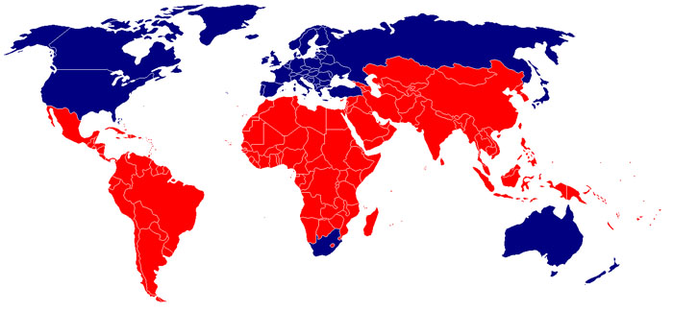
Global Variations in Development

Slide 4
Globalisation
The spread and acceptance of economic, social and cultural ideas across the world.

Slide 5
Evidence of increased globalisation
Increased
world exports
worldwide foreign investment
turnover in the world´s foreign exchange markets
tourism
time spent on international telephone calls

Slide 6
The stronger links and interactions have led to:
Lower death rate of children
Higher life expectancy
Higher enrolment in school
Improved adult literacy rates
Increased global wealth
Increased average per capita income

Slide 7
...but huge differences between individuals and countries
The widest the inequality gap has ever been
 = 57 ☑
2.7 billion people live on less than US$ 2 per day

Slide 8
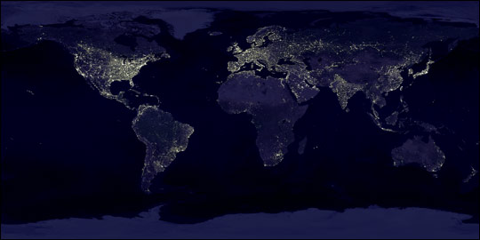
High HDI countries tend to be in North America, Europe and Australasia, while low HDI countries tend to be in parts of Asia and Africa.

Slide 9
Although quantitative measures such as GNP per capita and composite measures such as HDI give broadly similar findings…
…one can find countries with similar HDI but differing incomes (such as Greece and Singapore) and countries with similar income but different human development (such as Sri Lanka and the Ivory Coast)

Slide 10
Remember that economic development is a dynamic process of change.

Slide 11
Rapidly developing countries during the 1990s
The most rapidly developing economies during the 1990s were in southern and western South America, and in South, South-East and East Asia
=
the tiger economies

Slide 12
Countries where GNP per capita declined during the 1990s
Countries that were part of the former Soviet Union or former communist countries in Eastern Europe (adjusting to market economy)
Central areas of Africa (AIDS/HIV, political instability)
Arab oil producing states (falling oil prices)

Slide 13
Almost no countries are experiencing a declining HDI (except for Zimbabwe and Zambia)
HDI - Trends

Slide 14
Although the rate of development is rising (almost) everywhere…
…the medium and high human development countries are improving at a faster rate than the others, thus widening the gap between the rich and the poor countries.

Slide 15
The reasons that a country´s economy develops quickly or slowly are complex, and in many ways unique to that country .
The factors affecting the rate of development may be
political,
social,
physical or
historical.

Slide 16
External forces (factors affecting the country from elsewhere)
culture contact
trade
financial flows and investment
technological change
transnational corporations
bilateral and multilateral agreements

Slide 17
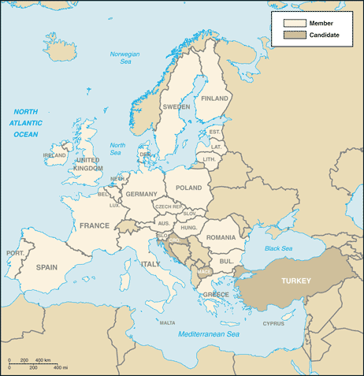
The EU

Slide 18
Internal forces (factors operating from within the country)
transport and other infrastructure
political systems
population change
availability of natural resources
internal capital formation

Slide 19
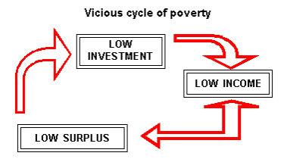
Vicious cycle of poverty

Slide 20
Equity issues

Slide 21
Differences within a country
between
urban and rural areas (China)
religious groups (Nepal)
ethnic groups (Australia)
gender (Arab countries)

Slide 22
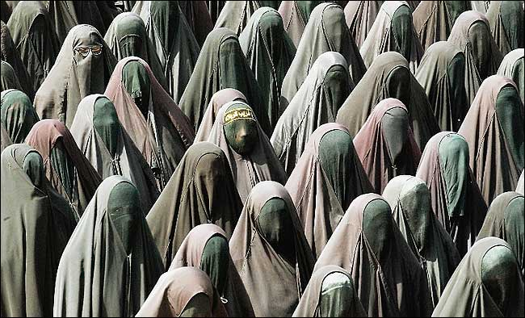
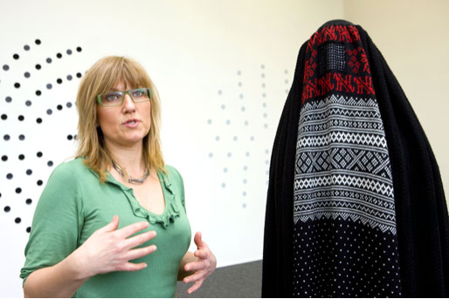
Conclusion
From this discussion, it can be seen that issues of equity among countries are complex, and depend upon a variety of issues.

