Slide 1
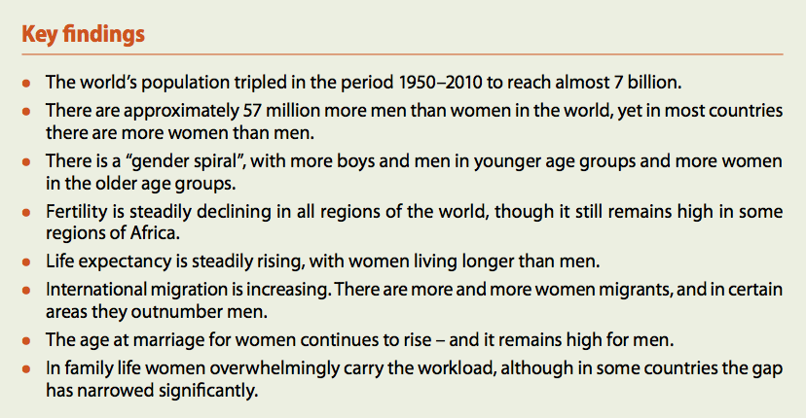
population

Slide 2

The Girl Effect

Slide 3
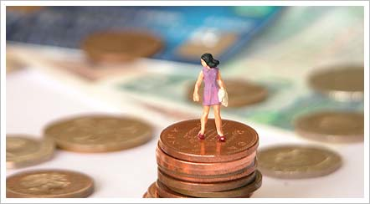
Gender equality as smart economics

Slide 4


Why women matter
Madam Curie var den første kvinnen i Europa som tok en vitenskapelig doktorgrad, hun oppdaget de radioaktive grunnstoffene polonium og radium, hun var den første kvinne som vant en Nobelpris i fysikk, den første overhodet som vant to Nobelpriser, den første kvinne som ble lærer, professor og laboratorieleder ved Sorbonne og den første kvinne som på grunn av egne bedrifter ble gravlagt i Pantheon.

Slide 5
HDI
The Human Development Index measures the average achievement of a country in basic human capabilities. The HDI indicates whether people lead a long and healthy life, are educated and knowledgeable, and enjoy a decent standard of living.
The HDI examines the average condition of all people in a country.

Slide 6
GDI
The Gender-related Development Index does the same, but takes note of inequality in achievement between men and women.
The methodology used imposes a penalty for inequality, such that the GDI falls when the achievement levels of both women and men in a country go down or when the disparity between their achievement increases.
The GDI is simply the HDI adjusted downwards for gender inequality.

Slide 7
GEM
The Gender Empowerment Measure examines whether women and men are able to actively participate in economic and political life and take part in decision-making.
While the GDI focuses on expansion of capabilities, the GEM is concerned with the use of those capabilities to take advantage of the opportunities of life.

Slide 8

Gender empowerment index

Slide 9

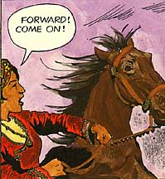
Gender empowerment measure

Slide 10
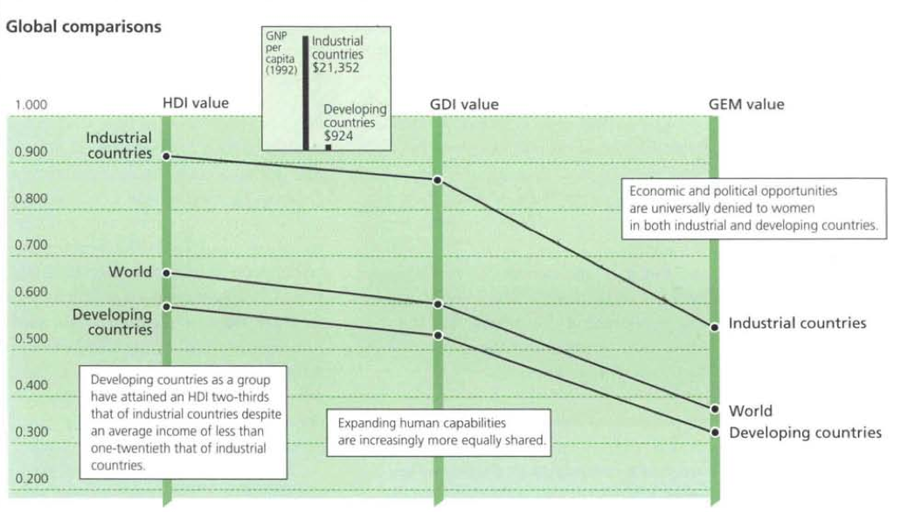

Slide 11
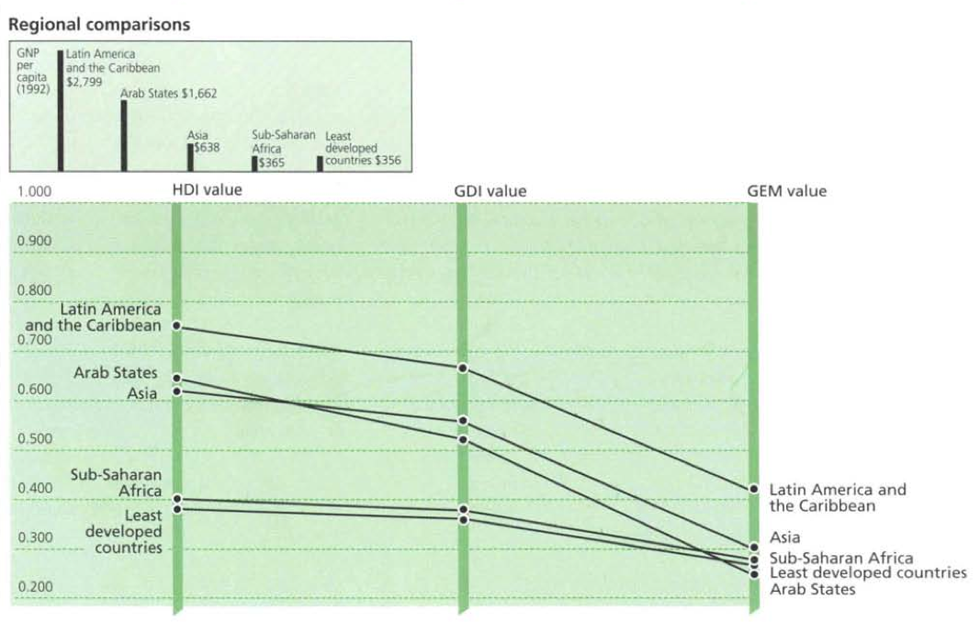

Slide 12
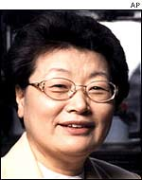

Korea’s (only) woman on top

Slide 13
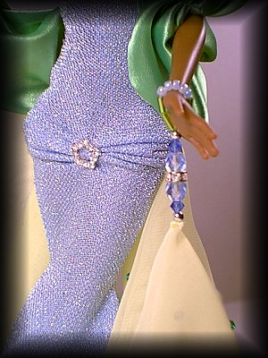
Women to rule Rwanda parliament

Slide 14


UNIFEM

Slide 15
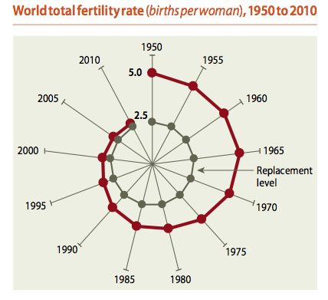
Every country has made progress
in developing women's capabilities,
but women and men still live in an unequal world.

Slide 16
Geography all the way
Gender inequalities in culture and status
Gender inequalities in education
Gender inequalities in birth ratios and family size
Gender inequalities in employment
Gender inequalities in empowerment
Gender inequalities in health and life expectancy
Gender inequalities in migration
Gender inequalities in legal rights and land tenure

Slide 17

Geography all the way
Gender inequalities in gender and status

Slide 18
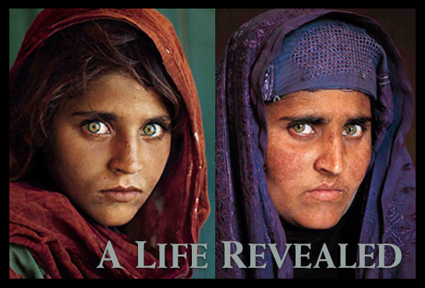
Best and worst places to be a woman

Slide 19

Gender inequalities in education

Slide 20
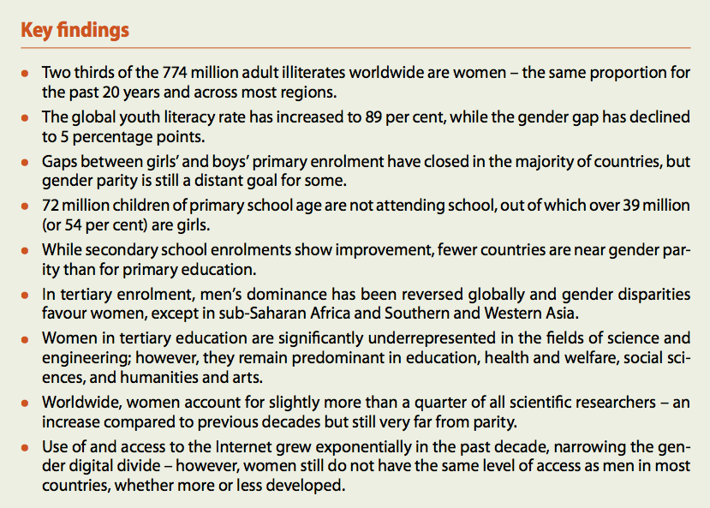
Education

Slide 21

Enrolling girls in record numbers
In the poorest countries, girls account for 55 percent of all out-of-school children. Although these numbers represent considerable progress—30 years ago, girls represented only 38 percent of primary school enrollments—disparities remain due to gender-specific obstacles. For example, girls are expected to help with housework, and many face sexual harassment getting to school and in the classroom.

Slide 22
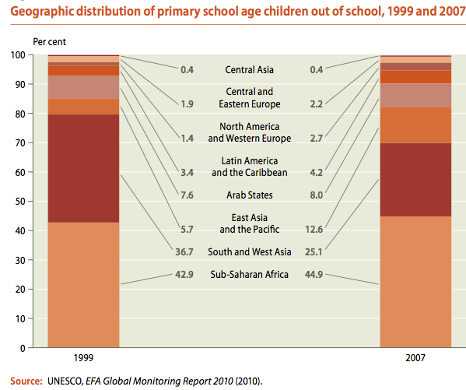

Slide 23
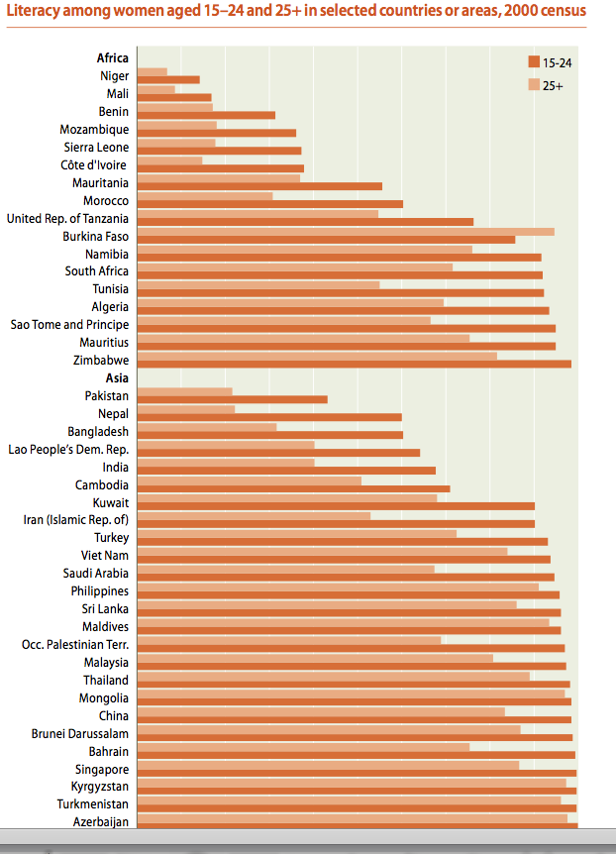

Slide 24

Gender inequalities in birth rate and family size

Slide 25
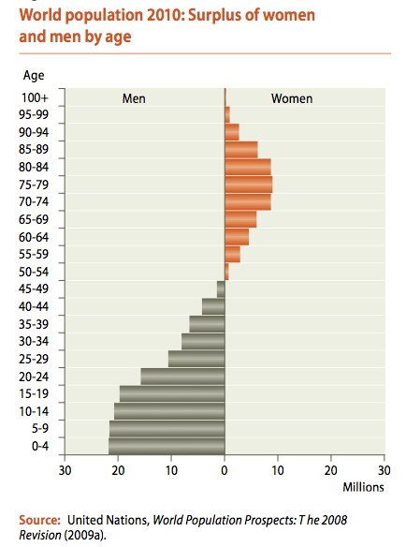

Slide 26
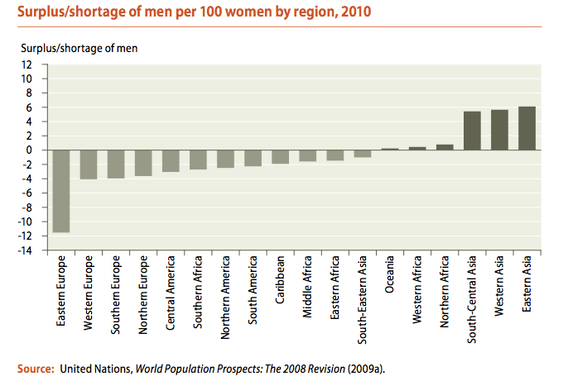

Slide 27
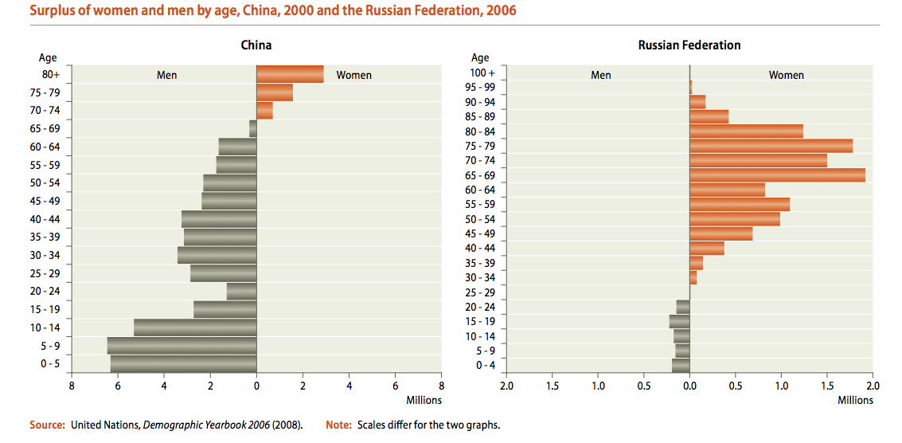

Slide 28

Gender inequalities in employment

Slide 29
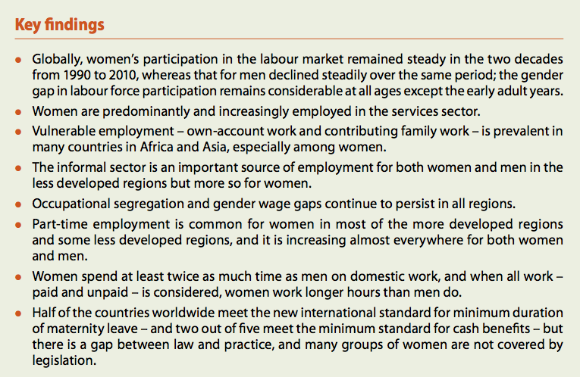

Slide 30
Government intervention is necessary
through policy reforms (Sweden has allowed parents of children under age ten the right to shorten their workday by two hours)
and affirmative actions (Some countries have expanded public services to day-care centres and school lunches, helping women and men to pursue careers).

Slide 31
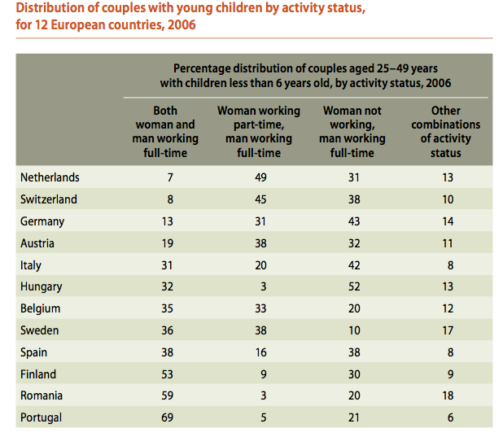
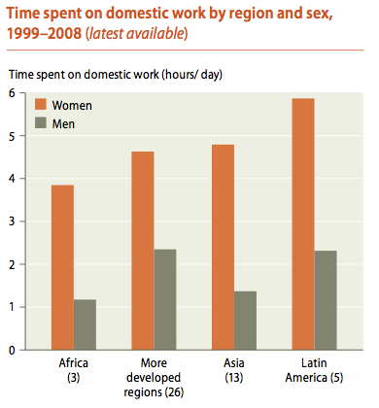

Slide 32
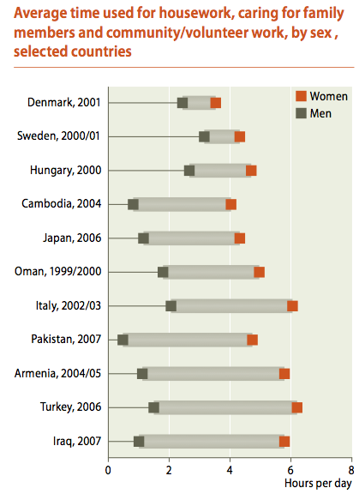

Slide 33
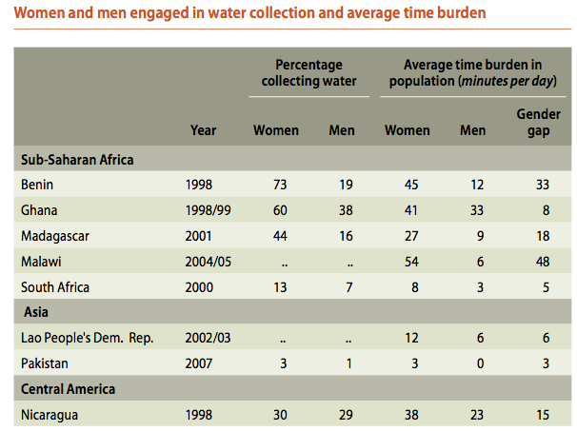

Slide 34
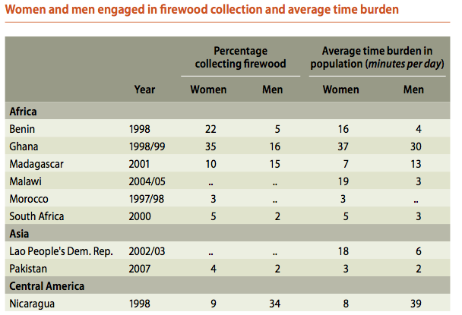

Slide 35
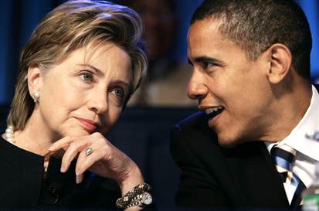
Gender inequalities in empowerment

Slide 36
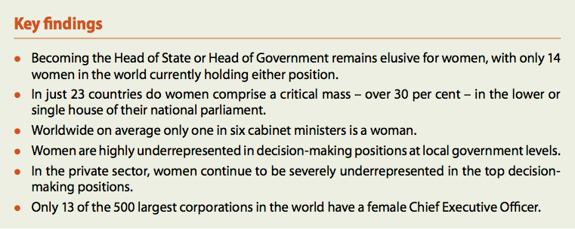
Power and decision-making

Slide 37

Empowering women through opportunity
In many developing countries, women lack a voice in their households, communities, and governments, as well as access to resources. Increasing women’s economic opportunities and participation—such as through access to land, financial services and other resources—can promote women’s status and help their countries reduce poverty and develop faster.

Slide 38
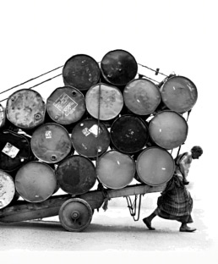
3 billion people have little or no access to financial services
Microfinance emphasizes building local financial markets to meet the diverse financial needs of poor people. Access to a range of microfinance services—savings, loans, and money transfers—enables poor families to invest in enterprises, better nutrition, improved living conditions, and the health and education of their children. It is also a powerful catalyst for women’s empowerment.

Slide 39
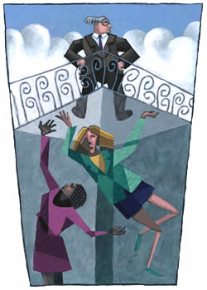
glass ceiling
In economics, the term glass ceiling refers to situations where the advancement of a qualified person within the hierarchy of an organization is stopped at a lower level because of some form of discrimination, most commonly sexism and racism.

Slide 40
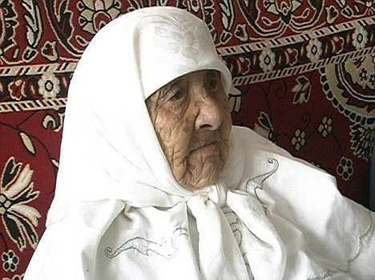
Gender inequalities in health and life expectancy

Slide 41
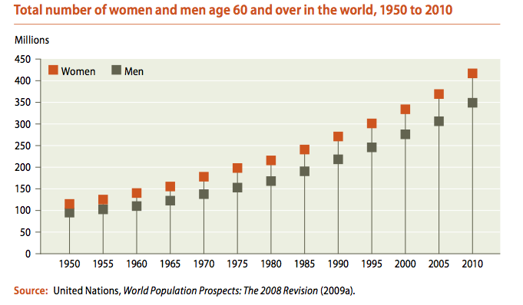

Slide 42
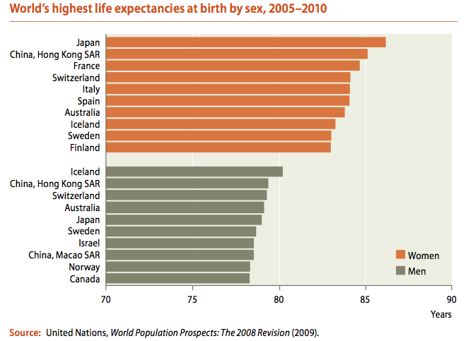

Slide 43
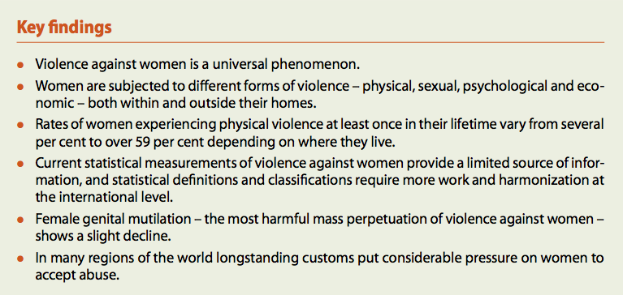
Violence against women

Slide 44
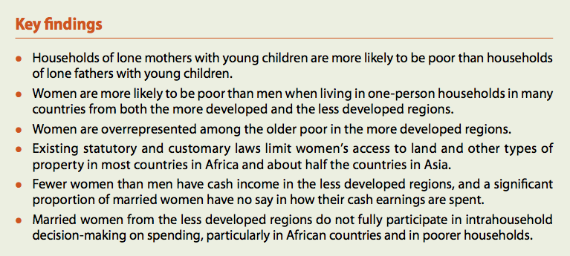
Poverty

Slide 45

Gender inequalities in migration

Slide 46
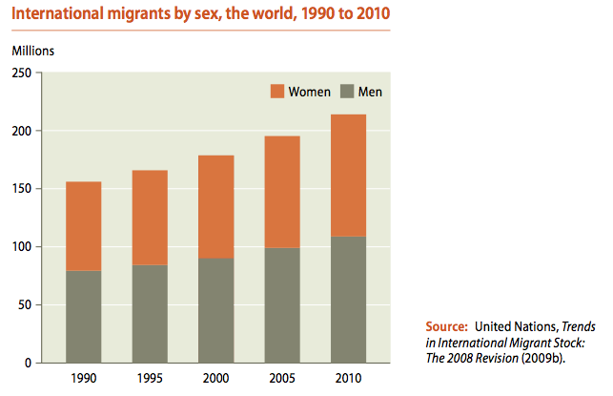

Slide 47
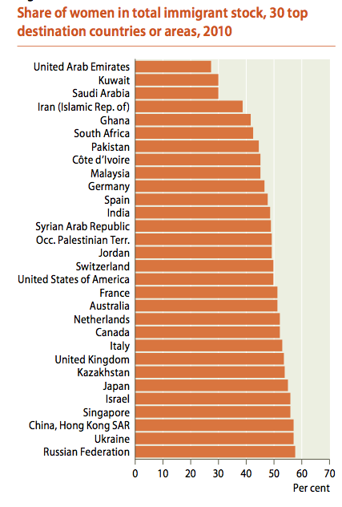

Slide 48

Gender inequalities in legal rights and land tenure

Slide 49
tenure
Tenure is defined as the way in which the rights, restrictions and responsibilities that people have with respect to land (and property) are held
Formal law, traditional legal systems and societal norms, including customary and religious laws, often deny women the right to acquire and inherit property, particularly in countries where shariah law applies.

Slide 50
Access to productive resources is critical to enhancing women’s choices
For low-income women – the vast majority of women in the world - lack of access to bank credit is a persistent barrier to attaining economic independence and widening choices.
Experience in many countries demonstrates that poor women invest money wisely and make sound decisions to maximize returns.

