Slide 1
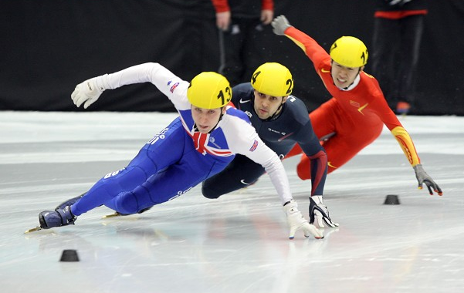
Leisure at the International Scale
Sport
Sport

Slide 2
The Olympic Games

Slide 3
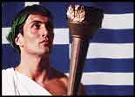
The Olympic Games were a series of athletic competitions held for representatives of various city-states of Ancient Greece held in honour of Zeus. The exact origins of the Games are shrouded in myth and legend but records indicate that they began in 776 BC in Olympia in Greece.

Slide 4
Modern Olympic Games - international multi-sport event held since 1896

Slide 5
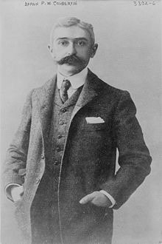
Baron Pierre de Coubertin founded the International Olympic Committee (IOC) in 1894.
The IOC has since become the governing body of the Olympic Movement, whose structure and actions are defined by the Olympic Charter.

Slide 6
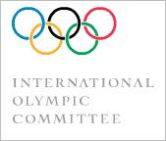
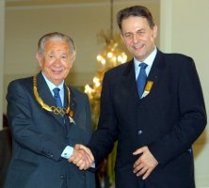
THE INTERNATIONAL OLYMPIC COMMITTEE
The organization that controls the Olympic Movement is the International Olympic Committee based in Lausanne, Switzerland.
Samaranch and Rogge

Slide 7
The Olympic Movement currently comprises international sports federations (IFs), National Olympic Committees (NOCs), and organizing committees for each specific Olympic Games. As the decision-making body, the IOC is responsible for choosing the host city for each Olympic Games.
The host city is responsible for organizing and funding a celebration of the Games consistent with the Olympic Charter. The Olympic program, consisting of the sports to be contested at each Olympic Games, is also determined by the IOC. The celebration of the Games encompasses many rituals and symbols, such as the Olympic flag and torch, as well as the opening and closing ceremonies.
There are over 13,000 athletes that compete at the Summer and Winter Olympics in 33 different sports and nearly 400 events.
The first, second, and third place finishers in each event receive gold, silver or bronze Olympic medals, respectively.

Slide 8
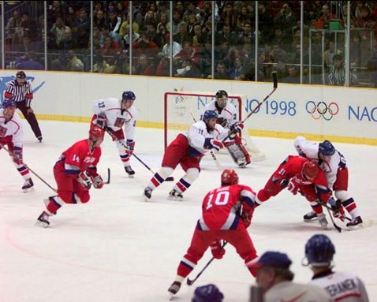
The evolution of the Olympic Movement during the 20th century forced the IOC to adapt the Games to the world's changing social circumstances.
Some of these adjustments included the creation of the Winter Games for ice and snow sports, the Paralympic Games for athletes with physical disabilities, and the Youth Olympic Games for teenage athletes.
The IOC also had to accommodate the Games to the varying economical, political, and technological realities of the 20th century. As a result, the Olympics shifted away from pure amateurism, as envisioned by Coubertin, to allow participation of professional athletes.
The growing importance of the mass media
created the issue of corporate sponsorship and commercialization of the Games.
Professional NHL players were allowed to participate in ice hockey starting in 1998 (1998 Gold medal game between Russia and the Czech Republic pictured).

Slide 9
A winter sports week (it was actually 11 days) was held in 1924 in Chamonix, France; this event became the first Winter Olympic Games.
As of the 1988 Summer Olympics in Seoul, South Korea, the host city for the Olympics has also played host to the Paralympics.
Starting in 2010, the Olympic Games will be complemented by Youth Games, where athletes between the ages of 14 and 18 will compete. The first Summer Youth Games will be in Singapore in 2010, while the inaugural Winter Games will be hosted in Innsbruck, Austria, two years later.

Slide 10
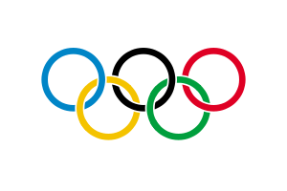
The Olympic Games are a major international event featuring summer and winter sports, in which thousands of athletes participate in a variety of competitions.
The Games are currently held every two years in even-numbered years, with Summer and Winter Olympic Games alternating, although they occur every four years within their respective seasonal games.

Slide 11
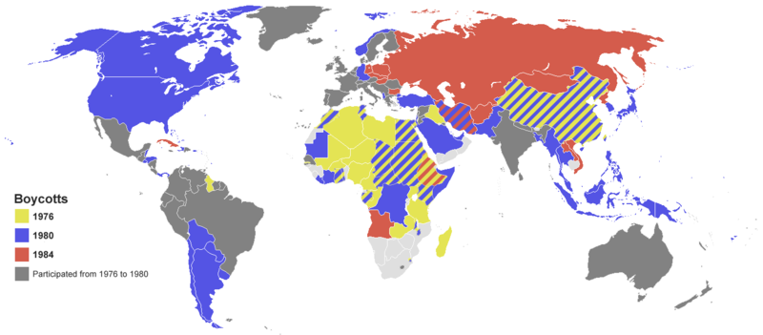
The Games have grown in scale to the point that nearly every nation is represented. Such growth has created numerous challenges, including boycotts, doping, bribery of officials, and terrorism. Every two years, the Olympics and its media exposure provide unknown athletes with the chance to attain national, and in particular cases, international fame. The Games also constitute a major opportunity for the host city and country to promote and showcase themselves to the world.
Map show the countries that boycotted the 1976 (yellow), 1980 (blue) and 1984 (red) Summer Olympics.

Slide 12
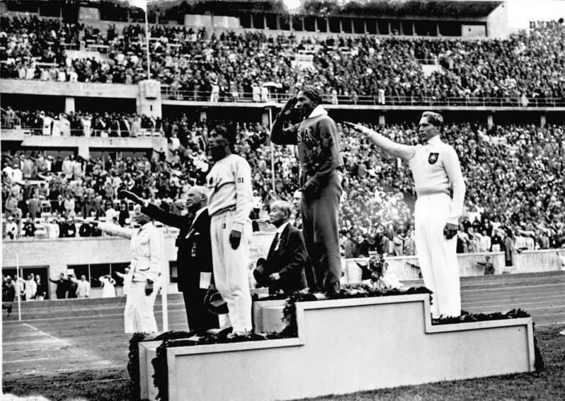
Jesse Owens on the podium after winning the long jump at the 1936 Summer Olympics

Slide 13
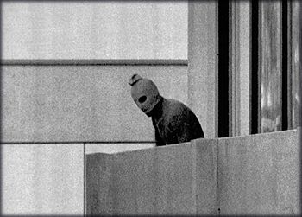
"Arab Commando Group Seizes Members of the Israeli Olympic Team at their Quarters at the Munich Olympic Village." This is an iconic image showing one of the hostage takers during the event known as the Munich Massacre.
The Munich massacre is an informal name for events that occurred during the 1972 Summer Olympics in Munich, West Germany, when members of the Israeli Olympic team were taken hostage and eventually murdered by Black September, a militant group with ties to Yasser Arafat’s Fatah organization.

Slide 14
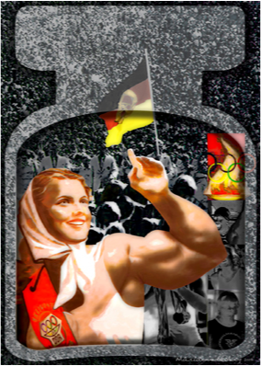
Forgotten victims of East German doping take their battle to court. Athletes who were given drugs to compete in the name of communism seek £8m compensation.
The competition between countries as a matter of national pride began in the 1950s as superpower rivalries between the capitalist USA and the communist USSR intensified.

Slide 15
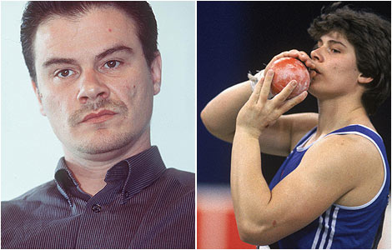
Athlete says sports steroids changed him from woman to man
Heidi Krieger is among an estimated 10,000 East German athletes thought to have been given performance-enhancing drugs to help build their country into a sports powerhouse.
In the 1970s and 1980s, the German Democratic Republic (DDR) was one of the most successful Olympic Games nations. But after the fall of the Soviet Communism, it was revealed just how much steroids were fueling the medal machine.

Slide 16
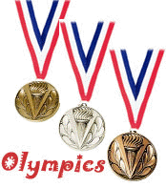
So comparing medal tallies can be misleading
Large populations (on a per capita basis, Jamaica was a winner in Beijing)
Wealth and economic development
Availability of resources (in such respect North Korea was a winner in
Beijing in 2008)
National identity issue (Australians are obsessed with sports)
Cultural or historical reasons (basketball in the USA, table tennis in
China, marathon in Kenya)
Climate

Slide 17
"Countries" Participating in the 2008 Summer Olympic Games in Beijing
12 Non-Countries Are Competing in the Olympic Games
May 5 2010The media reports that there are 204 "countries" competing in the 2008 Summer Olympic Games in Beijing but with only 195 countries in the world, how does that work out?
Allow me to explain.All but three of the 195 independent countries of the world are participating in the Olympic Games, thus there are 192 countries participating.There are twelve territories or other entities that have been permitted by the International Olympic Committee to have their own National Olympic Committee (NOC)
Three Countries Not Participating in the Olympic Games
Brunei has planned on sending its two athletes to the Summer Games but they unfortunately did not register swimmer Maria Grace Koh and shot putter Mohammed Yazid Yatimi Yusof on time.
Kosovo is the world´s newest country and does not yet have complete international recognition. Therefore, Kosovo does not have a National Olympic Committee and could not compete in Beijing.
The Vatican City does not have a National Olympic Committee and has not publicized any aspirations to form one in order to compete in the Olympic Games.

Slide 18
Non-Countries Participating in the Olympic Games. These are the twelve non-countries participating in the Summer Games. I have included the reason that each entity is not a country.
American Samoa (a territory of the United States)
Aruba (part of the Netherlands)
Bermuda (a territory of the United Kingdom)
British Virgin Islands (a territory of the United Kingdom)
Cayman Islands (a territory of the United Kingdom)
Cook Islands (self-governing in free association with New Zealand)
Guam (a territory of the United States)
Hong Kong (special administrative region of China)
Netherlands Antilles (a territory of the Netherlands)
Palestine (Palestine is not a country.)
Puerto Rico (a territory of the United States)
U.S. Virgin Islands (a territory of the United States)

Slide 19
While more than 200 "countries” traditionally participate in the Summer Games, only 85 are scheduled to show up in Turin. Below is a listing of the ten most populous countries not participating in the Winter Games in Italy.
1) Indonesia 2) Bangladesh 3) Nigeria 4) Philippines 5) Vietnam 6) Egypt 7) Ethiopia 8) Thailand 9) Democratic Republic of Congo 10) Myanmar

Slide 20
The cities that have hosted the Olympic Games have been heavily concentrated in Europe, and to a lesser degree, in North America.

Slide 21
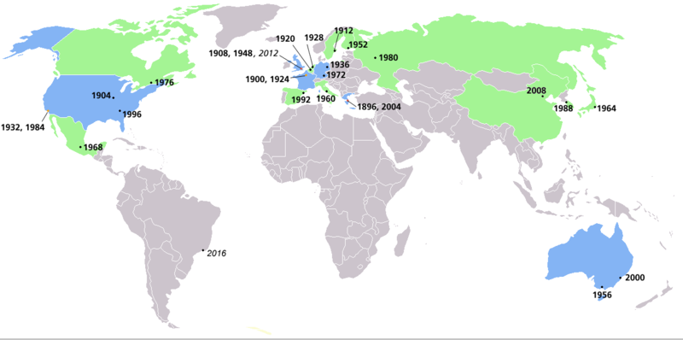
Map of Summer Olympics locations. Countries that have hosted one Summer Olympics are shaded green, while countries that have hosted two or more are shaded blue.

Slide 22
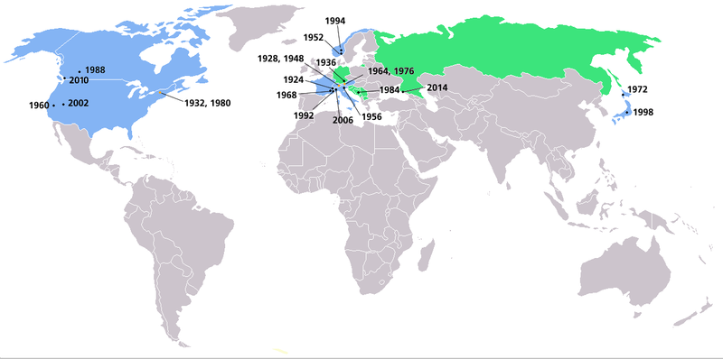
Map of Winter Olympics locations. Countries that have hosted one Winter Olympics are shaded green, while countries that have hosted two or more are shaded blue.

Slide 23
The Olympic Games have never been held in either Africa or South America, nor in West/Central/South Asia.

Slide 24
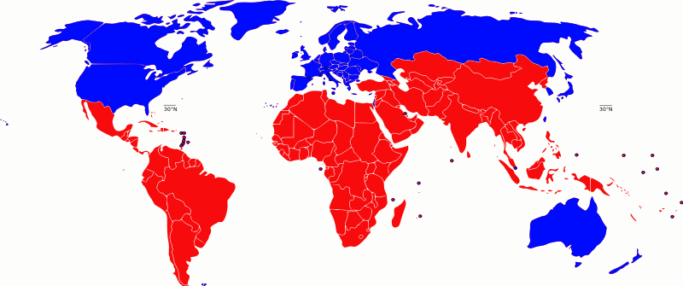
The distribution of Olympic host cities is a mirror of levels of economic development as well as the traditional origin of athletics within Europe.
The updated view of the north-south divide. Blue includes G8 states and developed/ first world states.

Slide 25
The largest number of bids have come from cities in Europe and North America. Although bids have been received from a few cities in Africa and South America, they have never offered the large-scale input of resources and facilities promised by cities in MEDCS.

Slide 26
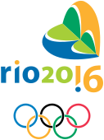
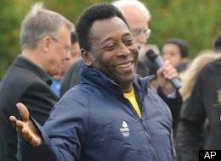
Brazilian soccer great Pele isn't worried President Barack Obama's star power could help Chicago win the bid for the 2016 Olympics at the expense of Rio de Janeiro:
"We have some reason to believe in Rio de Janeiro, not only Rio but South America, because we have never had the Olympics," Pele said.
Rio gained IOC praise for having strong public support, a stable economy and experience from hosting the Pan American Games in 2007. Rio also is hoping to gain points for its fun-loving people and natural beauty, with mountains covered with thick green jungle towering above gorgeous beaches.
The Rio 2016 Summer Olympic Games will be the second edition held in Latin America after Mexico City 1968, the first edition held in South America, the third edition held in the Southern Hemisphere (the first of those three outside of Australia), and the first games in a lusophone country.

Slide 27
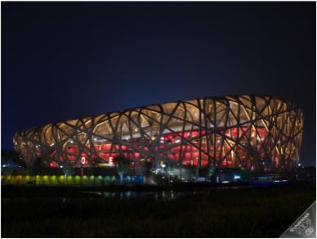
Bird´s Nest, Beijing
There are significant costs involved in building sports facilities, but these remain available for many years after the event.

Slide 28
Costs and benefits
The Beijing Olympics in 2008 cost US $ 42 billion over seven years.
The Games added US $ 4 trillion to China´s GDP in 2008 alone.

Slide 29
Costs of hosting the Olympics -
Very costly
Political interference
Fear of terrorism
Money spent on sports facilities and urban infrastructure might divert money away from the less visible needs of the local population
Relocated people

Slide 30
Geographic benefits of hosting the Olympic Games

Slide 31
Economic benefits +
Tourism is boosted.
Visitors raises income (has a multiplier effect)
New sporting facilities and other infrastructure creates employment and efficiency in the economy and improvement in the quality of life for the residents.
Service jobs

Slide 32
Social benefits +
National pride increases
Goodwill generated
Awareness of sports (fitter population)
Sense of community (relies on voluntary work)
Empowerment of low income residents
Urban renewal (in disused or run down areas)
The Green Games (Sydney 2000)

