Slide 1
Globalisation and global shift

Slide 2
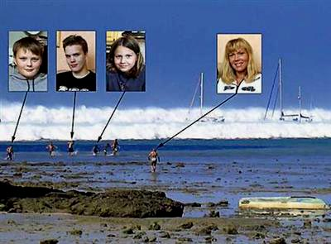
Global interdependence
- the way in which economies and societies are interlinked.

Slide 3
“Globalisation is the term for the process of integration in the realms of trade, economic relations and finance (it is broader, including social relations, knowledge, culture and politics) and it is not new, it has been aided by the ICT revolution that has destroyed distance and indeed time. Brands are known the world over and are potentially destroying local diversity.”

Slide 4
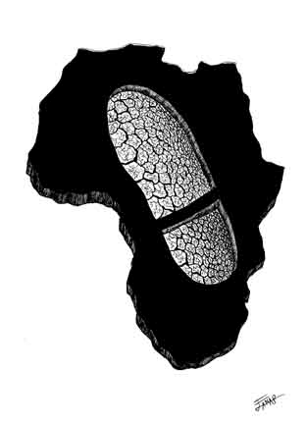
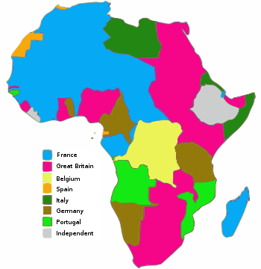
Colonialism and mercantilism
Financed the Industrial Revolution (1760-1850)
Empires like the British, French and German
Notes:
Mercantilism is an economic theory that holds that the prosperity of a nation is dependent upon its supply of capital, and that the global volume of trade is "unchangeable". Economic assets or capital, are represented by bullion (gold, silver, and trade value) held by the state, which is best increased through a positive balance of trade with other nations (exports minus imports). Mercantilism suggests that the ruling government should advance these goals by playing a protectionist role in the economy; by encouraging exports and discouraging imports, especially through the use of tariffs.

Slide 5
1918 to 1945
The Communist Revolution
The Depression
The rise of Keynesian interventionism (1930s)
…led to a new world economic order
Notes:
According to Keynesian economics the state should stimulate economic growth and improve stability in the private sector — through, for example, interest rates, taxation and public projects.

Slide 6
After 1945
The World Bank
GATT (the General Agreement on Tariffs and Trade)
Bretton Woods Agreement (1948)
…were the foundations of a new system.
Trade was governed by conventions that supported
the economies of the wealthy nations.
Notes:
GATT was formed in 1947 and lasted until 1994, when it was replaced by the World Trade Organization.
The Bretton Woods Conference had introduced the idea for an organization to regulate trade as part of a larger plan for economic recovery after World War II.
The GATT's main objective was the reduction of barriers to international trade. This was achieved through the reduction of tariff barriers, quantitative restrictions and subsidies on trade through a series of agreements. The GATT was a treaty, not an organization.

Slide 7
Origin of modern globalisation
1975 OPEC oil price rises
New wealth of oil producers
Money deposited in MEDC banks
Lent the money to developing countries
Fall of the Soviet bloc in 1989 led to further opportunities for investment.

Slide 8
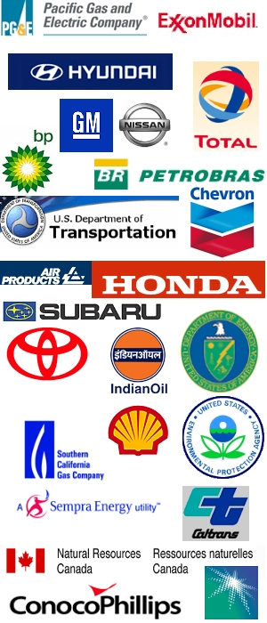
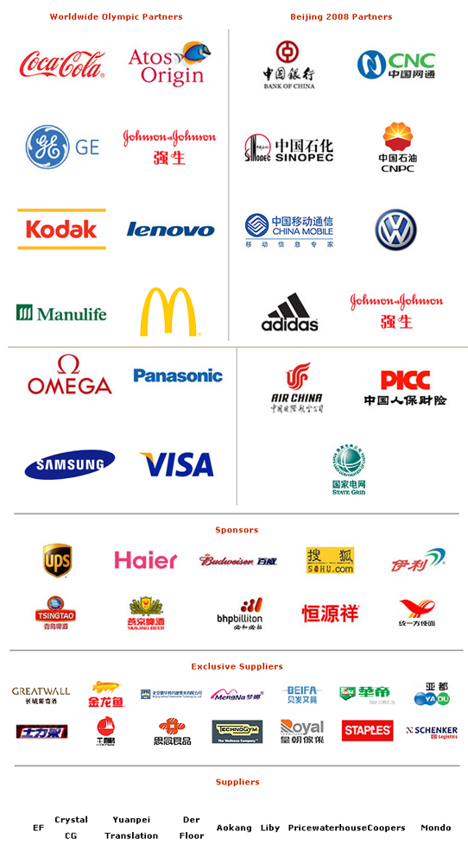
Today global corporations have become more important than governments, controlling greater wealth and investment thanks to support from the World Trade Organization (WTO).

Slide 9
Globalisation takes three forms
Economic
Cultural
Political
Geographers like to add a fourth form:
environmental globalisation

Slide 10
Economic
Growth of TNCs at the expense of national governments

Slide 11
Cultural
Increased Western influence, especially American, over aspects of culture (music –iPods), the arts (films) and the media (CNN).

Slide 12
Political
The increased influence of Western democracies and the decline of the centralised Soviet economies.

Slide 13
Environmental
Globalisation is creating problems (global warming, hole in the ozone layer)
These require global solutions

Slide 14
Factors promoting globalisation
Money from the OPEC price rise
ICT
Fibre optic cables and satellites
Internet
Cheaper and quicker transport
WTO and trading blocs promoting free trade
Rise of multinational companies
New products
Services at a global scale

Slide 15
Two views
+ Globalisation as a cycle that returns some economic power to the those countries that lost it as a result of colonialism.
(view held by economists, business leaders, TNCs and global institutions like the World Bank).
= historical inevitability

Slide 16
- Others see it as a set of linear stages in the process of economic development and domination of the world economy by the wealthy.
(view held by environmentalists, human rights advocates, trade unionists, dispossessed farmers and citizens´ groups)
Globalisation has widened the development gap (debt crisis, TNCs retain control and R&D in the home country)

Slide 17
Global shift
First to NICs (Newly Industrialized Countries like Hong Kong, Singapore, South Korea and Taiwan – the Asian “tigers”)
Then to RICs (Rapidly Industrializing Countries like Brazil, Chile, Mexico, Indonesia, Malaysia, and Thailand)
And then to LEDCs

Slide 18
Global shift
is one consequence of the latter stages of globalisation.

Slide 19
Outcomes of globalisation and global shift
Less regulation of companies
Privatisation
Deregulation of financial markets
Failing returns on primary products
“The global casino”
Environmental consequences
A widening development gap
Cultural consequences
Geopolitical consequences

Slide 20
Less regulation of companies
So much that private companies may have the same rights as national governments in countries.

Slide 21
Privatisation
Leads to lower labour costs.
May lead to declining demand in MEDCs due to slower wage rises.

Slide 22
Deregulation of financial markets
So that currencies become more volatile, to the detriment of many LEDCs.

Slide 23
Falling returns on primary products
See Year 9 textbook.

Slide 24
“The global casino”
International finance, including share and currency traders and foreign exchange (Forex) and derivatives markets have increased wealth.

Slide 25
Environmental consequences
Deforestation
Pollution

Slide 26
Cultural consequences
Economic migration, refugees and asylum seekers in search for the economic wellbeing.

Slide 27
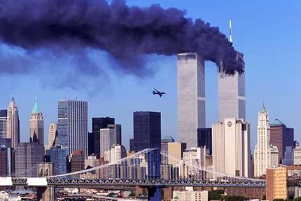
Geopolitical consequences
+ Moves towards greater unity of economies
like the Euro zone and trade blocks.
- Protest movements, revolution and terrorism.

Slide 28
3 types of large companies
Transnational companies (TNCs) or multinational enterprises (MNEs)
Multinational companies (MNCs)
Global companies

Slide 29
Trends
Dominance of US companies.
The major global companies are increasingly service-oriented.

