Slide 1
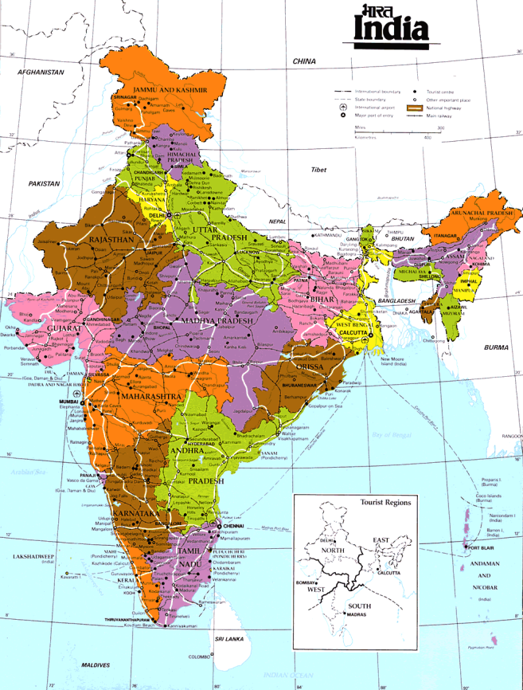
INDIA
By: Alice Almighty and Dansk-Maria

Slide 2
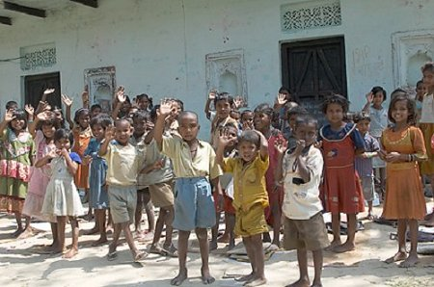
India Background information
1.15 billion
Birth rate: 24 per 1000
Population growth 1.578%
Despite their effort, India’s population control success has been modest
35% of the population are under 15 years old

Slide 3
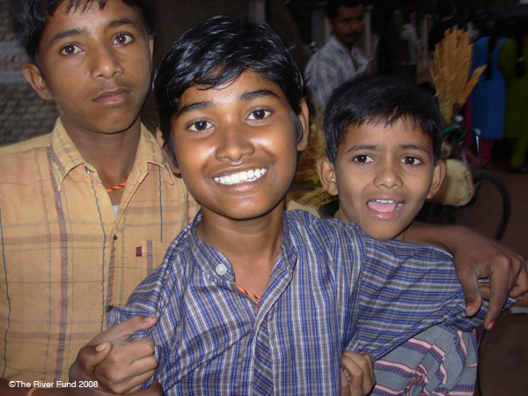
One child policy?
Not formally introduced
Decrease birth rate & population growth.
>Pressure – keep the family name

Slide 4
Anti-Natalist
One of the first countries to introduce this policy.
Have launched programmes to limit population growth:
> 1952 – volunteers – sterilised
> 1970 – forced sterilization

Slide 5
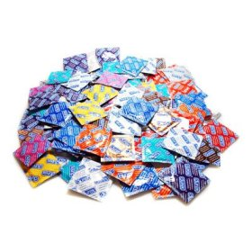
The five year plan
Encourages use of contraceptives.
The five year plan for India’s economy:
> Controlling population growth = the sixth most important target.

Slide 6
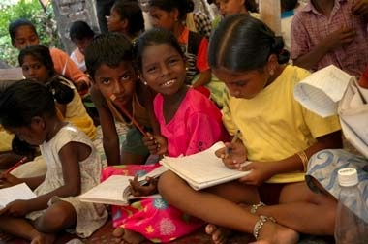
Achieving this:
Incentives
New schools

Slide 7
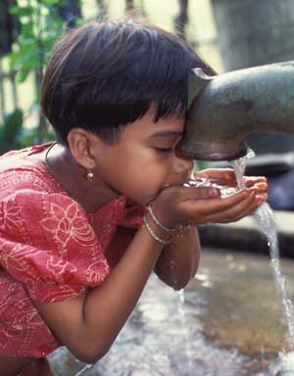
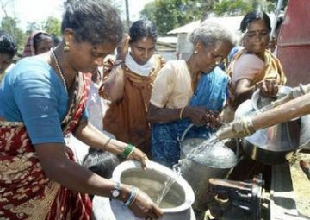
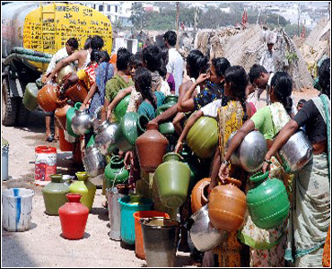
Drinking water facilities

Slide 8
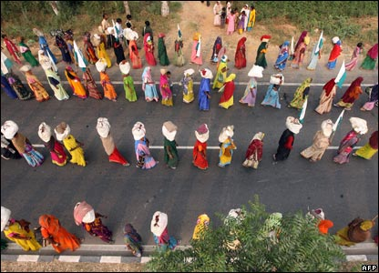
New road links

Slide 9
Cash incentives
For people willing to be sterilised or have an IUD inserted
Commisions for health workers who succesfully motivate couples to become sterilised
Couples who wait 2 years before having kids recieve 5000 rupees (if they wait another year they will recieve an extra 2500 rupees)

Slide 10
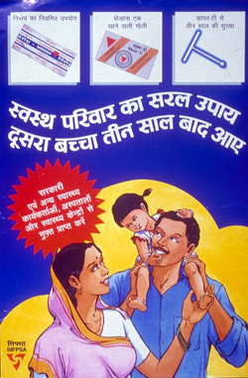
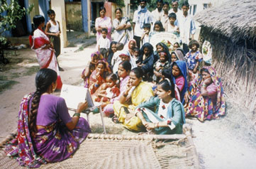
Family planning services
> free of charge
A woman uses a flip chart to discuss family planning with a group of adolescent girls, women, and young men as part of the "Come Let's Talk" campaign in India

Slide 11
Birth rates:
Birth rate per 1000 people: | Year:
38.2 | 1975
29.1 | 1995
25.2 | 2000
24 | 2008

Slide 12
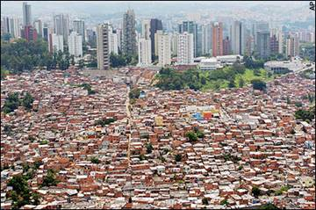
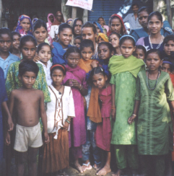
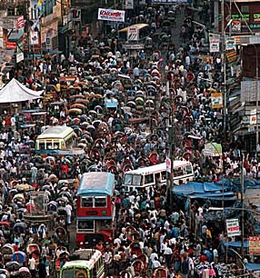
Continue to try and control Population control

