Slide 1
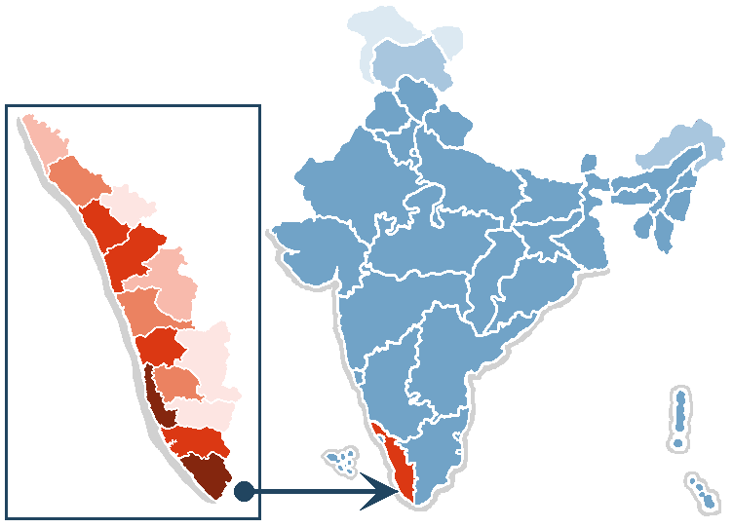
Kerala

Slide 2
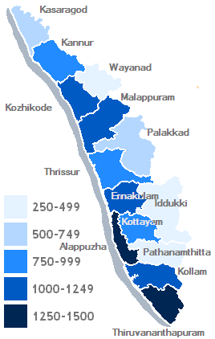
Population
3.44% of India’s people
Three times as densely settled as the rest of India

Slide 3
Demographic information
Population growth rate is far lower than the national average (0.87%)
Fertility rate 1.70
Life expectancy 73.4 years
Sex ratio 1058 females to 1000 males

Slide 4
Population control
Traditionally Kerala had the highest fertility rates and lowest death rates
Over only 30 years the birth rate fell from 42 per 1000 to 17 per 1000
Fertility rate 1.7. Way below replacement level
No strong regulations or government incentives

Slide 5
Reasons
Female literacy
Money spent on education and health care in rural areas
Knowledge about contraception
Religion. Fertility declined more among
non-Muslims
Attitudes of the people

Slide 6
