Slide 1
Leisure at the International Scale Tourism

Slide 2
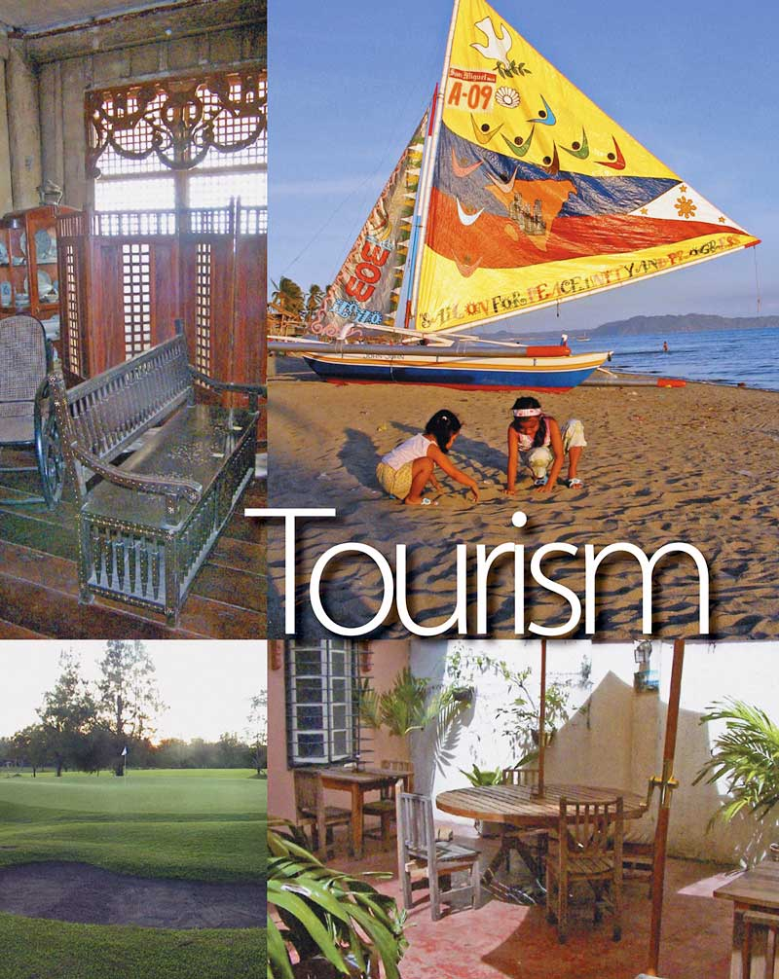

Slide 3
What is the significance of the tourism industry in the 21st century?
Tourism is a complex social, cultural and economic phenomenon and one of the most significant global phenomena, not to say the world's largest industry as many claim.
We are increasingly mobile in the 21st century, making more and more trips. Our lives are defined by these trips. Tourism in its many different guises is central to our experience as human beings - you can’t get away from it. The Olympics, climate change, poverty alleviation, sustainable development, place promotion and investment – all the hot topics relate to tourism in one way or another. You simply can’t understand the world today without understanding tourism.

Slide 4
Leisure
- any freely chosen activity or experience that takes place in non-work time.

Slide 5
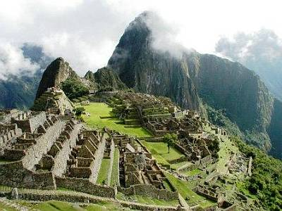
Carrying capacity
Machu Picchu
- the maximum number of visitors/participants that a site/event can satisfy at one time.

Slide 6
Primary tourist/recreational resources
- the pre-existing attractions for tourism or recreation (that is, those not built specifically for the purpose.

Slide 7
Environmental carrying capacity
- the maximum number before the local environment becomes damaged.

Slide 8
Perceptual carrying capacity
- the maximum number before a specific group of visitors considers the level of impact, such as noise, to be excesssive.

Slide 9
Recreation
- a leisure-time activity undertaken voluntarily and for enjoyment.

Slide 10
Resort
- A settlement where the primary function is tourism.

Slide 11
Sport
- A physical activity involving events and competitions at the national and international scale with professional participants.

Slide 12
Tourism
- Travel away from home for at least a one night for the purpose of leisure.

Slide 13
Subdivisions of tourism:

Slide 14
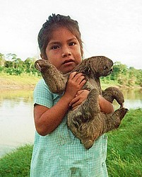
Ecotourism
Tourism focusing on the
natural environment
and
local communities.

Slide 15
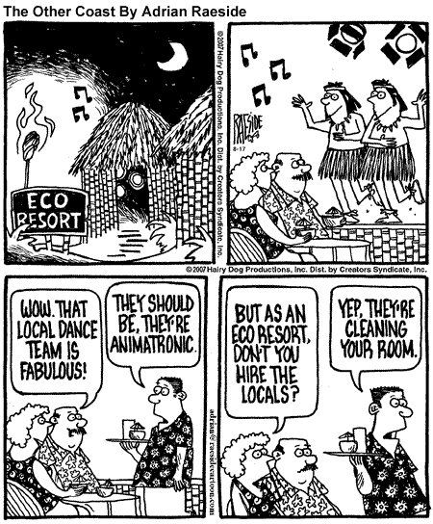

Slide 16
Heritage tourism
- Tourism based on a historic legacy (landscape feature, historic building or event) as its major attraction.

Slide 17
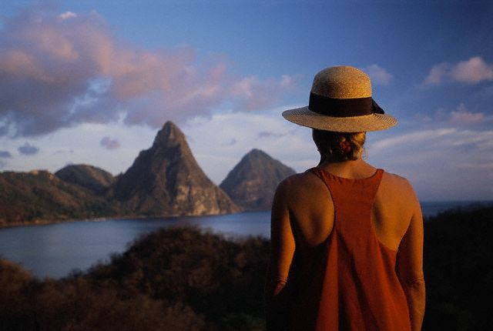
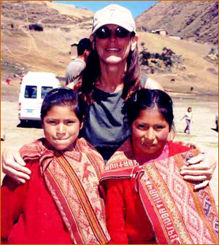
Sustainable tourism
- Tourism that conserves primary tourist resources and supports the livelihoods and culture of local people.

Slide 18
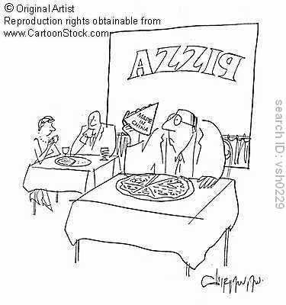

Slide 19
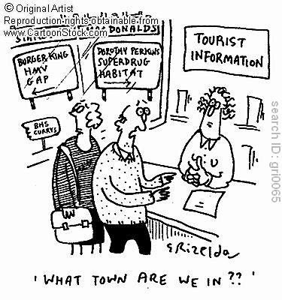

Slide 20
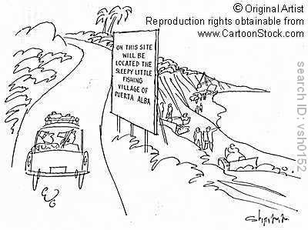
On this site will be located the sleepy little fishing village of Puerta Alba.

Slide 21
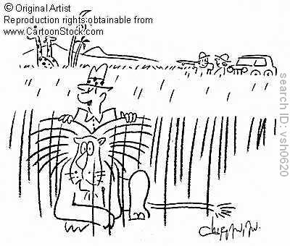
Safari.

Slide 22
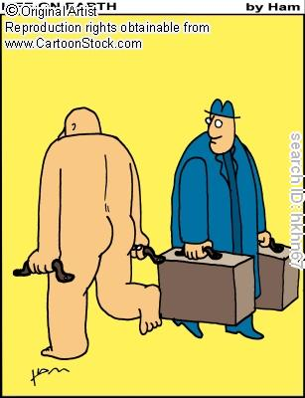
Nude tourist.

Slide 23
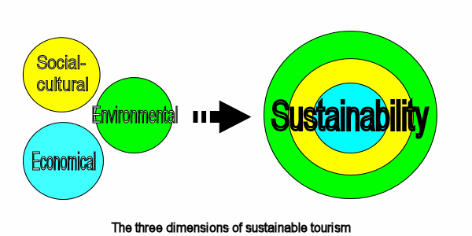

Slide 24
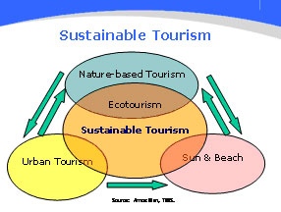

Slide 25
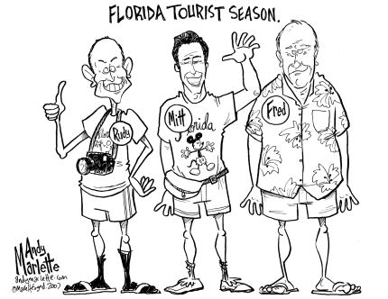
Mass tourism
- an organized form of large-scale tourism, in which travel, accommodation and meals are booked and paid for in advance.

Slide 26
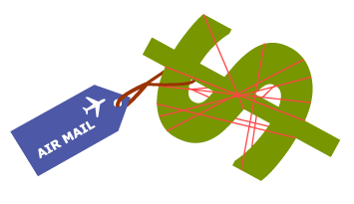
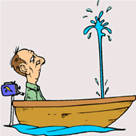
Leakage
- refers to the money that “escapes” from a tourist destination and makes its way to other countries via airline companies, hotel companies, MNCs, food importers etc.

Slide 27
Rapid growth of tourism since 1950
mobility
affluence
advertising
media coverage of exotic tourist destinations
mass tourism by TNCs
reduction in cost
improvements to facilities and infrastructure for tourists

Slide 28
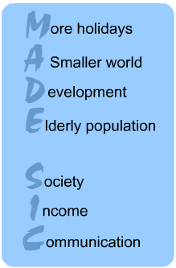

Slide 29
Movie

Slide 30
Butler Model

Slide 31
Butler Model 2

Slide 32
Butler model
The Butler Model is a model of tourism that represents tourism as the life cycle of a resort. It depicts tourism as exploitation of a resource. There are 5 stages and from the 5th stage it either continues rising of falls into a decline.
-Exploration - New land is discovered by a few people, not many people there yet
-Involvement - More people arrive and try to get involved to help develop this new destination
-Development - This is when a lot of people are trying to build this new destination, at this point the destination is well habited
-Consolidation - Tourists start to pour into the country to get first impressions about it
-Stagnation - Large numbers of tourists enter the country in this part of the model, the Butler model has reached its first peak
Then once it finishes, the model can either go through
-Decline - People have found out that there is a lot of instability and are trying to leave the country before they are really badly affected by the decline
-Rejuvenation - This is when measures are taken by the government and the local people to try and reduce the chances of a decline actually happening, if the measures are successful then the country will continue rising up the Butler model (this is the second peak)

Slide 33
This model is based on MEDC tourism as it has to go through all of the stages. LEDC's however can be kick started by TNC's from MEDC's.

Slide 34
Whereas Butler’s Model describes the carrying capacity of tourism in an area when tourism is market-driven…

Slide 35
…the Hawkins Model attempts to take into account a broader set of factors.

Slide 36
The Hawkins Model
Shows how the positive attitudes that may exist between tourists and local residents can change and become more negative as the threshold of the carrying capacity is reached.

