Slide 1
NIGERIA
By Madina Semega-Janneh

Slide 2
Facts
Nigeria has one of the fastest growing populations in the world!
1950 - Population was 32.9 million people
2008 – A staggering 148.1 million
Notes:
In 1950, Nigeria’s population was a mere 32.9 million people. By 1990, it had increased to 96.2 million, almost triple to what it was! In 2008, the population increased to a staggering 148.1 million people.. That’s ALOT. It has been further estimated that nigeria’s population will increase to 2882.2 million by 2050. Hopefully it won’t reach that.

Slide 3
Nigeria compared to USA

Slide 4
Rates in 1925
Birth rate was 46.3 per 1000 people
Death rate 20.2 per 1000
Annual population growth rate 2.61%
Notes:
In 1925, Nigeria had a pretty high birth rate of 4.3 per every 1000 people. The death rate was relatively high: 20.2 per every 1000 and the annual population growth was 2.61% .. One of the HIGHEST in the world!

Slide 5
Rates in 2008
Birth rate was 43 per 1000 (STILL HIGH!)
Death rate reduced to 18 per 1000 people
Annual population growth 2.5%
Notes:
By 2008, the birth rate had decreased to 43 per every 1000, death rate to 18 per every 1000 and the annual population growth dropped to 2.5% which is not so much of a difference.

Slide 6
DID YOU KNOW?
Nigeria’s fertility rate in 1981-82 was 5.94 children per woman?
By 1990 it had climbed to 6.01?
And today it is 5.9?
Notes:
In 1981-82, Nigeria’s fertility rate was 5.94 children per woman and by 1990 had climbed to 6.01%. Today it has fropped slightly to 5.9.

Slide 7
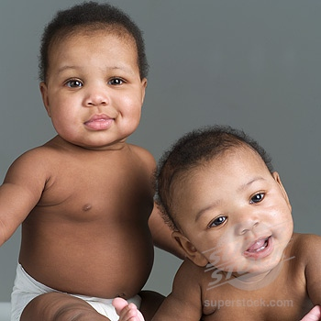
BUT WHY ALL THESE BABIES?!?!

Slide 8
LACK OF CONTRACEPTIVES!

Slide 9
EARLY AGE OF MARRIAGE!

Slide 10
So What Is Their Goverment Doing About It?

Slide 11
Introducing...
THE NATIONAL POLICY ON POPULATION!

Slide 12
Objectives
Promoting an awareness of population problems and the effects of rapid population growth
Providing information on the benefits of small family size
Making family planning services easily accessible to all couples at an affordable cost

Slide 13
Few of Many Targets
Reducing the proportion of women marrying before age 18 by 80%
Reducing the average number of children a woman bears down to 4
Extending family planning coverage to 80% of women in child bearing age
Reducing the rate of population growth from 3% to 2%
Promoting use of contraception

Slide 14
How likely will the targets be met?
Err...
NOT SO LIKELY!

Slide 15
So far the Nigerian policy has not achieved its targets, even though some gains have been made.
WHY?
Religion - vast majority of population are muslims
They prefer large families with many kids
Culture

Slide 16
In conclusion...
NIGERIA
IS
ANTINATALIST!
(Or atleast the government is...)

Slide 17
THE END!

