Slide 1
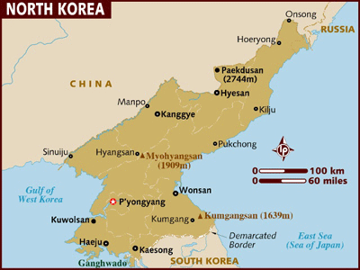
North Korea

Slide 2
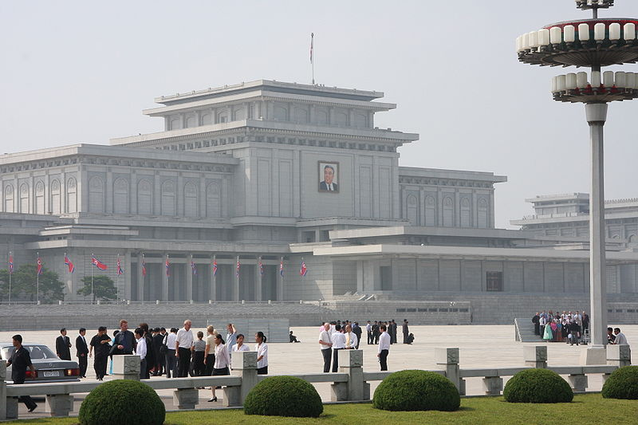
Kumsusan Memorial Palace
Admission – carefully controlled and must be pre-arranged
Dress formally
Security checks
Shoes disinfected
Strong air blowers
Awards and medals of Kim Il Sung

Slide 3
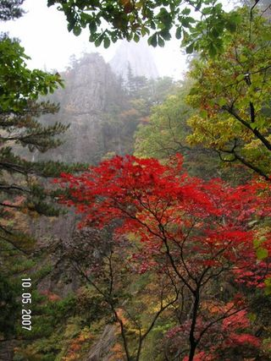
Natural Environment
South Korean tourists
Mount Kumgang
Restort by Hyundai
Suspended in 2008 because a South Korean tourist was shot

Slide 4
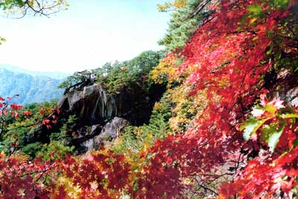
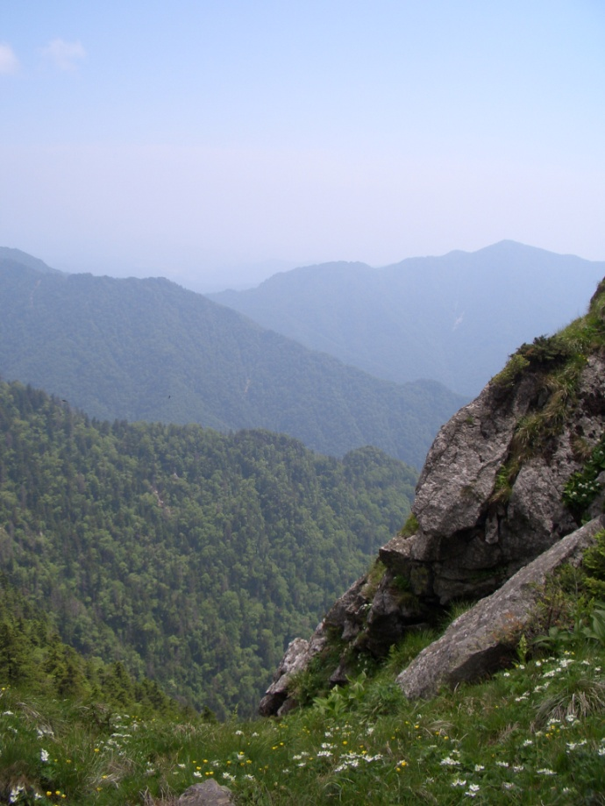
Mount Myohyang
Trails for walking
Landscape of steep mountains, valleys and waterfalls
Bare rock cliff faces are engraved with slogans and quotes from Kim Il Sung

Slide 5
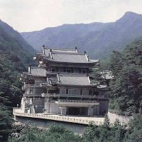
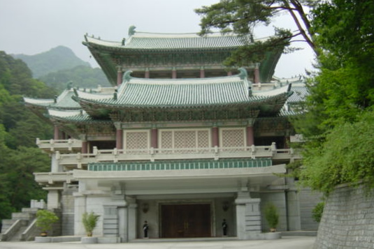
International Friendship Exhibition
120 rooms, almost 250,000 gifts presented by world dignitaries and governments to Kim Il Sung
For example bullet proof cars from Joseph Stalin
Portaits in different styles of the leader

Slide 6
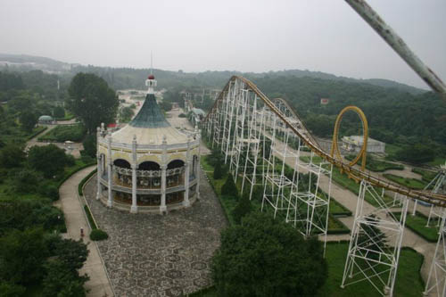
Free Time
North Koreans usually do not travel
Weekends and holidays in the park, as a family
Communal singing of patriotic songs or dancing
Amusement parks – low prices

Slide 7
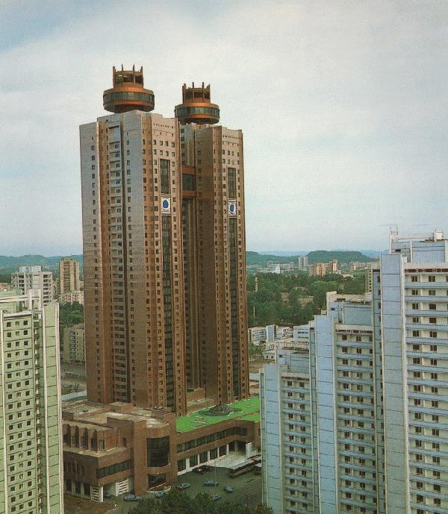
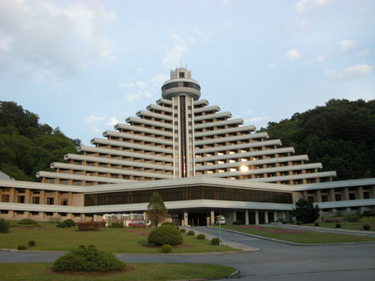
Hotels
All hotels are state-owned and managed
6,000 rooms but only 2,000 tourists annually
Koryo Hotel
Myohyang

Slide 8
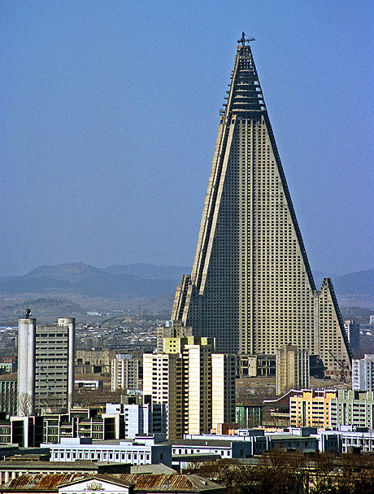
Ryugyong Hotel
World’s largest
Construction began 1987 stopped in 1992
24th highest
330 metres and 7 revolving restaurants
Started in 2008
Planned opening in 2012 + Kim Il Sung’s 100th birthday

Slide 9
Issues
Since everything is government owned, profits from tourism would be used to support a regime accused of human right abuses and disregarding international laws
United Nations World Tourism Organisation endorses visits – outsiders best way to break the government’s monopoly
Experience suggests that keeping North Koreans isolated cements government monopoly of information over people
Illegal for them to listen to foreign radio
All televisions are tuned into the government’s channels
Restricting tourism is to control the flow of information to the locals

Slide 10
SWOT analysis
SWOT
Strengths
Weaknesses
Opportunities
Threats

Slide 11
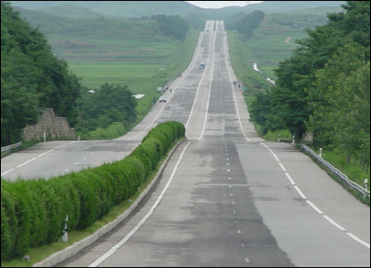
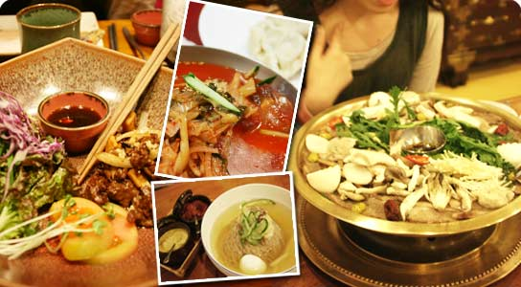
Strengths
Wide range of natural attractions
3 star hotels in Pyongyang and key locations
Good choice of local cuisine
Historical and cultural heritage
Hospitality
Impressive monuments and government buildings
Good network highways
clean and well-maintained tour coaches
Well-trained guys, excellent foreing language skills
Facilities capable of handling small conferences

Slide 12
Weaknesses
Limited air access
Strict visa requirements
Public image of North Korea- driven by politics and hostile media
Tourism infrastructure need upgrading
Limited training for personnel dealing with tourists
Limited choice of non-Korean food
Limited range of souvenirs, expensive
Restrictions of foreign private investments
Harsh winter reduces tourist season to 9 months or less

Slide 13
Opportunites
A trip to North Korea – novelty, ’bragging rights’
Perception of last bastion of socialism/communism
Focused marketing and destination brand development
Attract foreign arilines to open scheduled or charter air services
Foreign tourism development
Huge potential markets in neighbouring countries
Potential niche products, winter sports, ecotourism, VFR, conferneces
Accelerating cooperation with South Korea and potential for joint destination marketing

Slide 14
Threats
Government bureaucracy
Lack of tourism infrastructure funds
Lack of destination marketing funds
Negative impact on markets of ongoing political developments
Possible instability if and when the country’s leadership changes
Fear of an invasion by US and South Korean forces

Slide 15
