Slide 1
EFFECTS OF CULTURAL INTEGRATION

Slide 2
Homogenisation of landscapes
The trend towards uniformity in the character of different places

Slide 3
“westernisation”
buildings
shops
services

Slide 5
Most cultures in the world today are open to change (willingly or otherwise), leading to hybridisation and homogenisation

Slide 6
ECONOMIC DOMINANCE AND DEPENDENCE

Slide 7
When culture contacts occur, they are often caused by the actions of powerful international corporations or media interest.
...resulting in the developing countries becoming more dependent on the developed world.

Slide 8
For instance: Because the American culture is perceived as the road to wealth and affluence in many countries,
...these values can sometimes be accepted somewhat uncritically in other countries.

Slide 9
This is often enforced through advertising which supports foreign investment and economic activity
By portraying a foreign product as part of the local culture
By doing the opposite

Slide 10
“The marketing of breast milk substitutes in developing countries has attracted particular criticism and calls into question the ethical acceptability of the company (Nestle)”.

Slide 11
The Nestlé boycott is a boycott launched on July 4, 1977 in the United States against the Swiss based Nestlé corporation. It soon spread rapidly outside the United States, particularly in Europe. It was prompted by concern about the company's marketing of breast milk substitutes (infant formula), particularly in less economically developed countries (LEDCs), which campaigners claim contributes to the unnecessary death and suffering of babies, largely among the poor.[
The World Health Organization recommends that, in the majority of cases, babies should be exclusively breast fed for the first six months. According to UNICEF, if every baby were exclusively breastfed from birth to six months, an estimated 1.3 million additional lives would be saved each year.

Slide 12
When either of the two aims of advertising is followed:
...local people’s perception of their own culture is being challenged and modified in a way that encourages another foreign culture to emerge in a more dominant position.

Slide 13
THREATS TO CULTURE DIVERSITY AND SOVEREIGNTY

Slide 14
Things that are becoming more similar:
landscapes
economies
cultures
attitudes

Slide 15
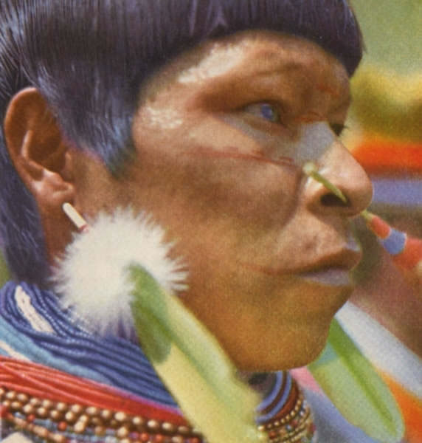
In some countries, traditional cultures are sustained mainly through the economic value of
... tourism

Slide 16
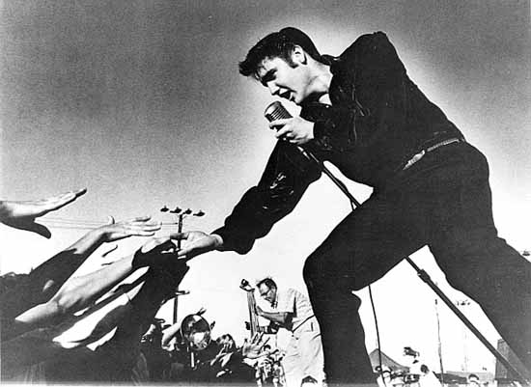
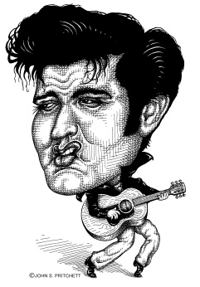
One aspect of culture that is becoming more uniform as a result of globalisation is
...music

Slide 17
Where powerful transnationals corporations operate in a country, a nation may find itself dealing with a company that is financially larger than the country itself.
In such cases, countries are vulnerable to the wishes of companies who can threaten to sack local workers or even withdraw operations from a country completely if they do not get what they want.

Slide 18
Story of stuff

Slide 19
David Harvey (The most cited geographer)

Slide 20
turnover time of capital
Investors are constantly searching of new place where a profit can be made more rapidly than elsewhere.

Slide 21
time-space compression
Harvey argued that the search for shorter and shorter turnover times of capital
is the real cause of
the shrinkage of time-space
(time-space compression)

Slide 22
Change is moving at Internet speed!

Slide 23
Harvey points out that many of the transportation and communication technologies advanced by capitalist corporations have had the effect of shrinking space.
Spatial barriers have become overcome largely through increases in the speed of sending
goods, information, and people.

Slide 24
As distance has been overcome, time too becomes compressed.
The best-known instance of this is “jet lag” when we travel too rapidly across time zones.

Slide 25
Marshall McLuhan
Defined changes in cultures as detraditionalisation.

Slide 26
Followers of David Harvey:
Detraditionalisation is the result of social practices being overwhelmed by foreign business and economic interests.

Slide 27
Other geographers would argue that culture contact is not all one-sided.
People from the dominant western culture
are also being influenced
by other cultures.

Slide 28
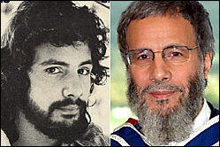
Cat Stevens Yusuf Islam

