Slide 1
Population Issues
The example of Papua New Guinea

Slide 2
Papua New Guinea’s Economic Background

Slide 3
Lack of development compared with Australia
Other side of the world from Europe
Did not have many spices
High rainfall, rainforest and pests, diseases and parasites
Does not produce an agricultural surplus of food staples for export
Importing huge quantities of food
Steep terrain, many islands, coastal swamps
Development suited the needs of the colonial
powers instead
Exporting mainly primary products (agriculture and mining)

Slide 4
Highest population density

Slide 5
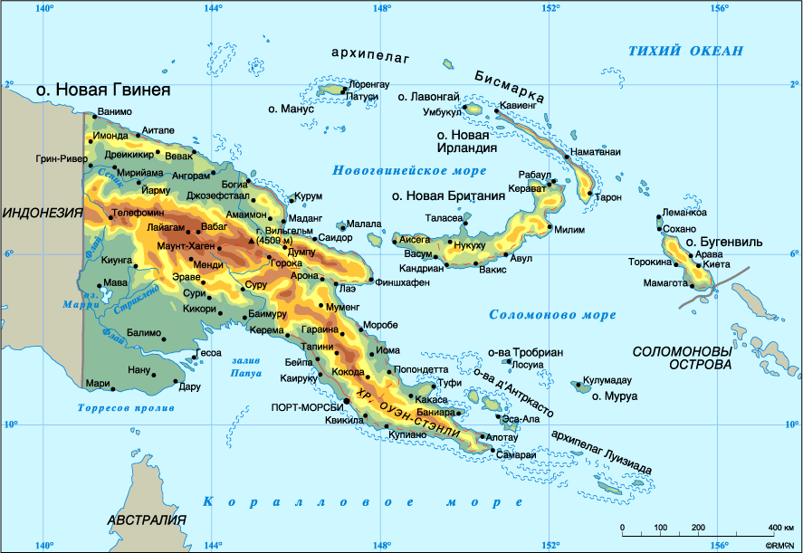
+ Mountain valleys of the Highlands

Slide 6
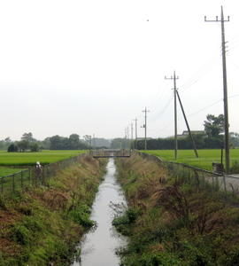

Slide 7
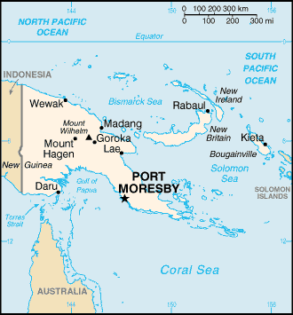
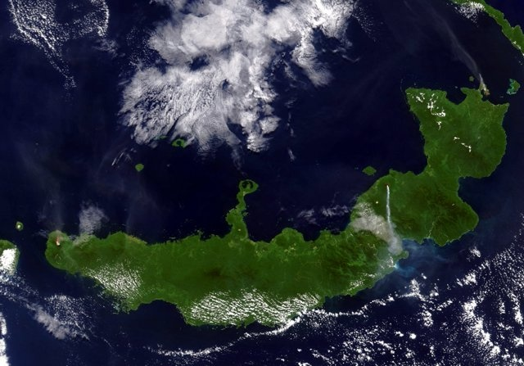
Northern end of New Britain Island

Slide 8
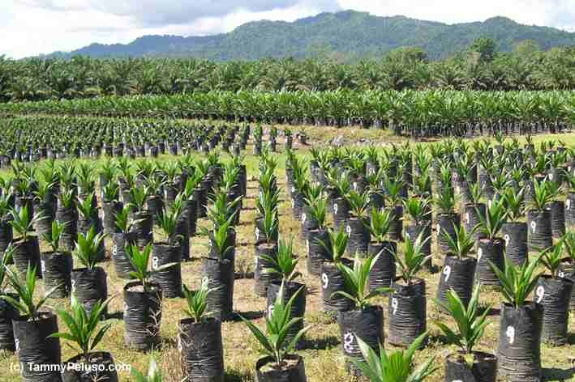
plantations
Coffee, cocoa, coconut (copra), oil palm and kernels. Other export commodities include tea, cardamom, rubber, chillies and pyrethrum as well as the great number of varieties of tropical fruits and vegetables.

Slide 9
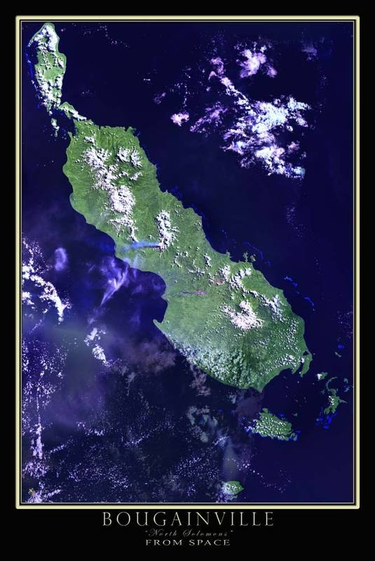
North Solomon Islands

Slide 10
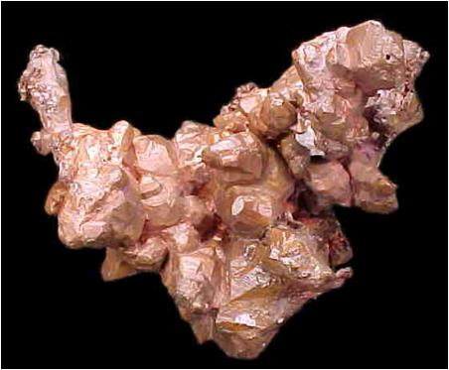
copper mining

Slide 11
least density
low-lying swampy coastal areas

Slide 12
Some parts underpopulated
Other parts overpopulated

Slide 13
Migration
Any movement of people.

Slide 14
Emigration
When people leave a country.

Slide 15
Immigration
When people enter a country from abroad.

Slide 16
Internal migration
The movement of people within a country.

Slide 17
Out-migration
When people move away from a particular district or town.

Slide 18
In-migration
Movement of people into a particular town or district.

Slide 19
Spectacular increase in urban population
natural increase
urban boundaries being expanded
rural-urban migration

Slide 20
Circular migration
The workers returned home after a period of time.

Slide 21
Chain migration
A one-way movement of people in steps, first from villages to small towns, then to larger towns, and finally to cities.

Slide 22
Overall, there has been a movement from densely populated interior regions (the Highlands) to the New Guinea Islands (plantations and mining towns) and to some coastal towns like Port Moresby

Slide 23
50% of rural-urban migrants return home within 5 years of their move (circular migration).
Young, single, adventurous males.

Slide 24
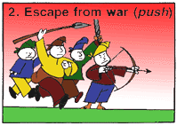
pressure on the land
the need to raise fast cash (tax, consumer goods and bride price)
desire to avoid traditional obligations and authority
an extended adolescence
personal factors
boredom with village life

Slide 25
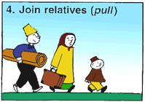
Wish to acquire skills or education
easy access to towns (roads, air, shipping)
more services
migration as a rite of passage into manhood
bright lights
perception the important thing = psychic motives

Slide 26
Result
often
unemployment
poverty
poor accommodation
misery

Slide 27
Men are relatively free to migrate
Because most subsistence cultivation (and other things)
are done by women

Slide 28
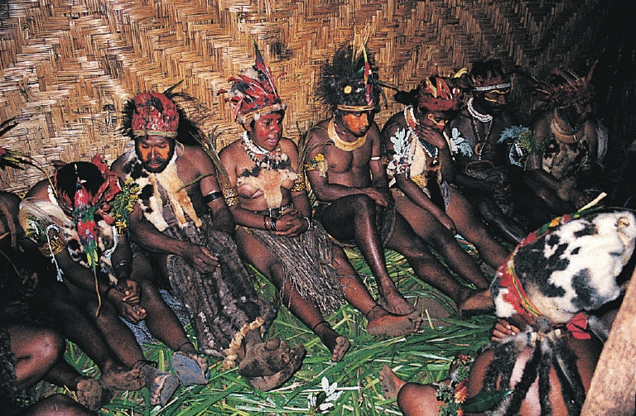
Consequences in the rural areas
unbalanced population structure
excess of children, old people and women
does not usually affect food production
seldom a major economic problem
has not led to great differences in attitudes
traditional ceremonies are beginning to die away
gardening has stopped in some places

Slide 29
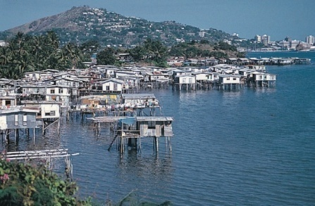
Port Moresby Consequences in the urban areas
1.38 males to every woman
abundance of young people of working age
no formal job training houseboys, cleaners, unemployed
raskals
street bashings
barbed wire fences
unemployment
some engaged in subsistence activities or just visiting
ethnic conflict in the towns
squatter settlements
overcrowding
traditional social systems tend to break down (no “big man”)

