Slide 1
North Korea
Seunghee Woo

Slide 2
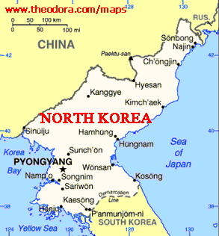
The Democratic people Republic of Korea
One of the worlds last example of a centrally planned government tourism industry.
KITC( Korea international travel Company) controls every aspect of tourism.

Slide 3
One of the worlds smallest tourism industries.
Fewer than 2,000 foreign tourists are allowed to enter North Korea each year.

Slide 4
Today, operates just 3 regular international flights.
Beijing, Shenyang(China), Vladivostok(Russia)
The tourists today are so small, the Infrastructure to support tourism is quite underdeveloped.

Slide 5
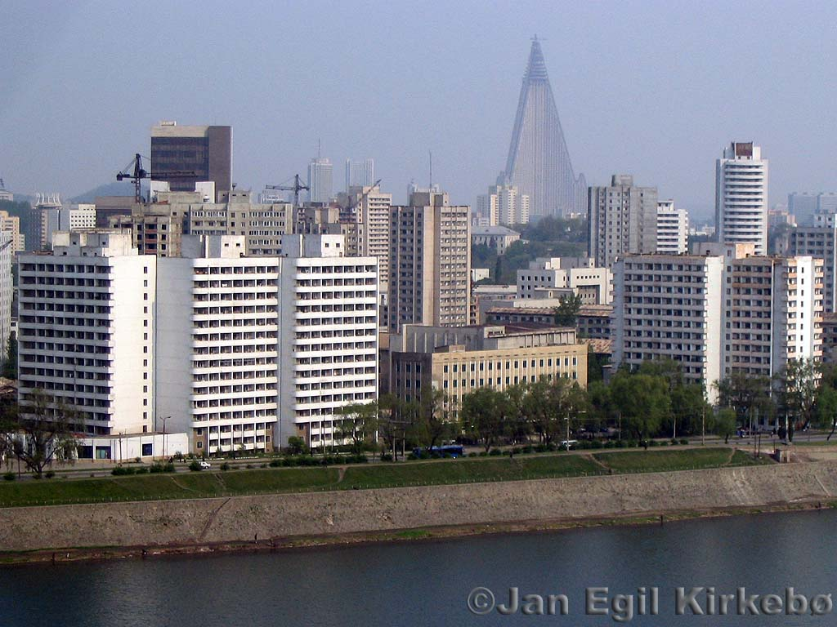
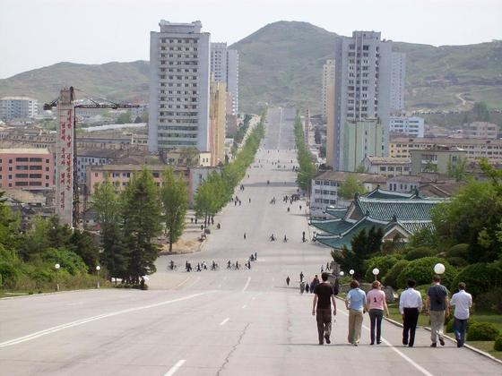
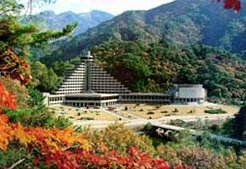
First visit
Chinese visitors were first permitted to enter North Korea in 1989
Restricted to a zone that extended only 40 kilometers in from the Chinese border
-> 1991 permitted to visit Pyongyang, Kaesong and Mount Myohyang

Slide 6
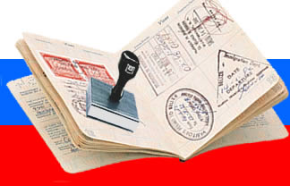
The issuing of visas for all nationalities is strictly controlled
achieved by requiring formal letters of invitation from an official organiation withing North Korea.
Air tickets are usually issued only the day before departure.

Slide 7
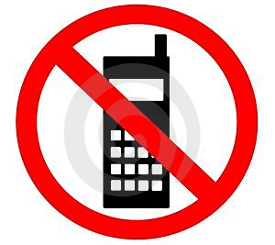
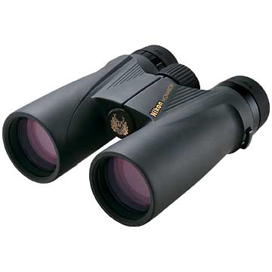
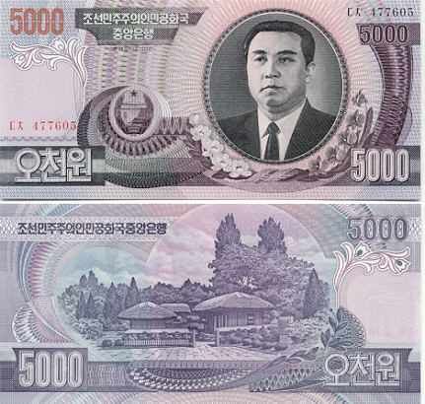
Restrictions
Mobile phones may not be taken into the country.
Binoculars are banned
Males required to conform to the hair regulations (2~5cm)
(over 50, allowed up to 7cm to hide their emerging baldness)
Forbidden from holding any local currency (won)
All purchases must be made using foreign currency.

Slide 8
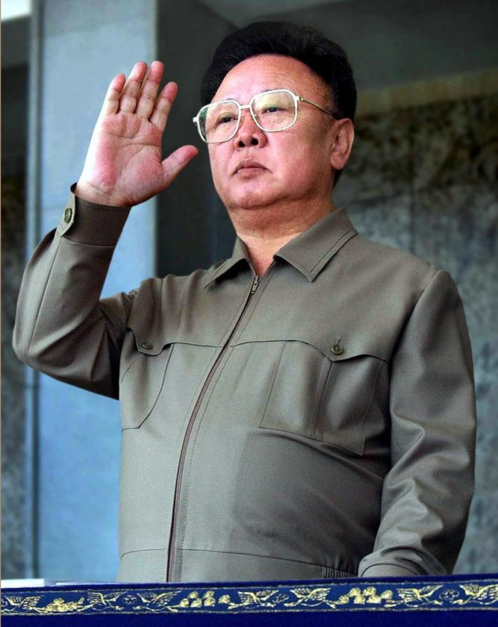
Visitors are required to conform to local laws and regulations.
Not criticising the leadership.
In the early 2000s, a
German tourist was detailed
for several months for
asking her interpreter why
Kim Jong Il was the only fat
man in North Korea.

Slide 9
One of the Safest destination.
General law and order in North Korea is so effective.
with almost 0 crime rates+the fact that foreigners are under the care of their guides during almost every waking moment
X foreigner has ever been reported being attacked,robbed threatened or mugged

Slide 10
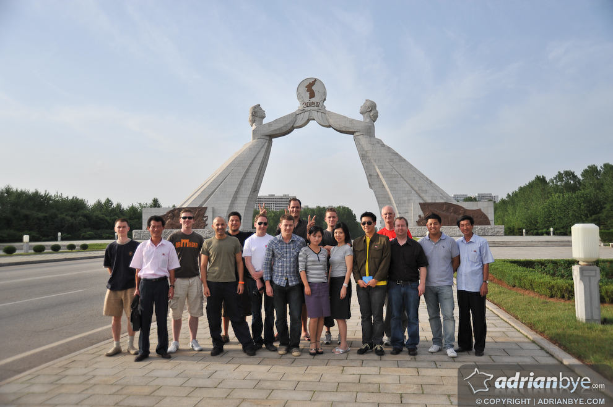
Reasons tourists travel to North Korea
X appeal to tourists seeking beach reorts, theme parks,self exploring or time to relax.
All tourists are ruquired to travel as part of an all-inclusive group tour which is accompanied by 2guides and a driver.

Slide 11
Not allowed to leave their hotel compounds without permission, only if accompanied by a guide and usually without their camera.

Slide 12
Restrictions
Normally X permitted to talk to local people
Photographs allowed only with the permission of their guides
X allowed for photographing military or strategic objects, soldiers,poverty
->report incident to the police
`

Slide 13
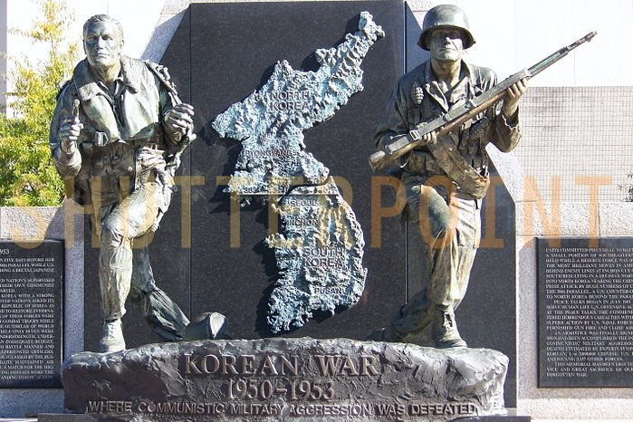
Regulations on photography may be explained in part by the country’s turbulent history.
1950~1953 Korean peninsula was devastated by a brutal war. Ended with an armistice signed on 27th July 1953.

Slide 14
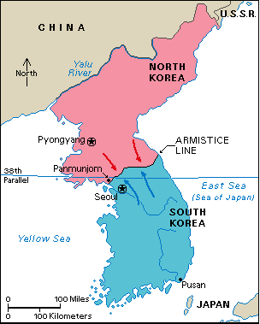
Piece treaty never been signed.
Technically, North Korea is still at war with South Korea-accomodate large numbers of US combat soldiers in its territory.

Slide 15
Paradoxically, it is the distinctive characteristics of the country that emerged from that turbulent history that are the main attractions to tourist who visit North Korea.

Slide 16
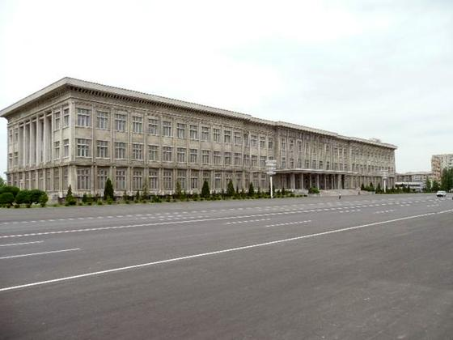
Major tourist sights
Have a strong political and ideological flavour.
Ex) the museum in the country’s capital city, Pyougyang,that is devoted to the Korean war.

Slide 17
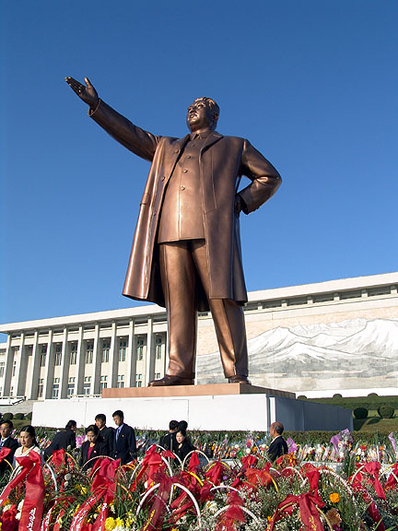
20metre high bronze statue of Kim Il Sung
Tourists are taken to innumerable socialist monuments &memorials to the grilliance of the country’s founder, the Great Leader Kim Il Sung, and his son.
Kim Il Sung still serves as president.

Slide 18
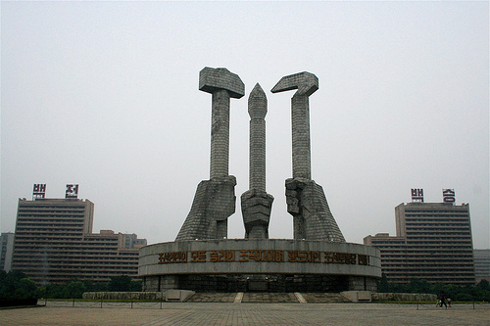
founding of the Korean Workers Parry
The monument to the founding of the Korean Workers Parry In Pyongyang.
Hammer= worker
Sickle=farmers
Writing brush=Intellectuals

Slide 19
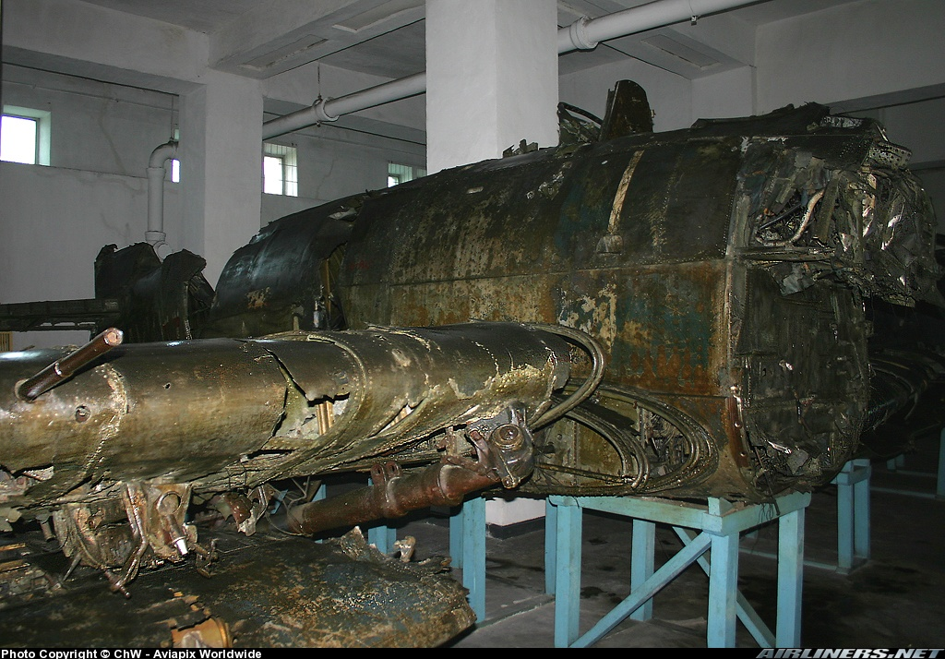
War Museum
A display of captured and destroyed American planes and equipment in the War Museum, Pyongyang

Slide 20
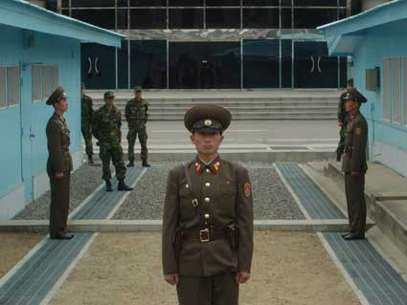
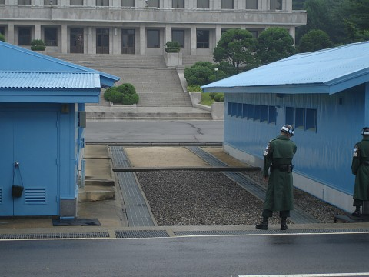
The border between North and South Korea
The border between North and South Korea at Panmunjom
Marked by the thin concrete strip through the middle of each blue hut

Slide 21
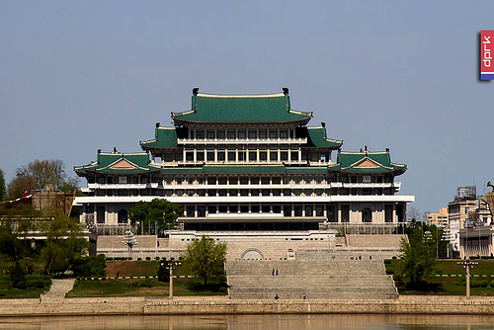
Grand People Study House
The Grand People Study House, which overlooks Kim Il Sung Square in the city centre.

Slide 22
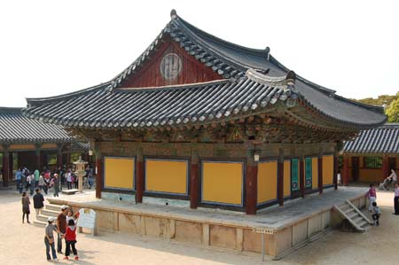
Major tourist sights
Buddhist monasteries in North Korea, although neither is functioning as a place of worship.

Slide 23
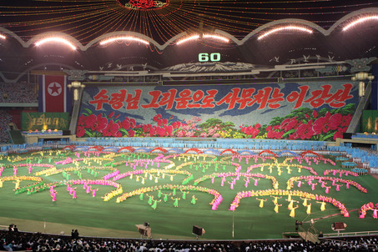
Mass gymnastics
Unlike sports competitions, where athletes compete for prizes or awards, the mass gymnastics are designed to represent a pure model of communism where each individual sacrifices his or her individuality for the greater common good of the excellence of the collective performance.

Slide 24
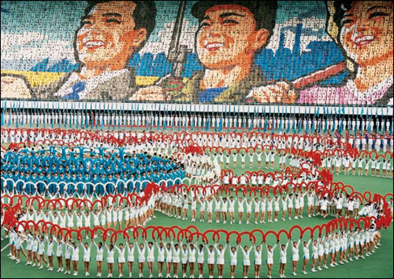
All the performers are volunteers
Tens of thousands of school children who participate, practice takes several hours every day after school for about 6months.

Slide 25
Not all tourism in North Korea is undertaken by foreigners. There is a domestic tourist industry and although no statistics are available.
Also the scale is extremely small.

Slide 26
North Koreans require special permission to travel beyond the limits of their home town, and frequent road blocks check the papers and documents of all travelers.
Access to some parts of the country are completely forbidden to domestic and foreign travelers alike.

Slide 27
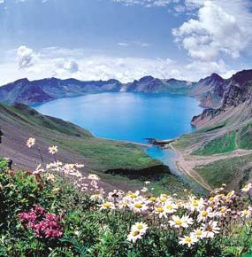
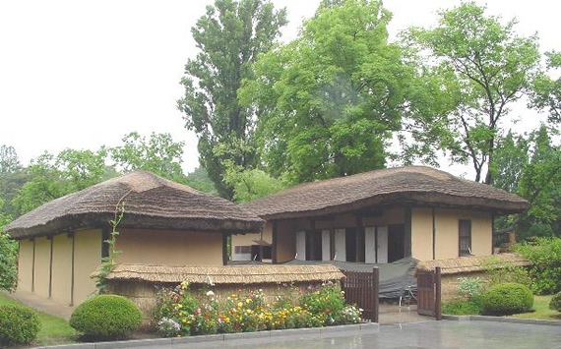
Domestic travel is usually organized by a person's work unit, and members of the same work unit usually travel together.
Usual travel destinations for North Koreans are revolutionary sites.
-Mount Paektu or the birthplace of Kim Il Sung in Pyongyang.

