Slide 1
Singapore’s Population Policy
By Kristina

Slide 2
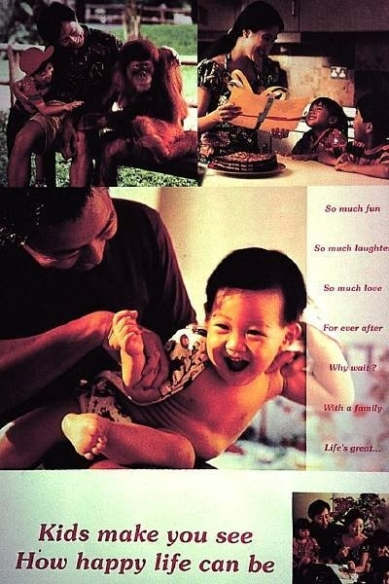
Pro- natalist

Slide 3
Pro-natalist
People are the most precious resource of Singapore
Effort, drive and talent of Singaporeans made the country what it is now
Although Singapore has no natural resources, it’s a thriving and modern economy thanks to the people

Slide 4
Singapore
4.8 million people
685 square km
Population density 7,742 people per square km- among the highest in the world
Birth rate- 11 births per 1000 people
Death rate- 5 deaths per 1000 people
Population is ageing

Slide 5
During 1960, when Singapore became independent, the rapidly rising population was causing concern.
People migrating from China, Malaysia and India
Anti-natalist government policy of ‘stop-at-two’ was introduced
Policy was successful- growth falling below replacement level

Slide 6
New Population Policy
New Population Policy (pro-natalist) was introduced in 1987
Target- young couples who were choosing career and personal interests above marriage and parenthood
Posters- ‘Children- Life would be empty without them’ and ‘Now that you’ve married, take the next step’

Slide 7
Aim of New Population Policy- increase fertility rate to 2.1
1986- fertility rate 1.4
1988- fertility rate 2.0

Slide 8
New Population Policy targets intellectually talented people
University graduates are encouraged to have 4 children instead of 2
Immigration of well-educated people is encouraged
Emigration of university graduates is discouraged

Slide 9
Thank you!

