Slide 2
The syllabus says:
Examine the progress in meeting the Millennium Development Goals (MDGs) in poverty reduction, education and health.

Slide 3
Let's end poverty now

Slide 4
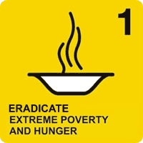
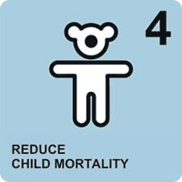
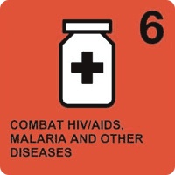
…but focus on poverty reduction, education and health

Slide 5
Ban Ki-moon says UN Millennium Goals 'can be met'

Slide 6
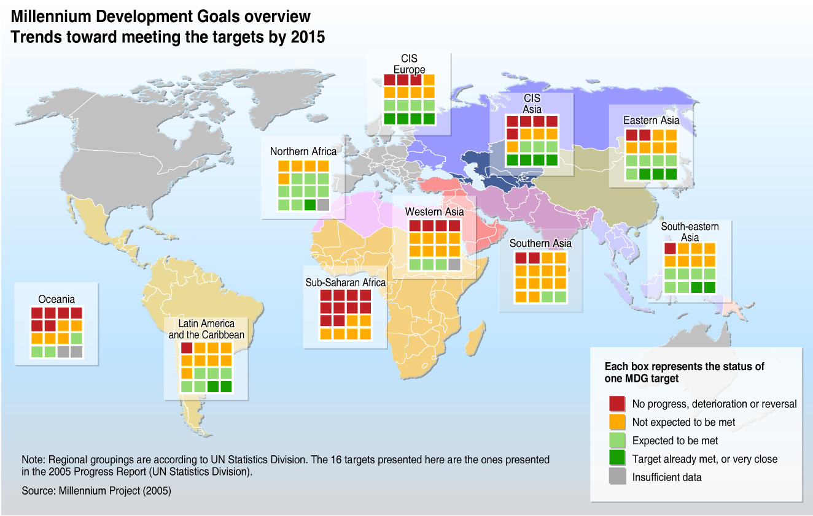

Slide 7
Millennium Development Goals Progress

Slide 8
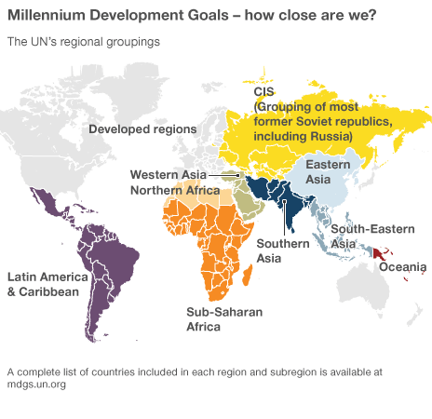

Slide 9
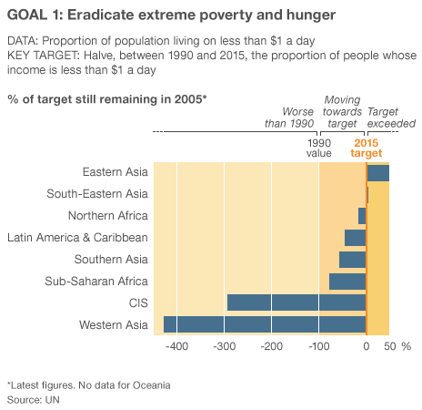
- Developing nations are on track to meet the poverty target largely because of progress in China.
- But in Sub-Saharan Africa and Western Asia the proportion of hungry people has increased.
- Globally, the number of hungry people rose from 842 million in 1990-92 to 1.02 billion people in 2009.

Slide 10
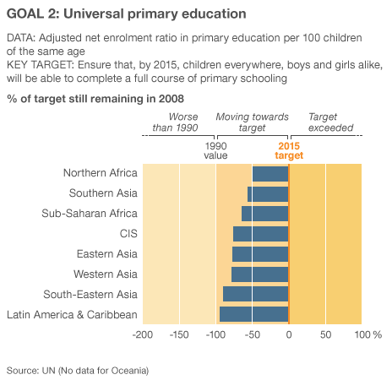
- While countries in Sub-Saharan Africa have seen great improvements by abolishing school fees and offering free school lunches, the target is unlikely to be met.
- The drop-out rate is high, and although there has been some investment in teachers and classrooms, it is not enough.

Slide 11
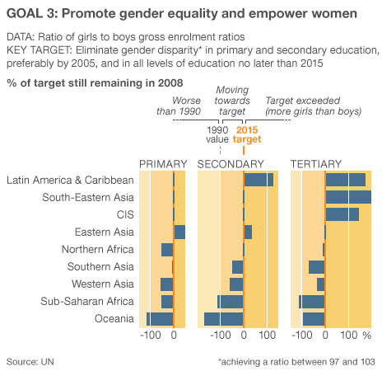
- Gender gaps in education have narrowed, but remain high at university (tertiary) level in some developing countries because of poverty.
- Employment for women has improved but there are still many more women than men in low-paid jobs.
- There have been small gains for women in political power.

Slide 12
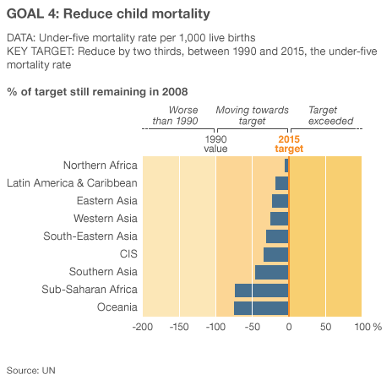
- Child deaths are falling but at the current rate are well short of the two-thirds target. They more than halved in Northern Africa, Asia, Latin America and the Caribbean but remain high in parts of Southern Asia. In Sub-Saharan Africa the absolute number of children who have died actually increased.

Slide 13
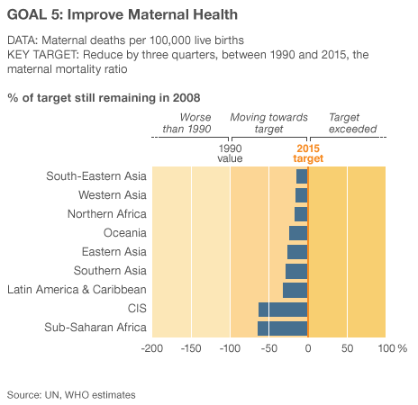
Although in all regions there are advances in providing pregnant women with antenatal care, the maternal mortality rate is unacceptably high, with progress well short of the decline needed to meet the target. Those at most risk are adolescent girls, yet funding on family planning is falling behind.

Slide 14
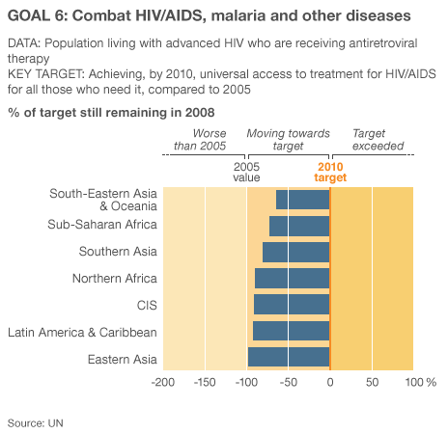
The HIV/AIDS epidemic has stabilised in most regions, but new infections are rising in some areas and antiretroviral treatment has mushroomed.
Global funding has helped control malaria but is still far short of what is needed.
- On current trends tuberculosis will have been halted and started to reverse.

Slide 15
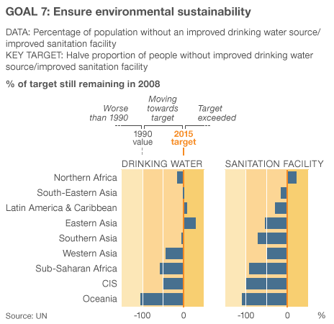
- The world will meet the drinking water target on current trends but half the population of developing regions still lacks basic sanitation.
- The 2010 target to slow decline in biodiversity has been missed.
- Improving the lives of 100 million slum dwellers has been achieved but their actual numbers are rising.

Slide 16
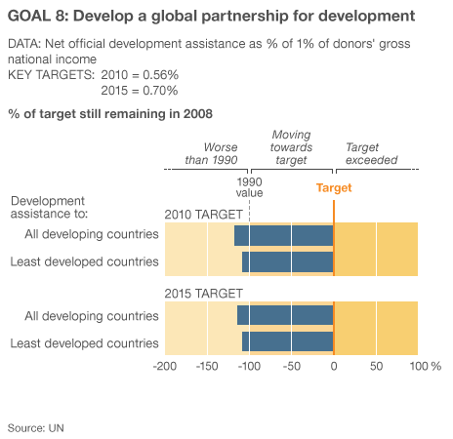
- Levels of aid continue to rise, but major donors are well below target. In terms of volume the USA, France, Germany, UK and Japan are the largest donors.
- G8 countries have failed to deliver on a promise to double aid to Africa.
- Debt burdens have been eased for developing countries.

Slide 17
Millennium Development Goals

