Slide 1
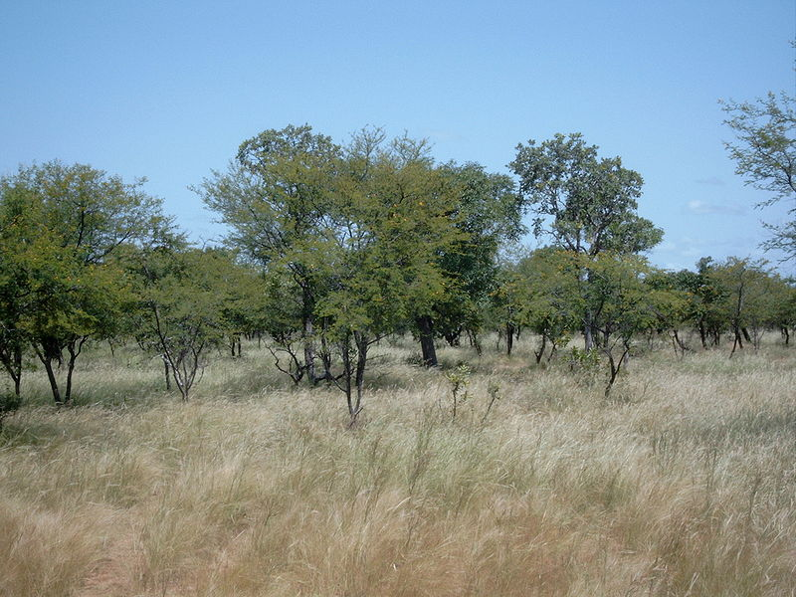
The savanna (savannah)
A medium energy Biome
(Grassland Biome)

Slide 2
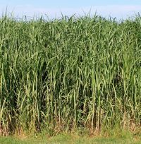
About...
Defined as a Grassland Biome, where trees are spaced enough as to ensure there is no closed canopy.
The open canopy means a lot of sunlight hits the ground, resulting in thriving grass growth.
The predominant vegetation consists of grasses and forbs (small broad-leaved plants)
Elephant grass
Savannas cover 20% of the globe not including oceans
Sometimes classified as a forest and can be thought of as an underdeveloped rainforest.

Slide 3
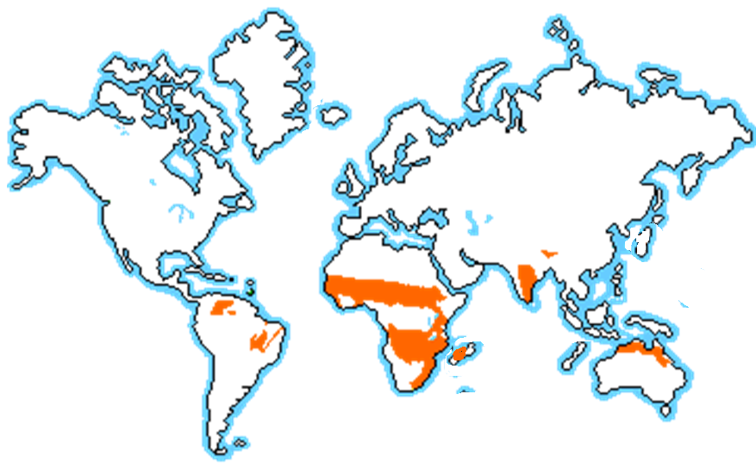
Where!

Slide 4
climate
Seasons
Hot, wet, high-sun
Hot, dry, low-sun
Allot of sunshine all year round, seasonal fires, and October generally brings a thunderstorm with some wind that signals the beginning of the dry season.
annual rainfall is from about 50.8 to 127 cm per year
If the rain were evenly distributed throughout the year, the grassland would likely become a tropical rainforest.

Slide 5
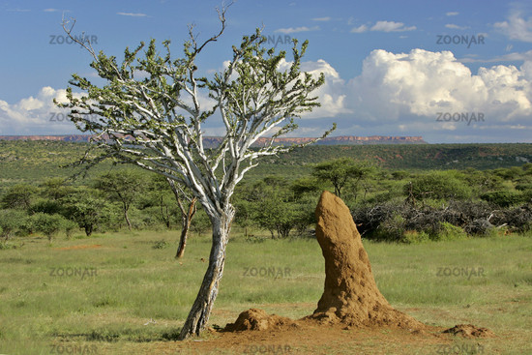
Soil
The soil of the savanna is porous, with rapid drainage of water.
Thin layer of humus (similar to the tropical rainforest)
Some savannas (such as in Kenya) the soil is so thin that trees only grow on termite mounds. Aka Grouped-tree savannas

Slide 6
Forms of human impact on the savanna
Fire management
Grazing
Tree clearing
Foreign plants
Climate change

Slide 7
Fire management
The savannas are subjected regularly to human use of fire
Creates a dominance of fire resistant trees and plants
Older trees generally survive, but saplings don’t
Forest will not recover

Slide 8
Grazing
Open canopy forests are ideal for herbaceous (grass) growth. This makes grasslands a desired location for grazing.
The removal of grass tends to reduce the competition between grass and trees, resulting in boosted tree growth, and damaging the balance of the savannah.

Slide 9
Tree clearing
Trees are being cleared for further grazing, also in order to reduce the tree dominance caused by grazing.
Improves quality and quantity of feed available for livestock in a short term solution. (then move on to clear more forest)
Slash and burn is commonly used

Slide 10
Foreign plants
Many foreign plants are categorized as environmental weeds.
Damaging and competing with the native species.
Permanently changes the ecosystem of a savanna.

Slide 11
sources
http://www.ucmp.berkeley.edu/exhibits/biomes/grasslands.php
wikipaedia

