Slide 1
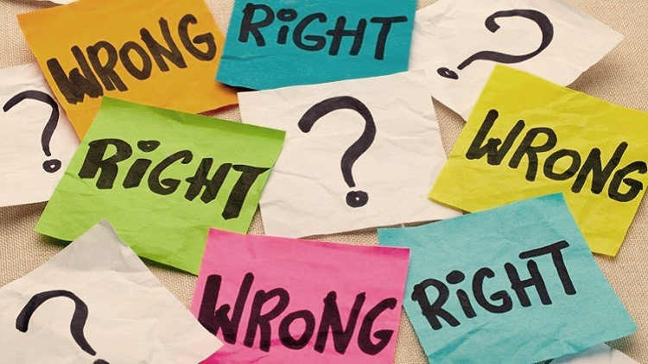
Year 10 Technology, Philosophy & the Future
What is Morality?
Approaches to Ethics

Slide 2
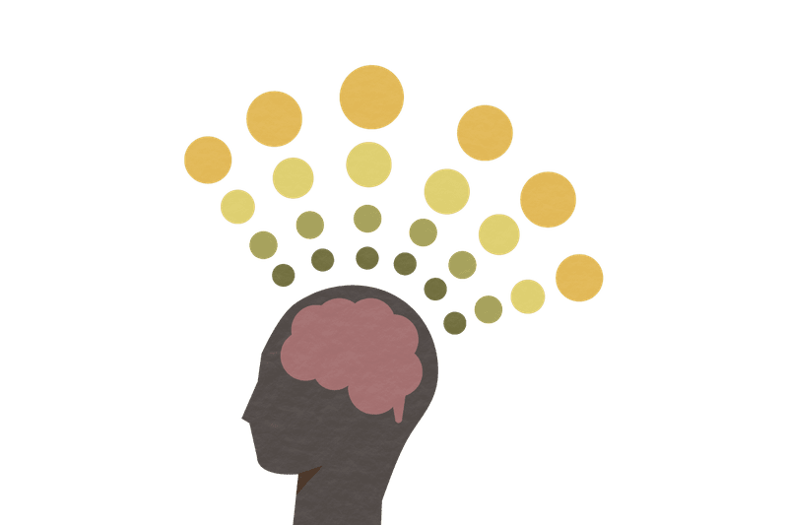
Approaches to ethics
As so many philosophical issues require a good theoretical understanding of morality and ethics, it’s important that we begin with a consideration of (1) what, exactly, morality requires of us, and (2) the range of ethical theories and frameworks we can draw on in coming to a reasoned judgment in response to the ethical questions generated by new technologies.
For this reason, we shall commence with an examination of two text extracts written by contemporary philosopher James Rachels:
Reading One: James Rachels (2014) “What is Morality?”
Reading Two: James Rachels (2007) “A Short Introduction to Moral Philosophy.”

Slide 3
Approaches to ethics
Warning: Ethics can often take us into some challenging territory. The case studies we will examine will sometimes be a little confronting. For this reason, it’s important to ensure that you approach the material with a relatively clinical and academic focus.
However, should you find any of the material distressing, you are always welcome to exclude yourself from the discussion or request a break.

Slide 4
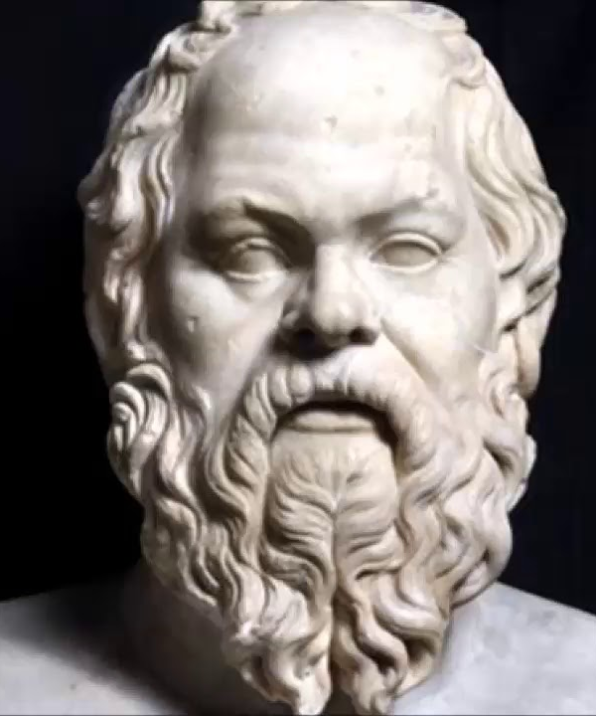
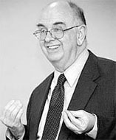
James Rachels “What is Morality?”
What is Morality?
“We are discussing no small matter, but how we ought to live.” ~ Socrates (ca. 390BCE), in Plato’s Republic.
The Problem of Definition:
According to James Rachels, moral philosophy is the study of what morality is and what it requires of us. As Socrates said, it’s about “how we ought to live” – and, importantly, why. It would be helpful if we could begin with a simple, uncontroversial definition of what morality is, but unfortunately we cannot. There are many rival theories, each expounding a different conception of what it means to live morally, and any definition that goes beyond Socrates’ simple formulation is bound to offend at least one of them.
As Rachels notes, recognising this should make us cautious, but it need not paralyse us. In his paper, he describes what he terms the “minimum conception” of morality, which, as the name suggests, should be a core that every moral or ethical theory or framework should accept, at least as a starting point.
In an effort to bring out the features of the minimum conception of morality as Rachels conceives of it, we will commence by examining some moral controversies concerning real case studies involving children with significant physical and/or intellectual disabilities.

Slide 5
Case one: baby Theresa
Theresa Ann Campo Pearson, an infant known to the public as “Baby Theresa,” was born in Florida in 1992. Baby Theresa had anencephaly, one of the worst genetic disorders. Anencephalic infants are sometimes referred to as “babies without brains,” but that is not quite accurate. Important parts of the brain – the cerebrum and cerebellum – are missing, as is the top of the skull. The brain stem, however, is still there, and so the baby can breathe and possess a heartbeat. In the United States, most cases of anencephaly are detected during pregnancy, and the foetuses are usually aborted. Of those not aborted, half are stillborn. Only a few hundred are born alive each year, and they usually die within days.
Baby Theresa’s story is remarkable only because her parents made an unusual request. Knowing that their baby would die soon and could never be conscious, Theresa’s parents volunteered her organs for immediate transplant. They thought that her kidneys, liver, heart, lungs, and eyes should go to other children who could benefit from them. Her physicians agreed. Thousands of infants need transplants each year, and there are never enough organs available. But Theresa’s organs were not taken, because Florida law forbids the removal of organs until the donor has died. By the time Baby Theresa died, nine days later, it was too late – her organs had deteriorated too much to be harvested and transplanted.
What is your initial position with regard to this case? Would transplanting Baby Theresa’s organs be morally permissible or morally impermissible? What are your reasons for thinking so?
Let us consider some of the reasons or arguments that have been given both in favour of and against the parents’ request…

Slide 6
Case one: baby Theresa
Baby Theresa’s case was widely debated. Should she have been killed so that her organs could have been used to save other children? A number of professional “ethicists” – people employed by universities, hospitals, and law schools, who get paid to think about such things – were asked by the press to comment. Most of them disagreed with the parents and physicians. Instead, they appealed to time-honoured philosophical principals to oppose taking the organs.
“It just seems too horrifying to use people as means to other people’s ends,” said one such expert.
Another explained: “It’s unethical to kill person A to save person B.”
And a third added: “What the parents are really asking for is, kill this dying baby so that its organs may be used for someone else. Well, that’s a really horrendous proposition.”
Is it horrendous? Opinions were divided. These ethicists thought so, while the parents and doctors did not. But we are interested in more than what people happen to believe. We want to know what’s true. Were the parents right or wrong to volunteer their baby’s organs for transplant? To answer this question, we have to ask what reasons, or arguments, can be given on each side. What can be said for or against the parents’ request?
We will examine three arguments:
The benefits argument (in favour of transplanting the organs)
The argument that we should not use people as means (against transplanting)
The argument from the wrongness of killing (against transplanting)

Slide 7
Case one: baby Theresa argument One: the Benefits Argument
The parents believed that Theresa’s organs were doing her no good, because she was not conscious and was bound to die soon. The other children, however, could be helped. Thus, the parents seem to have reasons: If we can benefit someone without harming anyone else, we ought to do so. Transplanting the organs would benefit the other children without harming baby Theresa. Therefore, we ought to transplant the organs.
Your Task:
See if you can put the argument into standard form (two premises and a conclusion).
Evaluate the argument: (1) If the premises were true, would the conclusion follow? (2) Are the premises, in fact, true? What questions might you need to ask?
Standard Form:
P1. If we can benefit someone without harming anyone else, then we ought to do so.
P2. Transplanting the organs would benefit the other children without harming Baby Theresa.
____________________________
C: Therefore, we ought to transplant the organs.
Evaluation:
If the premises were true, the conclusion would have to follow (‘good form’)
P1 seems relatively uncontroversial.
P2 is more controversial. Can Baby Theresa be “harmed”?
Notes:
Identify the conclusion. Once this is achieved, much else falls into place.
Remove any conclusion indicators and other expressions that are not directly involved in expressing the conclusion.
Write down all of the premises, one under the other, and label them P1, P2, etc. Again, remove any premise indicators or other expressions that are not directly involved in expressing the reasons being offered in support of the conclusion. (Note, too, that there may be as few as one premise or in some cases many more.)
Insert any unstated premises and label them UP1, UP2, etc.
Draw a line (i.e., the ‘inference bar’) underneath the premises and then write the conclusion (labelled “C”) underneath.

Slide 8
Case one: baby Theresa evaluating argument One: the Benefits Argument
Which argument relating to P2 of the Benefits Argument is more compelling?
The Benefits Argument in
Standard Form:
P1. If we can benefit someone without harming anyone else, then we ought to do so.
P2. Transplanting the organs would benefit the other children without harming Baby Theresa.
____________________
C: Therefore, we ought to transplant the organs.
An Argument Against P2:
P1. In all cases, causing the death of a person harms that person.
P2. Transplanting the organs would cause the death of Baby Theresa.
__________________________________________
C: Therefore, transplanting the organs would harm Baby Theresa.
An Argument in Favour of P2:
P1. To harm someone is to take away something that benefits them.
P2. Being alive is a benefit only if it enables you to have thoughts, feelings, and other things of value.
P3. Baby Theresa is incapable of having thoughts, feelings, and other things of value.
__________________________________________
C1: Therefore, Baby Theresa would not benefit from prolonged life
C2: Therefore, ending Baby Theresa’s life would not harm her.
Notes:
Identify the conclusion. Once this is achieved, much else falls into place.
Remove any conclusion indicators and other expressions that are not directly involved in expressing the conclusion.
Write down all of the premises, one under the other, and label them P1, P2, etc. Again, remove any premise indicators or other expressions that are not directly involved in expressing the reasons being offered in support of the conclusion. (Note, too, that there may be as few as one premise or in some cases many more.)
Insert any unstated premises and label them UP1, UP2, etc.
Draw a line (i.e., the ‘inference bar’) underneath the premises and then write the conclusion (labelled “C”) underneath.

Slide 9
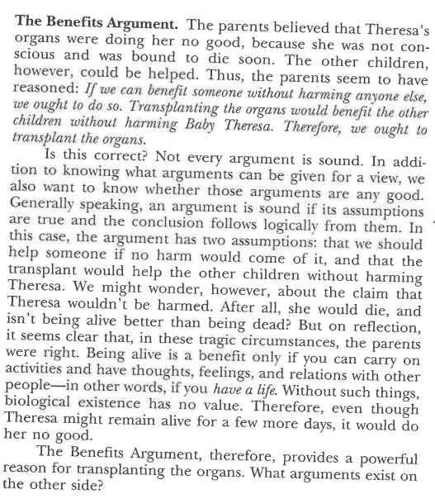
Case one: baby Theresa argument One: the Benefits Argument
According to James Rachels, the Benefits Argument provides “a powerful reason for transplanting the organs.”
Given our discussion thus far, do you agree with Rachel’s evaluation of this argument?
Why / Why not?

Slide 10
Case one: baby Theresa Argument two: we should not use people as means
The ethicists who opposed the transplants offered two arguments, the first of which, was based on the idea that it is wrong to use people as means other people’s ends. Taking Theresa’s organs would be using her to benefit the other children; therefore, it would be wrong to take Theresa’s organs.
Task One:
See if you can put the argument into standard form (two premises and a conclusion).
Standard Form:
UP1: Baby Theresa is a person
P1. It is wrong to use people as means to other people’s ends.
P2. Taking Theresa’s organs would be using her to benefit other children.
____________________________
C: Therefore, it would be wrong to take Theresa’s organs.
Task Two:
Evaluate the argument: (1) If the premises were true, would the conclusion follow? (2) Are the premises, in fact, true? What questions might you need to ask?
Evaluation:
If true, the conclusion would follow (‘good form’)
UP1 Is Baby Theresa a “person”?
P1 How you assess this premise in relation to Baby Theresa will depend, in part, on your answer to the previous question… However, the idea that we should not “use” people is appealing. It is also, however, a little vague. What, exactly, does it mean? “Using people” typically involves violating their autonomy – i.e., their ability to decide for themselves how to live their own lives, according to their desires and values. Would Baby Theresa’s autonomy be violated? Does Baby Theresa even have the capacity for autonomy?
P2 is true.
Notes:
Identify the conclusion. Once this is achieved, much else falls into place.
Remove any conclusion indicators and other expressions that are not directly involved in expressing the conclusion.
Write down all of the premises, one under the other, and label them P1, P2, etc. Again, remove any premise indicators or other expressions that are not directly involved in expressing the reasons being offered in support of the conclusion. (Note, too, that there may be as few as one premise or in some cases many more.)
Insert any unstated premises and label them UP1, UP2, etc.
Draw a line (i.e., the ‘inference bar’) underneath the premises and then write the conclusion (labelled “C”) underneath.

Slide 11
Case one: baby Theresa Evaluating argument two: we should not use people as means
What do you think?
Does a ‘person’ have to have a mind?
We Should Not Use People As Means in
Standard Form:
UP1: Baby Theresa is a person
P1. It is wrong to use people as means to other people’s ends.
P2. Taking Theresa’s organs would be using her to benefit other children.
_______________
C: Therefore, it would be wrong to take Theresa’s organs.
Is Baby Theresa a “person”?
The ‘We Should Not Use People as Means’ argument against transplanting Baby Theresa’s organs assumes that Baby Theresa is a ‘person.’ At first, the assumption may seem obvious and innocuous, but it is, in fact, highly contentious. Consider the following argument:
The ‘Not a Person’ Argument:
P1. All persons have minds (and, if something does not have a mind, then it is not a person)
P2. All things with minds are capable of conscious mental activity (e.g., thoughts, feelings, etc.)
P3. Baby Theresa is not capable of having conscious mental activity
P4. Therefore, Baby Theresa does not have a mind (from P2 and P3)
__________________________________________________
C: Therefore, Baby Theresa is not a person (from P1 and P4)

Slide 12
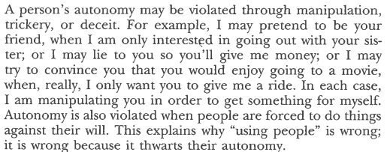
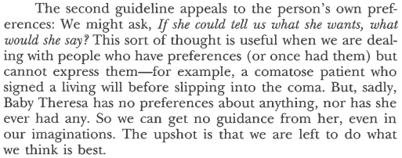
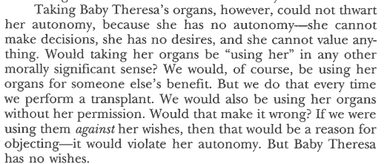
Case one: baby Theresa Argument two: we should not use people as means
According to James Rachels, the argument that we should not use people as means is not all that helpful. He argues that “upshot is that we are left to do what we think is best.”
Given our discussion thus far, do you agree with Rachels evaluation of this argument? Why / Why not?

Slide 13
Case one: baby Theresa Argument Three: It is Wrong to kill
The ethicists also appealed to the principle that it is wrong to kill one person to save another. Taking Theresa’s organs would be killing her to save others, so taking the organs would be wrong.
Task One:
See if you can put the argument into standard form (two premises and a conclusion).
Standard Form:
UP1: Baby Theresa is a person
P1. It is wrong to kill one person to save another.
P2. Taking Theresa’s organs would be killing her to save others.
____________________________
C: Therefore, taking Theresa’s organs would be wrong.
Task Two:
Evaluate the argument: (1) If the premises were true, would the conclusion follow? (2) Are the premises, in fact, true? What questions might you need to ask?
Evaluation:
If true, the conclusion would follow (‘good form’)
UP1 Is Baby Theresa a “person”?
P1 Is it always wrong to kill one person to save another? Can you think of any exceptions? If Baby Theresa is a person, might her case be an exception?
P2 Taking Theresa’s organs would kill her – that seems relatively uncontroversial.
Notes:
Identify the conclusion. Once this is achieved, much else falls into place.
Remove any conclusion indicators and other expressions that are not directly involved in expressing the conclusion.
Write down all of the premises, one under the other, and label them P1, P2, etc. Again, remove any premise indicators or other expressions that are not directly involved in expressing the reasons being offered in support of the conclusion. (Note, too, that there may be as few as one premise or in some cases many more.)
Insert any unstated premises and label them UP1, UP2, etc.
Draw a line (i.e., the ‘inference bar’) underneath the premises and then write the conclusion (labelled “C”) underneath.

Slide 14
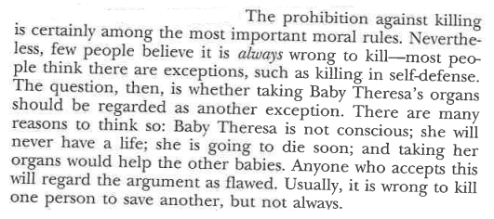
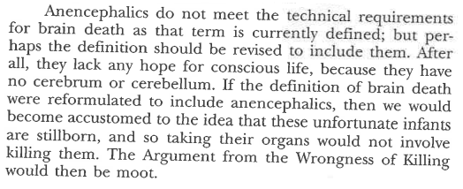
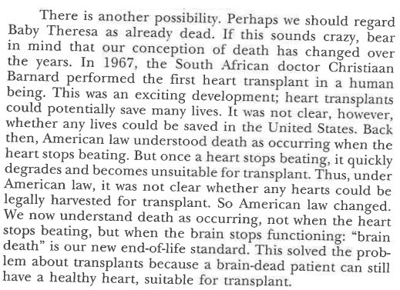
Case one: baby Theresa Argument Three: The wrongness of killing
According to James Rachels, the whilst it is “usually […] wrong to kill one person to save another, [this is not] always [the case]. Moreover, he suggests that “if the definition of brain death were reformulated to include anencephalics” then “taking their organs would not involve killing them [and the] Argument from the Wrongness of Killing would then be moot.”
Given our discussion thus far, do you agree with Rachels evaluation of this argument? Why / Why not?
Notes:
Is Baby Theresa a ‘person’ with a right to life?

Slide 15
Case one: baby Theresa what’s your position?
We’ve now examined and evaluated three arguments in relation to the Baby Theresa case, and we’ve considered plenty of other ideas along the way. Write a short reflection that covers the dot points below.
What is your final judgment in this case? Would transplanting Theresa’s organs be morally permissible or morally impermissible? What are your reasons?
Have you changed your mind in light of our discussion? If so, what was responsible for the change?
What reservations or concerns might you still have with regard to the position you have ultimately taken?
What have you learned about the nature of ethics through examining this case?
What did you find most challenging? Most interesting?
Let’s consider another two, equally tricky, cases….

Slide 16
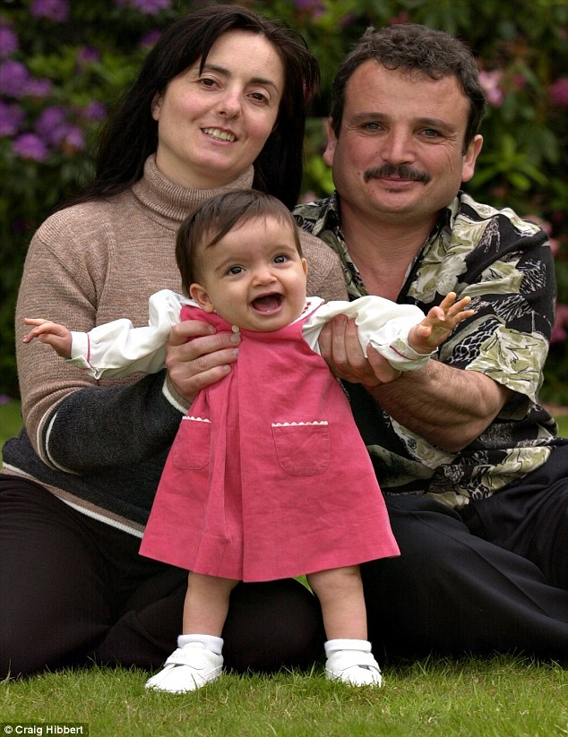
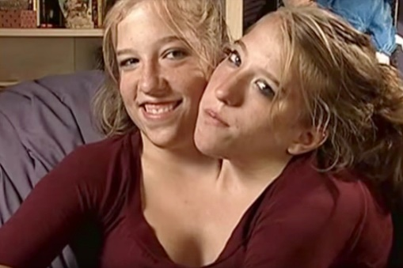
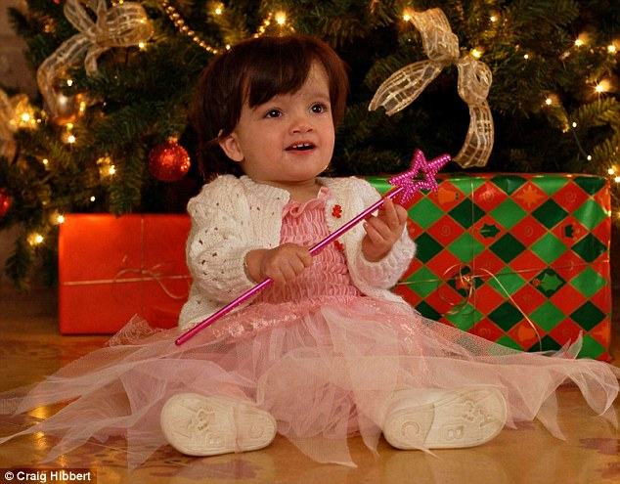
Case Two: Jody and Mary
In August 2000, a young woman from Gozo, an island south of Italy, discovered that she was carrying conjoined twins. Knowing that the health care facilities on Gozo couldn’t handle such a birth, she and her husband went to St. Mary’s Hospital in Manchester, England. The infants, known as Mary and Jodie, were joined at the lower abdomen. Their spines were fused, and they had one heart and one pair of lungs between them. Jodie, the stronger one, was providing blood for her sister. No one knows exactly how many conjoined twins are born each year, but the number seems to be in the hundreds. Most die shortly after birth, but some do well. They grow to adulthood and marry and have children themselves.
However, the outlook for Jodie and Mary was grim. The doctors said that without intervention the girls would die within six months. The only hope was an operation to separate them. This would save Jodie, but Mary would die immediately. The parents were devout Catholics, opposed to the operation on the grounds that it would hasten Mary’s death. “We believe that nature should take its course,” they said. “If it’s God’s will that both our children should not survive, then so be it.” The hospital, hoping to save Jodie, petitioned the courts for permission to perform the operation anyway. The courts agreed, and the operation was performed. As expected, Jodie lived and Mary died.
In thinking about this case, we should distinguish the question of (1) Who should make the decision? from (2) What should the decision be? You might think, for example, that the parents should be the ones to decide, and so the courts were wrong to intrude. But there remains the separate question of what would be the wisest choice for the parents (or anyone else) to make. Hence, we shall focus on the latter question:
Would it be right or wrong to separate the twins?

Slide 17
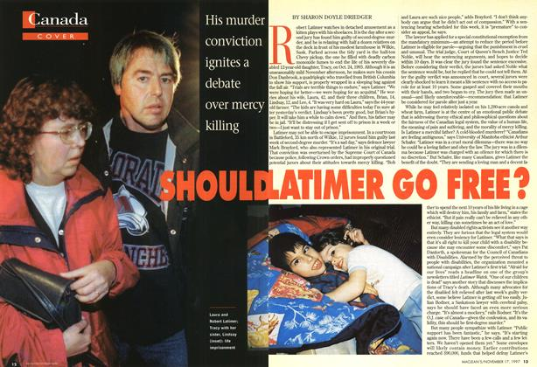
Case three: tracy latimer
Tracy Latimer, a 12-year old victim of cerebral palsy, was killed by her father in 1993. Tracy lived with her family on a prairie farm in Saskatchewan, Canada. One Sunday morning while his wife and other children were at church, Robert Latimer put Tracy in the cab of his pickup truck and piped in exhaust fumes until she died. At the time of her death, Tracy weighed less than 40 pounds, and she was described as “functioning at the mental level of a three-month old baby.” Mrs Latimer said she was relieved to find Tracy dead when she arrived home. She said that she “didn’t have the courage” to do it herself.
Robert Latimer was tried for murder, but the judge and jury did not want to treat him harshly. The jury found him guilty of only second-degree murder and recommended that the judge ignore the mandatory 10-year sentence. The judge agreed and sentenced him to one year in prison, followed by a year of confinement to his farm. But the Supreme Court of Canada stepped in and ruled that the mandatory sentence must be imposed. Robert Latimer entered prison in 2001 and was paroled in 2008.
Legal questions aside, did Mr Latimer do anything wrong? The case involves many of the issues that we saw in the other cases. One argument is that Tracy’s life was morally precious, and so her father had no right to kill her. In his defence, it may be said that Tracy’s condition was so catastrophic that she had no prospects of a “life” in any but a biological sense. Her existence consisted in pointless suffering, and so killing her was an act of mercy.
Was Robert Latimer right or wrong in ending Tracy’s life?

Slide 18
Group activity
Group One - Jody and Mary
Together, re-read the Jody and Mary Case on p. 6 of the Rachels (2014) text. Share your initial position regarding the primary ethical question: Would it be right or wrong to separate the twins?
Read ‘The Argument That We Should Save as Many as We Can’ on pp. 6-7 and put the argument into standard form.
Evaluate the argument, with a focus on assessing the truth of the premises. Consider the points Rachels’ raises. Is the argument a good one?
Read ‘The Argument from the Sanctity of Human Life’ on p. 7-8 and put the argument into standard form.
Evaluate the argument, with a focus on assessing the truth of the premises. Consider the points Rachels’ raises. Is the argument a good one?
Are there any other reasons / arguments / evidence / analogies / examples that could be helpful in answering the primary ethical question listed above?
Each student needs to construct a reasoned response to the primary ethical question. Group will then report back to the class.
Group Two – Tracy Latimer
Together, re-read the Tracy Latimer Case on p. 8 of the Rachels (2014) text. Share your initial position regarding the primary ethical question: Was Robert Latimer right or wrong in ending Tracy’s life?
Read ‘The Argument from the Wrongness of Discriminating Against the Handicapped’ on pp. 8-9 and put the argument into standard form.
Evaluate the argument, with a focus on assessing the truth of the premises. Consider the points Rachels’ raises. Is the argument a good one?
Read ‘The Slippery Slope Argument’ on pp. 9-10 and put the argument into standard form.
Evaluate the argument, with a focus on assessing the truth of the premises. Consider the points Rachels’ raises. Is the argument a good one?
Are there any other reasons / arguments / evidence / analogies / examples that could be helpful in answering the primary ethical question listed above?
Each student needs to construct a reasoned response to the primary ethical question. Group will then report back to the class.
Notes:
JODY & MARY
The Argument That We Should Save as Many as We Can
P1. We have a choice between acting to save one infant or letting both die
P2. Acting to save one infant has the best possible consequences (one lives versus neither lives)
P3. We should always try to act to bring about the best possible consequences
__________________________
C: Therefore, we ought to act to save the one infant
NOTE: Premise 3 is the philosophical framework known as consequentialism / utilitarianism and is fiercely debated amongst moral philosophers. The idea that we should always act so as to bring about the best consequences is appealing, but many have found it wanting under close scrutiny.
The Sanctity of Human Life Argument
P1. It is always wrong to kill an innocent human being
P2. Mary is an innocent human being
__________________________
C: Therefore, it is wrong to kill Mary
Is there a morally relevant different between killing vs. letting die? (e.g., euthanasia, sending poisoned food to people in a famine ravaged region of the world, failing to save a drowning person vs. actively pushing their heads under the water). In the long run, Mary’s body would not be able to sustain her life, however, this would not be the cause of her death. The cause of death is that vital parts of her body will have been removed (i.e., heart, lungs).
Might Mary serve as an exception to the prohibition on killing an innocent human being?
TRACY LATIMER
The Argument from the Wrongness of Discriminating Against the Handicapped
P1. It is wrong to discriminate against the handicapped
P2. Robert Latimer killed Tracy because of her handicap
P3. Therefore, the killing was an act of discrimination against the handicapped
__________________________
C: Therefore, Robert Latimer was wrong to kill Tracy
Note the difference between discrimination vs. wrongful / unjustified discrimination (e.g., giving an acting role to an indigenous Australian over a white Australian because the person they are representing is indigenous; not wrongful / unjustified discrimination.
The Slippery Slope Argument
P1. If we allow that the killing of Tracy was morally justified, then we will be more inclined to look favourably on other so-called ‘mercy killings’
P2. Our definition of ‘mercy killing’ is then likely to expand, perhaps to include the elderly, the infirm, and others who are deemed to be ‘useless’ members of society
P3. Therefore, by approving of Tracy’s killing, we make ourselves more likely to approve of other, wrongful killings
__________________________
C: Therefore, we ought not to approve of Tracy’s killing

Slide 19
Read, discuss & annotate
Read, discuss, and annotate: “Reason and Impartiality” – Rachels (2014, pp. 10-13):
Rachels’ Two Basic Claims About the Nature of Morality
Reason: Morality is, first and foremost, a matter of consulting reason. The morally right thing to do, in any circumstance, is whatever there are the best reasons for doing.
Impartiality: Each individual’s interests are equally important; from within the moral point of view, there are no privileged persons. Therefore, each of us must acknowledge that other people’s welfare is just as important as our own.
Read, discuss, and annotate: “The Minimum Conception of Morality” – Rachels (2014, pp. 13-14)
Rachels’ Minimum Conception of Morality
“Morality is, at the very least, the effort to guide one’s conduct by reason – that is, to do what there are the best reasons for doing – while giving equal weight to the interests of each individual affected by one’s action.”

Slide 20
What’s next?
As Rachels notes, not every ethical theory accepts the ‘minimum conception.’ However, theories that reject it, tend to encounter serious difficulties. This is why most embrace the minimum conception in one form or another. I encourage you to embrace it, too…
Now that we have considered (1) What morality requires of us (namely, reason and impartiality), our next port of call is to consider (2) The range of ethical theories and frameworks we can draw on in coming to a reasoned judgment in response to ethical questions generated by new technologies.

Slide 21
Theories & Approaches to Ethics
Relativism
Divine Command Theory
Virtue Ethics (e.g., Aristotle)
Natural Law Theory
Social Contract Theory (e.g., Thomas Hobbes)
Consequentialism (e.g., Utilitarianism)
Deontology (e.g., Kant)
….and a bunch more.
We’re going to (briefly) examine theories 1 – 7.
Which is the correct ethical theory?
Even appeals to theory should ultimately be based on good reasons. Hence, you will need good reasons for thinking any one theory is better than another…

Slide 22
The ring of gyges

Slide 23
1. Relativism
Read: Relativism (Rachels 2007, pp. 2-3)
“…right and wrong are relative to the customs of one’s society.” Morality is just a matter of “social convention.”
Morality is not objective or universal
One set of customs is neither better nor worse than another – they are “merely different.”
Consider: monogamy, cannibalism, infanticide, driving on the left vs. right side of the road, respect for individual autonomy
Objection 1: Conservative – doesn’t allow ethical challenge of the status quo
Objection 2: Not all social customs are morally arbitrary – we can give reasons why some are better than others (e.g., good independent reasons why slavery is wrong, perhaps less so for funerary practices)

Slide 24
2. Divine Command theory
Read: Divine Commands (Rachels 2007, pp. 3-5)
“…moral living consists in obedience to divine commands.”
Things are right or wrong and good or bad if God / the Gods say so.
Objection 1: Practical difficulties (knowing what God commands).
Objection 2: Is something right/good because the Gods command it, or do the Gods command it because it is right/good?
There are two possibilities:
The Gods have reasons for commanding what they command, or
The Gods do not have reasons for commanding what they command.
If A, then “there is a standard of rightness independent of their commands - namely, the standard to which the gods themselves refer in deciding what to require of us.”
If B, the Gods’ commands are arbitrary making them “petty tyrants.”
This results in a “horned dilemma” (neither A nor B are likely to be agreeable to advocates of Divine Command Theory).

Slide 25
3. Virtue ethics
Read: Aristotle (Rachels 2007, pp. 5-6)
The morally right action is that which the virtuous person would choose, namely, the virtuous or “golden” mean between the vices of excess and defect.
Virtues = “qualities of character that people need to do well in life… [for example] courage, prudence, generosity, honesty…”
For example, the virtue of courage is the golden mean between the vices of cowardice (defect) and rashness (excess). The mean is relative to the person and the situation.
Objection 1: Difficulty in identifying the virtues without appeal to an independent standard of rightness / goodness or prior ideas about what it is “to do well in life.”
Objection 2: Is something right/good because it is virtuous, or is something virtuous because it is right/good? This results in a similar kind of ‘horned dilemma’ we saw in relation to Divine Command Theory. Either there is a standard of rightness independent of virtue (in which case, virtue is not the measure of rightness), or the virtues are morally arbitrary (neither option is likely to be agreeable to advocates of Virtue Theory).

Slide 26
4. Natural Law theory
Read: Natural Law (Rachels 2007, pp. 6-8)
“Things are as they ought to be when they are serving their natural purposes; when they do not or cannot serve those purposes, things have gone wrong […] some forms of human behaviour are ‘natural’ while others are not; and ‘unnatural’ acts are said to be wrong.”
Objection 1: Secular doubts about the “Natural Order of Things” (i.e., about divine plans and purposes)
Objection 2: It’s questionable as to whether or not human beings “are sacred” and permitted to “dominate the world [including animals / the natural environment] for their benefit.”
Objection 3: Just because something is natural (e.g., survival of the fittest), does that necessarily make it good / right?

Slide 27
5. Social Contract theory
Read: The Social Contract (Rachels 2007, pp. 8-10)
“…morality can be defined as nothing more or less than the set of rules that rational people will agree to obey, for their mutual benefit, provided that other people will obey them as well.”
Cooperation and mutual benefit are made possible by rules regarding truth-telling, promise keeping, property, non-violence, etc.
Advantage 1: “practical and down to earth”
Advantage 2: Shows how morality can be “rational and objective even if there are no moral facts.”
Advantage 3: Shows “why we should care about ethics.”
Advantage 4: Not too demanding in terms of altruism vs. self-interest.
Objections?

Slide 28
6. Consequentialism
Read: Utilitarianism (Rachels 2007, pp. 11-14)
Consequentialism = the right act is that which leads to the best consequences. On its own, it is not a complete theory. It needs a theory of the good (so that you can determine what is good / the best consequences).
Utilitarianism is a form of consequentialism. According to the utilitarian, the ultimate moral principle is that “we should always do whatever will produce the greatest possible balance of happiness over unhappiness for everyone who will be affected by our action.”
Advantage 1: Impartial. Every person’s happiness is valued equally.
Objection 1: Too demanding. You cannot preference your happiness (or the happiness of those you care most about) over anyone else’s.
Objection 2: Assumes that happiness is the ultimate goal.
Objection 3: Too permissive (e.g., as long as it leads to the best consequences /greatest happiness, you can lie, steal, murder, etc.)
Objection 4: Impossible to calculate all the possible consequences of your actions.

Slide 29
7. Deontology / Kantian ethics
Read: Kant (Rachels 2007, pp. 17-18)
For Kant – a prominent deontologist – morality is a product of “pure reason” and has nothing to do with self-interest, desire, happiness, or good consequences.
The ultimate moral principle for Kant = the “Categorical Imperative.”
Version 1: “Act only according to that maxim by which you can at the same time will that it should become a universal law.”
For Kant, consistency requires us to interpret moral rules as having no exceptions. For example, it is never morally permissible to kill another person, lie, steal, break promises…
Advantage 1: Version 1 is an ethical framework we often teach our children: Would you like it if someone did that to you? Should everyone be allowed to do that? Then don’t do it!”
Objection 1: Fails to recognise that sometimes the consequences are so significant that it might be better to break the rule (e.g., kill an escaped inmate on a killing spree).
Objection 2: It may be difficult to work out the ‘maxim’ (rule) you are supposed to follow in a complex situation (e.g., Nazi example).
Version 2: “So act that you treat humanity, whether in your own person or in that of another, always as an end and never as a means only.”
Notes:
Like the Utilitarians, the great 18th century German philosopher Immanuel Kant sought to explain ethics without appealing to God or “moral facts.”
Kant’s solution was to see morality as a product of “pure reason.” Just as we must do some things because of our desires – for example, because I desire to go to a live performance by Ed Sheeran, I must buy a ticket – similarly, moral law is binding on us because of our reason.
Again like the Utilitarians, Kant believed morality could be summed up in one overarching principle from which all our duties and obligations are derived. But his version of the ‘ultimate moral principle’ was very different from the Utilitarians’ ‘principle of utility’ because Kant did not emphasise the outcomes or consequences of actions.
What was important to him was “doing one’s duty” and he held that a person’s duty was not determined by calculating consequences.
Version 1: Act only according the that maxim by which you can at the same time will that it should become universal law.
Stated in this way, Kant’s principle summarises a procedure for deciding whether an act is morally permissible. When you are contemplating a particular action, you are to ask what rule you would be following if you were to do it (this will be the ‘maxim’ of the act).
Then you ask whether you would be willing for that rule to be followed by everyone all of the time (that would make it a ‘universal law’ in the relevant sense). If you would not be willing for everyone to follow the rule, then you may not follow it, and the act is morally impermissible.
There are some significant advantages to a Kantian approach to ethics:
It’s very clear – so much so that it’s a system we often implicitly teach our children: “Would you like it if someone did that to you? Should everyone be allowed to do that?” “No!” “Then don’t do it!”
It’s rational – Kant is not swayed by emotion. His theory does not allow us to show favouritism towards friends or family members. It is a purely rational approach.
It’s reliable – a system of rules works and everyone knows what their duties and obligations are and what they can and can’t do. If you allowed people to break the rules (say, because of consequences, or out of love) the whole system would be a mess and no one would know what they ought to do!
There have, however, been some objections raised against Kant’s unique approach to ethics:
Kant’s theory fails to recognise that there are some occasions where the consequences are so severe that many think it would be better to break a rule than to allow something awful to happen. For example, if an escaped inmate is on a killing spree then it may well be appropriate to break the rule “do not kill.”
Sometimes it is likely to be very difficult to work out what the maxim (rule) you are supposed to follow in a given situation is. If a person during WWII, for instance, was hiding Jewish people in their cellar and Nazis came to the door, which maxim (rule) should they be applying? “Do not tell lies” or “Do not expose innocent people to violence.”

Slide 30
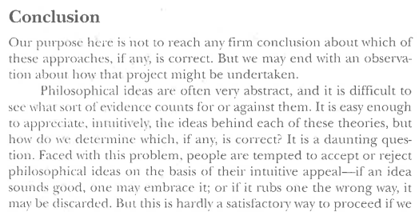
conclusion
As we commence the task of considering a range of ethical questions generated by means of new technologies, keep the theories we’ve considered in mind. What might these theories have to say? How might they help us to generate good reasons for the views we ultimately end up holding?
Relativism – should employing the technology in question be considered relative to the values, practices, and beliefs of the individual employing it?
Divine Command Theory – does the bible / God / the Gods / religion have something to teach us about whether or not the technology should be employed or not?
Virtue Ethics (e.g., Aristotle) – will the technology allow us to be virtuous? Is it a vice (excess or defect)? What can the particular person and the particular situation tell us about what the virtuous or ‘golden’ mean might be?
Natural Law Theory – is the technology natural / unnatural? Might this have a bearing on whether or not we should employ the technology?
Social Contract Theory (e.g., Thomas Hobbes) – if we all agree on a set of rules concerning the technology, does that make employing it morally permissible?
Consequentialism (e.g., Utilitarianism) – will the technology lead to good or bad consequences? Will it promote happiness or unhappiness? Should this have a bearing on whether or not we employ it?
Deontology (e.g., Kant) – is the technology in breach of certain moral maxims or rules? Would we be happy for everyone to employ the technology?

