Slide 1
Oil
Changing patterns in production
And
consumption

Slide 2
Syllabus point
Examine the changing patterns and trends in the production and consumption of oil.

Slide 3
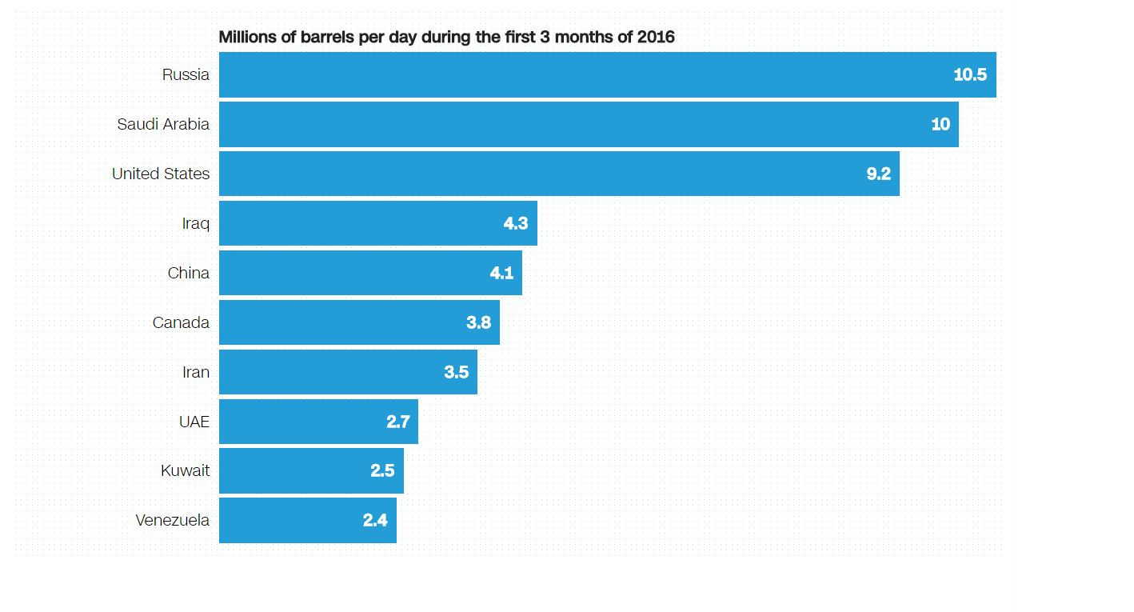
Biggest producers

Slide 4
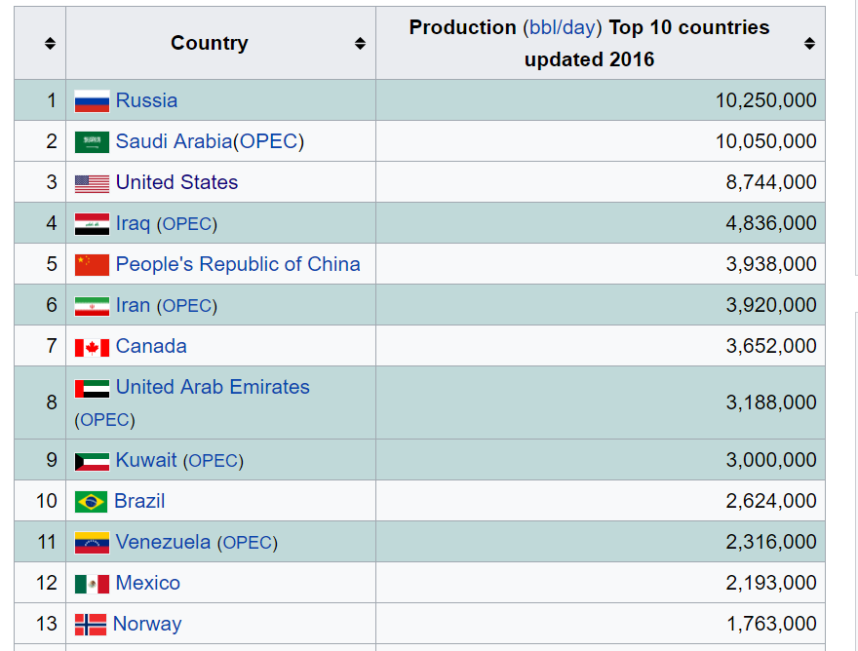
Biggest producers

Slide 6
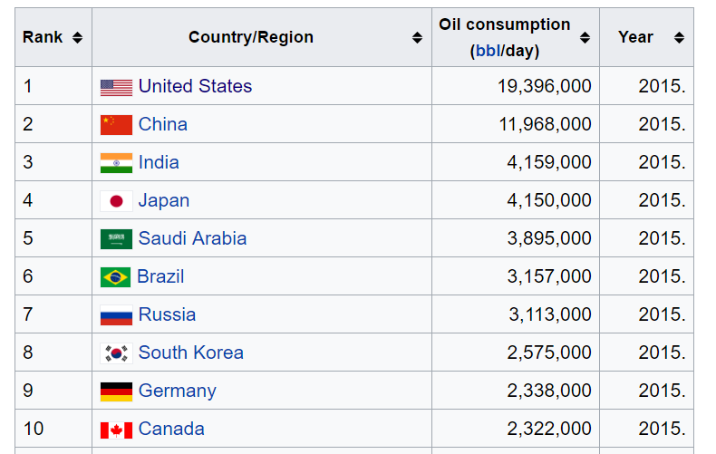
Biggest consumers

Slide 7
Syllabus point
Examine the geopolitical and environmental impacts of these changes in patterns and trends.
(See sheet)

Slide 11
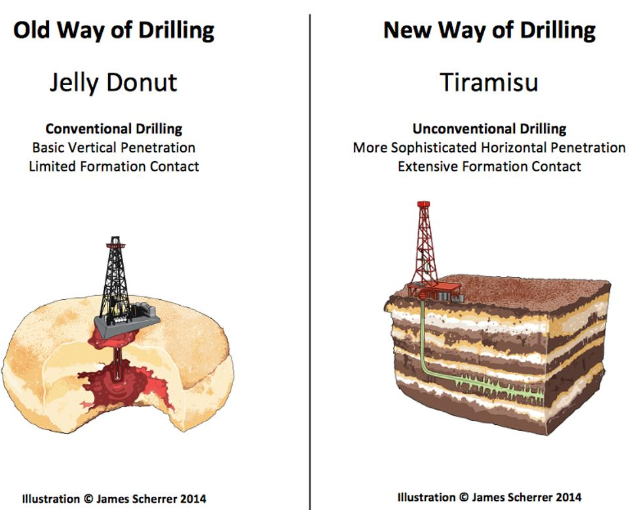
No Peak Oil For America Or The World

Slide 12
Syllabus point
Examine the changing importance of other energy sources.

Slide 13
Why 2016 Could Be a Turning Point the Energy Revolution

Slide 15
The breakthrough in renewable energy

