Slide 1
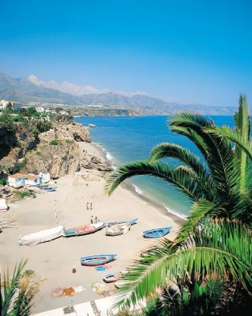
Costa del Sol
By Kristina Nikitina

Slide 2
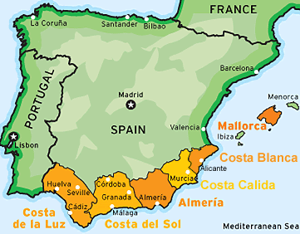
Location
Most southerly of Spain’s coasts
Faces the sun, Mediterranean Sea and North Africa

Slide 3
In the 1950s, the are was important only for farming and fishing
Since then, landscape and lives of locals have been transformed by…
TOURISM

Slide 4
Climate
Summers:
Hot, sunny, dry
Winters:
Wet, mild

Slide 5
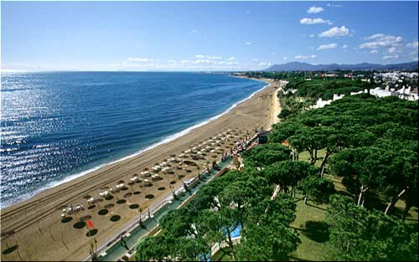
Landscape
Long stretches of sandy beach beside the warm, Mediterranean Sea.
Some beaches shingle, some artificial
Inland are Sierra Nevada Mountains

Slide 6
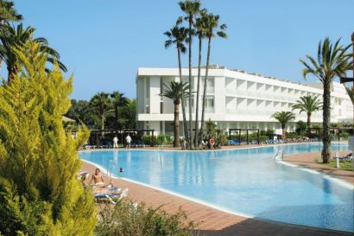
Accomodation
Torremolinos consists of high-density, low priced, high-rise hotels and apartments
Fuengirola’s hotels provide the cheapest accomodation along the coast
Marbella has the most modern and luxurious of the hotels

Slide 7
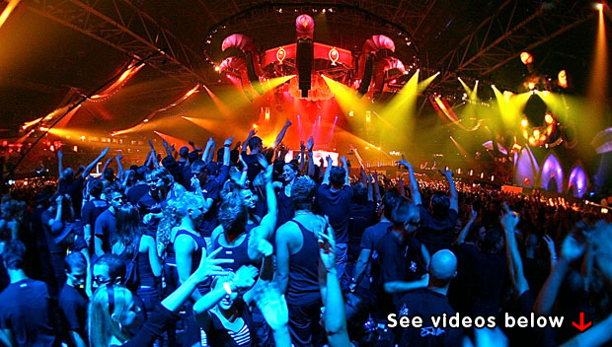
Nightlife and shopping
Illuminated shops
Restaurants
Cafes
Bars
Nightclubs
Local bazaars and souvenir shops
Chic boutiques with designer clothes
Leather goods, ceramics, perfume can be bought in most places

Slide 8
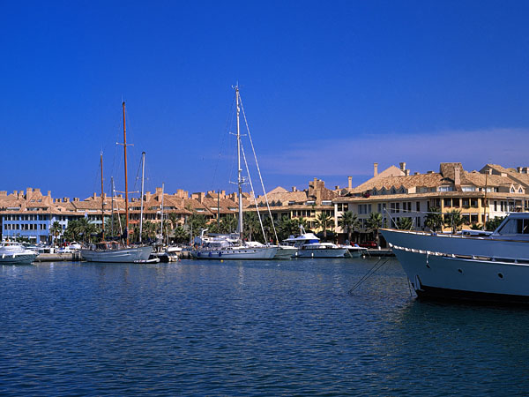
Things to do
Sea-linked activities:
Water sports, aquapark, yachting marinas and harbours
Golf courses
Visit:
the whitewashed village of Mijas
Ronda in higher mountains
Historic centres of Granada and Seville

Slide 9
Changes in tourism and to the environment
Pleasant climates and spectacular scenery
Tourist demand amenities and activities
Environment which first attracted tourists deteriorates or becomes congested
Tourists seek alternative places to visit

Slide 10
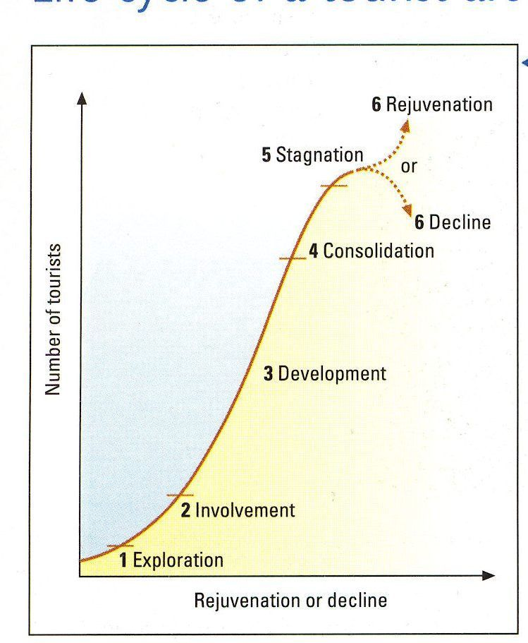
Butler’s model

Slide 11
Role of Spanish government
Government saw tourism as a way to provide jobs and to raise the standard of living
Construction of new hotels encouraged
Provision of leisure amenities encouraged (swimming pools, marinas and entertainment)
Recently stricter controls introduced to improve quality of environment (cleaner beaches, reduce sea pollution)

Slide 12
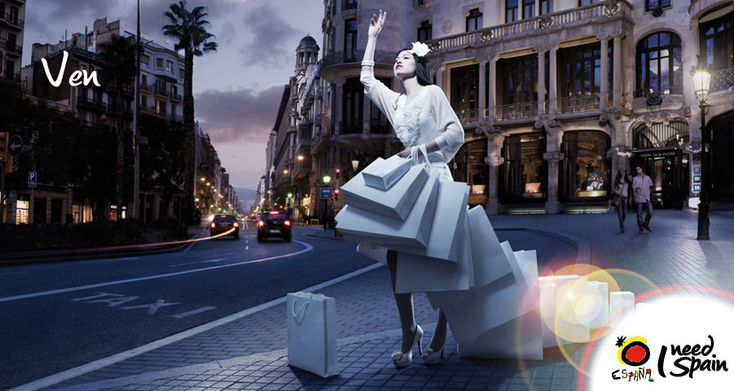

Slide 13
The syllabus says:
Tourism management in urban areas
For one named city or large town:
describe the distribution and location of primary and secondary tourist resources
discuss the strategies designed to manage tourist demands, maximize capacity and minimize conflicts between local residents and visitors, and avoid environmental damage.

Slide 14
Is a city in Andalusia, Spain, by the Mediterranean, situated in the province of Malaga, beneath La Concha. La Concha is the beautiful mountain overlooking Marbella and the coast down to Gibraltar and Morocco.
Marbella had circa 135,000 inhabitants in 2010.
Marbella and the nearby Puerto Banús are important beach resorts of the Costa del Sol.

Slide 15
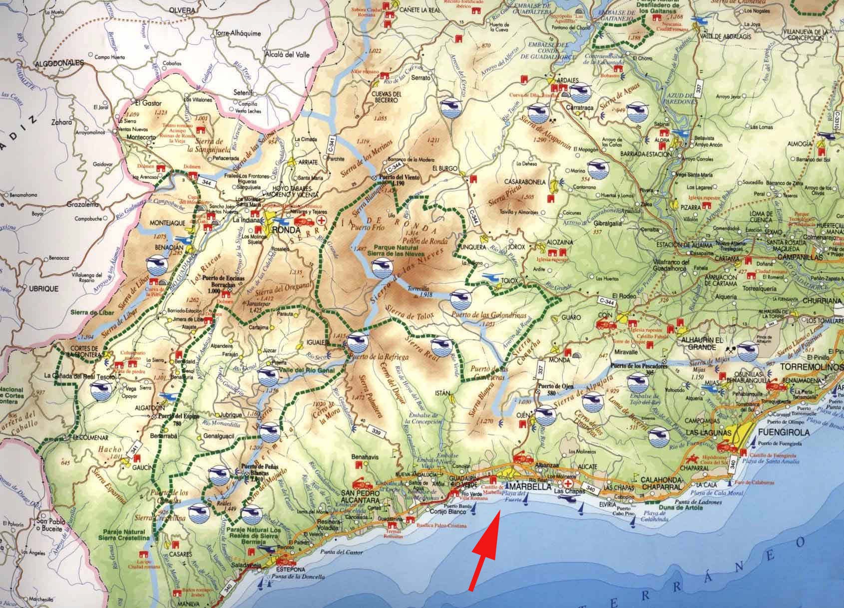

Slide 16
Sol Channel

Slide 17
describe the distribution and location of primary and secondary tourist resources

Slide 18
Primary tourist resources
Tourism is dependent upon the attractive power of the destination’s primary resources:
Natural resources (climate, landscape, ecosystems);
Cultural resources (urban heritage, arts, archaeological values, traditions, science values, folk crafts, friendliness and security);
Social resources (potential tourism developers with socio-demographic characteristics, abilities, financial capital, knowledge, health - environment - property security system, local community interests etc.).

Slide 19
Secondary tourist resources
Accommodation sector (hotel, motel, camping, guest house etc.);
Catering sector (café, restaurants, bistro etc.);
Travel organisation sector (agencies, tour operators etc.);
Transportation sector (air, boat, train, bus, etc.);
Entertainment sector (gambling, disco, etc.);
Information sector (tourism information network);
Supplementary services, facilities and service infrastructure

Slide 20
Location of primary and secondary tourist sources

Slide 21
Blessed with uneven geographical variation with the presence of sea, river, mountains and forests, this small resort town is an ideal place for various kinds of extreme sports. As for adventure, Marbella and other Andalucían regions offer excellent opportunities for many adrenaline catching outdoor activities which includes, paragliding, mountain biking, rock climbing, jet skiing, quad riding, etc. Thanks to the unique climate and varied topography, if you practice sports, here is a list of choices from nature, adventure and leisure.
Marbella is one of the best places in Spain to experience paragliding while discovering wonderful landscapes of the region. Placed approximately 1,000 meters above sea level, you will get a bird watching view of Marbella’s wealth of natural wonder. Here are some highest take off points to give you ultimate pleasure amid breathtaking natural surroundings. Unlike parachuting where you take help of a plane to be left in the air, paragliding is a little more technical while taking that first move. However, the dare to jump from a plane and fall free, sailing in the air has its own charm. Until you open your parachute and touch the land, it’s just magical to be in the sky.

Slide 22
Marbella scuba diving is another popular pursuit among tourists who want to discover a lot of marine life in the Mediterranean water. The clean and clear water of the area also makes it quite easy hunt for beginners. There are scuba diving schools and associations where you can learn the tricks before heading to explore the unique underwater environment. Among others, jet skiing is one of the enthralling water sports in which you will enjoy your trip while sliding and jumping on water. Almost all beaches along the Marbella coast have facilities and instructors for this sport to make your day out more entertaining, away from the city centre and mountainous terrain. Many beach clubs in Marbella have also facilities for a range of other water sports such as cable ski, surfing, deep sea fishing and windsurfing. A little flip from water sports, if you are a nature lover, a trekking in Sierra Blanca mountain range behind Marbella or a trekking trip along various other ecological paths – long way away from the rushed life of urban development – will surely take you to some unknown places where only Mother Nature rules the supreme. Regions of Southern Spain also offers great prospects for mountaineering, motorbiking, cycling, rock climbing and hiking. You will find some dedicated clubs for each adventure activity and get trained yourself before moving for one. There are well arranged sports facilities waiting for you. In any of the adventure sports, it’s not merely the thrill or excitement that comes to play, but the beauty of nature which catches your enthusiasm.

Slide 23
A particular aspect that has made Marbella so popular is its cosmopolitan character. Marbella is home for tens of thousands of people from every corner of the world, part or all of the year. It is precisely this marvelous mixture of cultures, traditions, languages and professions that creates the real magic of Marbella: the friendliness and peace of the people that live here have an incredibly positive influence on the property market.
“We can sum up the reasons why Costa del Sol property will remain a good investment in two words. The words are Florida and California. These two sunshine areas are the fastest growing places in the United States of America. People move there to retire or to live and work away from the colder northern weather. The Costa del Sol is in exactly the same privileged position compared to the rest of Europe and always will be.”

Slide 24
But what is the pull of Marbella?
What is it that brings property developers rushing into town like prospectors in the Golf Rush and high (or low) profile millionaires reaching for their chequebooks? Firstly there is the sub-tropical setting. Bordering the Mediterranean, sun-kissed beaches stretch to infinity, the sea alternates between sapphire and turquoise, the sky rarely clouds over and when it does, it clears within a short time.

Slide 25
Best climate in Western Europe: Located at the most southern part of Europe, Marbella is protected by the Atlantic winds by the bay of Gibraltar, and protected from the northerly winds by the Sierra Blanca mountains. This makes Marbella warmer than other parts of Spain in the winter, and cooler than other parts of Spain in the summer.

Slide 26
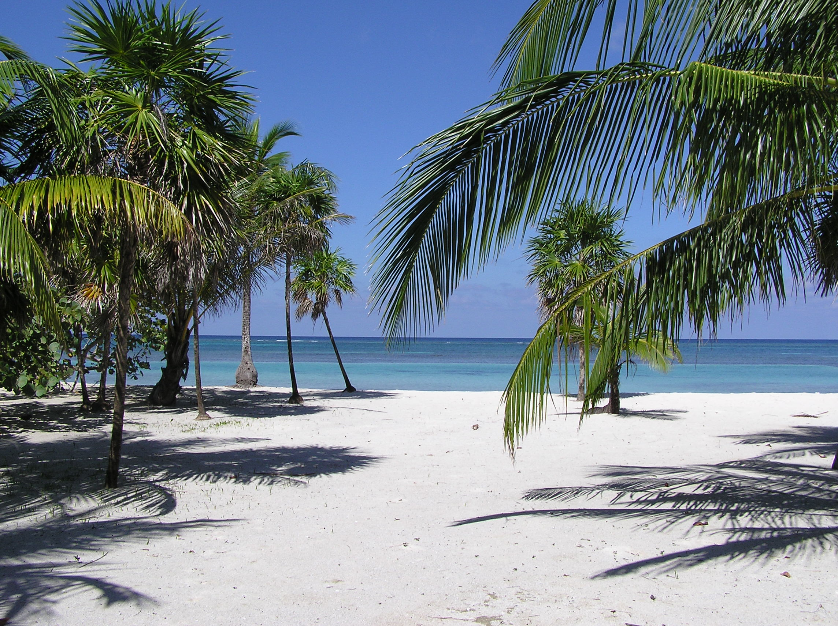
Annual average of 20°C and more than 320 sunny days a year.
24 beaches

Slide 27
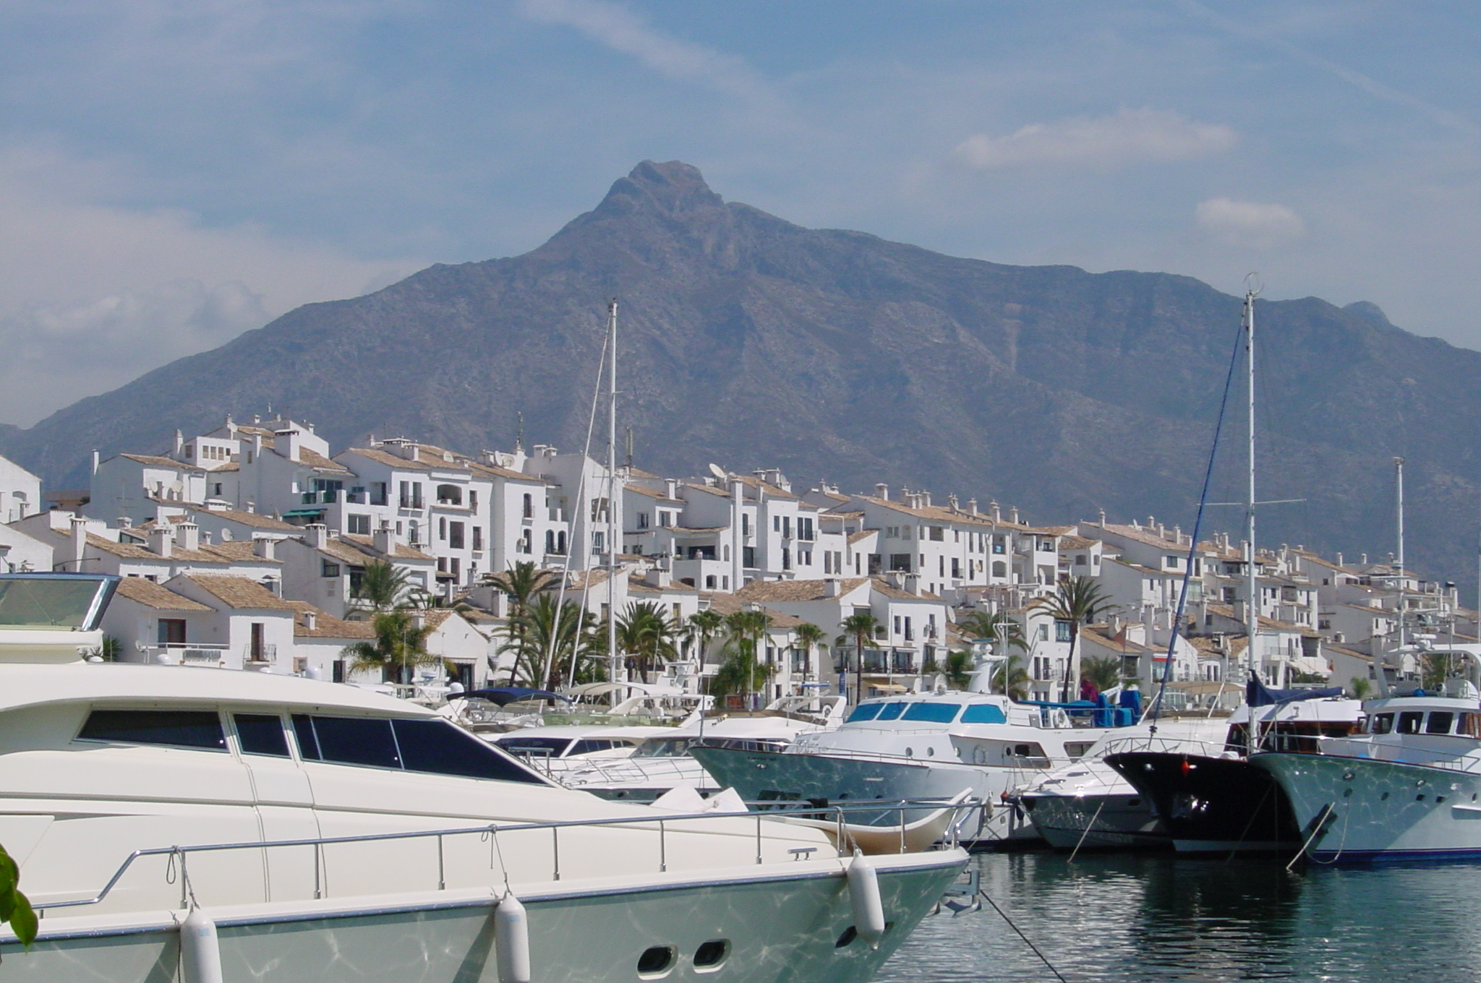
Marbella has four busy marinas.Puerto Banús is one of the main turistic sites of Marbella.

Slide 28
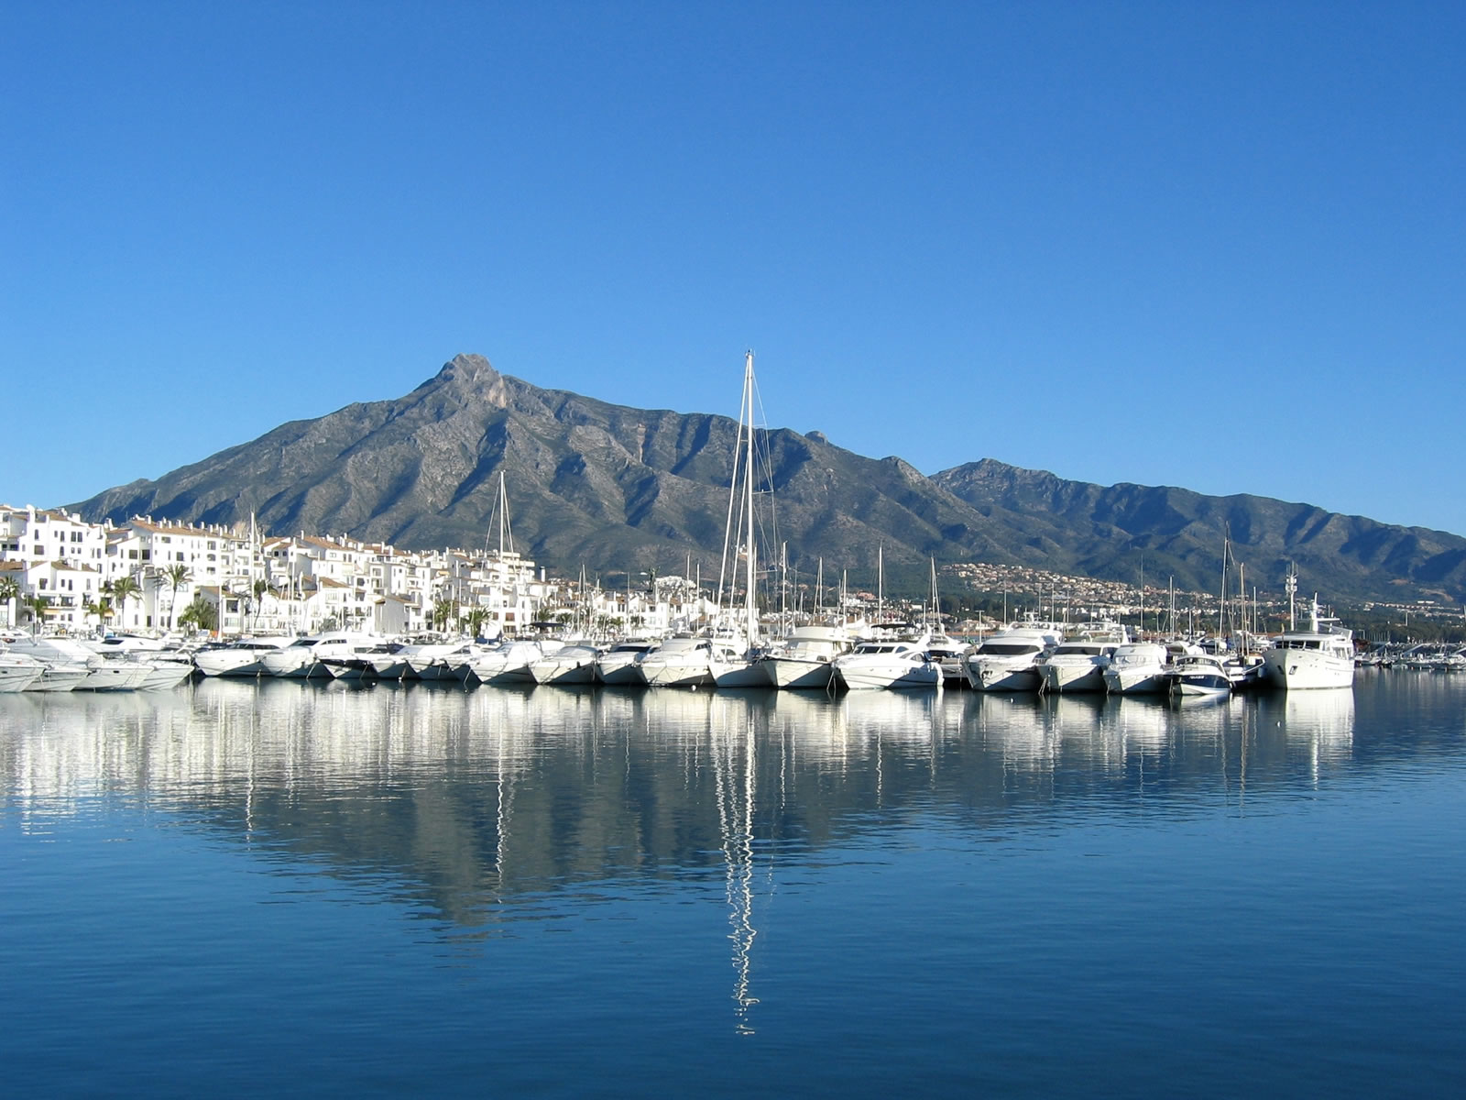

Slide 29
Marbella sailing. World famous "Puerto Banus” is one of the most cosmopolitan destinations in Europe. With luxury homes, exclusive 'boutiques', exciting nightlife and gourmet dining...

Slide 30
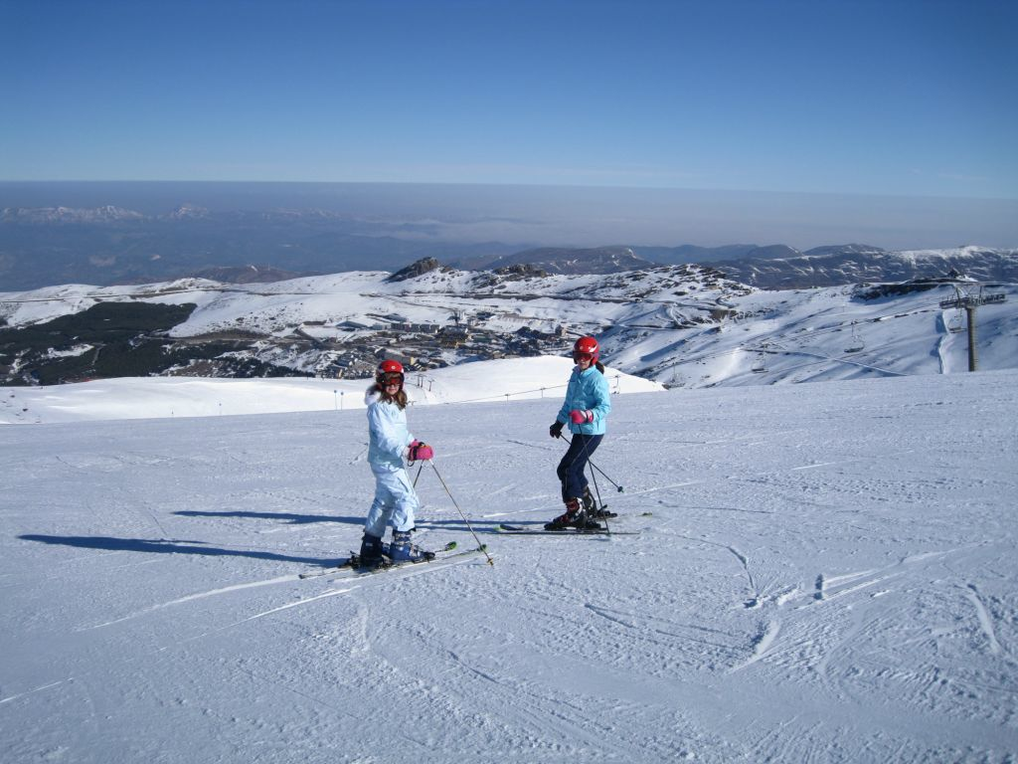
Sierra Nevada is just a few hours away

Slide 31
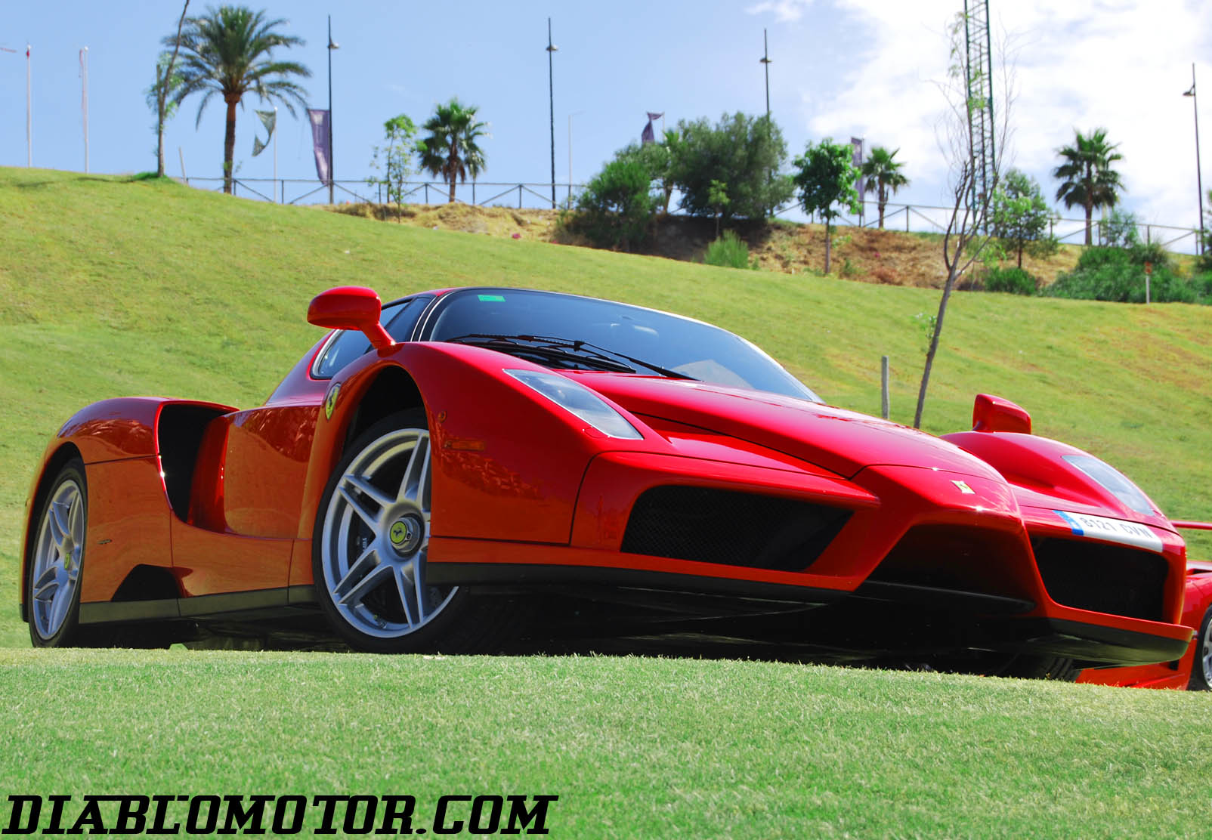
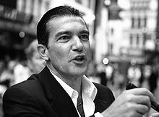
The town is famous for being the playground for the rich and famous.

Slide 32
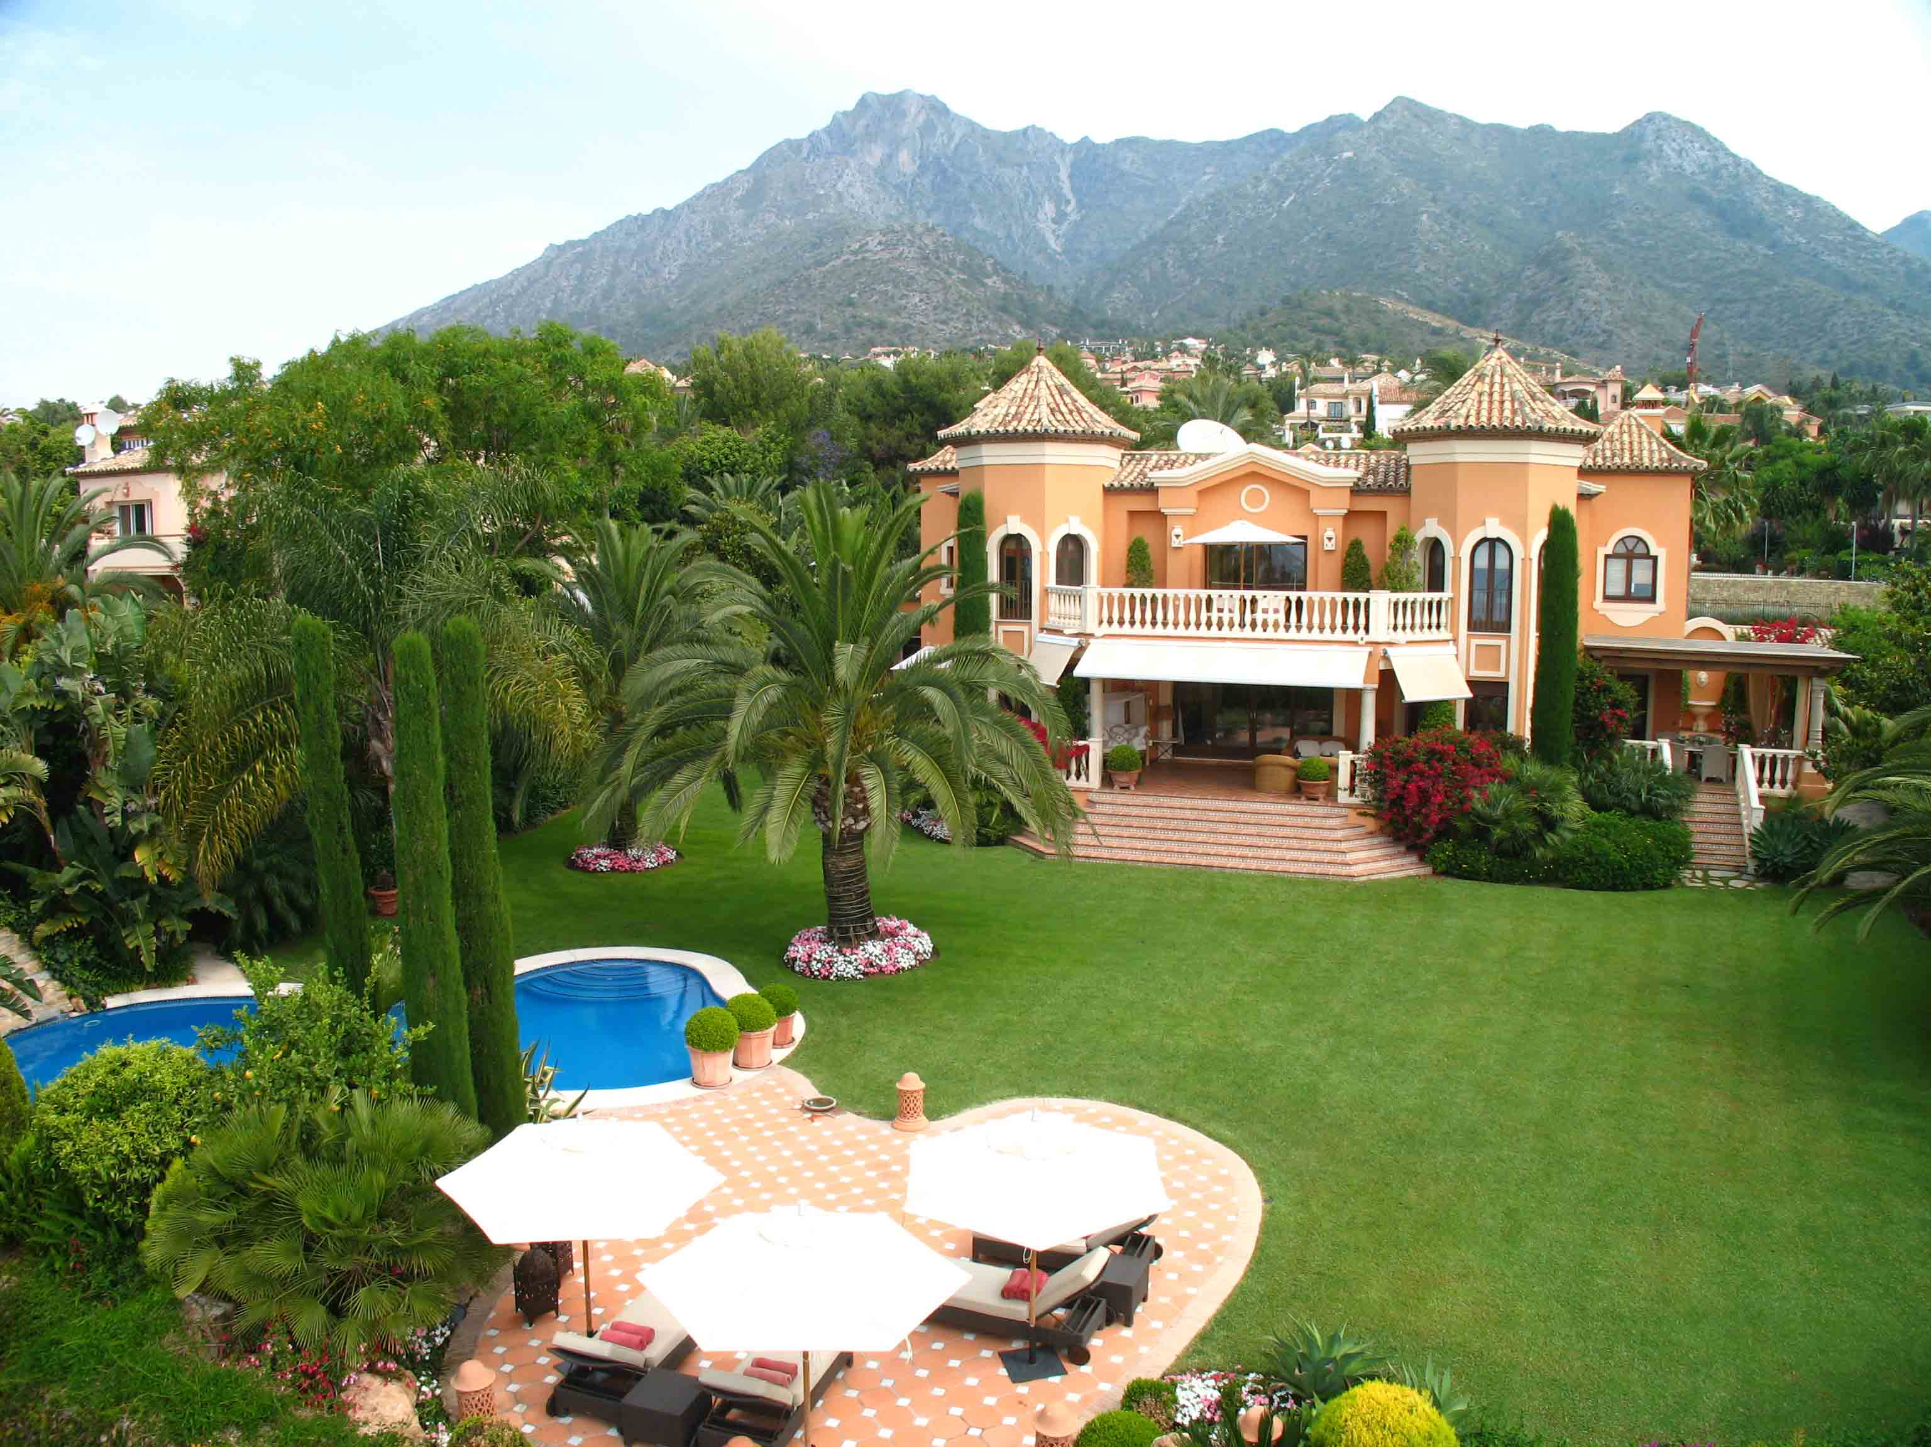
Marbella Luxury. Marbella is one of the elite worldwide holiday destinations. Marbella has a huge number of luxury mansions and palaces, dream homes and villas for sale or rent.

Slide 33
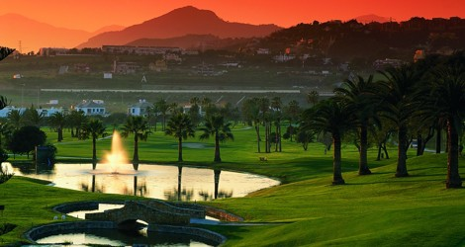
The Costa del Sol is also known as “Costa del Golf”, boasting more than 45 top-level courses.

Slide 34
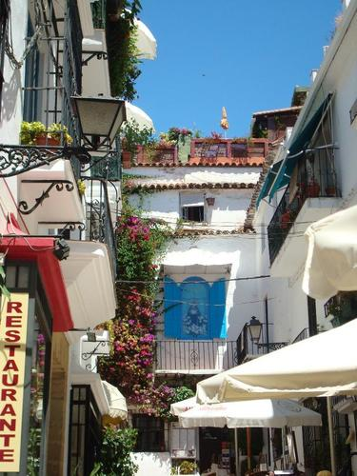
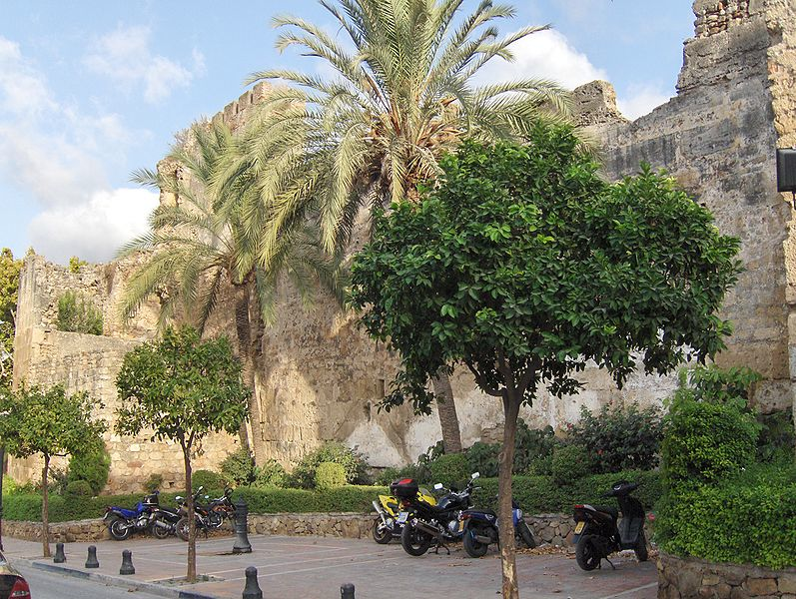
The old town has preserved its typically Spanish character.

Slide 35
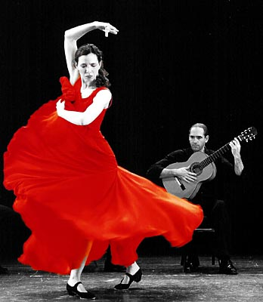
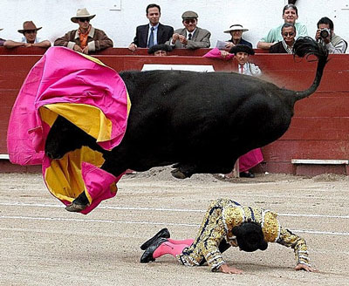
Bullfight
Flamenco

Slide 36
discuss the strategies designed to manage tourist demands, maximize capacity and minimize conflicts between local residents and visitors, and avoid environmental damage

Slide 37
The next few years are going to be critical for the success of Marbella in consolidating its growth, avoiding too much high-density development, and preserving high levels of the quality of environment.
If Marbella is going to continue to appeal to the quality sector of tourists and residential tourism, both the public and private sectors must take the necessary care to ensure that high standard planning, architecture, landscaping, management and services play a central role in the growth of the area over the medium and long term.
Recent events confirm that this is happening.

Slide 38
Marbella to integrate local and international business
Explaining the prospective of such new initiatives, Councillor for Tourism, Jose Luis Hernandez stressed on the significance of local and international business incorporation by involving both foreign business community and residents of the town.
Looking at the magnitude of tourism in Marbella and the business related, the City Council, through the municipal delegation of Tourism, has launched an advisory group to advance economic development.

Slide 39
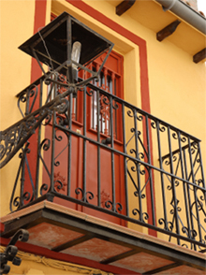
Marbella to keep aesthetic values of
Historic Centre
Recently, the Marbella Town Hall has approved a proposal to maintain the image of the Historic Centre by following some aesthetic rules.
As per the new regulation, all those buildings and commercial premises, constructed in recent time, have to undergo some minor modification or change their facades. It is to mention here that earlier there was no such attempt to consider the essential aesthetic aspects to preserve the spirit of this unique area.
Much before its popularity as an exclusive Mediterranean resort town, the Andalucian charm is typically characterized with its historic structures and associated culture.

Slide 40
Regional Master Plan intends to improve Coastal Infrastructure

Slide 41
Renovation of seafront promenade Realising the importance of promenade in tourism, the City is trying to make progress in the improvement of such areas. As seaside walkways usually attract numerous tourists for leisure time, the overall reconstruction and beautification certainly add up to the values.
Recently, the Town Hall has completed a comprehensive renovation of parts of the promenade. The project undertook modernisation works in installing street furniture, public lighting, drinking water network etc.

Slide 42
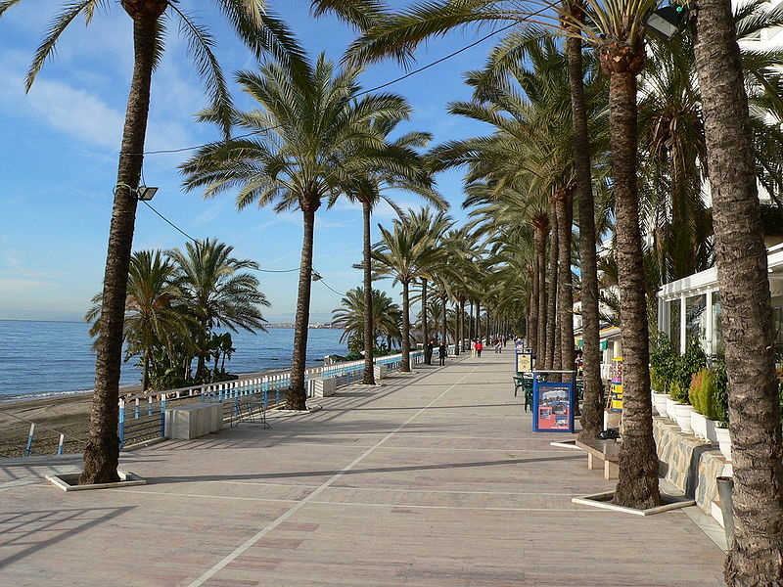
Malecon: jetty, breakwater (promenade)

Slide 43
Concern About Crime, but the Coast remains a relatively safe haven
With so many successful and wealthy people from all over the world residing on the coast all or part of the year, professionals of crime have inevitably followed to target their wealth. The rise of crime on the Coast is an obvious concern to all members of the Spanish and international community, and one that the Town Hall of Marbella has taken a firm stand in lobbying for more central government support.
Recently, the organized crime squad in Málaga has been reinforced with dozens of new specialist agents working along with their international counterparts, resulting in drastic measures against crime and money laundering, as witnessed recently in the press.

Slide 44
Reforestation and removal of stumps The delegation of Municipal Parks and Gardens has launched a plan for the removal of stumps of public roads throughout the municipality and the reforestation of basins where possible. This is in order to improve environmental standards and landscape of the municipality - to further maintain the sustainability and environmental standards that characterise Marbella”.

Slide 45
Then there is the feelgood factor. Quality of life is high, blue-collar crime, low. Thanks to the townhall who cleaned up the town and gave it a new image, attracting investors and young families, constant police patrols ensure citizen's safety, day and night. Like Monaco, residents can walk the "trottoir " in safety, bejewelled and bedazzling all who pass by. Marbella remains one of the few places in the world where there are more bodyguards than waiters at summer galas.

Slide 46
Underground parking facility
The City Council has informed to start an underground parking project.
The proposed plan provides recreational and leisure facilities, a bike lane and a large green area with native plants, among other facilities.
It has also been given a great walking area of modern design, which will have a shaded area and the large roundabout that will connect the central area of the park. For more, see the Pre-IB book.

