Slide 1
DISPARITIES IN WEALTH AND DEVELOPMENT

Slide 2
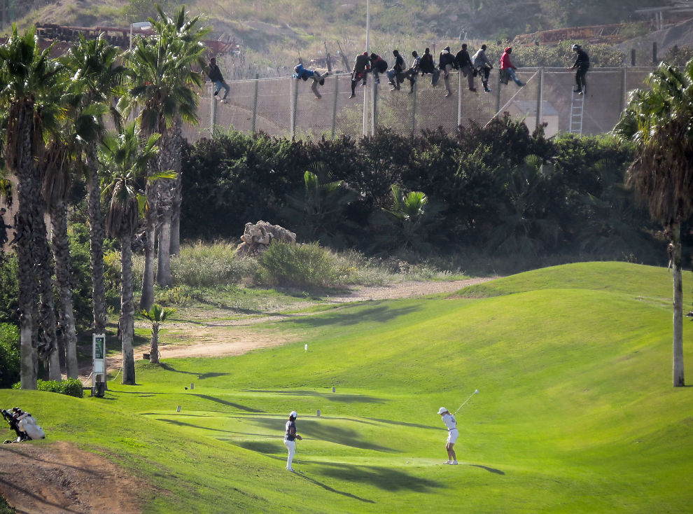

Slide 3
definitions

Slide 4
Aid
The transfer of money, food, goods, technology and education from one country, institution (World Bank, IMF) or NGO/charity (Oxfam) to a country in need.

Slide 5
What is aid?

Slide 6
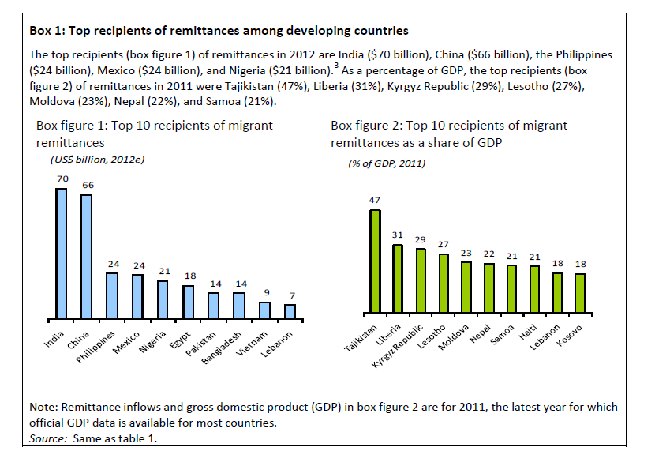
Remittances
to developing countries
will
surpass
$400 billion in
2012.
Remittances
Transfers of money/goods by foreign workers to their
home countries.

Slide 7
Core and periphery
The concept of a developed core surrounded by an undeveloped
periphery. The concept can be applied at various scales.

Slide 8
GNI
Gross national income (now used in preference to gross national product—GNP).
The total value of goods and services produced within a country together with the balance of income and payments from or to
other countries.

Slide 9
Geography Base Greenfield Ecumene

Slide 10
Define indices of infant mortality, education, nutrition, income, marginalization and Human Development Index.

Slide 11
Explain the value of the indices in measuring disparities across the globe.

Slide 12
You should be able to define each indicator and provide statistical examples of extreme values in all cases.

Slide 13
Explain disparities and inequities that occur within countries resulting from ethnicity, residence, parental education, income, employment (formal and informal) and land ownership.

Slide 14
When explaining disparities and inequalities, the scale used is national, which means that you are looking at social variations within one country and you should be able to name specific locations in your answer. For example, South-East China has a much higher level of development than in western provinces of China.

Slide 15
Case study: Racial inequality in the USA (page 29 in IB CC).
Race and ethnicity in Australia: the case of Australia’s aborigines (page 34 in IB CC).
Disparities within New York.

Slide 16
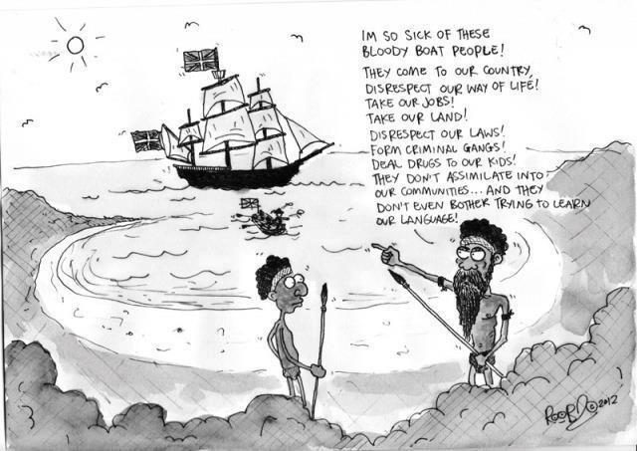

Slide 17
Identify and explain the changing patterns and trends of regional and global disparities of life expectancy, education and income.

Slide 18
You should be able to interpret spatial patterns on a world map and interpret trends over time on a graph.

Slide 19
Examine the progress made in meeting the Millennium Development Goals (MDGs) in poverty reduction, education and health.

Slide 20
Choose two countries with contrasting rates of progress towards the Millennium Development Goals. Explain the disparities between these two countries; the barriers to progress and incentives.

Slide 21
Progress towards MDGs in Mali and India (page 42 in IB CC).

Slide 22
Discuss the different ways in which disparities can be reduced with an emphasis on trade and market access, debt relief and remittances.

Slide 23
This section requires an overview of global inequalities and how they might be reduced. A case of one particular region or country in Africa, central Asia or South America would exemplify this well. The concept of internal and external forces determining disparities in wealth is fundamental to this question.

Slide 24
Case studies: Jamaica/Ethiopia.

Slide 25
Evaluate the effectiveness of strategies designed to reduce disparities.

Slide 26
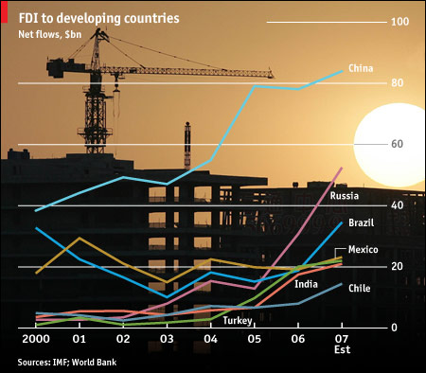
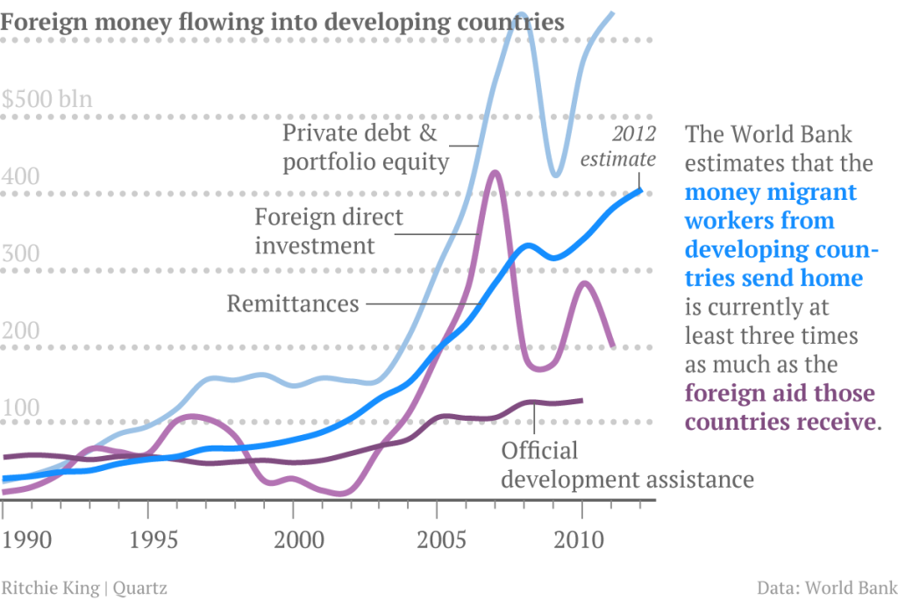
Migrant workers give poor countries three times the money foreign government aid supplies.

Slide 27
trade - selling things
market access - being able to sell things
fairtrade - selling things for a fair price
debt relief - reduction in a country's debts or the repayments upon those debts
aid - monies donated by one country or organization to another
remittances - money sent home by workers who have migrated
Greenfield

