Slide 1
Earthquake MEDC

Slide 2
L’Aquila, Italy, 2009

Slide 3
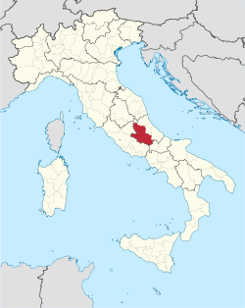
Where did it happen?
L'Aquila (Population: close to 70 000)
Abruzzo region
central Italy

Slide 4
 | When did it happen?
The main shock occurred at 3 o’clock in the morning on 6 April 2009.

Slide 5
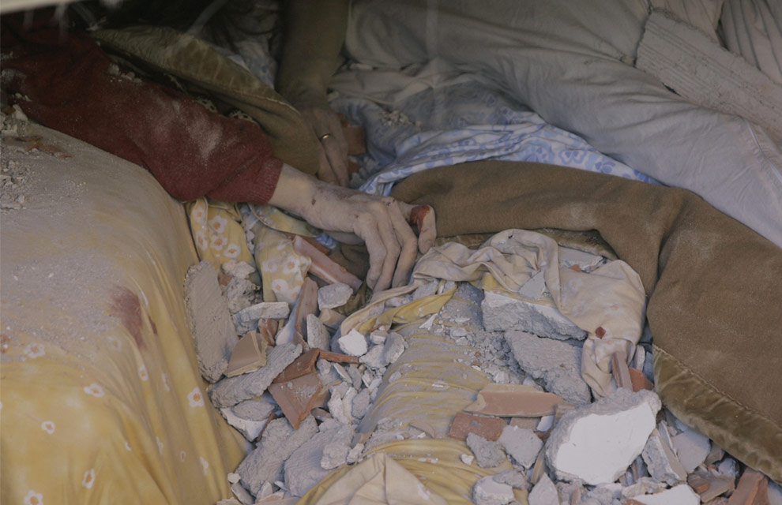

Slide 6
Why did it happen?
Italy is one of the world’s most earthquake-prone countries, with tremors occurring frequently.
This earthquake occurred on normal faulting on the Apennine mountain belt.
This faulting is related to the collision of the Eurasian and African plates (resulting in subduction in this case) and the opening of the Tyrrhenian Basin to the west.

Slide 7
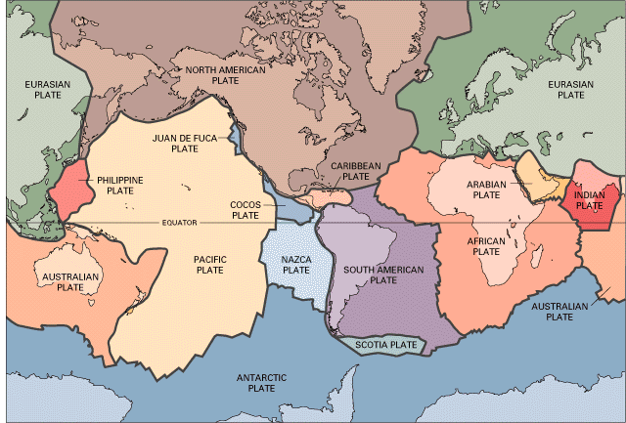

Slide 8
Who was affected by it happening?
L'Aquila Report
SEEP

Slide 9
Social
This earthquake resulted in 308 fatalities and 1.600 injured, displaced more than 65.000 inhabitants, and caused significant damage to more than 10,000 buildings in the L’Aquila area.
Most of the deaths occurred when people were buried under collapsed buildings.
After the earthquake, the Italian government set up shelters for people who were displaced.
A particular feature of this earthquake was the significant damage to historic and vintage buildings, including churches. Many of these structures were built centuries ago, and therefore such damage is a great loss.

Slide 10
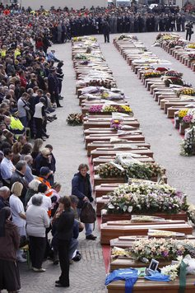
308 people were killed in L'Aquila

Slide 11
Economic
The total cost of this earthquake, including financial losses and reconstruction efforts, is expected to exceed US$16 billion.
Earthquake damage was not limited to buildings, however; roadways and bridges were also affected.
In addition, industrial and commercial structures sustained damage, leading to business interruption and other financial losses.
A particular feature of this earthquake was the significant damage to historic and vintage buildings, including churches. Many of these structures were built centuries ago, and therefore such damage is a great loss.

Slide 12
Environmental
Some landslides triggered by the earthquake.

Slide 13
Political

Slide 14
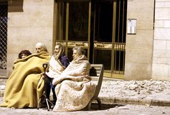
Earthquake Scientists Jailed Over 'Inexact' Statements Preceding 2009 L'Aquila Quake
After a series of small temblors in early 2009, the six seismologists and the government official held a public meeting in which they said it was "unlikely" that the shaking foreshadowed a larger quake.
Days later, on April 6, 2009, a 6.3-magnitude quake struck, crumbling L'Aquila's medieval buildings and killing 309 people.

Slide 15
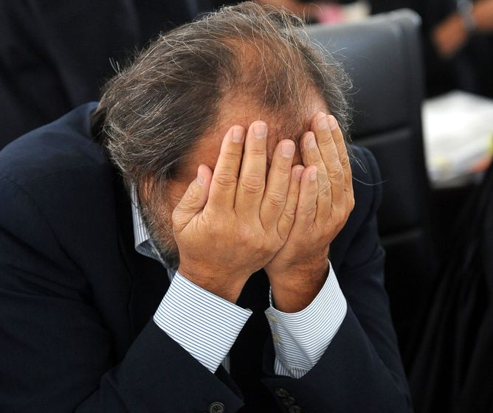
Dr Bernado de Bernardinis told residents to go home and enjoy a glass of red. Now he’s in the dock (later sentenced to six years in prison).

Slide 16
It’s maybe worth noting in passing that no action has yet been taken against the engineers who designed the buildings that collapsed and caused fatalities, or the government officials who were responsible for enforcing building code compliance. Some commentators have suggested local government officials may be scapegoating the scientists to avoid attention being focused on their own failings.

Slide 17
The destruction caused by the earthquake of 2009 surprised experts and generated discussions about the anti-seismic building standards adopted in Italy. While most of the medieval structures in rural areas collapsed or were heavily damaged, in L’Aquila most concern arouse from the observation that modern buildings suffered the greatest damage and that the death toll included mostly young people. L’Aquila was a university town and cheap accommodations which suffered severe damage were inhabited by students, also many students died when a dormitory at the University of L’Aquila collapsed. Even some buildings, believed to be “earthquake-proof”, collapsed, like parts of the new hospital and various buildings of the government.

Slide 18
However there was and still is a widespread disregard of building standards and the ignorance by people and (in part corrupt) authorities of the seismic hazards. Many concrete elements of the collapsed buildings (like the hospital) “seemed to have been made poorly, possibly with sand“, a common tactic to build fast and cheap by building enterprises controlled by criminal organisations.
The earthquake of L’Aquila was therefore only in part a natural disaster and the manmade catastrophe was strongly misused by Italian politics and many promises made shortly after the earthquake are still unrealized today.

Slide 19
What happened?
Magnitude 6.3 on the Richter scale (The Moment Magnitude Scale – (MMS – looks at the energy released, has succeeded the Richter Scale in many countries), although the Richter Scale (shaking amplitude of waves measured by a seismograph) is still widely referred to in the media.
The earthquake was a shallow event, with a depth of approximately 8 km.
Epicentre: Abrazzo region (5 km from L’Aquila)
The earthquake was a shallow event, with a depth of approximately 8 km.
The earthquake lasted 20 seconds.

Slide 20
Video
For more information, read the article.

