Slide 1
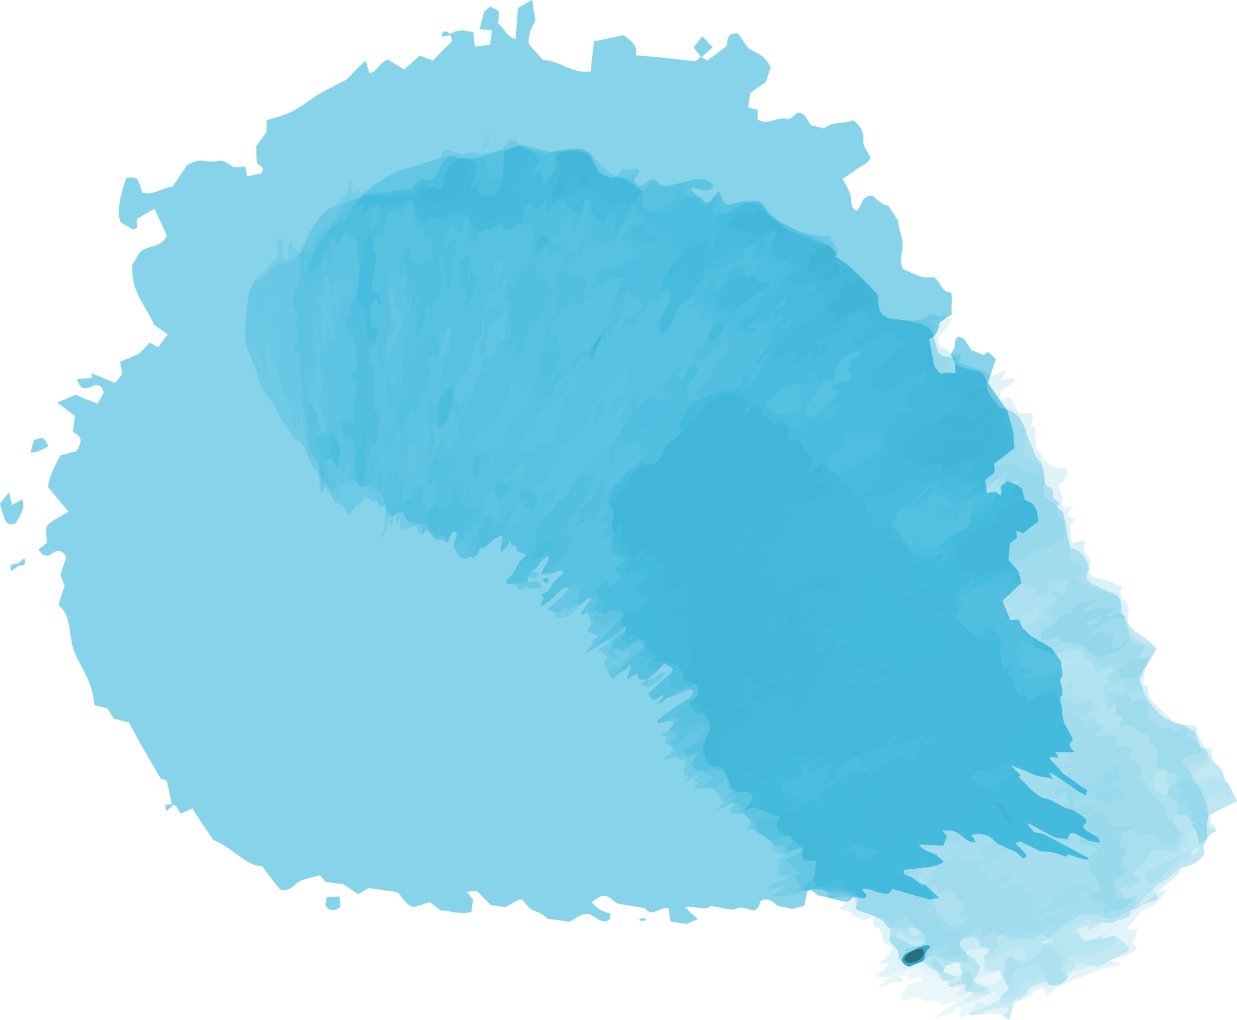
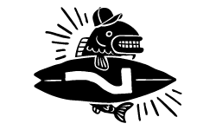
The Lofoten Islands
Unstad Arctic Surf

Slide 2
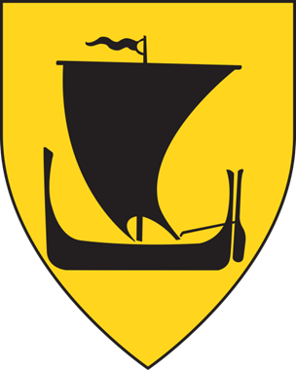
Lofoten, island group, in the Norwegian Sea, northern Norway. Lying off the mainland entirely within the Arctic Circle, the group comprises the southern end of the Lofoten-Vesterålen archipelago and includes five main islands. Contradictory to its high latitudinal position, the region experiences surprisingly high temperatures.
The Lofoten Islands are located in the Nordland County.

Slide 3
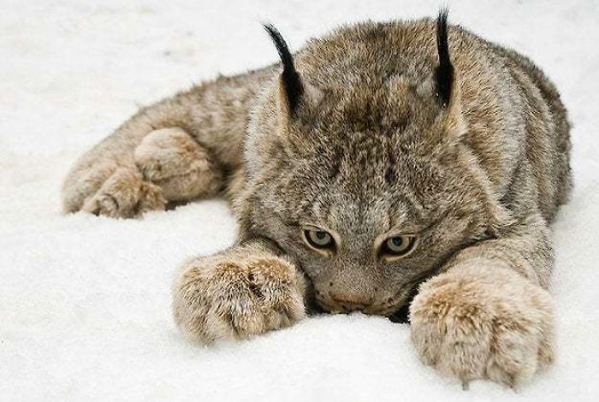
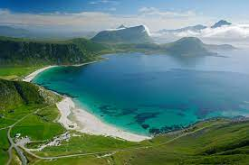
The name Lofoten
Navnet Lofoten kommer av gammelsvensk ló, 'gaupe', og norrønt fotr, 'fot'; opprinnelig brukt om Vestvågøya. Det er et sammenligningsnavn, antagelig brukt med utgangspunkt i de sterkt oppskårede kystlinjene.

Slide 4
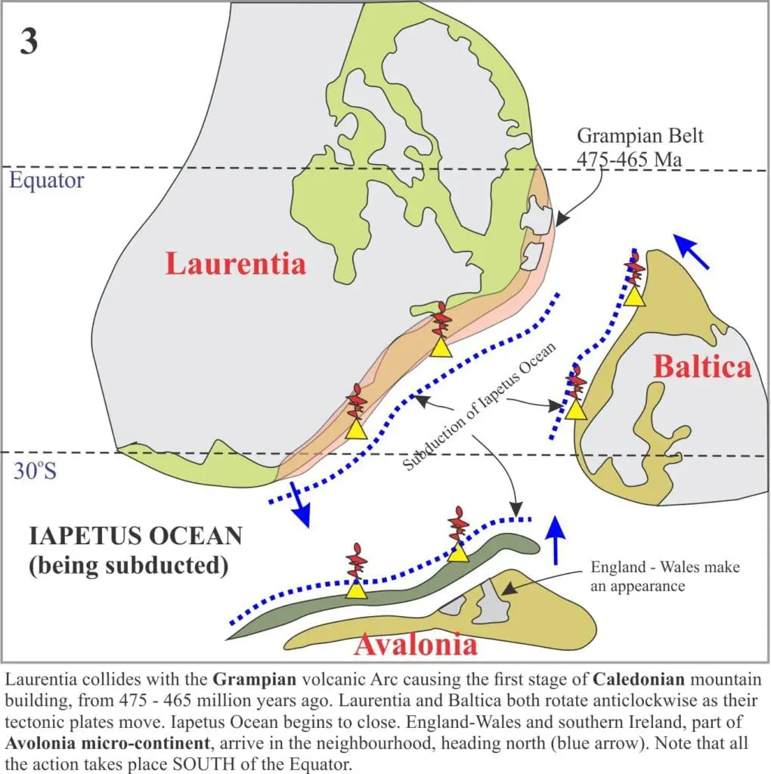

Slide 5
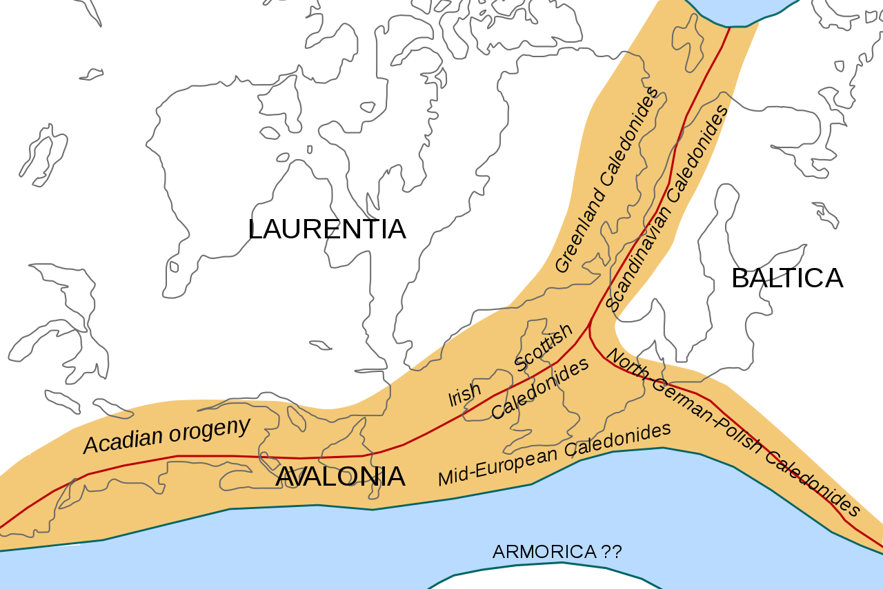

Slide 6
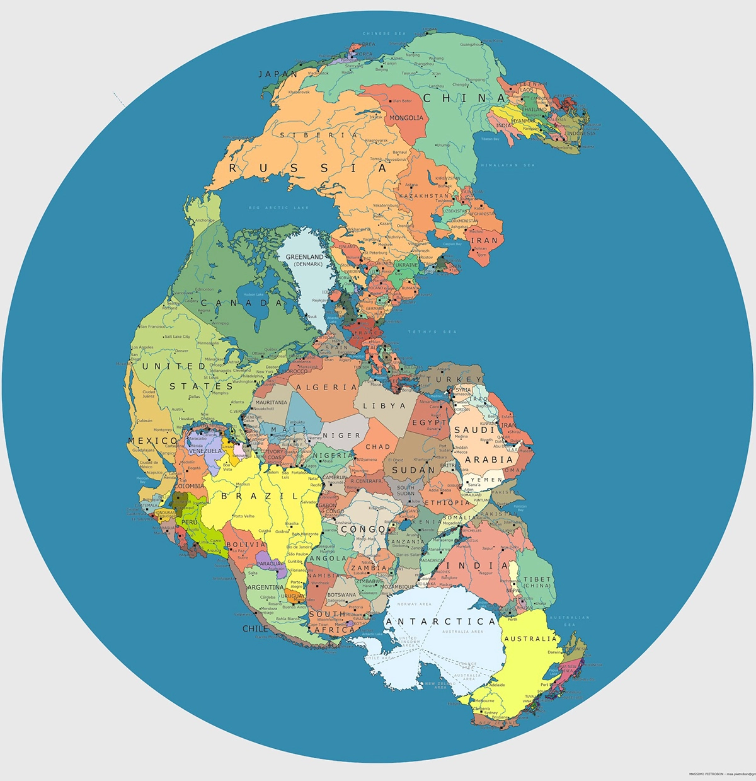
Pangea: The World As One
Breaking Up is Hard to Do

Slide 7
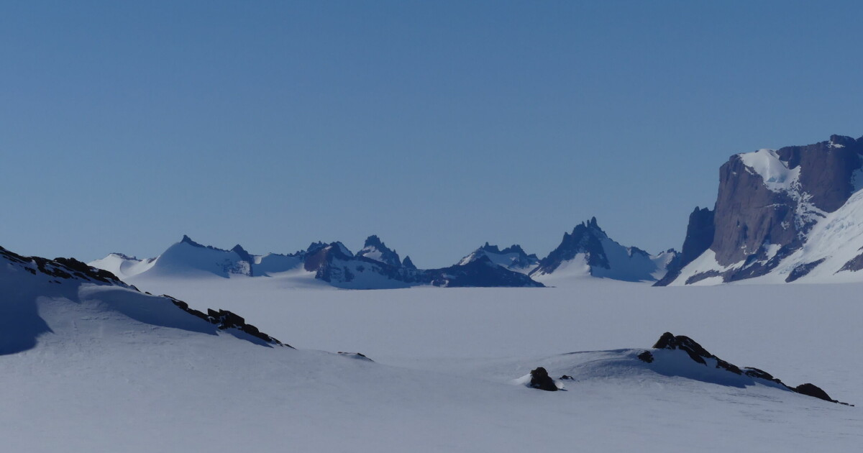
Nunatak

Slide 8
The Caledonian orogeny was a mountain building era. It left its mark in the northern parts of the British Isles, the Scandinavian mountains, Svalbard, eastern Greenland, northern Europe and the eastern United States. The events occurred roughly 490–390 million years ago. It was caused by the closure of the Iapetus Ocean when the continents and land of Laurentia, Baltica and Avalonia collided. During Caledonian continent-continent collision, the rocks exposed at the surface today were situated at considerable depth in the crust (ca 45 km). Compared to the sedimentary rocks adjacent to it, the Precambrian rocks along Lofoten are highly resistant to erosion. The Norwegian continental shelf has been through several rift phases since the Caledonian orogeny. The Røst Reef – the world's largest deep-water coral reef. There has been a 1000 metres of uplift occurred during the last 10 million years. The highest peak is 1147 m. Thinner icecap, nunatak. It is the exceptional combination of tectonic events and subsequent glacial erosion and weathering that has produced the unique geological setting and the stunning landscape of the Lofoten archipelago.

Slide 9
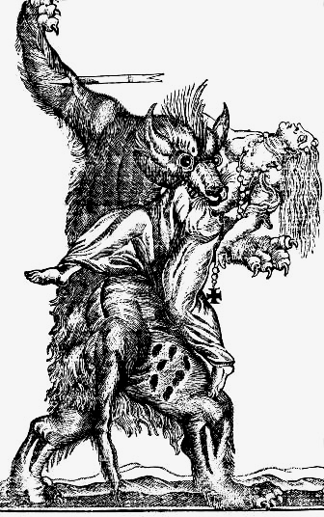
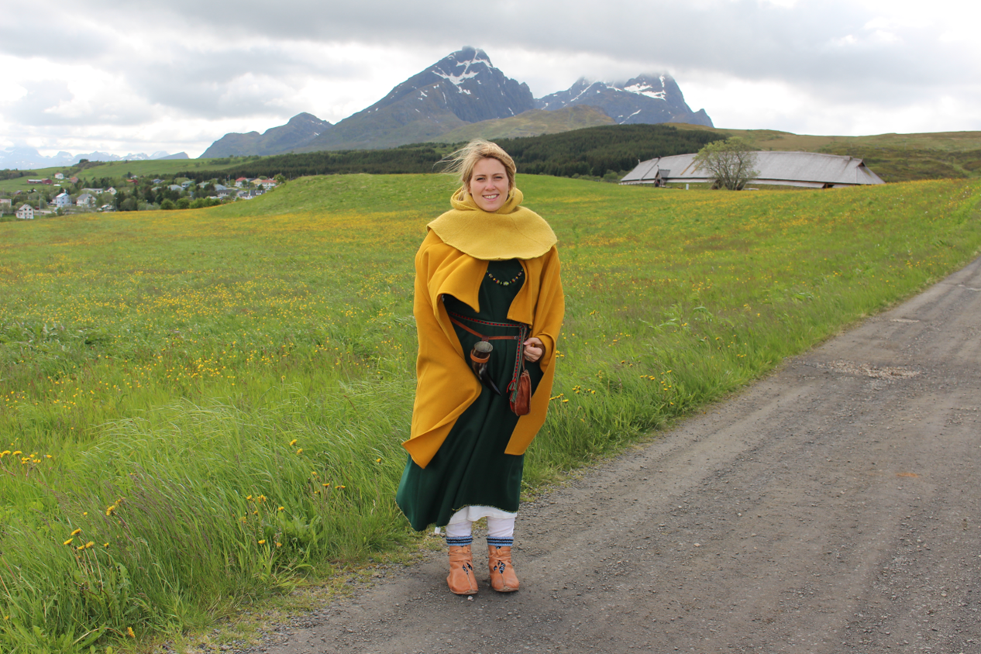
There is evidence of several such Viking chieftaincies, mostly situated in the Eastern part of the archipelago. The main one, in terms of architectural remains, is Borg in the middle of the island of Vestvågøy. Borg has the privilege of being the biggest Viking-Age building ever found. The local chieftain, probably the oddly-named Oláfr Uni-brow is also mentioned in one Icelandic saga as being a skin-changer (hamrammr), a werewolf that is…
Could Olav Uni-brow have been
a fierce and bloodthirsty werewolf?

Slide 10
Business life
A relatively large proportion of the jobs in Lofoten are in the primary industries . This applies to eight percent versus five percent in the county as a whole (2019). The high proportion applies particularly in the four municipalities at the far end of the archipelago, where fishing dominates.
Fishing creates the basis for several trades and industries. The food industry, where fish processing is the dominant activity, accounts for approximately half of all jobs in the industry (2019). Lofoten fishing from January to April has always been the dominant fishery.
Agriculture is still important in some areas, although the number of uses has been reduced over several decades. It is characterized by cattle and sheep farming with the production of dairy products and meat . Milk production is particularly important in Vestvågøy, and a number of chickens and pigs are also kept here . Sheep farming can be found throughout Lofoten, and in Vestvågøy there is also some goat farming .

Slide 11
The world’s richest cod-fishing takes place every winter in Lofoten. For nearly 1000 years, dried fish has been exported to Europe from here. Traditionally, it was the most important event in the calendar along the entire coast of Norway.

Slide 12
When the temperate waters of the Gulf Stream enter the grounds around the Lofoten archipelago, the temperature is exactly right for the Norwegian Arctic cod to spawn. Large cod swim down from the Barents Sea in the middle of the darkest winter, and become known as skrei on the way. They reach the western coast of Finnmark and Troms before Christmas and get to Lofoten in January.

Slide 13
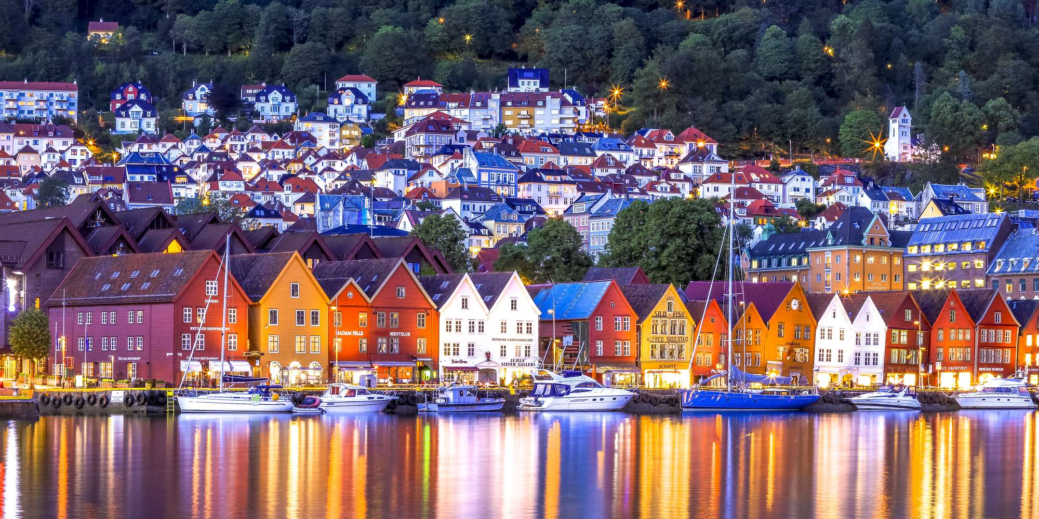
Fish trading
The trade in stockfish between Lofoten and Europe began in the early 12th century. In the summer, large cargo vessels transported the dried fish to Bergen.
The German Hanseatic merchants were waiting, and sold the fish on to the citizens of the thriving cities of northern Europe. Good Catholics eat fish on Fridays, and cod are rich in hearty proteins.

Slide 14
In order to preserve the fish, it is dried on large drying racks. It doesn’t need to be salted or smoked, as the temperature in Lofoten in the winter is just below freezing. The fish does not freeze into pieces, but it doesn’t rot either. The fish simply dries in the sun and wind from late winter until spring. Then, it is bone dry and easy to transport but still retains its key nutrients.

Slide 15
Stockfish from Lofoten have been exported for centuries. Local industries are related to fishing (cod-liver-oil processing and fertilizer manufacture from fish parts). Some potatoes and berries are grown, but the scanty soils will not support even the hardiest grains.

Slide 16
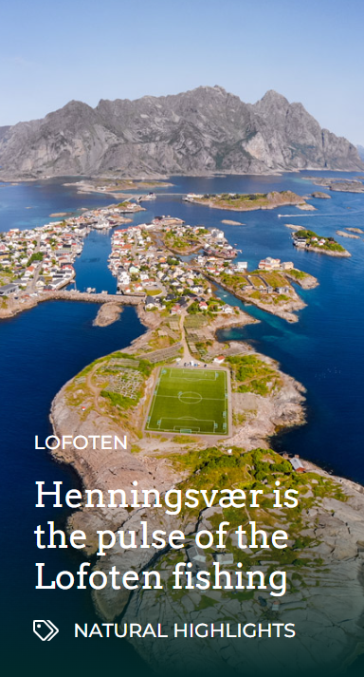

Slide 17
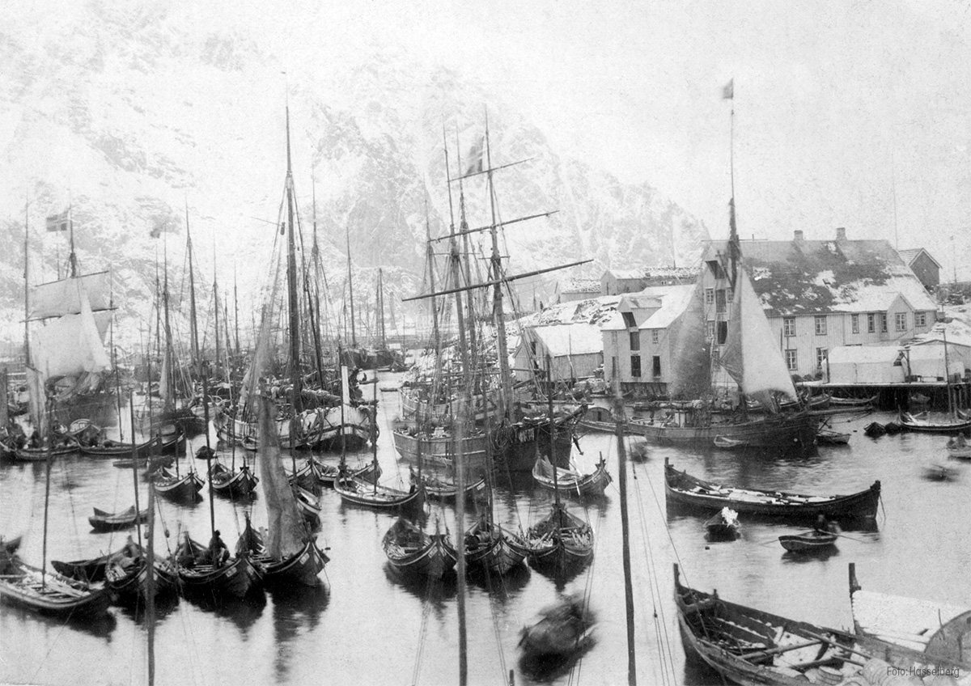

Slide 18
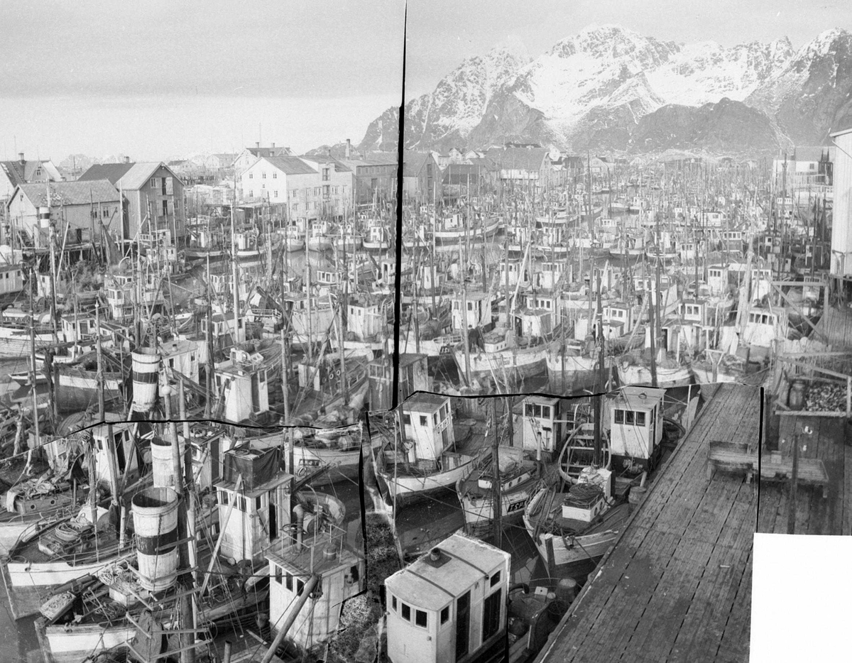

Slide 19
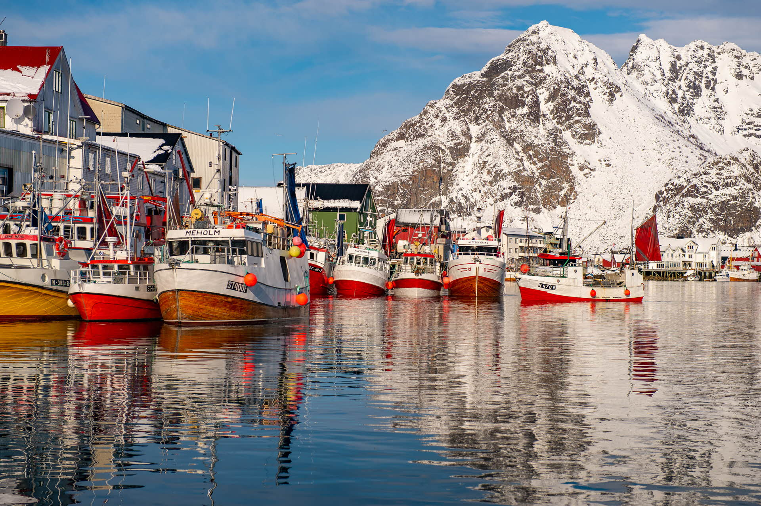

Slide 20
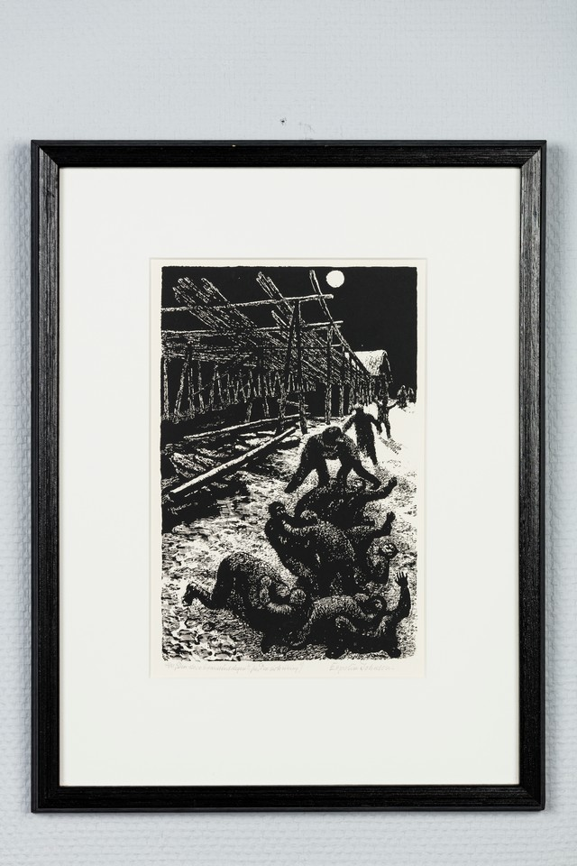
The Big Booze Day was a respite from hard work
The 25th of March, the Fiest of the Annunciation in church, was an important day in the Lofoten Fishery calendar. The cod roe was now so developed and coarse, that it could no longer be salted. The fishemen had consequently got paid for their hard work earlier in winter. This meant one could celebrate a little bit. Back then, celebration meant hard liquor. The 25th of March was known as “den store brennevinsdagen” – the Big Booze Day.

Slide 21
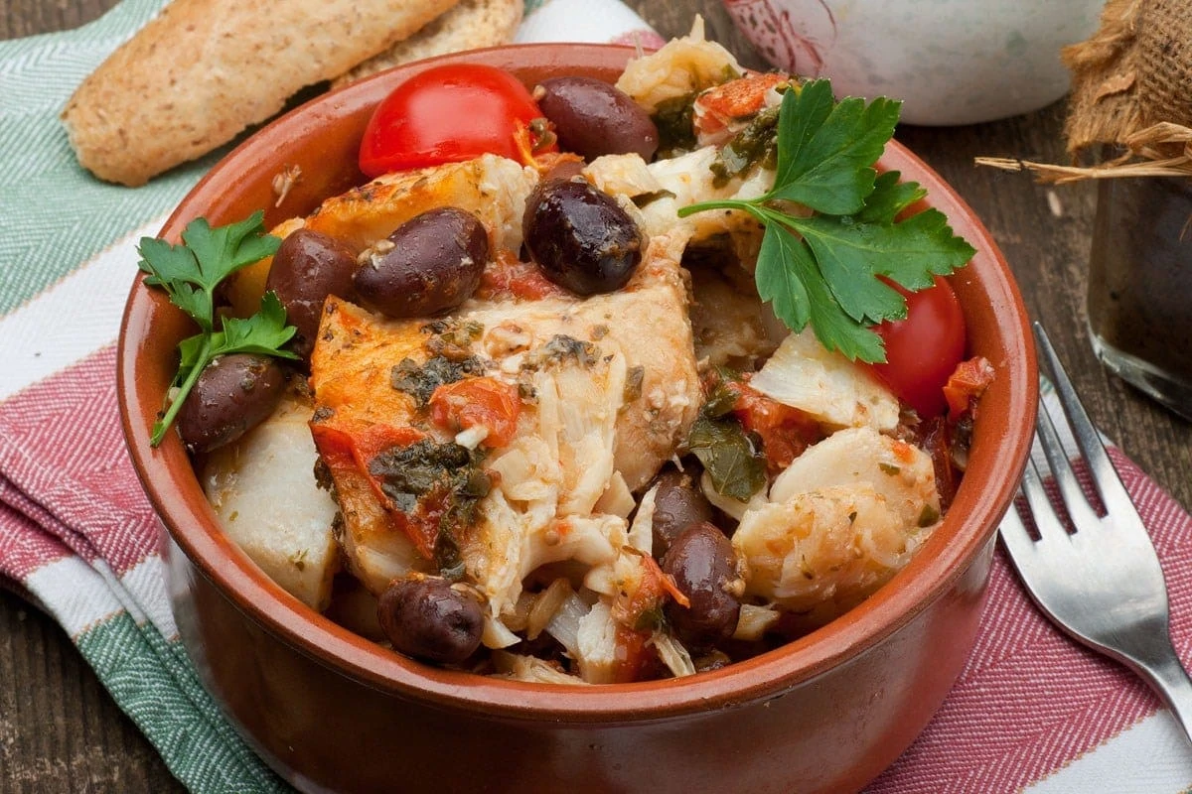
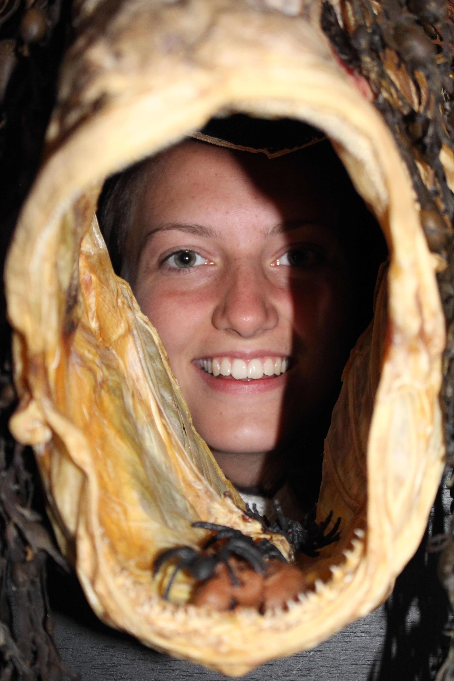
Cod prices cycle
In the 14th and 15th centuries, the Lofoten fishermen got very good prices ↑ In the 16th and 17th centuries, competition increased and demand fell ↓, and there were hard times along the coast. In the 19th century, demand increased again ↑, and the coast got a boost that has lasted, with a few interruptions, until today.
Today, most of the dried fish is
exported to Italy,
while airborne fresh fish is sold to
fine restaurants throughout Europe.
Baccalà alla Napoletana

Slide 22
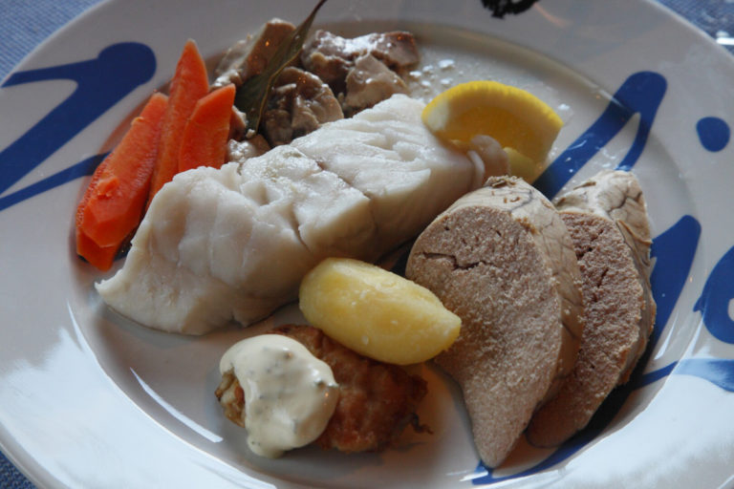
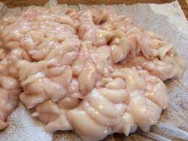
Mølje is a mix of cod, cod liver and cod hard roe, the little thing in the front is a cod's tongue. Protein and vitamin galore!

Slide 23
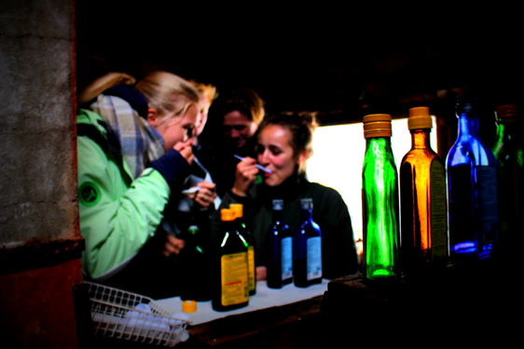
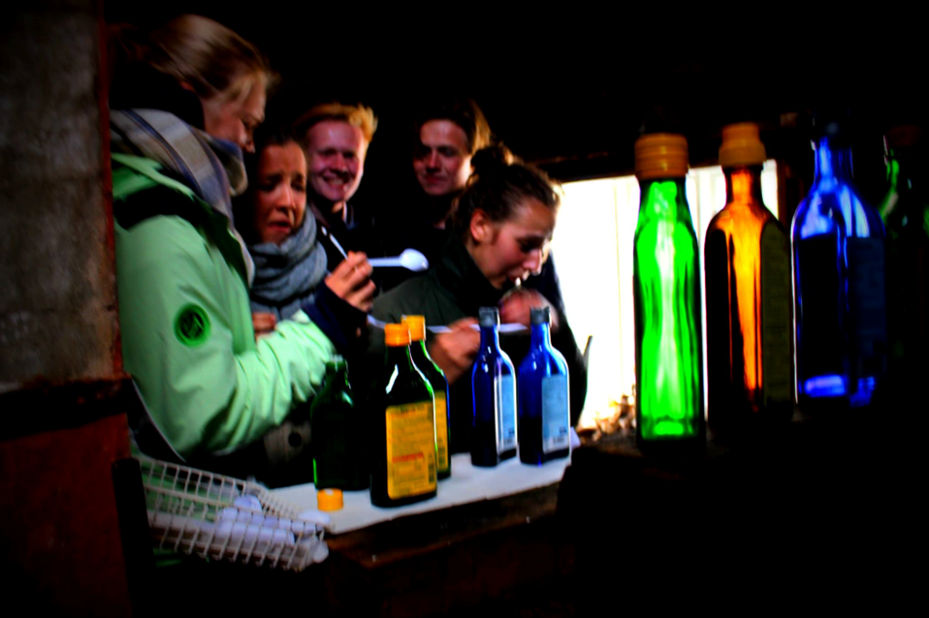
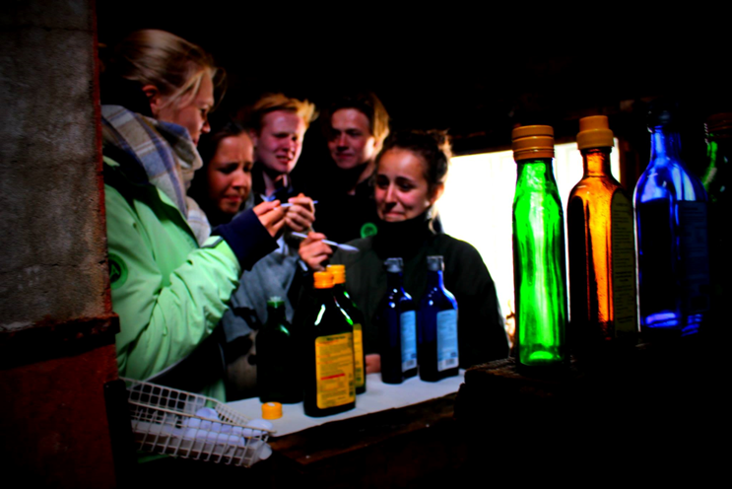

Slide 24
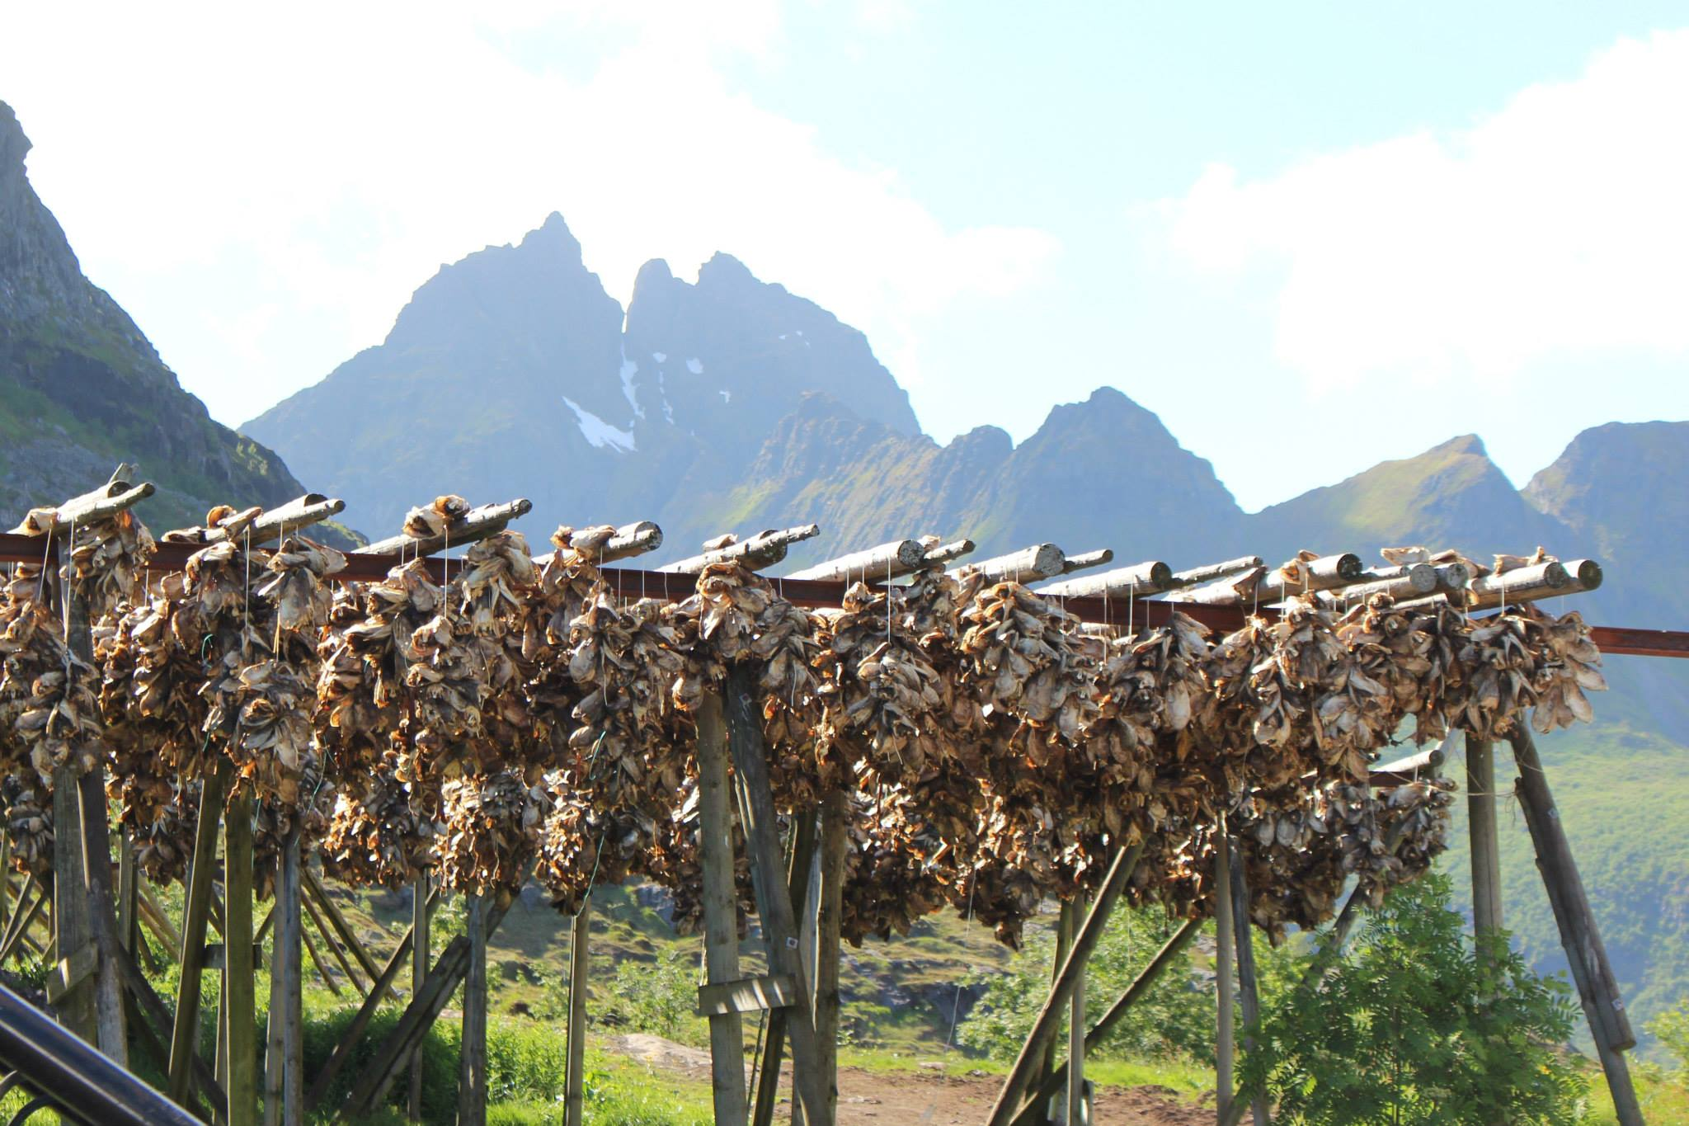

Slide 25
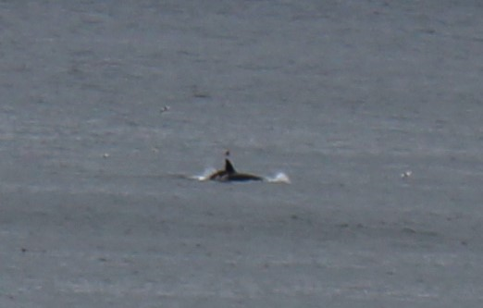
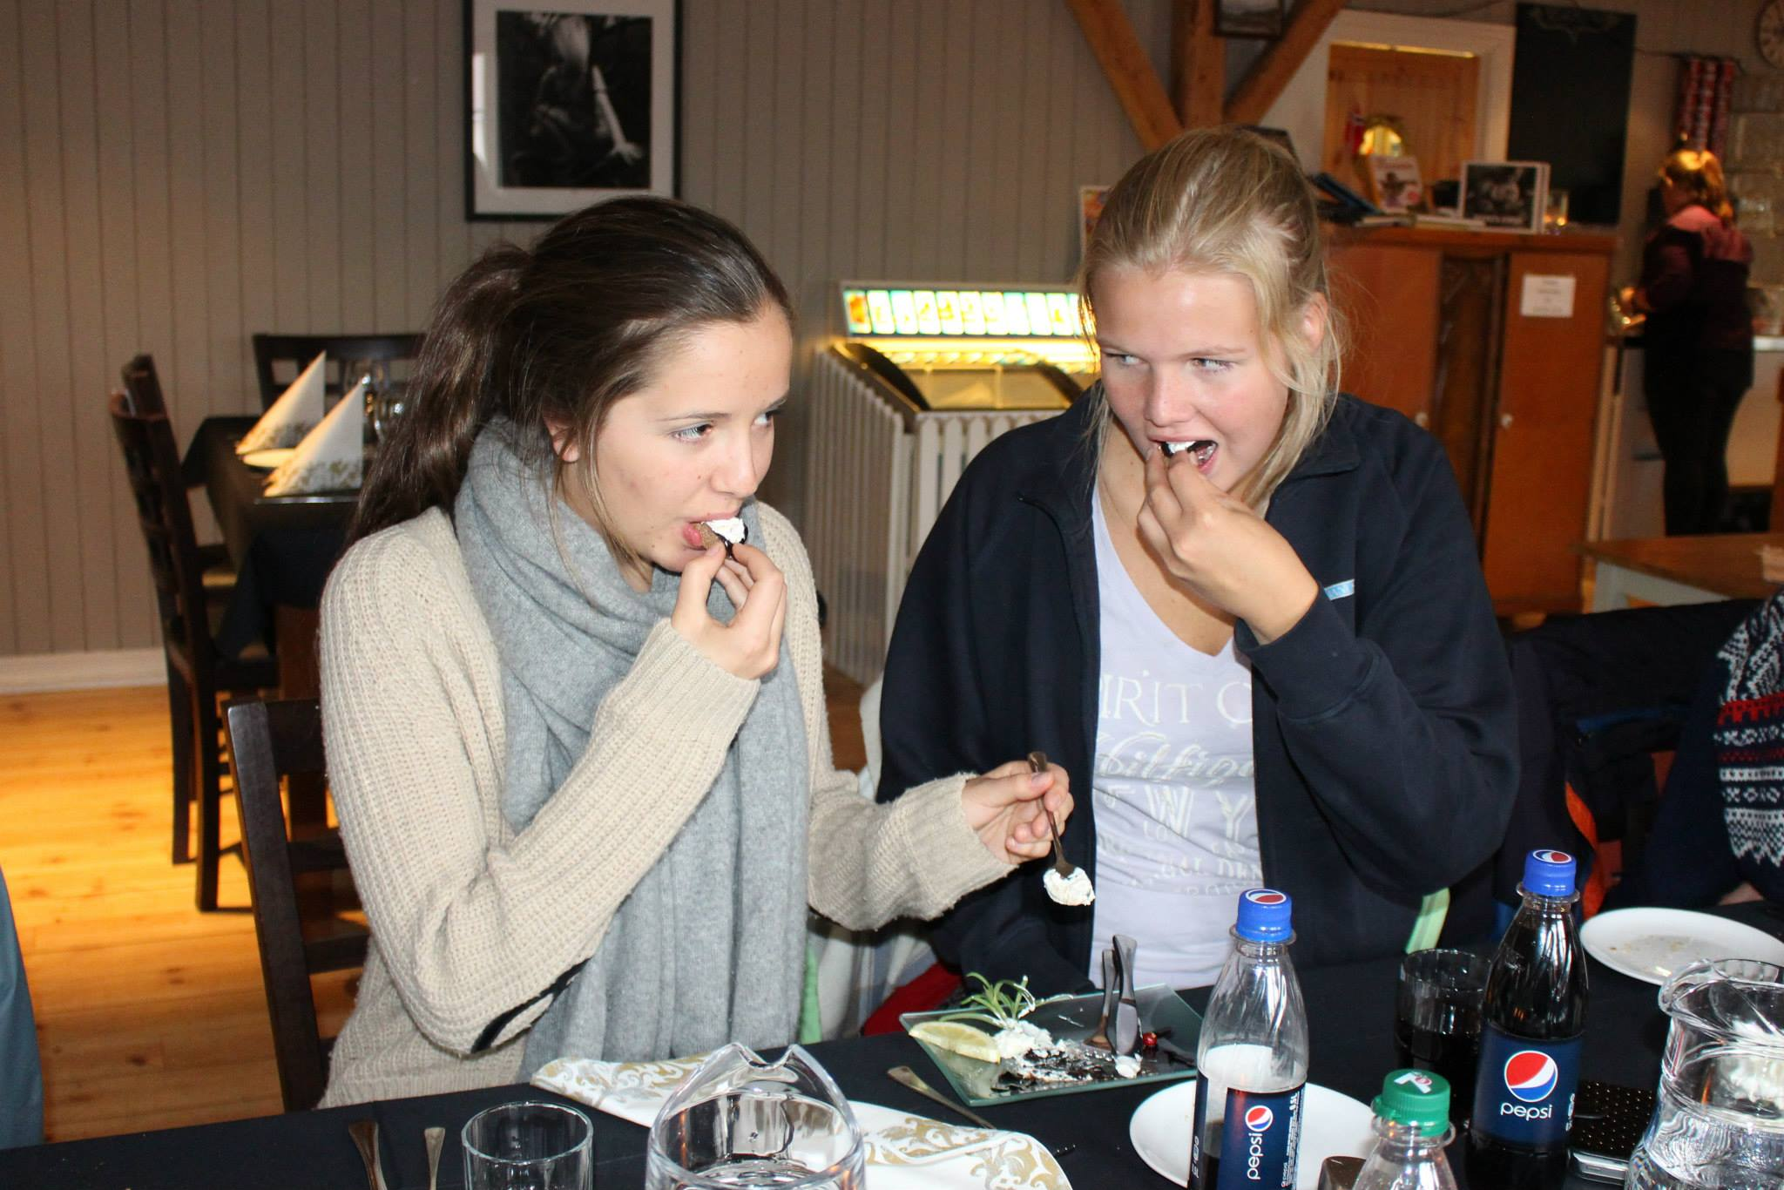
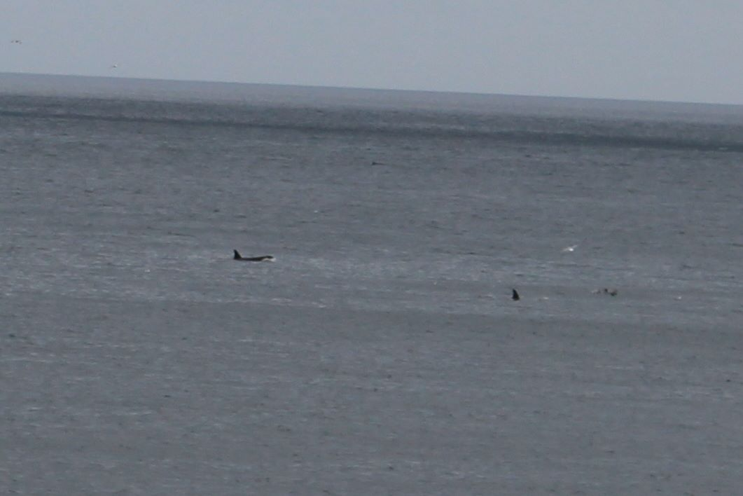

Slide 26
Development Of The Rorbu Cabin Culture
The Lofoten have been continuously inhabited since at least 1120, when King Øystein built a church and lodgings (“rorbu” cabins) for fishermen near Kabelvåg.
Even back then, the islands were an important centre for the fishing industry and the cold winter season was known as the cod season.

Slide 27
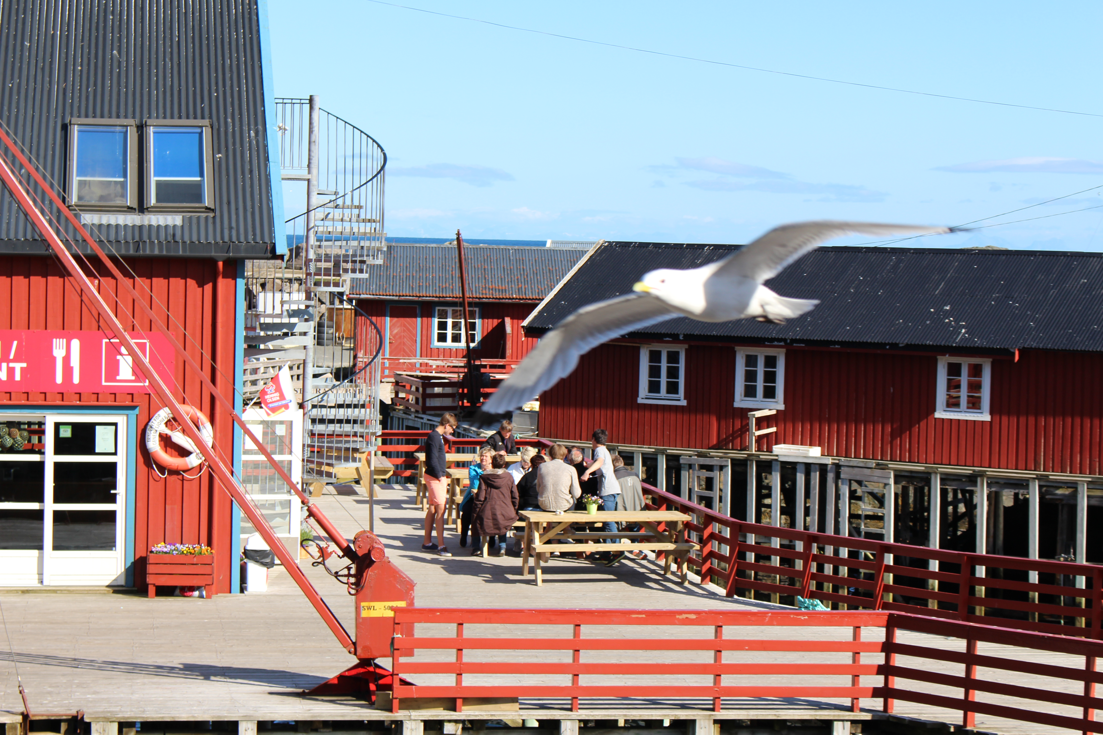
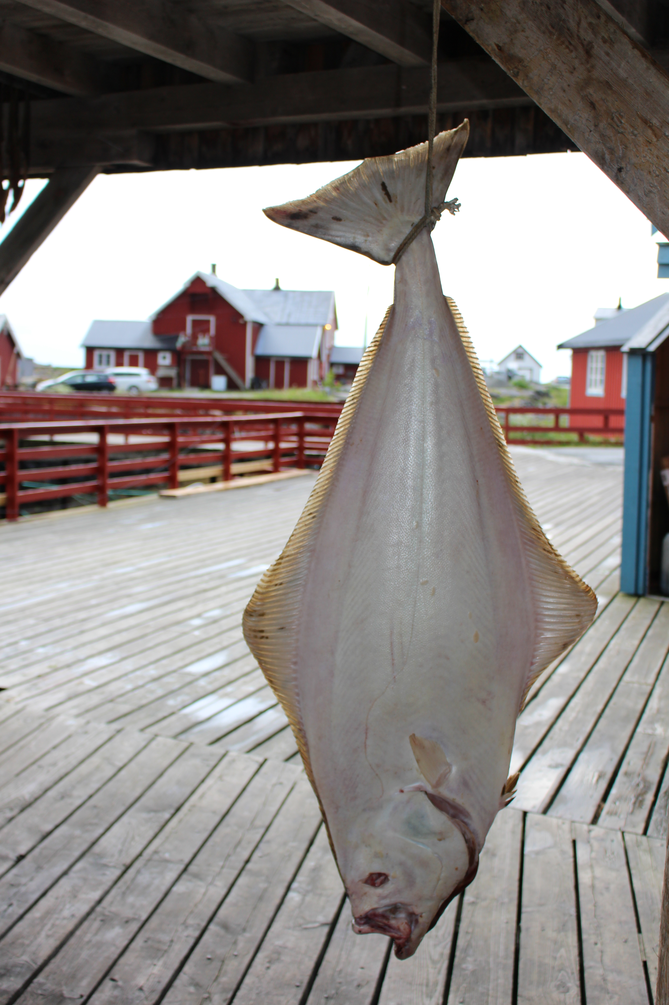
Fishermen`s shacks and markets
While they were in Lofoten (January-April), they lived in shacks — simple houses (“rorbuer”), where an entire crew lived in the same room. The boys were 14 years old and newly confirmed the first time they went out.
Pedlars, photographers, liquor dealers, carousel owners, magicians and “less reliable ladies” also visited Lofoten during this period, in case the fishermen had earned a little extra.

Slide 28
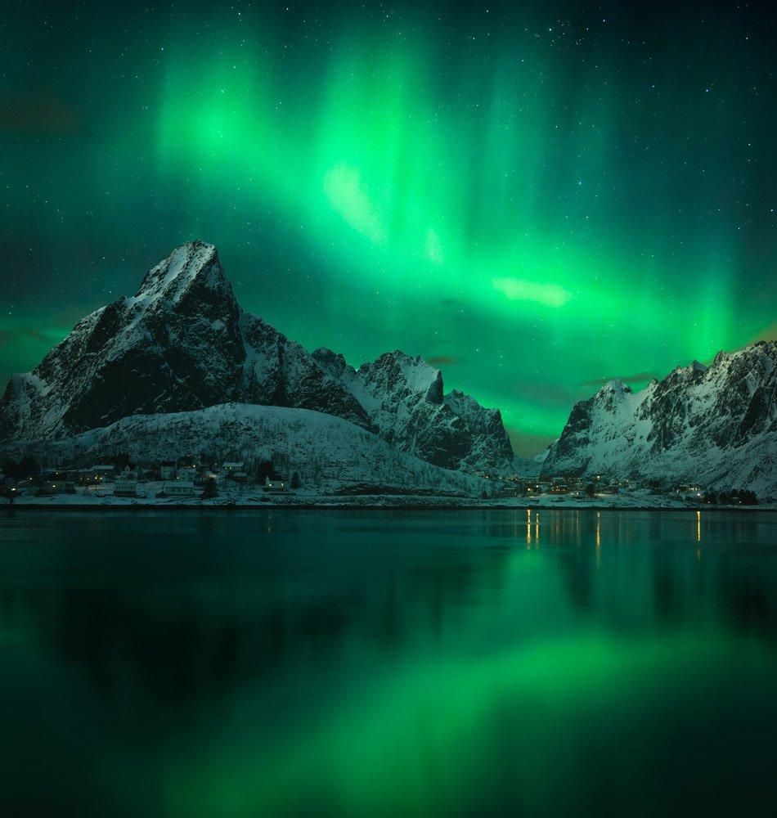
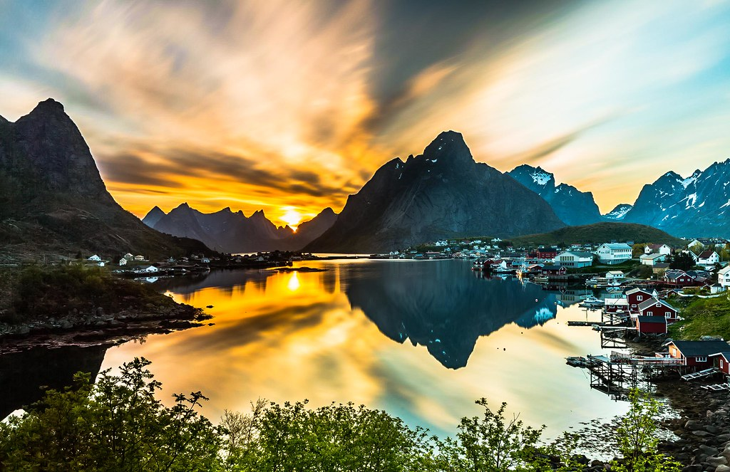

Slide 29
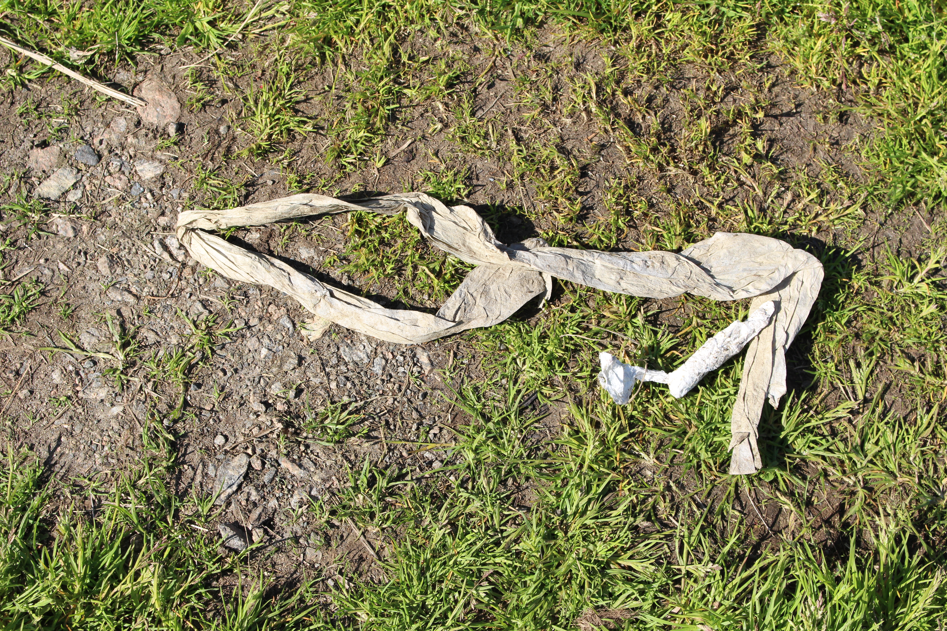
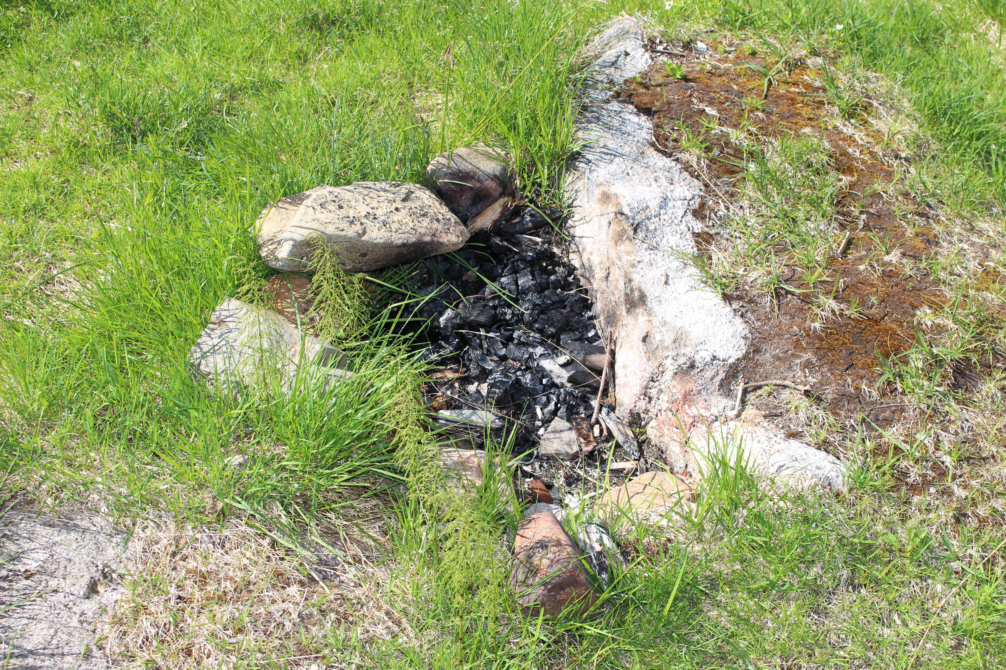
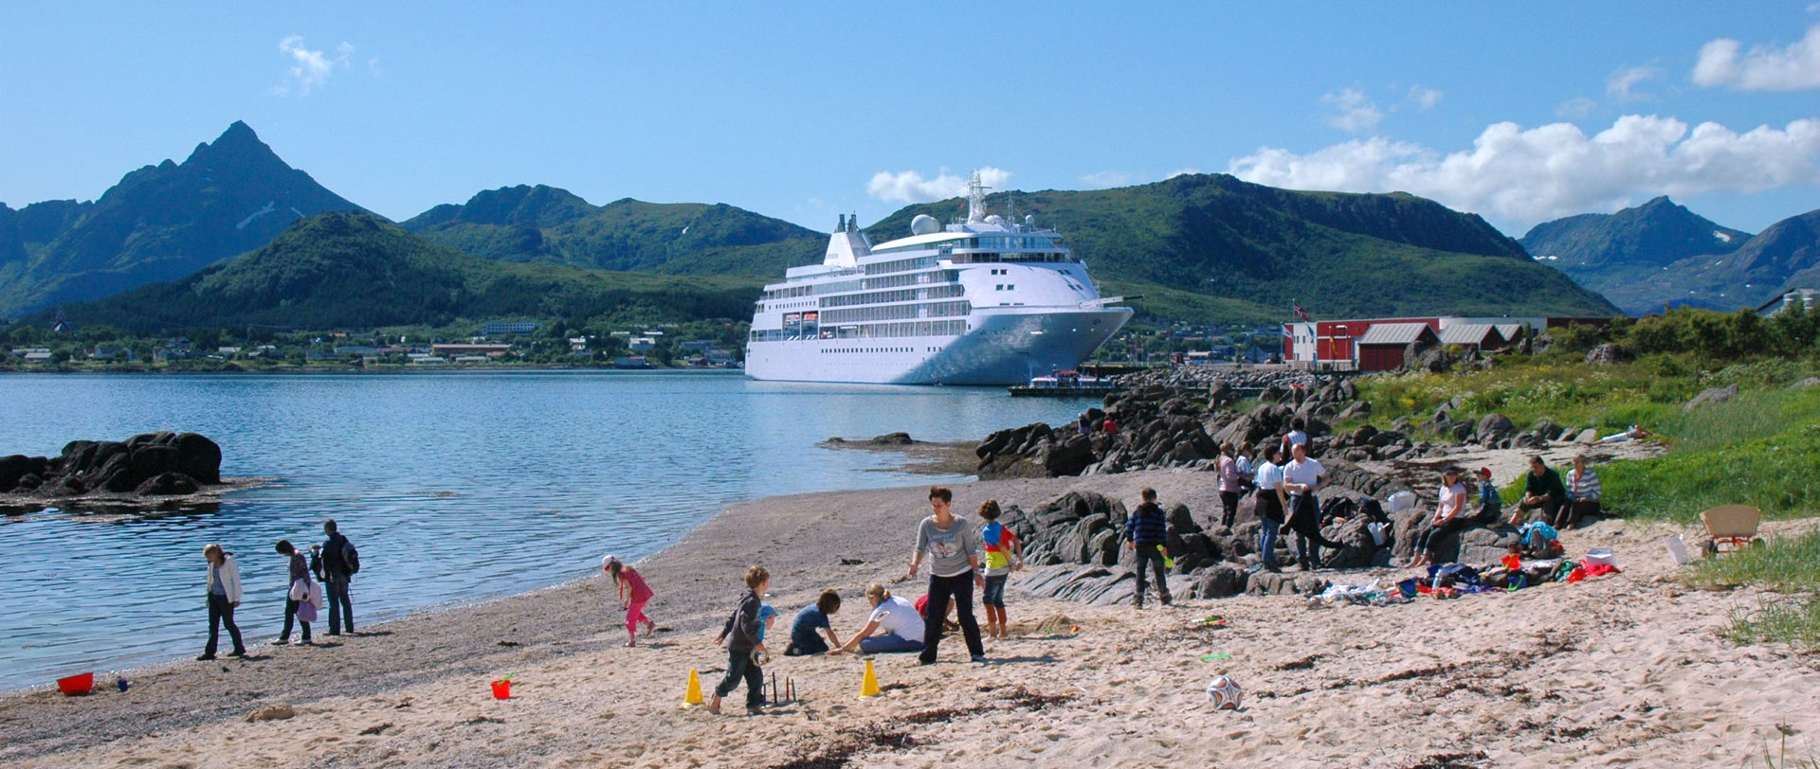
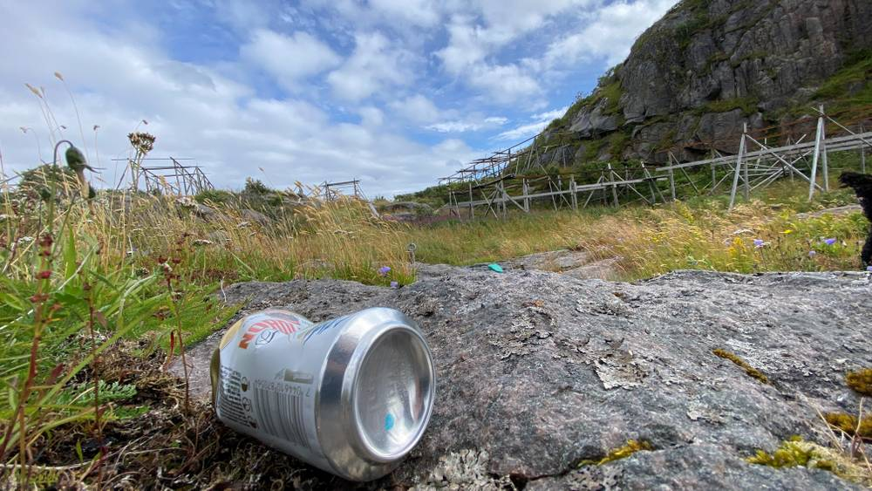

Slide 30
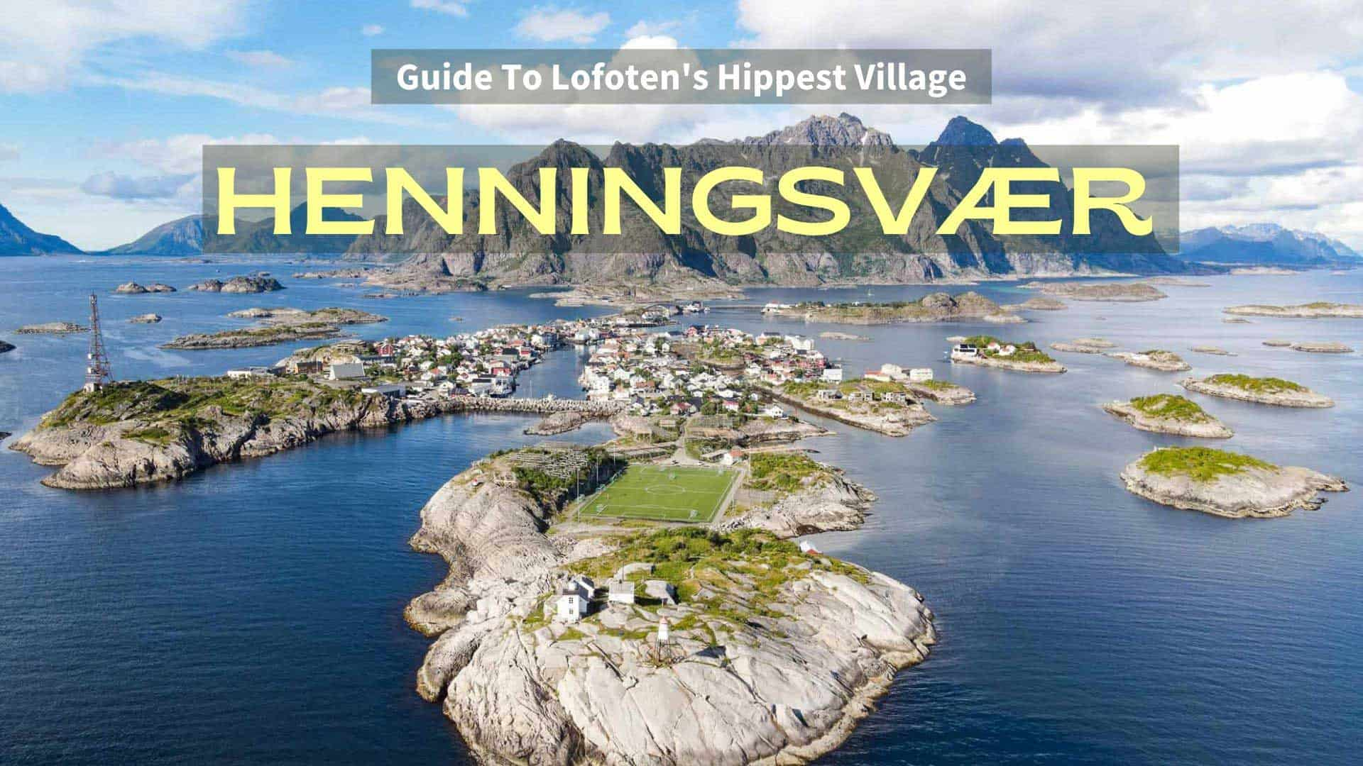

Slide 31
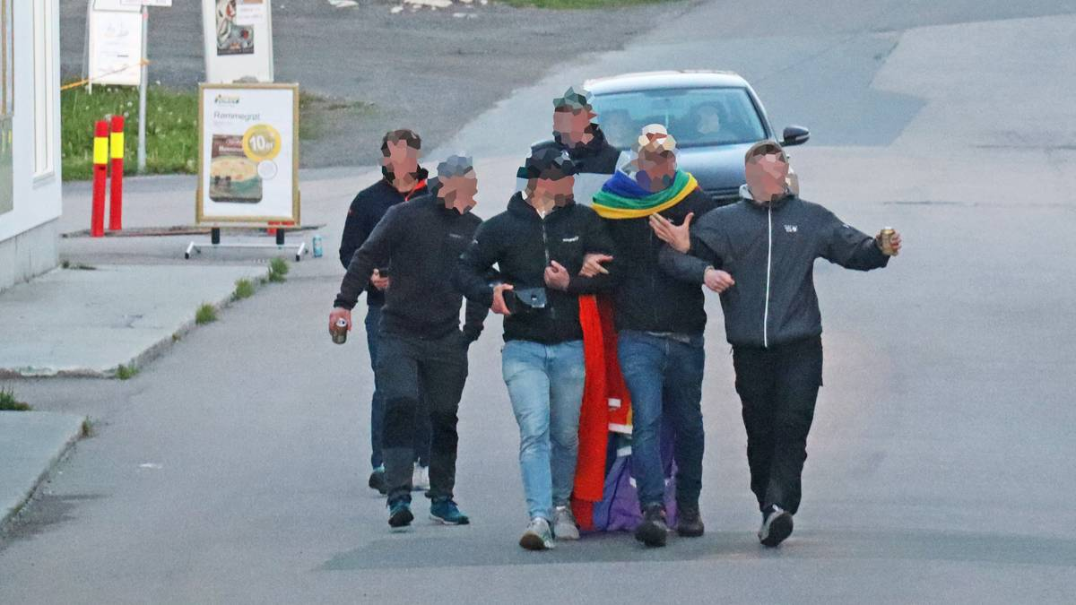
Politiet klarte ikke å stoppe fest i Lofoten: – Driter i de fastboende De siste årene har både politiet og kommunen gjort grep i forbindelse med festkultur i Henningsvær. I natt gikk det imidlertid over styr nok en gang.

Slide 32
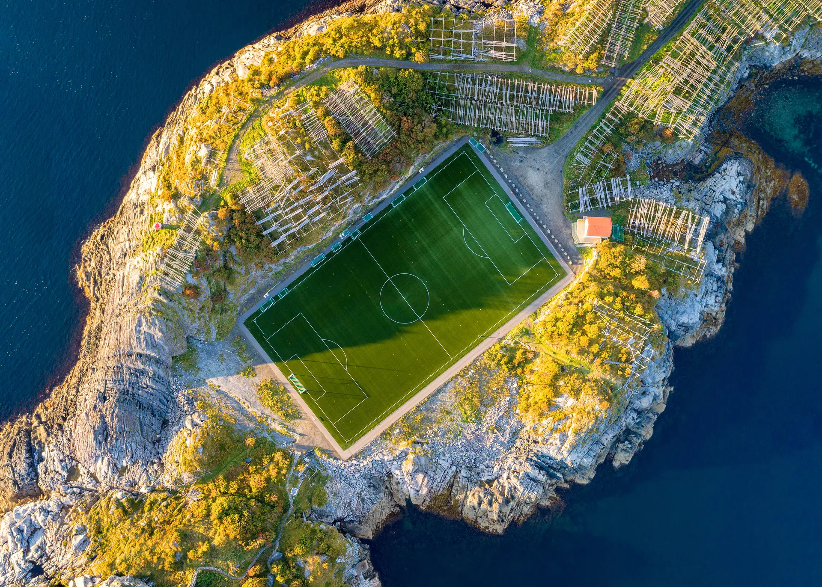
Henningsvær
Henningsvær may only have a population of around 500, but it has gained recent Insta-fame thanks to its awesome, highly photographable football stadium. The term "stadium" is a loose one, seeing as it's only used for amateur football and there is absolutely no seating, but the field's remote, rocky location is certainly worthy of attention.

Slide 33
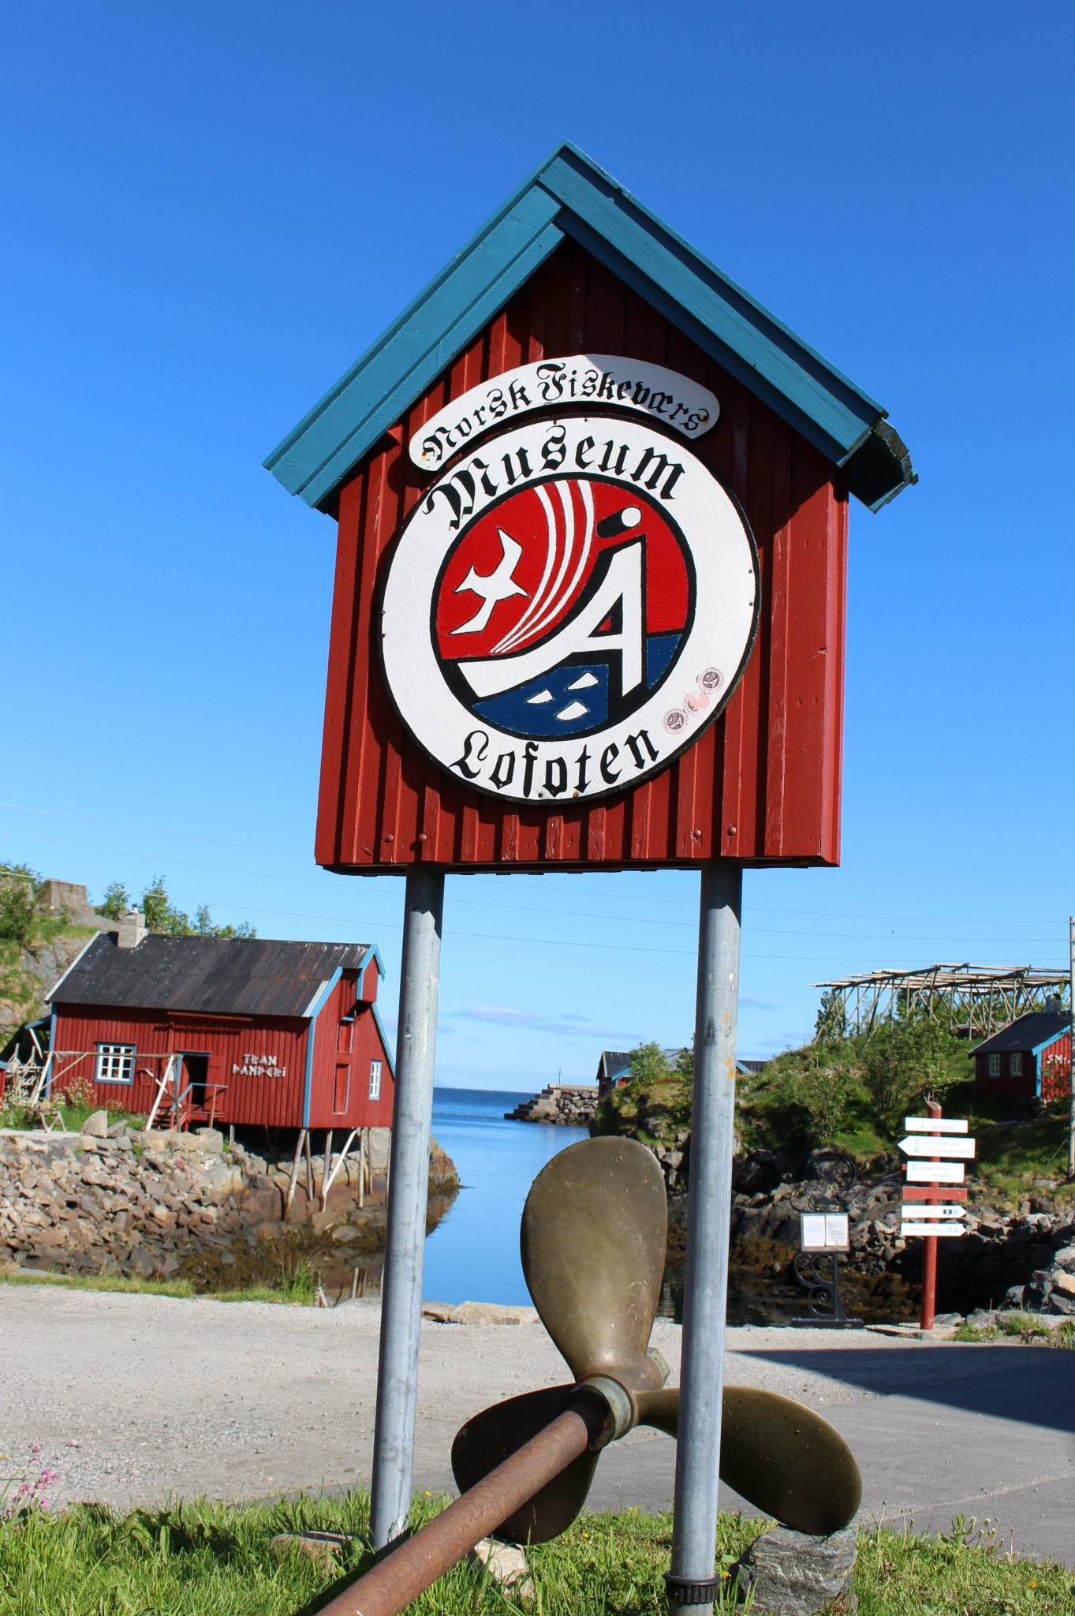
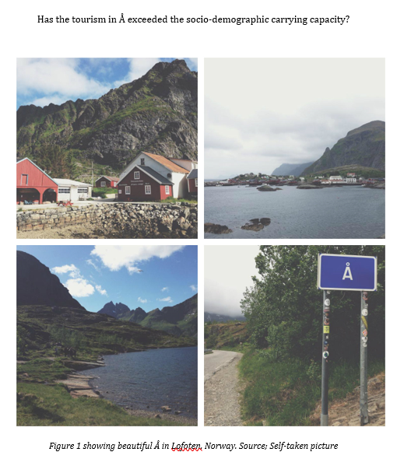

Slide 34
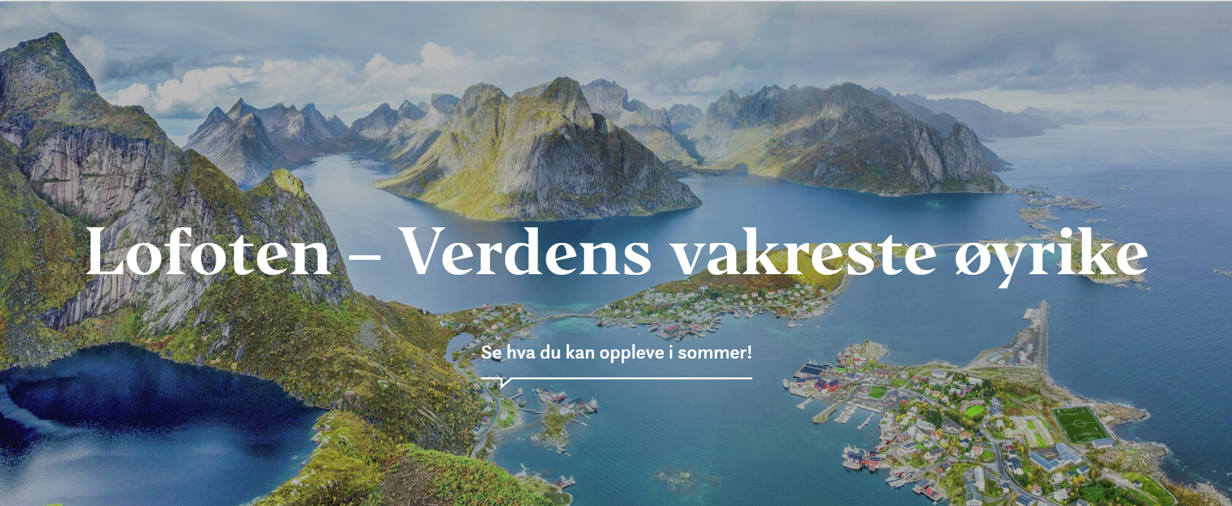

Slide 35
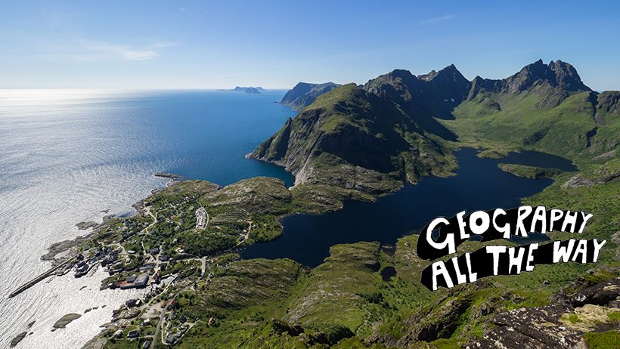

Slide 36
Environment groups therefore believe the areas off Lofoten are too sensitive for oil and gas production. As a result there is a moratorium on exploration, including geophysics, at the moment and there are moves to make the islands and much of their surrounding waters a protected UNESCO World Heritage site. It is unlikely that this area will be open for exploration for many years to come.

Slide 37
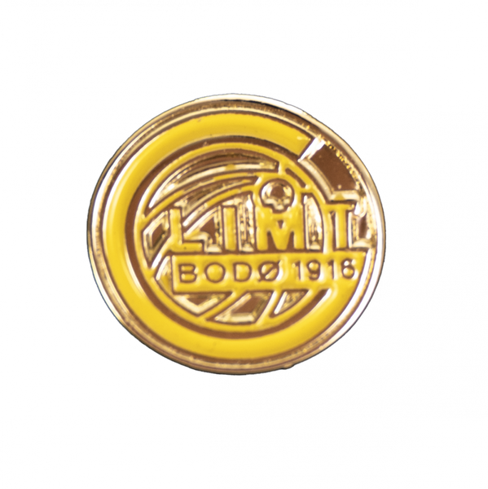
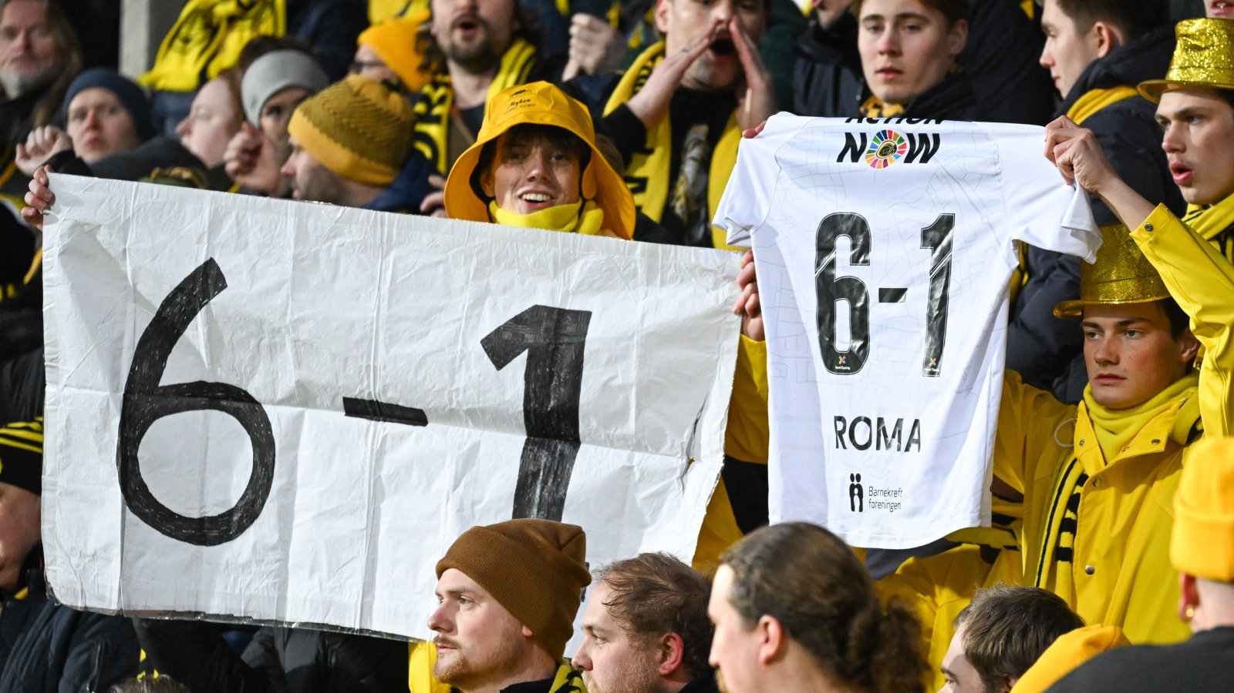
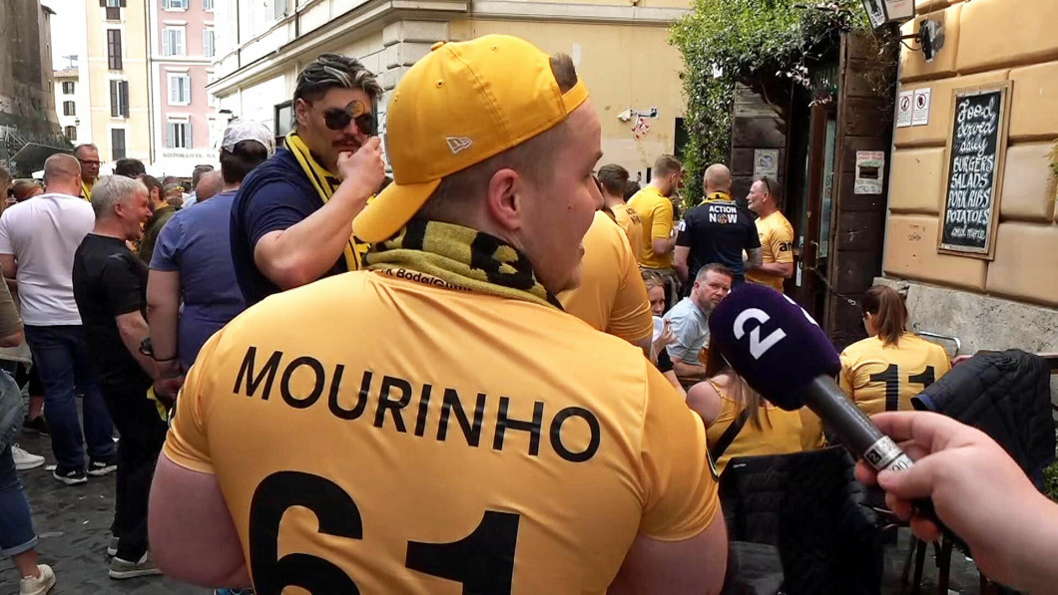

Slide 38
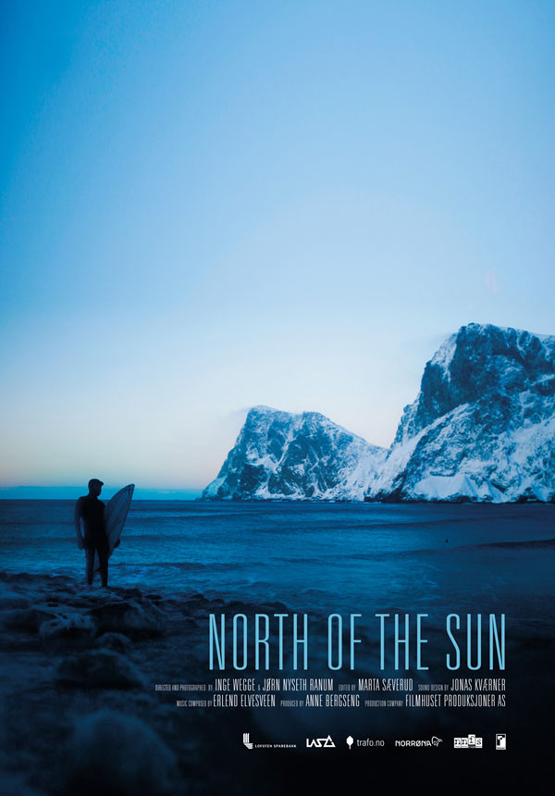

Slide 39
