Slide 1
Revision
Population
Globalisation
Tourism

Slide 2
population
S-cool population summary

Slide 3
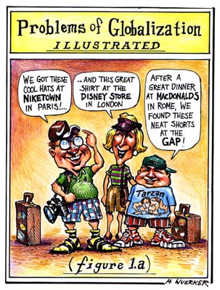
Globalisation

Slide 4
Definitions and Characteristics of Globalisation

Slide 6
Globalisation and economic activity

Slide 7
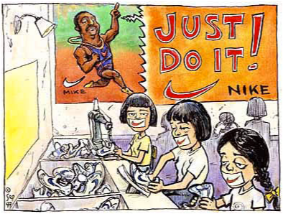
TNCs

Slide 8
ADVANTAGES-DISADVANTAGES
S-cool Industry

Slide 9
Whopper Virgins

Slide 10
Tourism
S-cool revision

