Slide 1
Power, places and networks
Unit 4

Slide 2
Power

Slide 3
Places

Slide 4
Processes

Slide 5
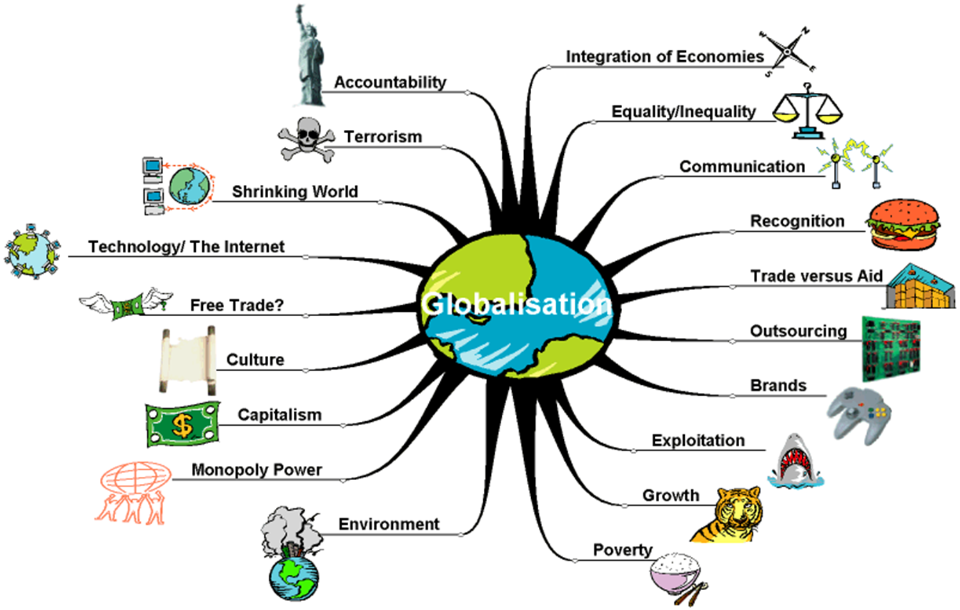

Slide 6
The International Baccalaureate (IB) syllabus uses the International Monetary Fund (IMF) definition of which is: ‘The growing interdependence of countries worldwide through the increasing volume and variety of crossborder transactions in goods and services and of international capital flows, and through the more rapid and widespread diffusion of technology.’
globalisation
The IB is an example of educational globalisation, with schools from a large number of countries following its courses. Almost 3000 schools in over 130 countries now offer IB programmes.

Slide 8
Global interactions
This phenomenon includes all of the varied economic, social, political, cultural and environmental processes that make up globalization.

Slide 9
1. Global interactions and global power

Slide 10
Globalization indices showing how countries participate in global interactions
How global
power
and influence
varies
spatially
KOF

Slide 11
Due to their greater degree of interdependence, for example with neighbouring countries, smaller countries tend to be placed higher up in this ranking than larger countries.
This leaves the largest national economies around the world in the mid-range.
The industrialised countries have gained the most from globalisation.

Slide 12
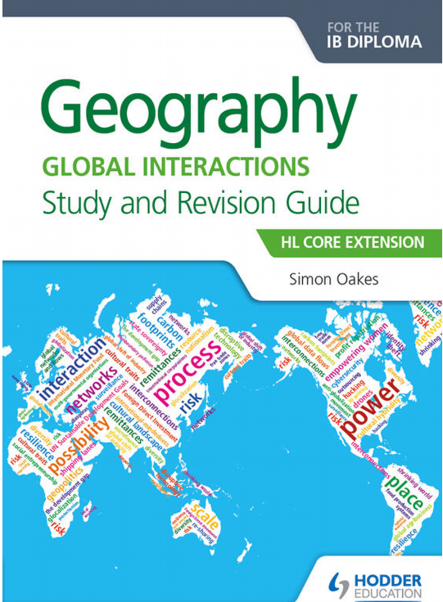
In 2015, the Netherlands was the most strongly globalised country in the world, followed by Switzerland and Sweden.
The next places in the ranking were occupied by Austria, Belgium, Denmark, France, Germany, Finland and Norway.
The first non-European countries were the United Arab Emirates in 11th place, Canada in 15th place and the United States in 23rd place.
The lowest rankings in the table were held by Eritrea, the Central African Republic, the Comoros and Sudan.
Page 3
geo41
KOF

Slide 13
Evaluation matrix (KOF Index of Globalisation)
STRAND | MEASURE | ADVANTAGE | DISADVANTAGE
ECONOMIC GLOBALISATION | Actual flows actual flows of trade, foreign direct investment and portfolio investment
 | Restrictions the restrictions applying to these flows
POLITICAL GLOBALISATION | the degree of political cooperation, measured by the number of embassies, membership of international organizations, participation in UN Security Council missions, and number of international treaties signed
SOCIAL GLOBALISATION spread of ideas, information, images and people | Data on personal contact international telephone traffic, transfers, tourism, foreign population, and international letters
 | Data on information flows Internet users, television ownership, trade in newspapers
 | Data on cultural proximity number of McDonald’s restaurants, number of Ikea shops per capita

Slide 14
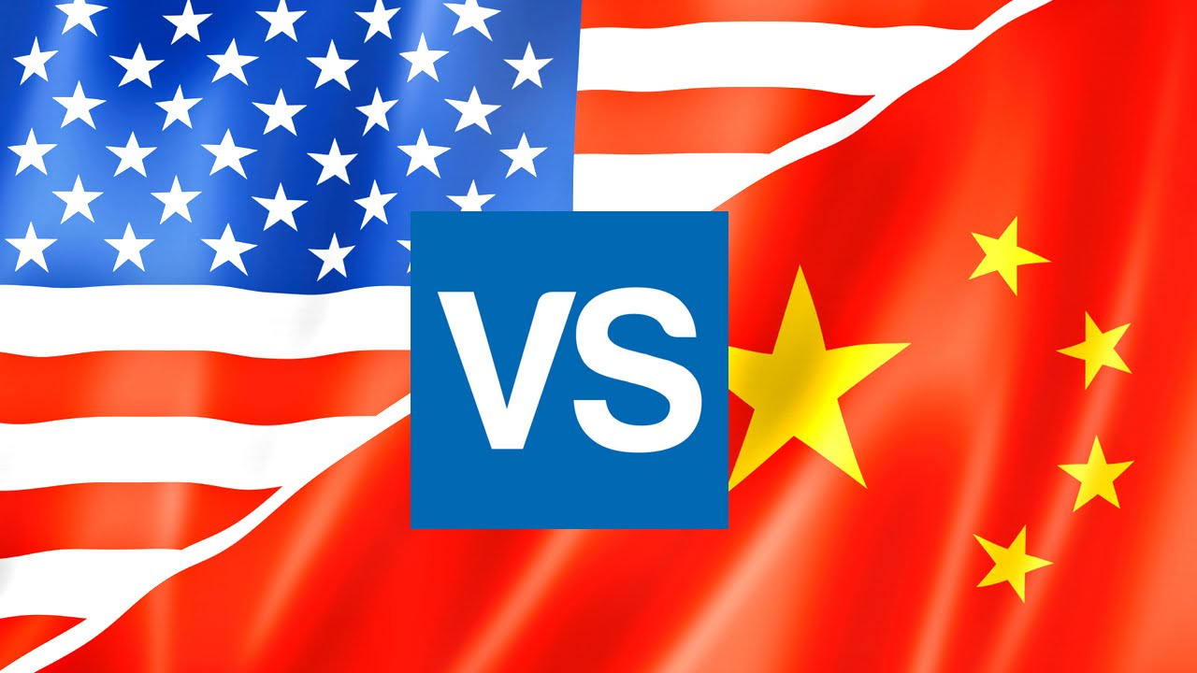
Global superpowers and their economic, geopolitical and cultural influence - Detailed examples of at least two actual or potential global superpowers

Slide 15
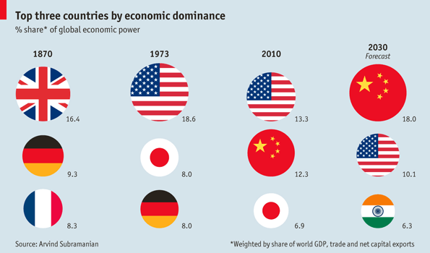
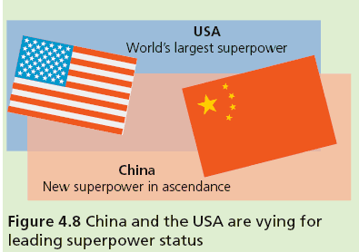

Slide 16
How different places become interconnected by global interactions
Page 7
These Are the 5 Reasons Why the U.S. Remains the World's Only Superpower

Slide 17
2. Global networks and flows

Slide 18
Powerful organizations and global groups: G7/8, G20 and Organization for Economic Cooperation and Development (OECD) groups Organization of the Petroleum Exporting Countries’ (OPEC) influence over energy policies global lending institutions, including the International Monetary Fund (IMF) and New Development Bank (NDB) Synthesis, evaluation and skills opportunities How wealthy and powerful places exist at varying scales, and how the global map is complex and subject to change Page 8
Powerful organizations and global groups

Slide 19
An overview of contemporary global networks and flows: global trade in materials, manufactured goods and services, an overview of international aid, loans and debt relief, international remittances from economic migrants illegal flows, such as trafficked people, counterfeit goods and narcotics
How different
places become interconnected by global interactions
Page 12
Geo41 Ecumene

Slide 20
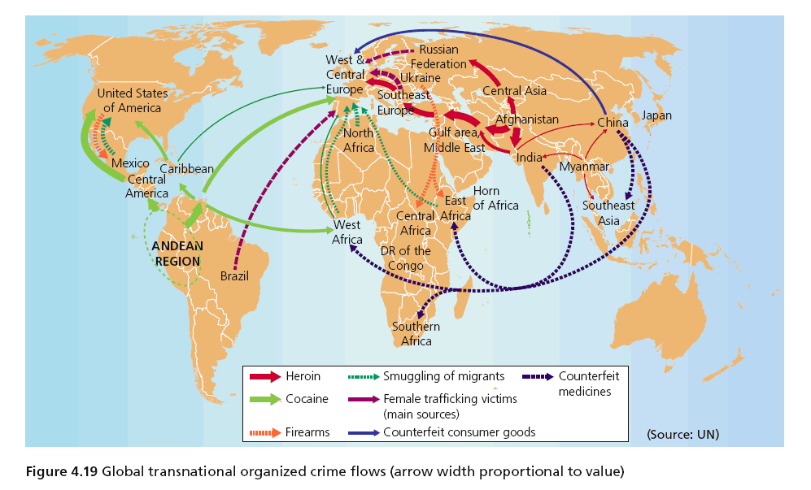

Slide 21
Foreign Direct Investment (FDI) and outsourcing by transnational corporations (TNCs), and ways in which this networks places and markets - Two contrasting detailed examples of TNCs and their global strategies and supply chains
How different
places become interconnected by global interactions
vs
Page 23

Slide 24
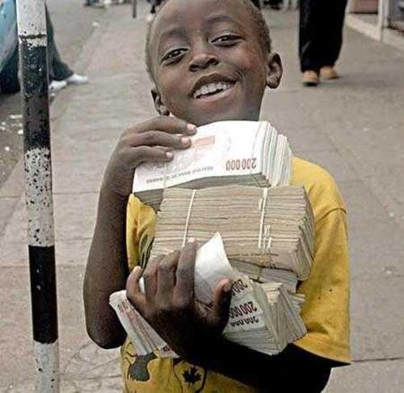
Zimbabwe 3 US Dollars Hyper Inflation

Slide 25
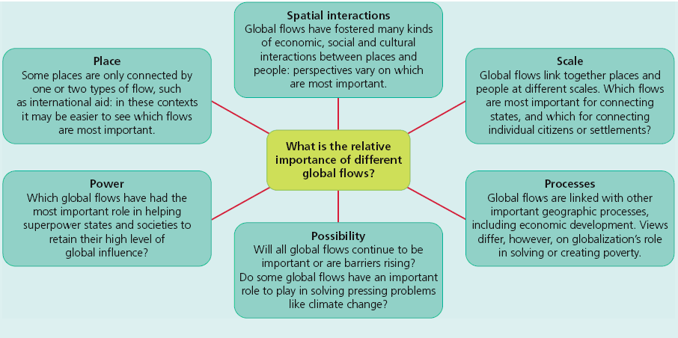
Synthesis, evaluation and skills opportunities The relative importance of different flows, and the suitability of different methods for graphically representing flows and interactions
How different
places become interconnected by global interactions

Slide 26
3. Human and physical influences on global
interactions

Slide 27
Political factors that affect global interactions: multi-governmental organizations (MGOs) and free trade zones
How political, technological and physical
processes
influence global interactions

Slide 28
Multi-governmental organizations (MGOs) comprise of a group of countries that collaborate to promote economic developmentt, maintain political stability, address and mitigate environmental challenges. Examples include trade blocs such as EU, NAFTA and ASEAN as well as international financial institutions such as WTO, IMF and the World Bank.
MGOs

Slide 29
How political, technological and physical processes influence global interactions

Slide 30
An industrial area, often near a coastline, where favourable conditions are created to attract foreign TNCs. These conditions include low tax rates and exemption from tariffs and export duties.
Special
Economic
Zone (SEZ)

Slide 31
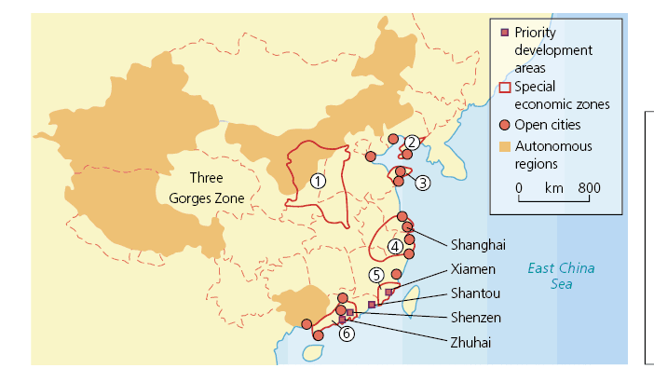
Strategically located in the Pearl River region, and adjacent to Macau and Hong Kong, Shenzhen is a principal doorway into mainland China. SEZs in China

Slide 32
Political factors that affect global interactions: economic migration controls and rules
How political, technological and physical processes influence global interactions
Page 29

Slide 33
Our “shrinking world” and the forces driving technological innovation: - changing global data flow patterns and trends
How political, technological and physical processes influence global interactions
Extension Book Handout

Slide 34
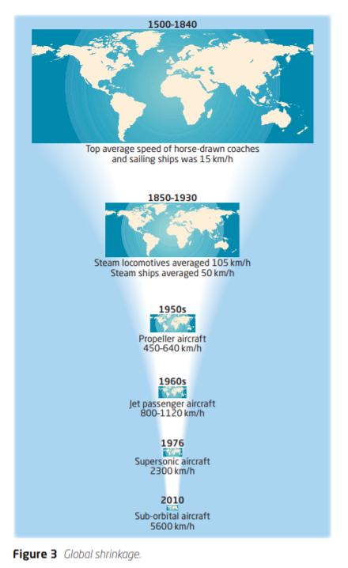
Time–space convergence

Slide 35
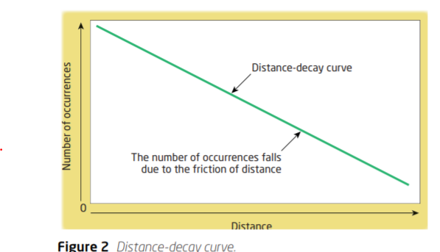
Distance-decay

Slide 38
Our “shrinking world” and the forces driving technological innovation: - transport developments over time - patterns and trends in communication infrastructure and use
How political, technological and physical processes influence global interactions
Extension Book Handout
geo41

Slide 39
Our “shrinking world” and the forces driving technological innovation: changing global data flow patterns and trends transport developments over time patterns and trends in communication infrastructure and use
How political, technological and physical processes influence global interactions

Slide 40
The influence of the physical environment on global interactions: natural resource availability the potentially limiting effect of geographic isolation, at varying scales
How political, technological and physical processes influence global interactions
Geography All the Way

Slide 41
Parts of the physical environment that are used to satisfy human needs and wants.
Natural resources

Slide 42
Also known as the paradox of plenty, refers to the paradox that countries with an abundance of natural resources (like fossil fuels and certain minerals), tend to have less economic growth, less democracy, and worse development outcomes than countries with fewer natural resources.
Resource curse
Page 37
The link between development, globalization and natural resources in DR Congo.

Slide 43
Geographic isolation at varying scales

Slide 44
Geographic isolation at varying scales .
Landlocked
Remote island nations

Slide 45
Synthesis, evaluation and skills opportunities How processes that influence spatial interactions are interlinked in complex ways that accelerate globalization
How political, technological and physical processes influence global interactions

