Slide 1
Chapter 6
Employment structures

Slide 2
Students should be able to
- Classify industries into primary, secondary and tertiary.
- Describe and explain how the proportions employed in primary, secondary and tertiary industries differ in LEDCs and MEDCs and may change with time and level of development.

Slide 3
How can employment be classified? There are four types of jobs
Primary jobs involve getting raw materials from the natural environment e.g. mining, farming and fishing.
Secondary jobs involve making things (manufacturing) e.g. making cars and steel.
Tertiary jobs involve providing a service e.g. teaching and nursing.
Quaternary jobs involve research and development e.g. IT.

Slide 4
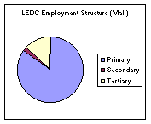
LEDC
• High primary (farming)
• Little mechanisation on farms
• Little manufacturing
• In early stages of economic development
• Informal service sector in the cities is quite strong

Slide 5
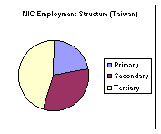
NIC
Strong manufacturing sector
Many transnationals move to NICs to take advantage of cheap labour and land

Slide 6
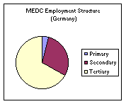
MEDC
• Farming mechanised
• Automation of manufacturing or transfer of manufacturing to NICs
• Very strong tertiary sector with large numbers employed in health, education and tourism
• Growth of jobs in the knowledge economy based on the processing of knowledge and information using telecommunications

Slide 7
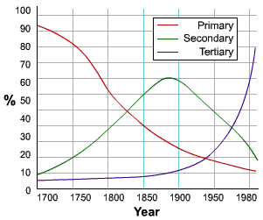
How do employment patterns change over time?

Slide 8
Primary: decreases
• Mechanisation of farms reduces need for farm workers. Rural workers migrate to the urban areas
• Raw materials become exhausted leading to loss of mining jobs
• Rural depopulation of farmers in MEDCs. Workers prefer the better paid and less physically demanding jobs in the tertiary sector

Slide 9
Secondary: increases at first, then decreases
• Industrialisation initially requires a large secondary workforce
• Factory jobs eventually replaced by automation
• Manufacturing industries increasingly move from MEDCs to NICs where land and labour are cheaper

Slide 10
Tertiary: increases
• Large and growing informal service sector in urban areas of LEDCs as workers migrate from the countryside
• As a country develops, demand grows for services such as health, education and tourism
• Strong growth in MEDCs of jobs in the knowledge economy based on the processing of knowledge and information using telecommunications
• Increase in producer services for manufacturing industry, e.g. market research

Slide 11
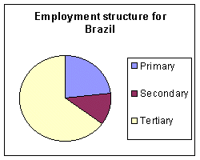
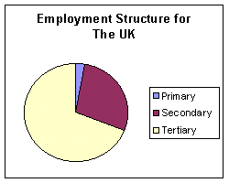
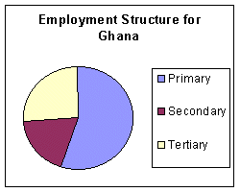

Slide 12
Chapter 7
Farming

Slide 13
Students should be able to
- Describe in general terms the main features of an agricultural system: inputs, processes and outputs.
- Describe the influence of natural and human inputs on the processes and outputs of the two agricultural systems listed in the Syllabus [a large-scale system of commercial farming and small-scale subsistence farming]. Studies should include natural inputs (relief, climate and soil) and human inputs (economic, social and sometimes political). Their combined influences on the scale of production, methods of organisation and the products of each system should be studied. Reference may be made to an example such as plantation agriculture or extensive commercial cereal farming or extensive livestock production etc., to illustrate a large-scale system of commercial farming. Examples such as intensive subsistence rice cultivation or shifting cultivation etc. could profitably illustrate a system of small-scale subsistence farming. Other illustrations might be selected rather than the above. In each case reference should be made to a detailed case study.
- Recognise the causes and effects of food shortages. Shortages of food may be related to natural problems such as soil exhaustion, drought, floods, tropical cyclones, pests, disease etc. There should be an awareness of the effects of these natural problems on selected areas within LEDCs. Economic and political factors and their effects upon food shortages should be noted, for example low capital investment, poor distribution /transport difficulties, wars etc. The effects of food shortages in encouraging food aid and measures such as those of the 'Green Revolution' to produce more food should also be considered.

Slide 14
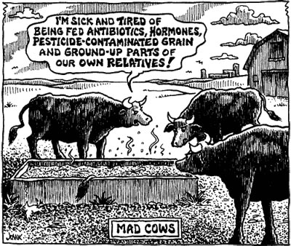

Slide 15
Farming is a system of Inputs, Processes and Outputs
Inputs - Labour, land, capital, seeds, climate, soil, relief, machinery, fertilisers, water
Processes - Ploughing, spraying, weeding, harvesting, sowing, milking, feeding, irrigation
Outputs - Crops, pollution, agricultural waste, profits, meat, wool, lambs, calves

Slide 16
Farming types
Arable - Growing crops
Pastoral - Rearing animals
Mixed - Growing crops and rearing animals
Subsistence - Producing just enough for your own and your families consumption
Commercial - Producing enough to sell to make a profit
Nomadic - Moving from one place to another especially with herds of animals
Sedentary - Farming in one place
Intensive - High levels of input into a small area producing high yields
Extensive - Low inputs over a large area providing low yields

Slide 17
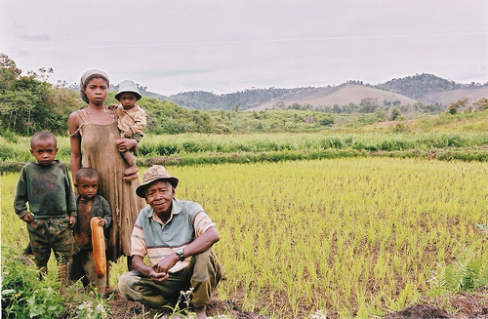
Subsistence farming

Slide 18
World Distribution of Rice Farming
Most of the world's rice is grown in South and South East Asia. Ideal rice growing conditions:
Growing season five months with temperatures above 21 °C
Annual rainfall over 2000 mm
Flat land to allow water to stay on the fields
Impermeable soil so water will not drain away

Slide 19
Green Revolution
By the 1960s an increase in population and subsistence farming in LEDCs meant it was essential to increase food production.
The Green Revolution:
Introduced new farming methods to LEDCs in the 1960s
It was an attempt to increase food production via intensive farming
New high yielding varieties (HYVs) were developed; these were genetically engineered seeds
Used machinery to plough fields
Set up irrigation schemes and projects

Slide 20
Successes and Failures of the Green Revolution:
Yields increased
Farmers had a better standard of living
New industries making fertilisers developed in rural areas

Slide 21
FAILURES
Many farmers can not afford machinery and fertilisers required
Machinery increases rural unemployment
Rural to urban migration increased
Increased yields make prices fall Farmers become poorer

Slide 22
Common Agricultural Policy
The Common Agricultural Policy (CAP) governs farming in all countries in the EU. After World War II Europe wanted to be agriculturally self-sufficient. Therefore, farmers were guaranteed a price for their crops regardless of market forces. This protected the farmers from cheap imports from abroad. EU farmers ended up producing too much food; this led to food mountains.

Slide 23
Set-aside
Set-aside is a scheme by which the EU pays farmers a subsidy to leave land uncultivated to reduce overall production. In order to continue receiving EU subsidies all farms with over 20 hectares of land must now leave 15 % of it as set-aside.

Slide 24
Desertification
Desertification is when a desert gradually spreads to the surrounding areas of semi-desert.
Case study: Sahel.

Slide 25
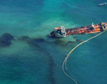
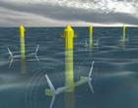
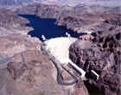
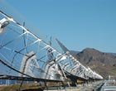
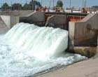
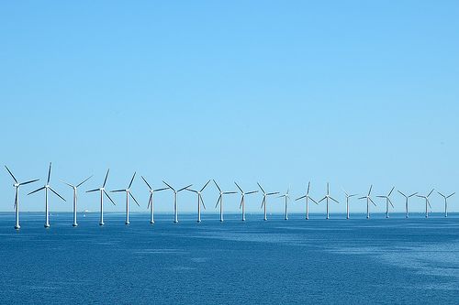
Chapter 8
Resources (energy)

Slide 26
Students should be able to
- Describe the significance of fuelwood in LEDCs and of non-renewable fossil fuels in terms of their availability in certain areas and in terms of the contribution made by coal, oil, natural gas and wood in supplying vast amounts of energy.
- Describe the growing significance of renewable energy supplies [geothermal, wind, running water, solar, biogas] to reduce dependence upon fossil fuels, to alleviate the world's energy crisis, and to offer opportunities for the development of alternative energy sources.
- Describe the factors influencing the siting of different types of electrical power stations with reference to those listed in the Syllabus [thermal, hydro-electric power, nuclear].
- Describe the uses made of water for agriculture, domestic and industrial demand. Candidates should also recognise that in certain areas there are water shortages which impact upon the local people and the potential for development. This leads to competition for the use of the available water resources and requires careful management.
All these aspects would benefit from the selection of appropriate case studies.

Slide 27
Advantages and disadvantages of energy production by renewable resources
Good for the environment
Will not run out
Non polluting
Expensive
Needs large input for little output – not as efficient
A blot on the landscape

Slide 28
Advantages and disadvantages of energy production by non-renewable resources
Cheap
Readily available
High density and relatively small size of energy transfer device makes more efficient
Cause pollution
Will run out
Nuclear fuels cause dangerous waste material

Slide 29
Nuclear Power: e.g. France, Sellafield (UK)
Clean because it does not produce air pollution.
Use little raw materials and there is still a large supply of uranium.
Can be made more efficient by research.
Dangerous because of a possible meltdown or leakage of radiation.
Difficult to dispose of waste materials (dangerous to local people).
It is still non-renewable.
The power stations cost much more than others.

Slide 30
Coal: e.g. Yorkshire
Can be efficient.
Non-renewable and there are only enough supplies to last 300 years.
The cost of production of electricity from coal has increased.
There is competition from oil which is cheaper.
Causes air pollution.
The remaining coal is difficult to get to (costs too much to mine it).
Miners are in danger of losing their jobs.

Slide 31
Oil e.g. North Sea
Cleaner than coal.
Relatively safe to use.
Easy to transport and to distribute.
Does not create as much air pollution as coal.
Prices fluctuate.
Dangers of spillage.
Expensive to find.

Slide 32
Hydroelectric Power: e.g. Kielder Water (UK)
Clean
Non pollution
Power stations are cheap to run
Can cause flooding.
Dams must be built as well as power stations which cost a lot.
Takes up large areas of land.

Slide 33
Wave power: (Severn Estuary)
Cheap to run.
Clean and non polluting.
Only available to coastal areas.
Affects marine life.
Unreliable for continuous power.
The technology needs development.

Slide 34
Nauru

Slide 35
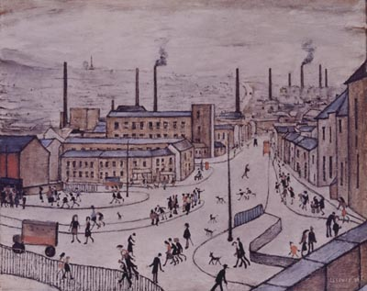
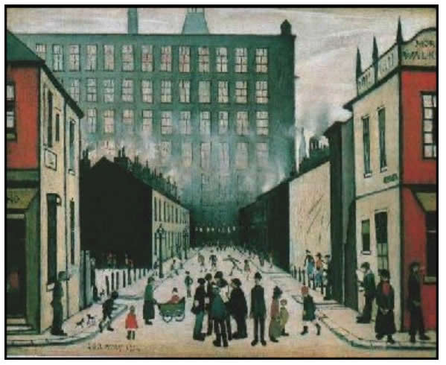
Chapter 9
Industry

Slide 36
How can industry be classified?
There are 4 types of industry:
Primary industry involves getting raw materials e.g. mining, farming and fishing.
Secondary industry involves manufacturing e.g. making cars and steel.
Tertiary industries provide a service e.g. teaching and nursing.
Quaternary industry involves research and development industries e.g. IT.

Slide 37
Quaternary industries are involved in research and development.

Slide 38
Candidates should be able to
- Describe and identify the influence of inputs on the processes and outputs (products and waste) of industrial systems.
- Describe and explain the factors influencing the distribution and location of high technology industries and one other manufacturing/ processing industry. Distribution should be studied on a global/ national scale. Study should also be made of particular zones and/or industrial plants with respect to locational and siting factors.

Slide 39
Industrial Systems
Factories have inputs, processes and outputs.
Inputs can be the raw materials need to make something. Inputs can also be labour, buildings, capital and machinery.
Processes are the things which go on within the factory. This is usually the manufacturing of goods. It can also be design and research - anything needed to make something.
Outputs are the things which leave the factory. This can include the finished product, profit or even waste.

Slide 40
What affects the location of industry?
There are many factors
which affect the location of industry.
These include
raw materials,
labour supply,
markets,
transport and
Government Policy.

Slide 41
Location of Industry
There are many factors that affect the location of industry. The type of industry will determine which factors will influence the location. For example industries which use heavy and bulky materials will locate close to the raw materials e.g. an iron and steel works will locate close to iron ore and coal. If the raw materials are imported, a coastal location may be chosen.

Slide 42
Changes in the location of the iron and steel industry in the EU: What are the changes?
In the past iron and steel factories were located close to raw materials such as iron and coal. They are now mostly located close to deep-water ports
Why have the changes occurred?
Raw materials have become exhausted. Raw materials are now imported from other countries.
Deepwater ports needed as raw materials are transported using bulk carriers
Close to water needed in the cooling process
Plants are now integrated
Governments and EU Policy has affected the location of modern steel works.
Case Study = Port Talbot, South Wales

Slide 43
Car Production Sites in the UK
Location factors:
Access to markets
Skilled labour
Foreign investment
Government Initiatives
Political Decisions
Case Study = Rover, Longbridge
Case Study = Nissan, Sunderland

Slide 44
High Tech Corridor in the M4
M4 Corridor – Area of development for Hi-Tech industry along the M4 Motorway spanning from London to Bristol (South Wales).
Location factors:
Accessibility
Good road links (M4)
Good railway links
Heathrow Airport provides links to Europe and the rest of the World
Research opportunities
Close to science parks & Universities
Footloose – therefore they can locate freely
Government Incentives
Attractive Countryside
Marlborough Downs – attractive environment favoured by educated people employed in Hi-Tech industry.

Slide 45
Multinational Companies
Examples include and
MNCs or Multinational companies are large companies which are located in more than one country.

Slide 46
Problems
Problems | Solutions
Cold might freeze the oil and stop it flowing | Heat oil to 80°c before it enters the pipeline
The mountains in the south are in an arctic earthquake zone | Make pipeline flexible to move with the earth
Construction work could destroy the frozen tundra | Strict rules for construction teams – rewards if they do well
Pipeline may block the Caribou migration | Build stilts 3 metres high

Slide 47
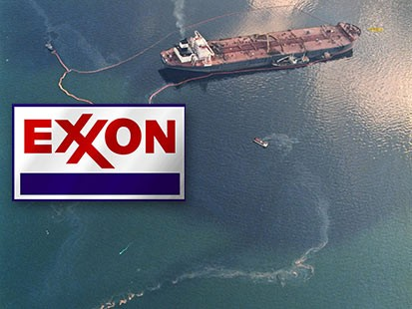
Exxon Valdez

Slide 48
Impact – Prudhoe Bay
What? | Where? | When? | Why? | So What?
Oil tanker – Exxon Valdez ran aground on rocks. | The Alaska coast, near Valdez | March 1989 | The tanker was 50 km off course | Total of 12 million gallons of crude oil were spilt damaging large areas of the land and marine ecosystem of Alaska. It contaminated 1900 km of coastline. The local wildlife and fishing industry was devastated. The clean up operation cost $1 Billion

