Slide 1
Resources (energy)

Slide 2
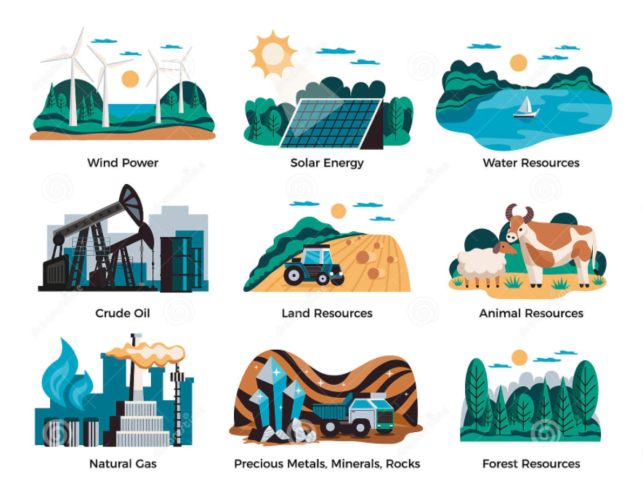
Natural
Resources
Non-renewable and
renewable (continuous
and sustainable)

Slide 3
The world
Most of the world's electricity is generated using non-renewable energy sources such as fossil fuels (coal, gas and oil ) and radioactive substances such as uranium. Burning fossil fuels remains the easiest and most cost- effective way of producing electricity. However, it does cause some damage to the environment.

Slide 4
Coal, oil and gas are called "fossil fuels" because they have been formed from the fossilised remains of prehistoric plants and animals.
At the time this page was written, they provided around 72% of the world's electrical power, and
85% of the world's total energy demands (including heating, transport, electricity generation and other uses).

Slide 5
Coal is crushed to a fine dust and burnt.
Oil and gas can be burnt directly.

Slide 6
Advantages and disadvantages of energy production by non-renewable resources
Advantages
Readily available
Very large amounts of electricity can be generated in one place using coal, fairly cheaply. Transporting oil and gas to the power stations is easy. Gas-fired power stations are very efficient. A fossil-fuelled power station can be built almost anywhere, so long as you can get large quantities of fuel to it.
Disadvantages
Cause air pollution
Will run out
Nuclear fuels cause dangerous waste material.

Slide 7
Fission is a nuclear reaction in which an atomic nucleus splits, or fissions, into fragments with the release of large amounts of energy in the form of heat and radiation.

Slide 8
How it works

Slide 10
Fission is a nuclear reaction in which an atomic nucleus splits, or fissions, into fragments with the release of large amounts of energy in the form of heat and radiation.

Slide 11
World Energy Balance

Slide 12
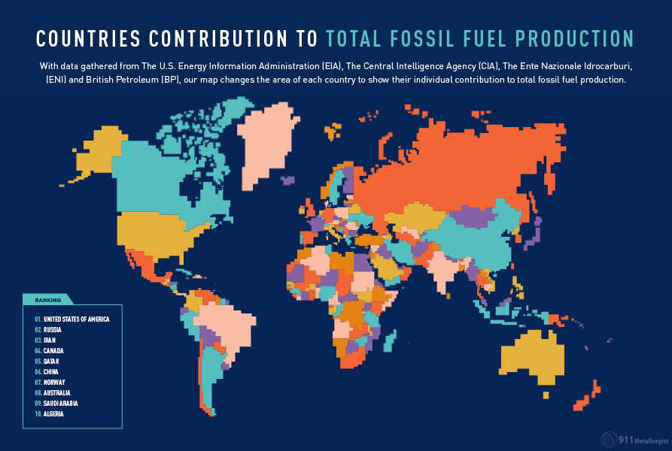

Slide 13
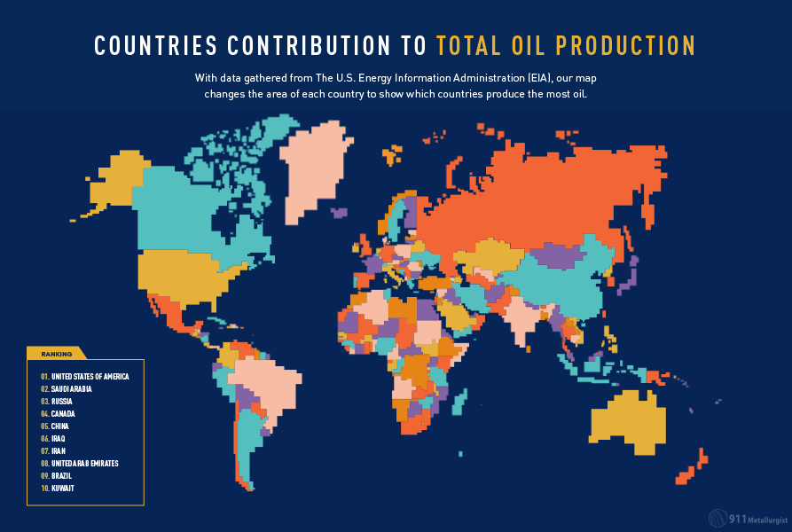

Slide 14
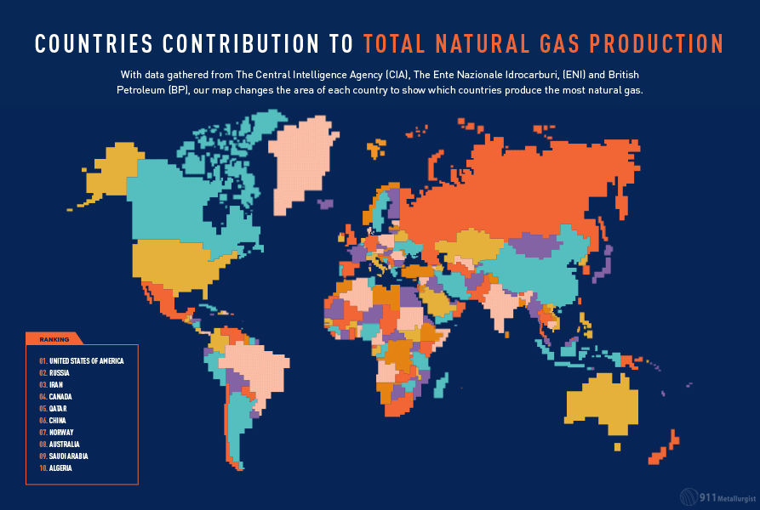

Slide 15
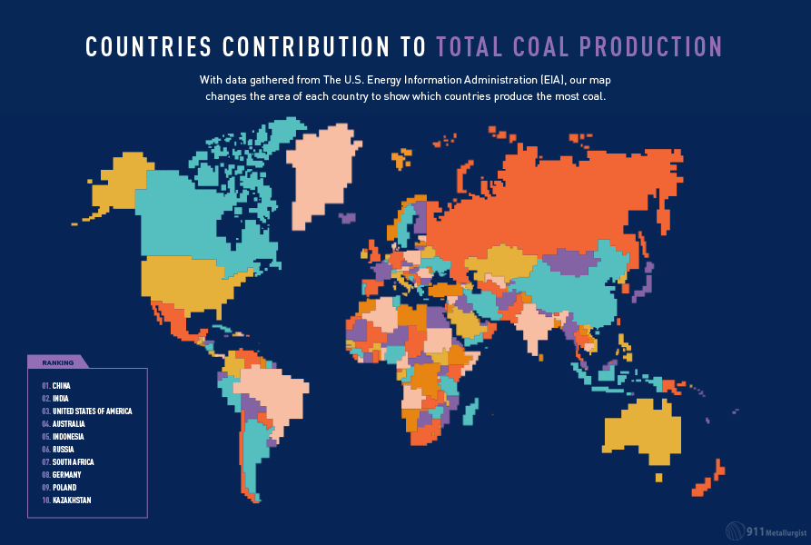

Slide 16
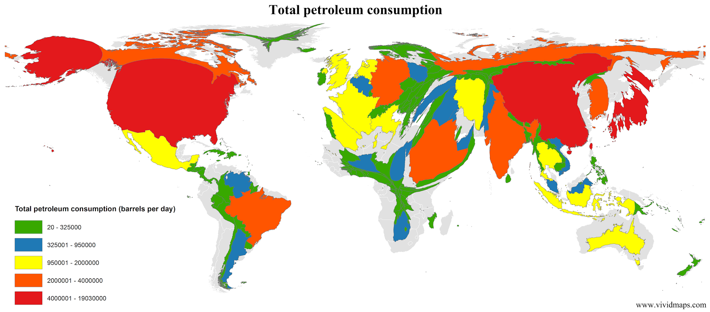

Slide 18
COP26
The pledges on greenhouse gas emissions on the table at the Cop26 climate summit in Glasgow would limit global temperature rises to below 2C, the first time the world has been on such a trajectory, according to research.
Plans by India, the world’s third biggest emitter, have made a sizeable difference to the global temperature estimate, research by the University of Melbourne has found.
If its commitments and those of other nations at the talks are fulfilled, temperatures would probably rise by about 1.9C above pre-industrial levels. That would be lower than the 2C upper limit but higher than the 1.5C lower limit set out in the 2015 Paris climate agreement.

Slide 19
India’s headline target, of reaching net zero by 2070, was criticised by some at Cop26 as being lacklustre and less than should be expected from a major country. Developed countries are being asked to meet net zero by 2050 at the latest, and developing countries by 2060. China has set 2060 as its goal but some analysts say the world’s biggest emitter is likely to meet it sooner.
India also pledged an increase in clean energy by 2030 and a reduction in emissions intensity of its economy by 45% by the same date. It reckons its emissions are likely to peak by 2040, but some of its actions are dependent on receiving suitable finance.
Australia is one of the countries yet to come up with emissions-cutting plans in line with a 1.5C limit. Meinshausen said: “Australia put forward a net zero pledge that is not conditional, but simply hollow and hard to believe, as it is not underpinned by any credible policies at home.”

Slide 20
Indias klima- og miljøminister Bhupender Yadav gikk ikke med på at all kullkraft uten fangst og lagring av CO2 må «fases ut», men krevde å endre dette til «fases ned».
Ettersom slutterklæringen krever full enighet, gikk de øvrige landene motvillig med på dette.
Slutterklæringen oppfordrer også å fase ut subsidieringen av fossil energi, og oppfordrer alle land til å skjerpe sine nasjonale klimamål innen utgangen av neste år. Håpet er at dette skal holde liv i Parisavtalens mål om å begrense den globale oppvarmingen til 1,5 grader.

Slide 21
Dødsdom
Andre er langt mindre fornøyde med utfallet fra klimatoppmøtet, blant dem mange utviklingsland som vil bli hardt rammet av klimaendringer og som hadde håpet på løfter om mer økonomisk støtte til tiltak for å motvirke ødeleggelser.
– Forskjellen mellom 1,5 og 2 grader er en dødsdom for oss, slo Maldivenes klima- og miljøminister Aminath Shauna fast.
– Resultatet av klimatoppmøtet i Glasgow er langt fra det verdens fattige land trenger for å stå imot klimakrisen, sier Utviklingsfondets leder Jan Thomas Odegard.

Slide 22
Nuclear power - hot potato in Glasgow 2021

Slide 23
To world leaders,
"Betrayal."
That's how young people around the world describe our governments' failure to cut carbon emissions. And it's no surprise.
We are catastrophically far from the crucial goal of 1.5°C, and yet governments everywhere are still accelerating the crisis, spending billions on fossil fuels.
This is not a drill. It's code red for the Earth. Millions will suffer as our planet is devastated -- a terrifying future that will be created, or avoided, by the decisions you make. You have the power to decide.
As citizens across the planet, we urge you to face up to the climate emergency. Not next year. Not next month. Now:
Keep the precious goal of 1.5°C alive with immediate, drastic, annual emission reductions unlike anything the world has ever seen.
End all fossil fuel investments, subsidies, and new projects immediately, and stop new exploration and extraction.
End 'creative' carbon accounting by publishing total emissions for all consumption indices, supply chains, international aviation and shipping, and the burning of biomass.
Deliver the $100bn promised to the most vulnerable countries, with additional funds for climate disasters.
Enact climate policies to protect workers and the most vulnerable , and reduce all forms of inequality.
We can still do this. There is still time to avoid the worst consequences if we are prepared to change. It will take determined, visionary leadership. And it will take immense courage -- but know that when you rise, billions will be right behind you.
It can feel incredibly hard to keep hope alive in the face of inaction. But my hope lies in people -- in the millions of us who are rising to save the future . It lies in our marches, in our dogged determination to keep fighting, and in our trembling voices as we speak truth to power. My hope is rooted in action and fuelled by a love for humanity and our most beautiful earth. It's what keeps me absolutely convinced that we can do this. And we must do this. Together.
With fierce hope, Greta from Sweden, with Vanessa from Uganda, Dominika from Poland, Mitzi from the Philippines, youth activists across the world, and the whole team at Avaaz

Slide 24
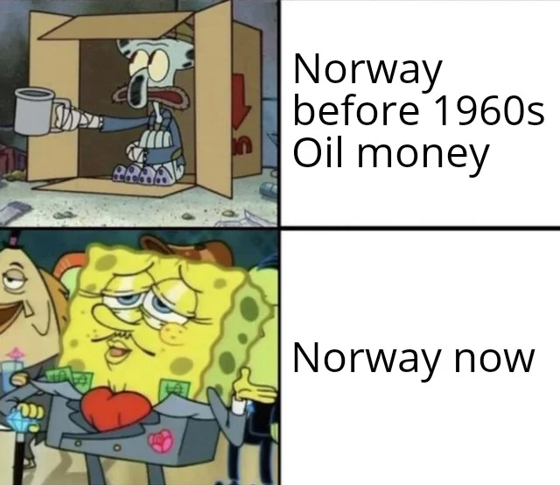
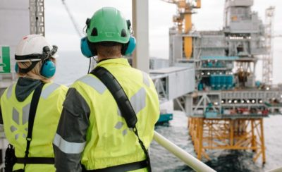
It’s business as usual for Norway’s oil
Norway’s own Equinor and other oil
companies will be free to keep drilling and
pumping up oil and gas under the new
government, despite all the international
calls for restraint in an effort to at least
slow down climate change.
PHOTO: Equinor

Slide 25
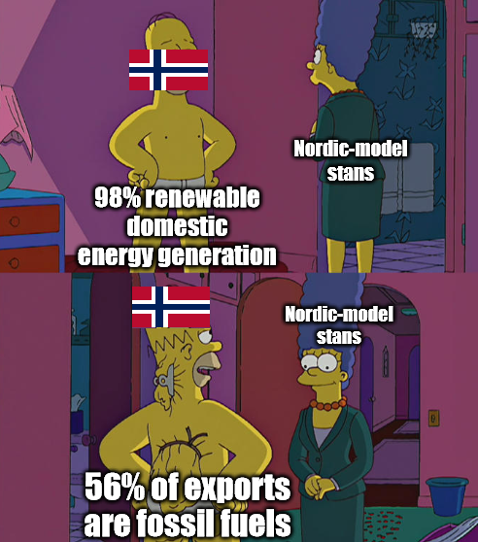
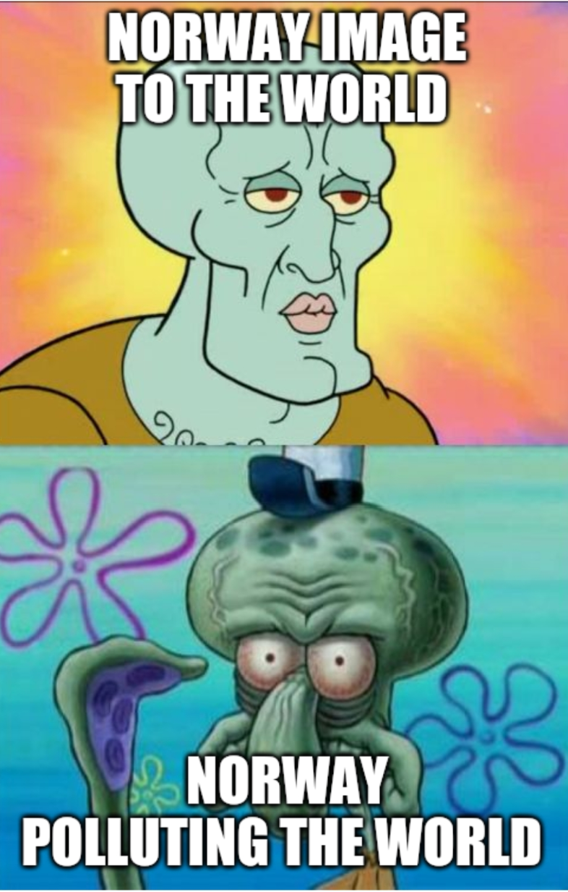
What about oil?
Norway’s contradiction is a fascinating one. It is a country that is a world leader in the development of electric technology that is directly contributing to the global decline of oil – one of the country’s biggest exports and the key source of its immense wealth.

Slide 26
Despite ongoing government support for the country’s fossil fuel industry, Norway has also been trying to have its cake and eat it too by also being a strong supporter of environmentally friendly policies within the country and globally.

Slide 27
12,000,000,0000,000

Slide 28
Advantages and disadvantages of energy production by renewable resources
Advantages
No air pollution
Will not run out
Disadvantages
Expensive
Needs large input for little output – not as
efficient
A blot on the landscape (visual, noise pollution?)

Slide 29
Barth Eide om krav til oljestans: – Hjelper ikke særlig mye

Slide 30
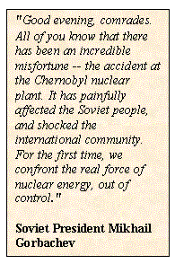
Chernobyl Nuclear Disaster
On April 25th -26th, 1986 the World's worst nuclear power accident occurred at
The Chernobyl accident killed more than 30 people immediately, and as a result of the high radiation levels in the surrounding 20-mile radius, 135,00 people had to be evacuated.
Chernobyl in the former USSR (now Ukraine). The Chernobyl nuclear power plant
located 80 miles north of Kiev had 4 reactors and whilst testing reactor number
4 numerous safety procedures were disregarded.
At 1:23am the chain reaction in the reactor became out of control creating
explosions and a fireball which blew off the reactor's heavy steel and concrete lid.

Slide 31
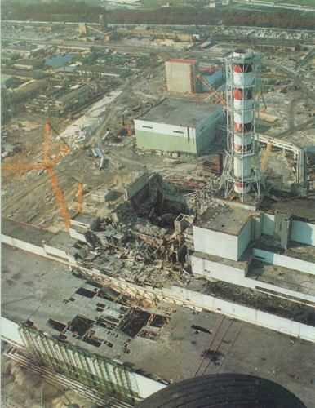

Slide 32
Children are the main victims of the reactor disaster

Slide 33
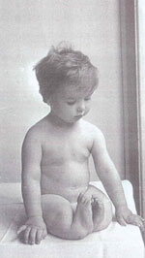

Slide 34
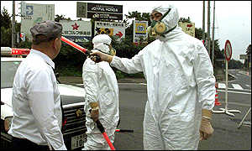
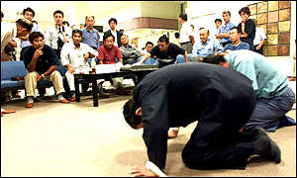
World: Asia-Pacific
Japan's vital but unpopular nuclear industry
The Tokaimura fire was the latest in a series of accidents
Japan's nuclear industry faces its most serious crisis following the radiation leak at the Tokaimura uranium-processing facility.
This is only the latest in a series of accidents, fires and leaks which have undermined public confidence in the safety of nuclear power.
According to the Japanese Science and Technology Agency, tests on two of those closest to the leak suggest they were subjected to radiation "equivalent to exposure to an atomic bomb".
The statement will provide an unpleasant echo for the Japanese public, which is still greatly influenced by the dropping of atomic bombs on Hiroshima and Nagasaki in World War Two.

Slide 35
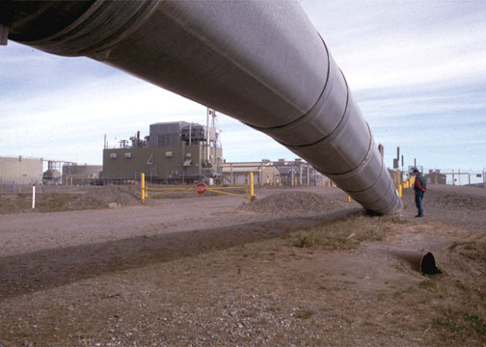
Trans-Alaska Pipeline Prudhoe Bay J Valdez

Slide 36
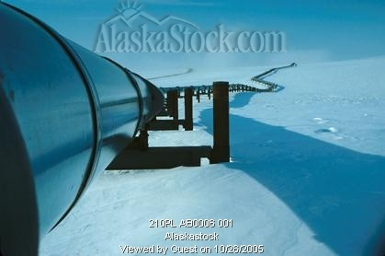

Slide 38
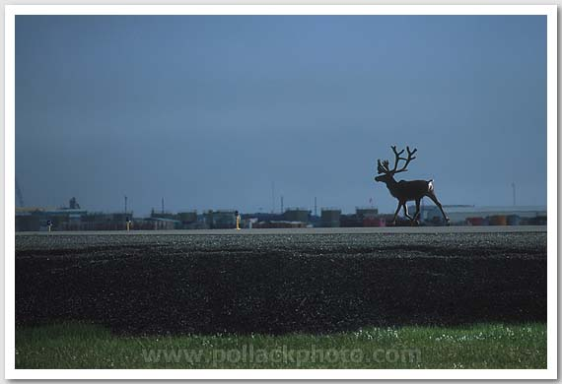

Slide 39
23 March, 1989

Slide 40
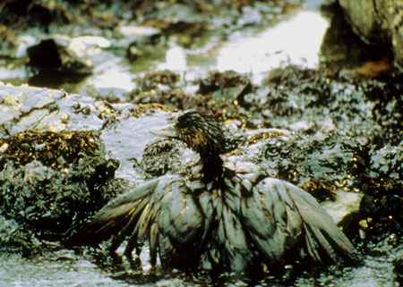
Exxon Valdez Oil Spill Images

Slide 44
In 2012, the Three Gorges Dam in China took over the #1 spot of the largest hydroelectric dam (in electricity production), replacing the Itaipú hydroelectric power plant in Brazil and Paraguay.
Itaipu (Brazil and Paraguay)

Slide 45
Itaipù
The production record of the year 2000 - 93.4 billion kilowatt-hours (kWh) - was responsible for the supply of 95% of the electric power consumed in Paraguay and 24% of the total demand in the Brazilian market.

Slide 46
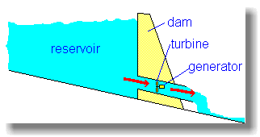
How it works A dam is built to trap water, usually in a valley where there is an existing lake. Water is allowed to flow through tunnels in the dam, to turn turbines and thus drive generators.

Slide 47
Biomass
Most of the world's population uses biomass as a primary fuel source: wood, straw or other dry plant-based residues are burned for heating or cooking purposes. Over and above this traditional use, the technique makes it possible today to make valuable use of "modern" biomass - waste from the timber and food processing industries, household waste, etc. - to produce heat or electricity.
Examples of biomass applied to energy generation
"traditional" biomass:
Wood
Vegetable residues
Animal residues
"modern" biomass:
Firewood commercialised or cut and burned for own uses
Sawdust, bark, deadwood, branches, etc.
Agricultural and food processing waste
Energy recovery from municipal waste and from residues from the transforming industries and food industries.

Slide 48
Community biogas plant at Methan in Gujarat, India Total families presently being benefitted with biogas plants 176 no. Daily dung feeding 4 Tractor Trolleys (8.0 to 8.5 tonnes per day) Total gas supply hours / day 5- 6 hours per day Slurry / manure production per year average 1920 tonnes per annum Annual firewood saving 72.75 tonnes/ year

Slide 49
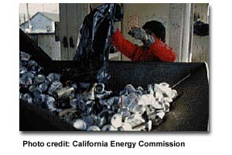
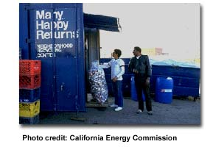
Recycling
To make all of our newspapers, aluminum cans, plastic bottles and other goods takes lots of energy.
Recycling these items -- grinding them up and reusing the material again -- uses less energy than it takes to make them from brand new, raw material.
So, we must all recycle as much as we can.

Slide 50
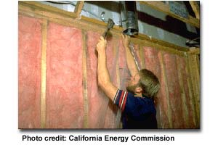
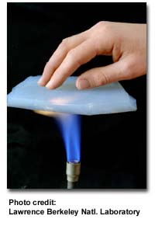
In your home, you can save energy by turning off appliances, TVs and radios that are not being used, watched or listened to.
You can turn off lights when no one is in the room.
By putting insulation in walls and attics, we can reduce the amount of energy it takes to heat or cool our homes.
Insulating a home is like putting on a sweater or jacket when we're cold...instead of turning up the heat.
The outer layers trap the heat inside, keeping it nice and warm.
New space-age materials are being developed that insulate even better. This person's fingers are protected by Aerogel Insulation Material created by the Lawrence Berkeley National Laboratory. The person cannot even feel the flame.

Slide 51
Recycling
To make all of our newspapers, aluminum cans, plastic bottles and other goods takes lots of energy.
Recycling these items -- grinding them up and reusing the material again -- uses less energy than it takes to make them from brand new, raw material.
So, we must all recycle as much as we can.

Slide 52
The Ocean Bottle

Slide 53
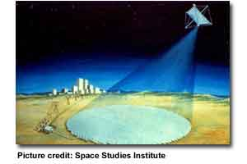
Solar Power Satellites
One suggestion for energy in the future is to put huge solar power satellites into orbit around the earth. They would collect solar energy from the sun, convert it to electricity and beam it to Earth as microwaves or some other form of transmission. The power would have no greenhouse gas emissions, but microwave beams might affect health adversely. And frequent rocket launches may harm the upper atmosphere. This idea may not be practical for another century; if at all.
The picture on the right is an early and simple drawing of how a space solar power satellite would beam energy to electrical power grid on Earth.

Slide 54
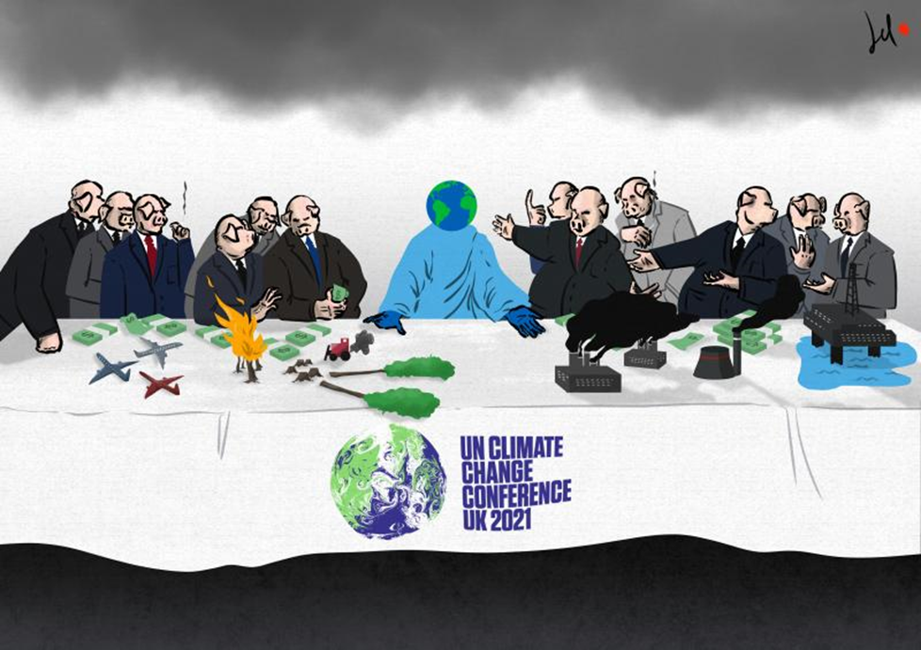

Slide 55
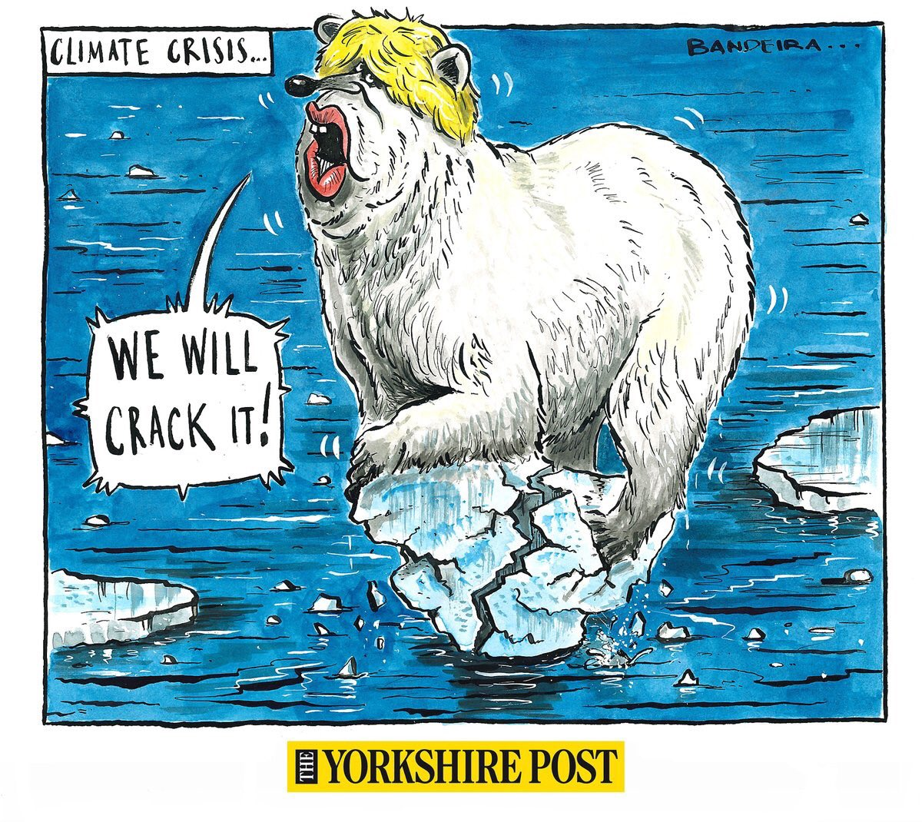
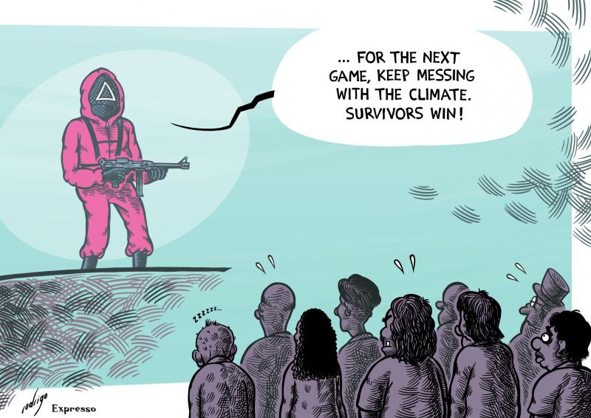
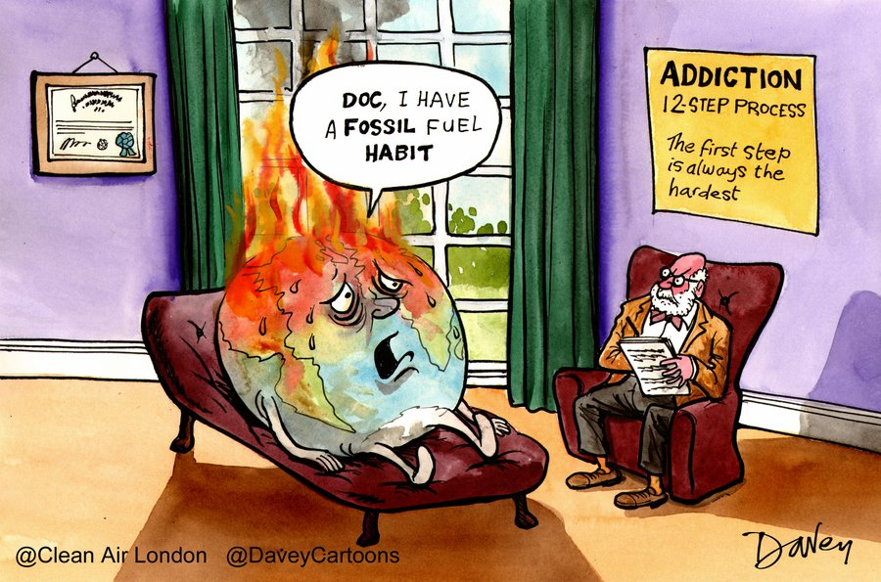
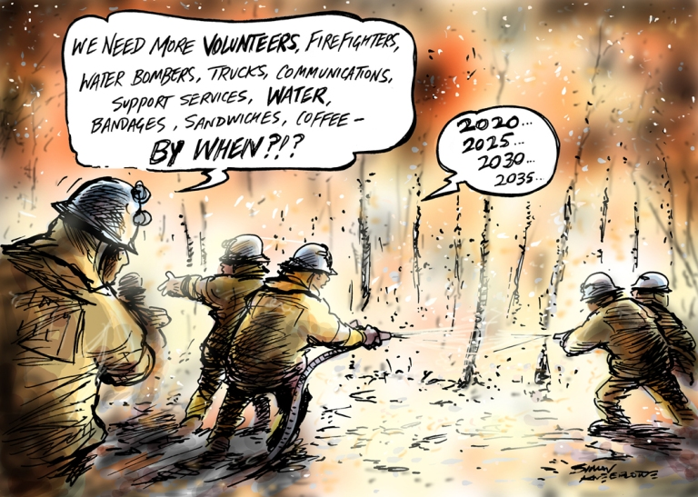
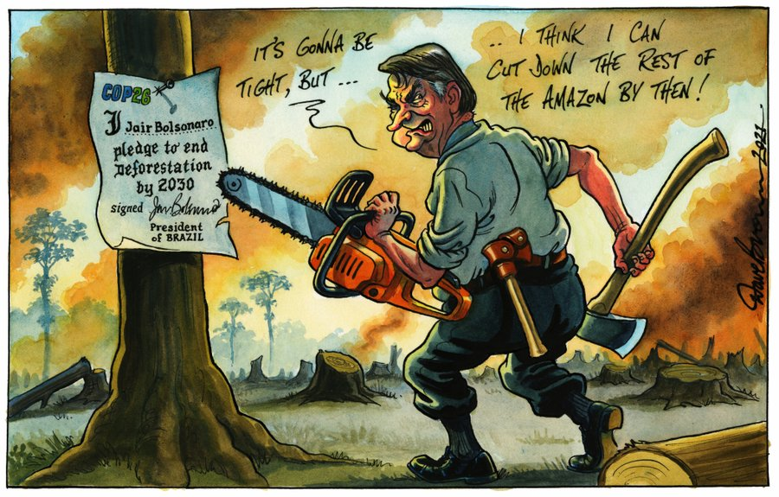
Mercury
Jupiter
Mercury is the smallest planet
Jupiter is the biggest planet
Venus
Mars
Venus has a beautiful name
Despite being red, Mars is cold

Slide 56
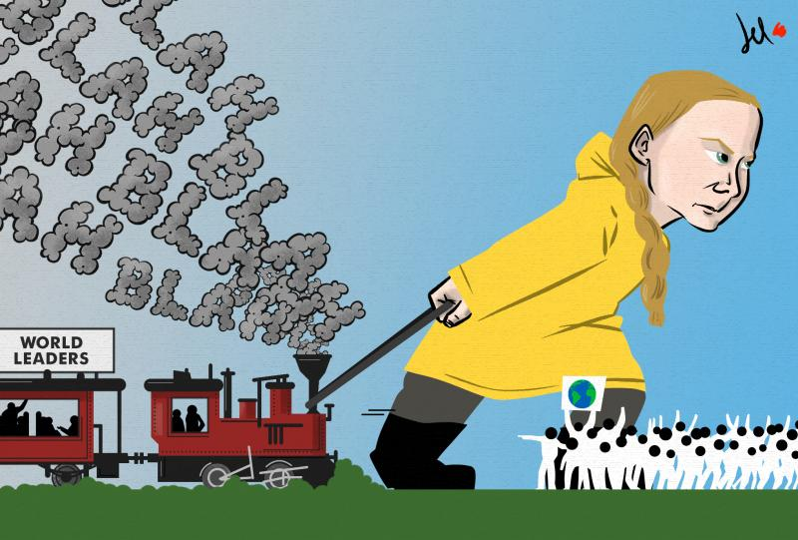
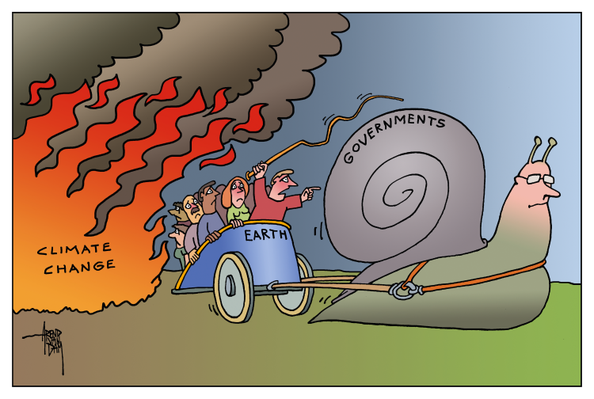
—Someone Famous

Slide 57
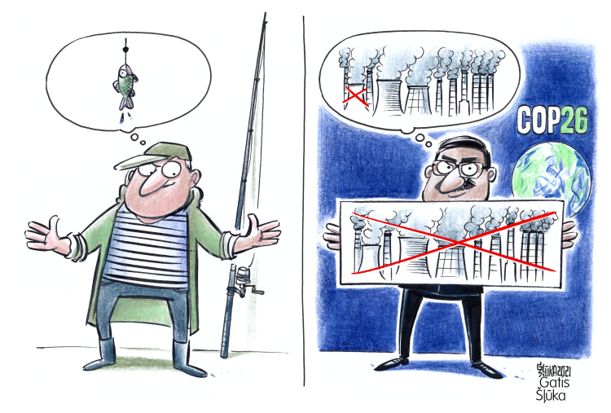

Slide 58
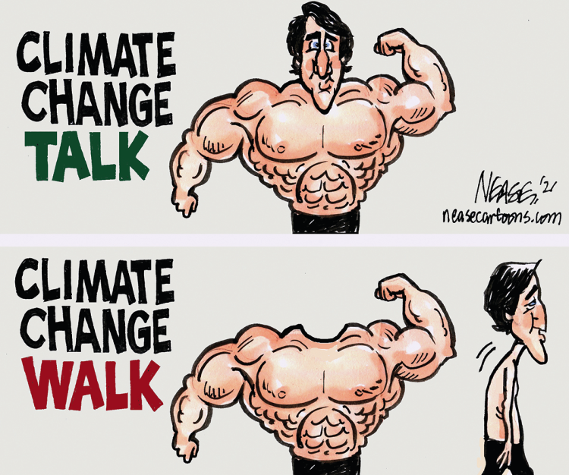

Slide 59
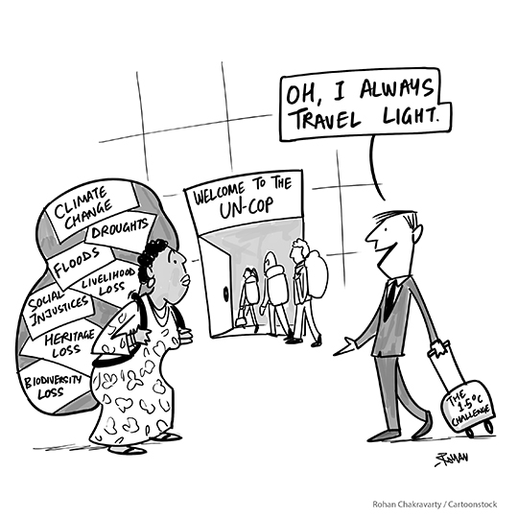

Slide 60
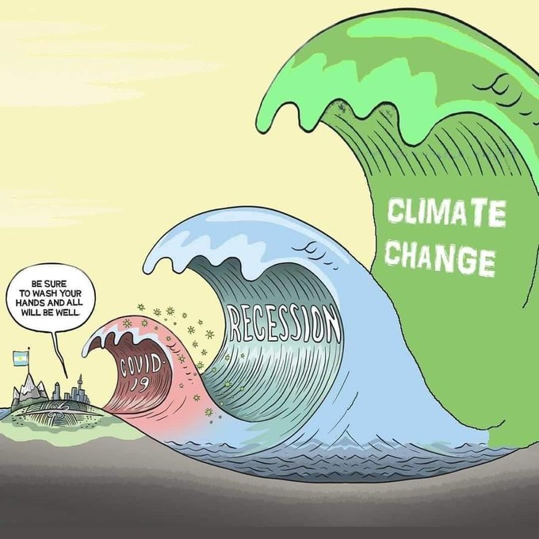

Slide 61
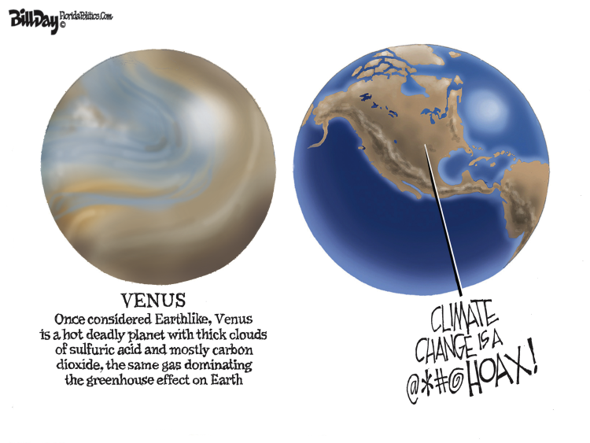

Slide 62
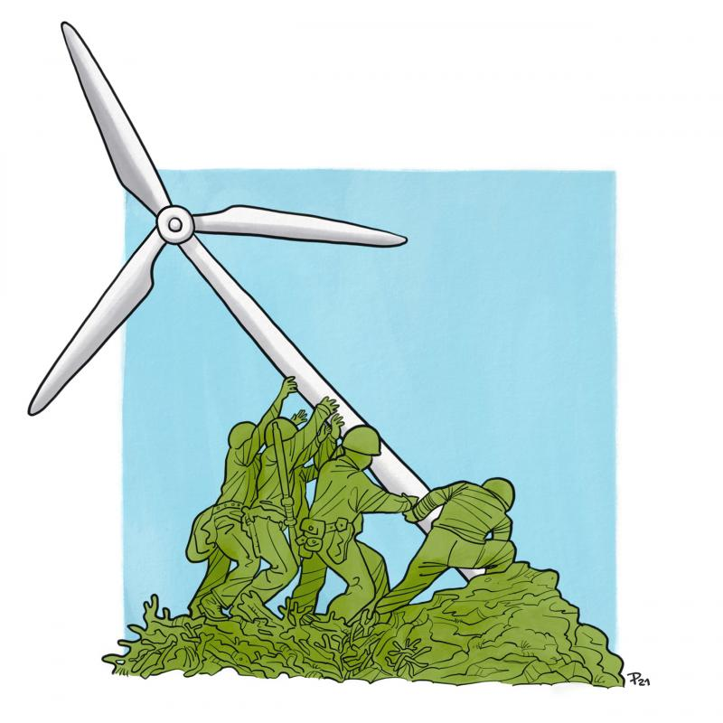

Slide 63
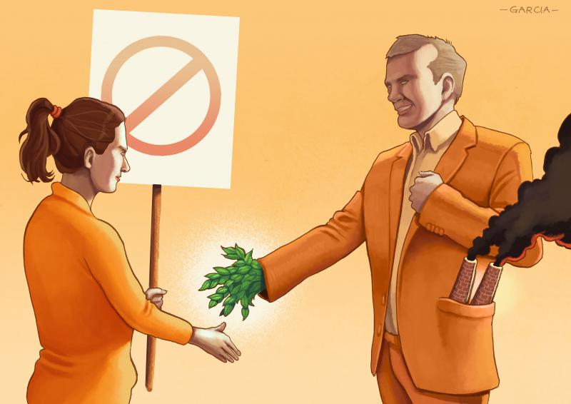

Slide 64
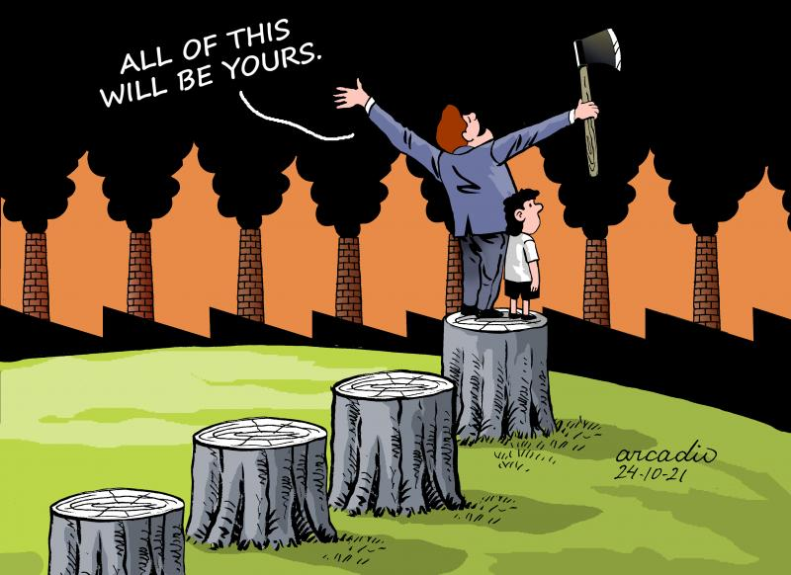

Slide 65
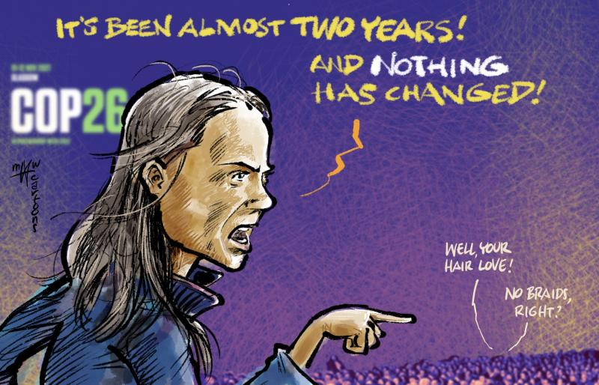

Slide 66
Ap vil bruke oljefondet til å redde klimaet
Climate change dominates elections in oil-rich Norway
Norway’s Energy Policies: Caught Between ‘Black Gold’ and Green Ambitions?

Slide 67
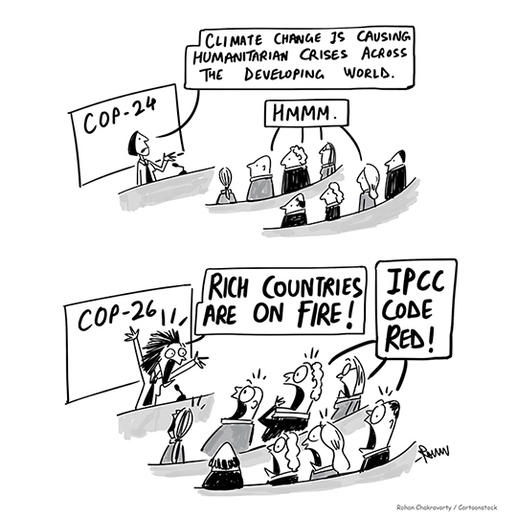
“

Slide 68
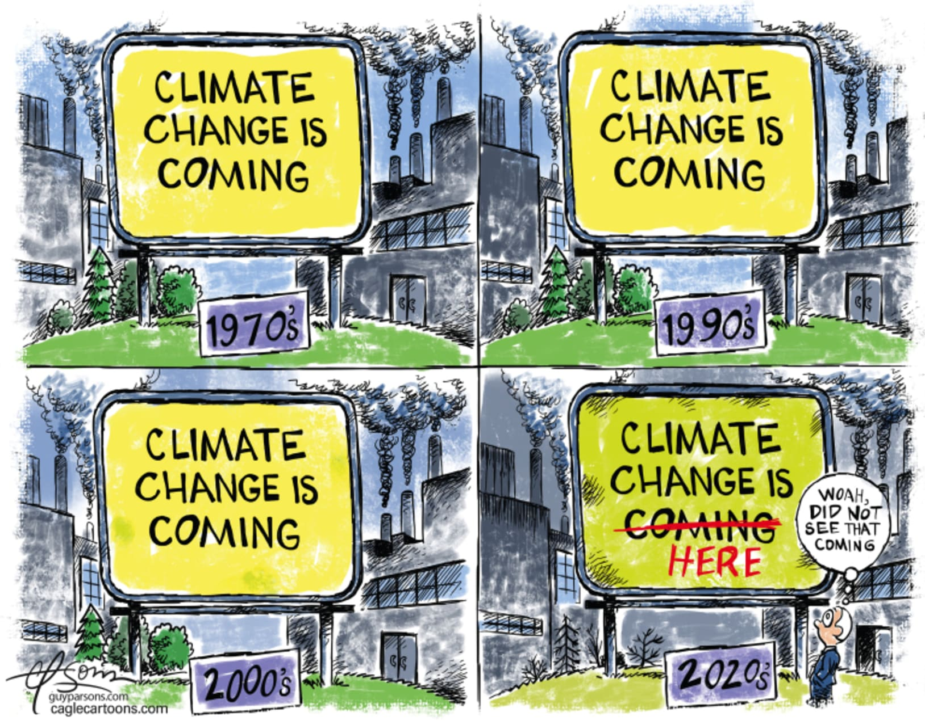

Slide 69
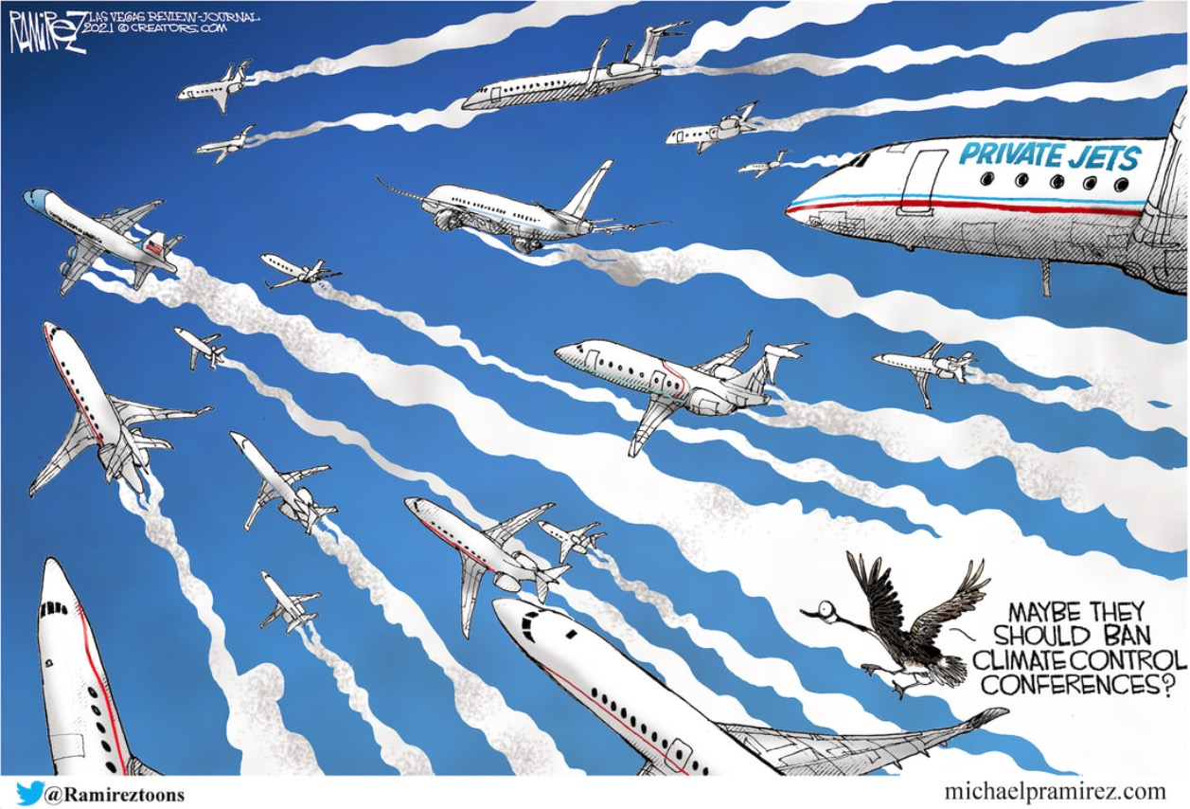
400

Slide 70
