Slide 1
Changing Population
Population and Economic Development Patterns

Slide 2
A conceptual and contextual approach

Slide 3
Geography concepts

Slide 5
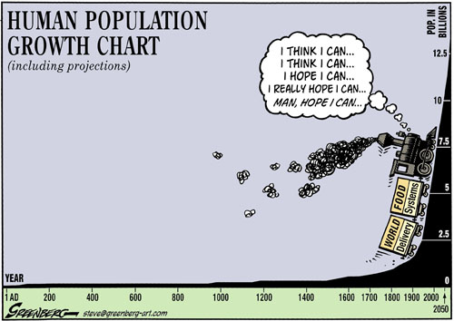

Slide 6
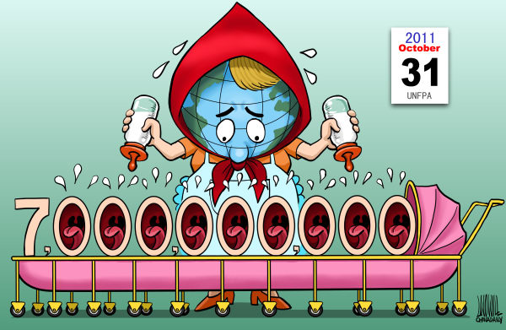

Slide 9
1. Population and economic development patterns

Slide 10
World Clock

Slide 12
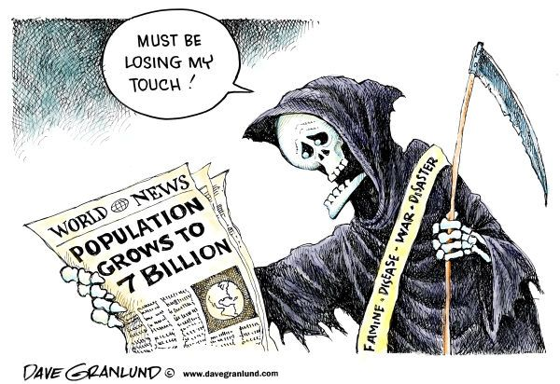

Slide 13
How population varies between places
Physical and human factors affecting population distribution at the global scale

Slide 14
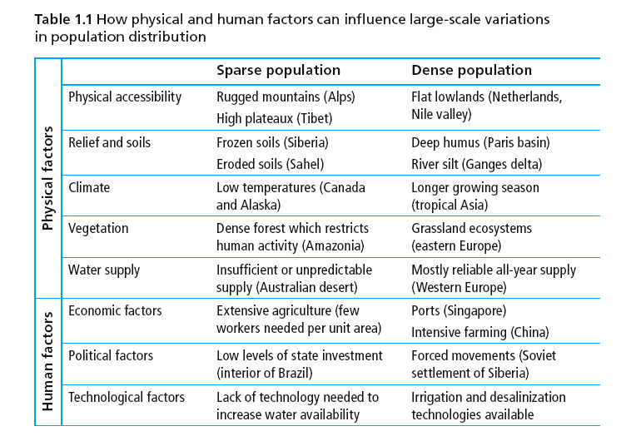

Slide 15
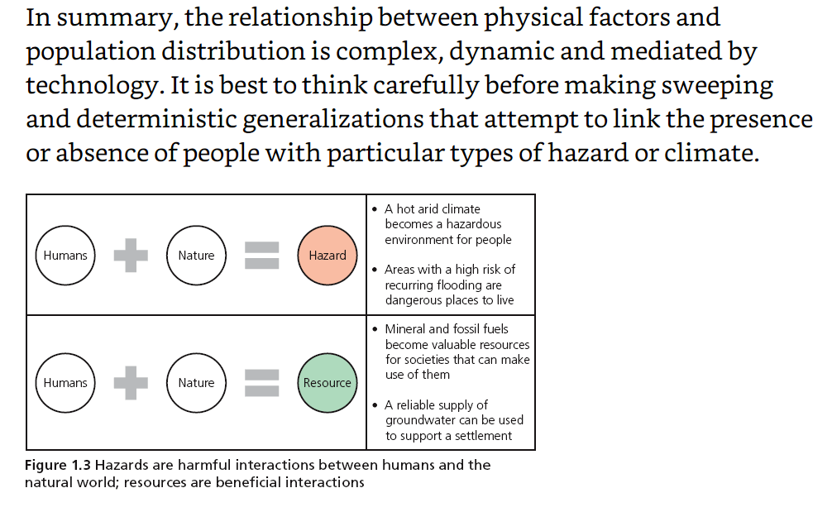

Slide 17
T
terminology

Slide 18
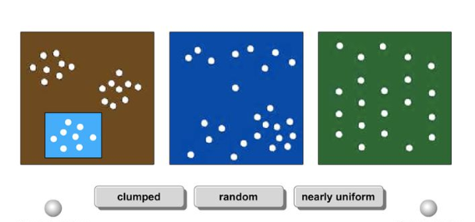
Population distribution
The way in which people are spread out across the Earth’s surface.
Example:
1114 present Pin Code of the world.
1125 Pin Code 2050

Slide 19
GNI
GDP + net income from abroad
(income from Norwegians abroad – income from foreigners in Norway)

Slide 20
Population density
The number of people living within a specified area.
Example:
Norway
14 people per square km of land area.

Slide 21
Lorenz curve
A diagrammatic expression of the extent to which a distribution is unequal.

Slide 22
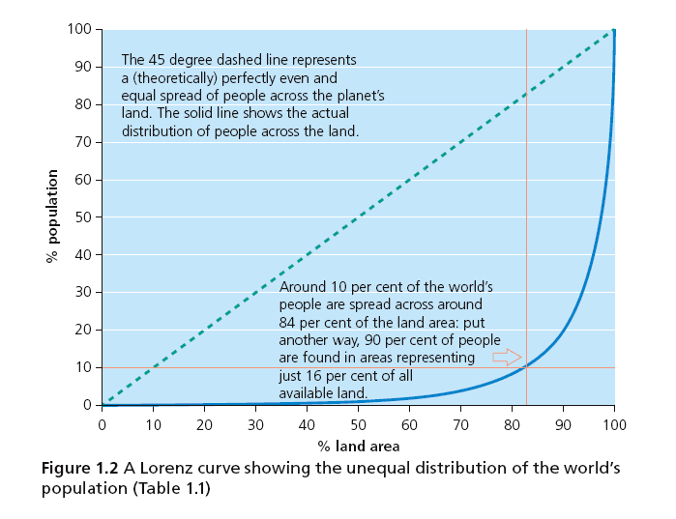

Slide 23
Arid
A climate whose precipitation is less than 250 mm annually.

Slide 24
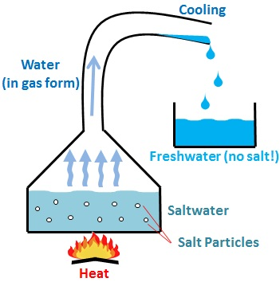
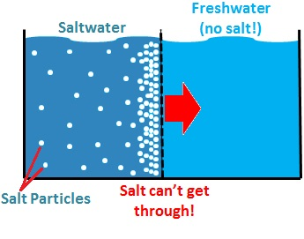
Desalinization
The removal of salt water and other minerals from seawater.

Slide 25
Key terminology

Slide 31
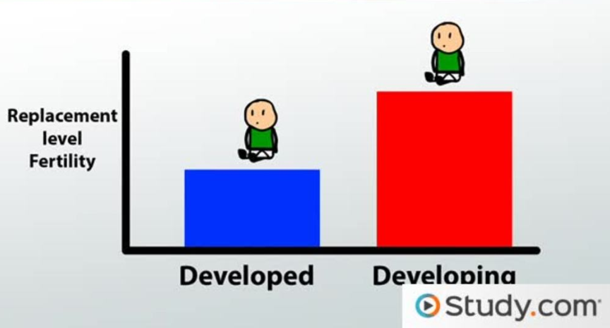
Why 2.1 children?
Replacement level

Slide 33
How population varies between places
Global patterns and classification of economic development:
low-income countries
middle-income countries and emerging economies
high-income countries

Slide 34
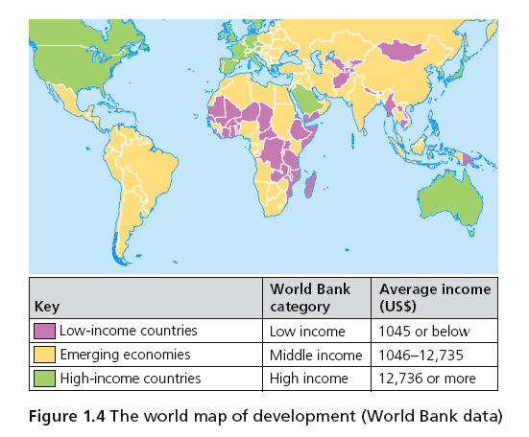
The World Bank currently divides economies into four income groupings (2018):
Low ($1,005 or less) Mozambique, Afghanistan
Lower-middle ($1,006 and $3,955) Bangladesh, India
Upper-middle ($3,956 and $12,235) Brazil, Mexico
High ($12,236 or more) Norway, USA
Income is measured using gross national income (GNI) per capita, in U.S. dollars, converted from local currency.

Slide 35
GNI
Gross national income is the sum of a nation's gross domestic product and the net income it receives from overseas.

Slide 39
How population varies between places
Population distribution and economic development at the national scale, including voluntary internal migration, core-periphery patterns and megacity growth
• Two detailed and contrasting examples of uneven population distribution

Slide 41
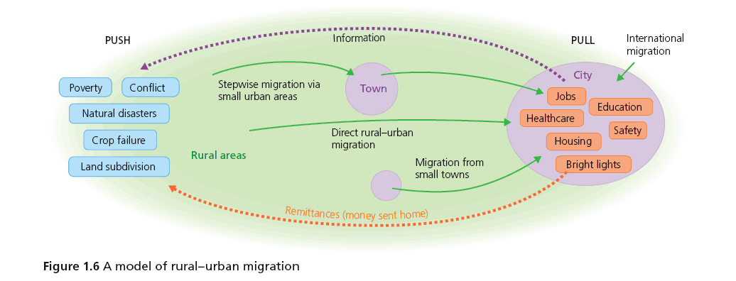

Slide 43
How population varies between places
Population distribution and economic development at the national scale, including voluntary internal migration, core-periphery patterns and megacity growth
• Two detailed and contrasting examples of uneven population distribution
USA and China
(pages 8 and 9 in your textbook)

Slide 44
Disparities in China
By looking at the map to the right showing GDP per capita of China's provinces, it is fairly clear that the east of China is a lot wealthier than the centre and the west of China. There are a number of human and physical factors that have led to these disparities. Physical Factors: Large areas of the north of China are covered in the Gobi Desert, because of desertification the desert is actually growing south further into China. Deserts are arid places incapable of supporting large scale agriculture and therefore populations. The south west of of China is largely covered by the Tibetan Plateau (The Himalayas) making agriculture, transportation, construction and communication all hard. On the other hand the south east has an extensive coastline make transport and communications much easier. The land in the east is also much flatter, has a good water supply (Yangtse and Yellow River) and is more fertile making farming, transport and construction all easier.

Slide 45
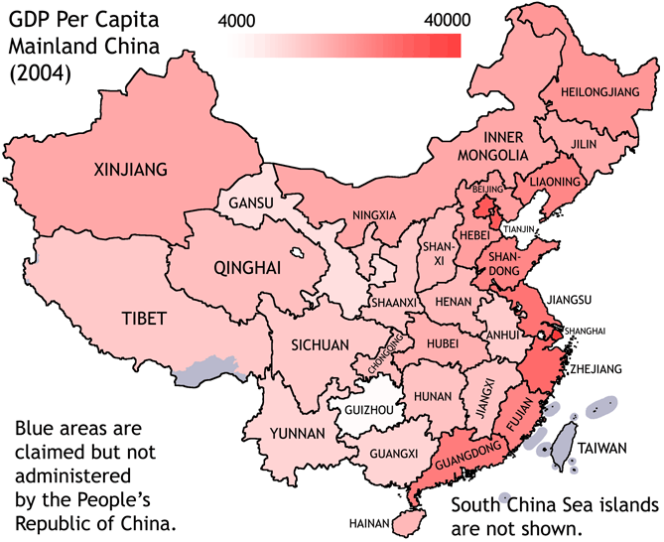
Human Factors: Most of China's major cities are located in the east (Shanghai, Beijing, Guangzhou, etc.) and it is these that have seen the greatest investment in infrastructure (roads, rail and air) and attracted the most investment and therefore seen the largest growth in jobs and economic development. Ethnically China is predominantly Han and it is the Han that dominate government. Therefore Han people have often been favoured and minority groups like the Tibetans in the south west and the Uighers in the north west have been marginalised.

Slide 46
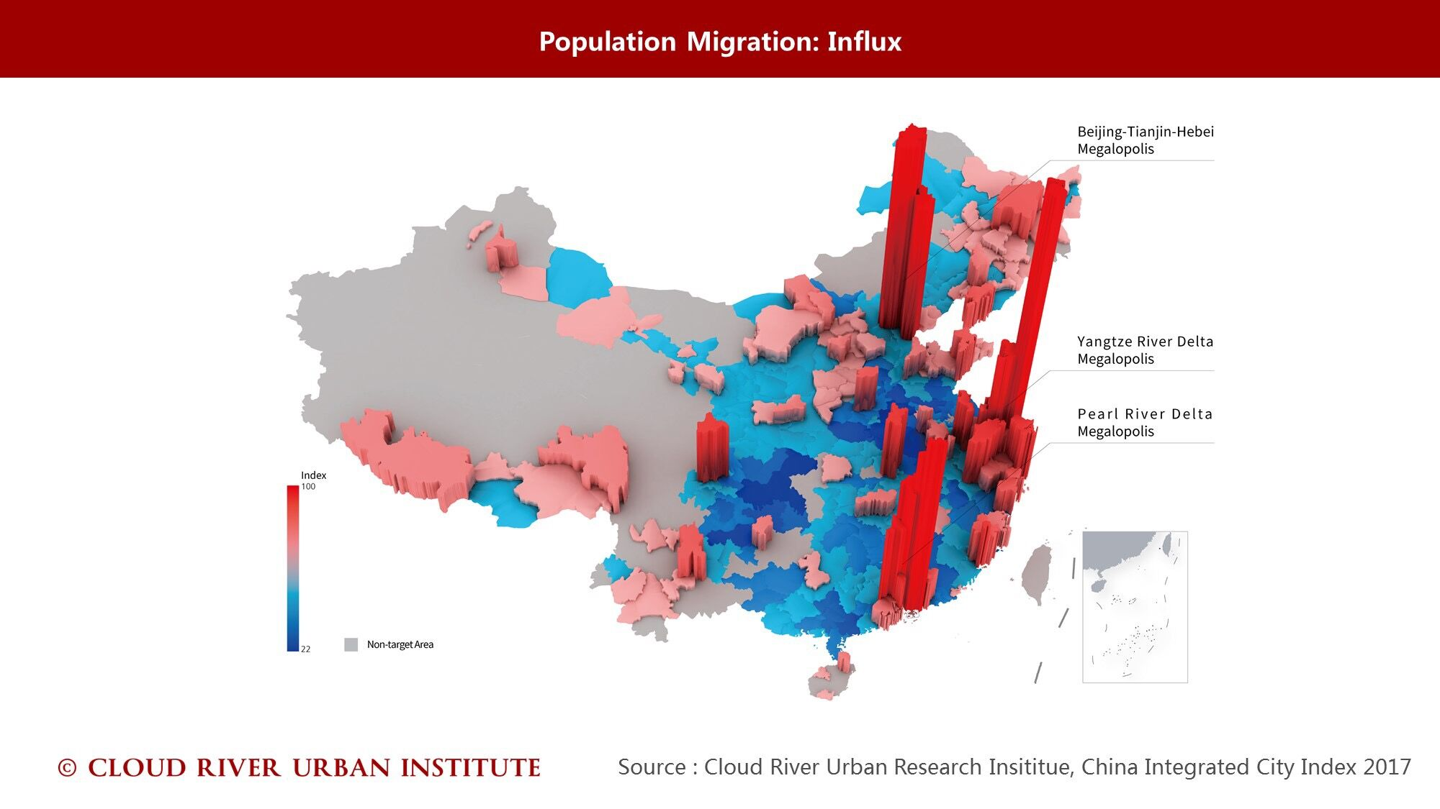

Slide 47
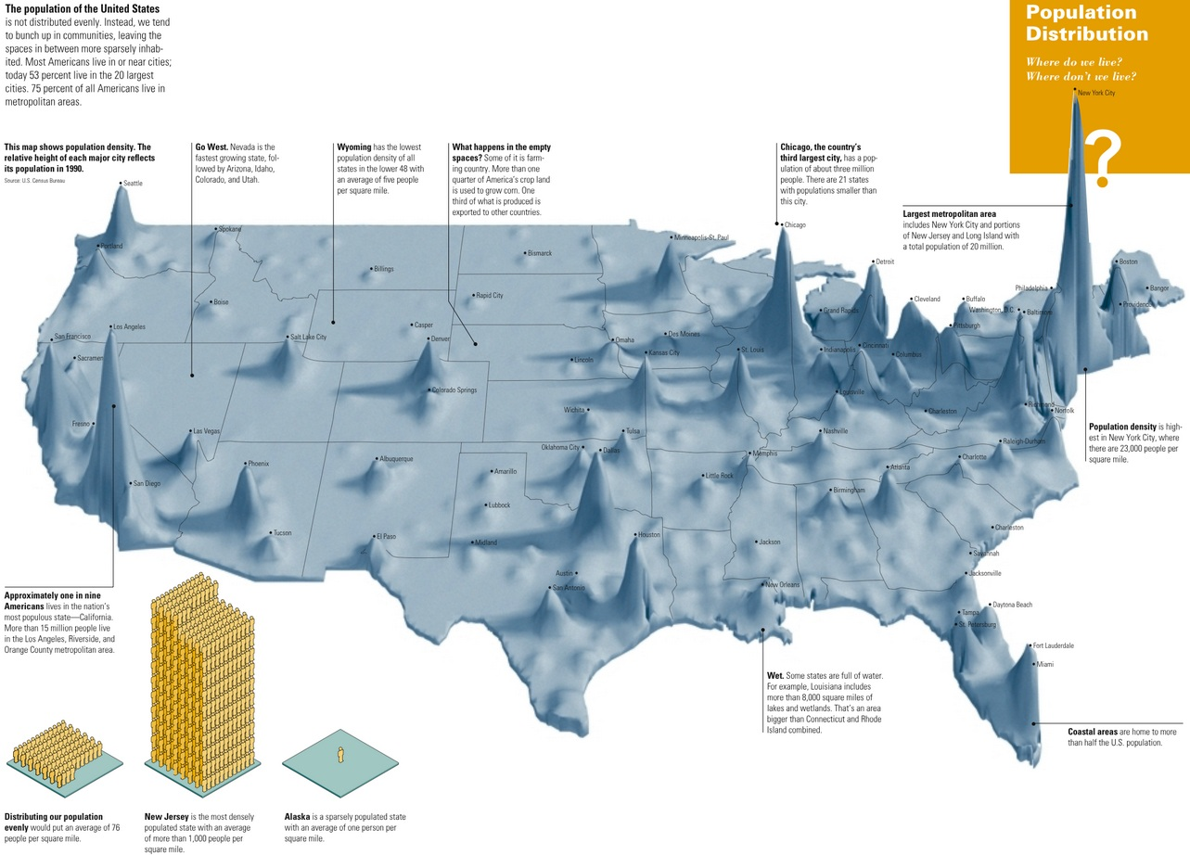

Slide 48
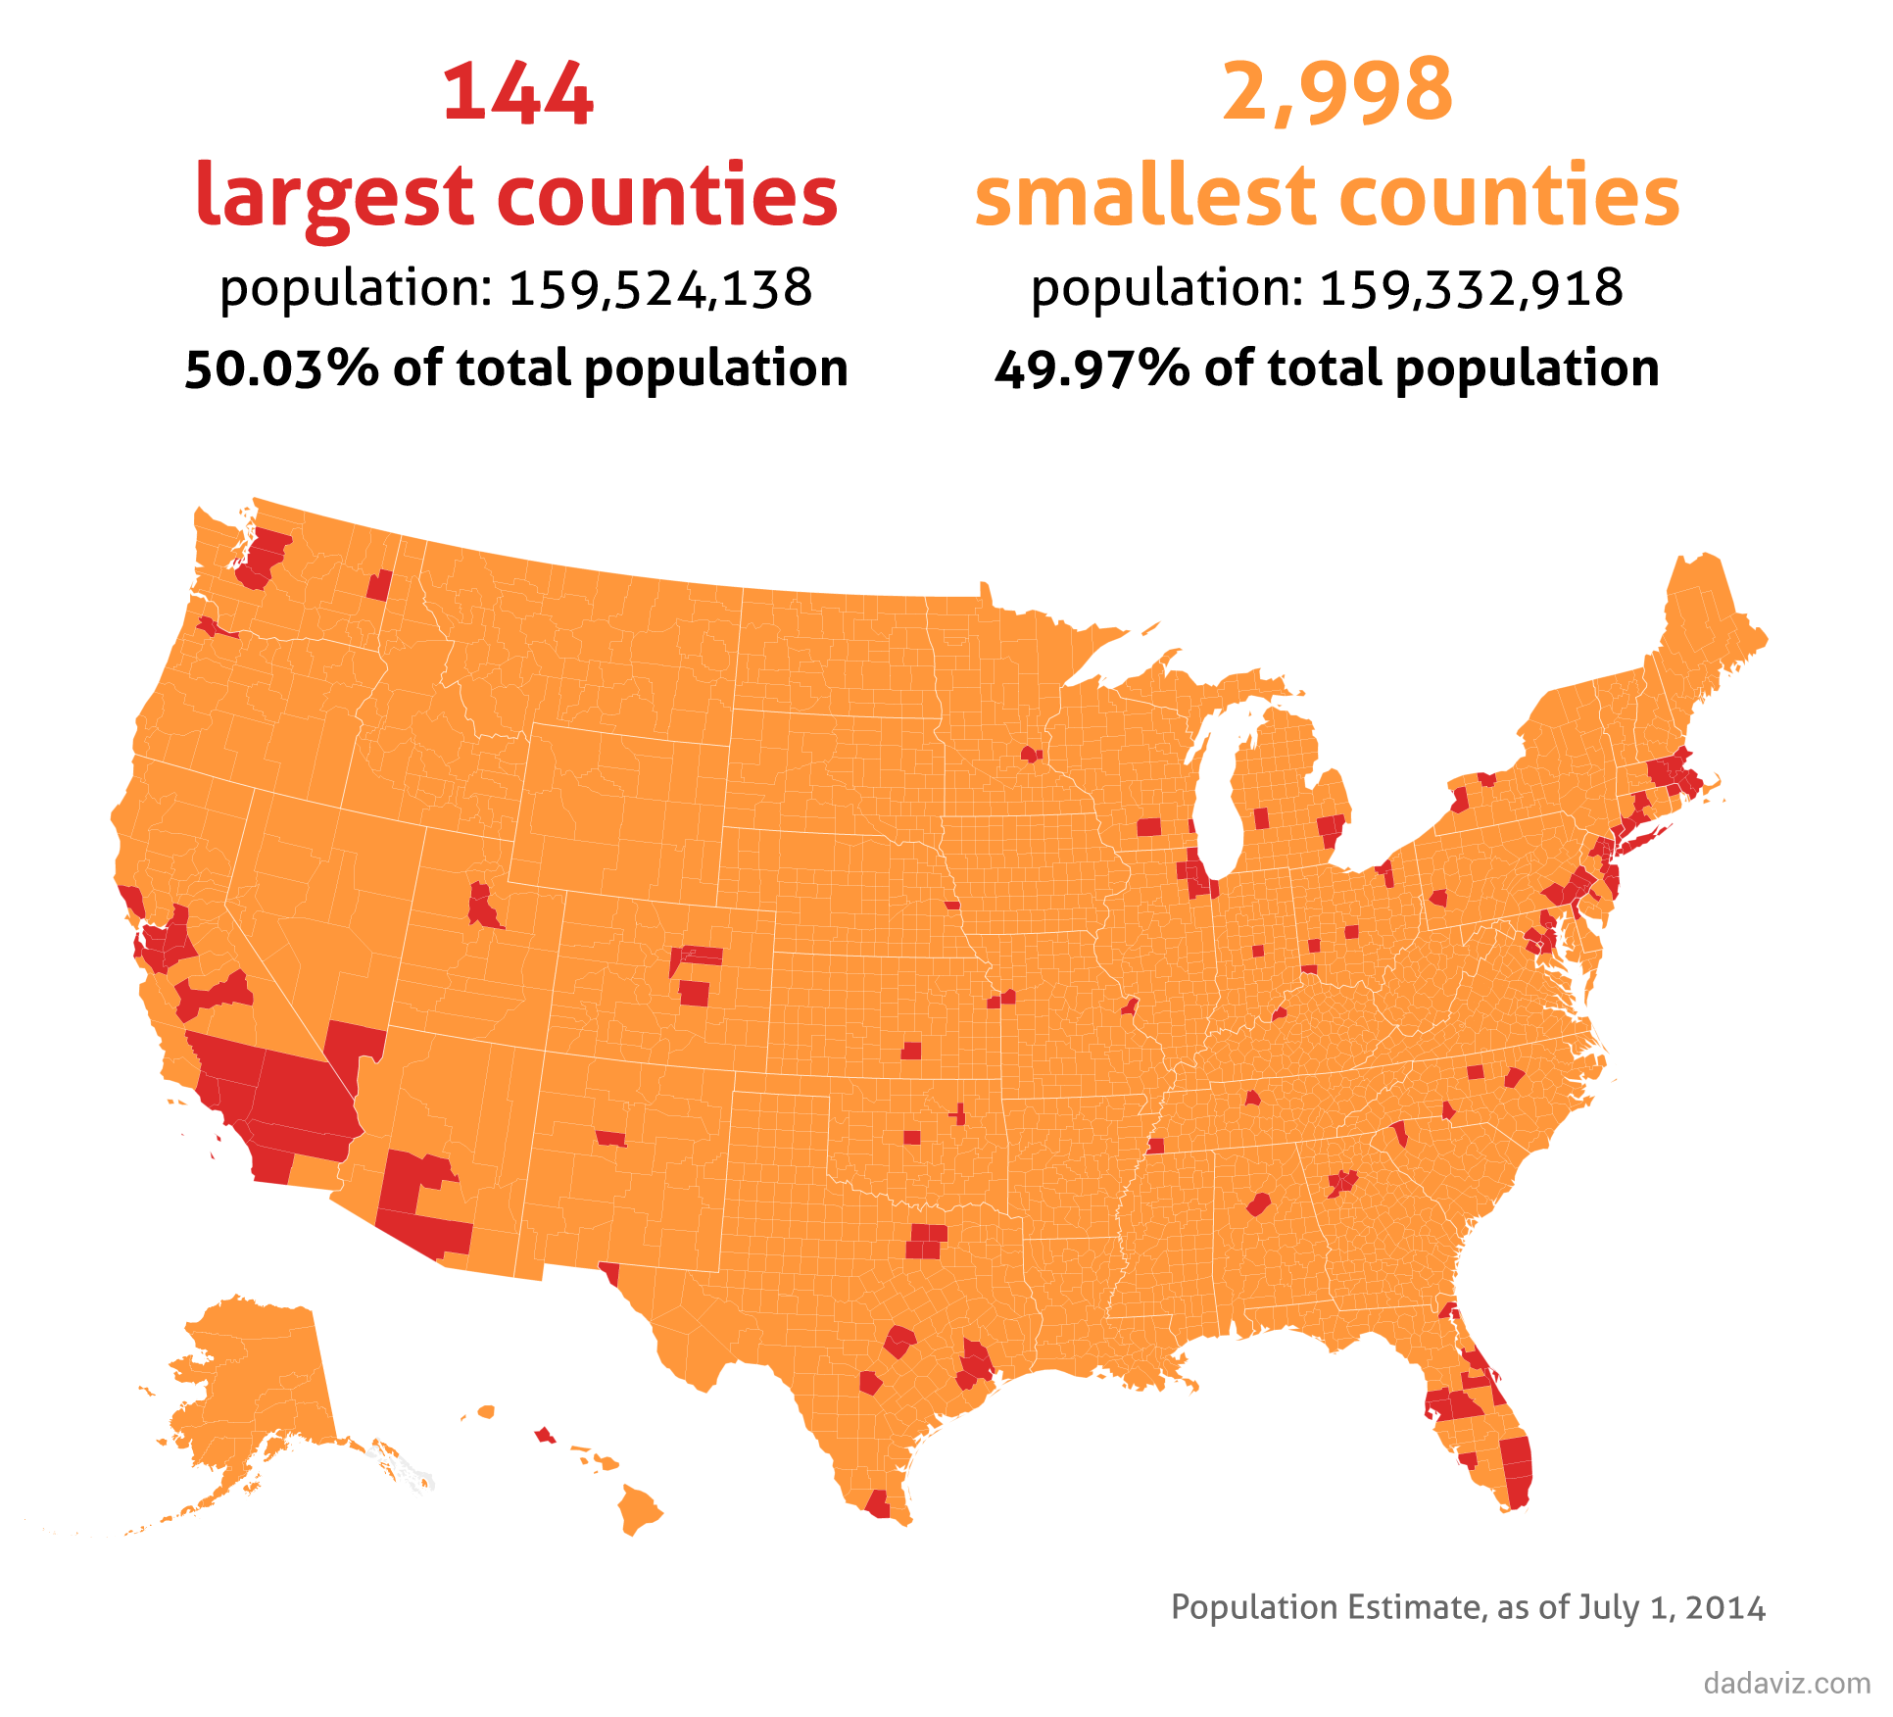

Slide 49
How population varies between places
Synthesis, evaluation and skills opportunities
The relative importance of different influences on where people live and spatial interactions between places at varying scales

Slide 50
2. Changing populations and places

Slide 51
Processes of population change and their effect on people and places
Global and regional/continental trends in family size, sex ratios, and ageing/greying

Slide 52
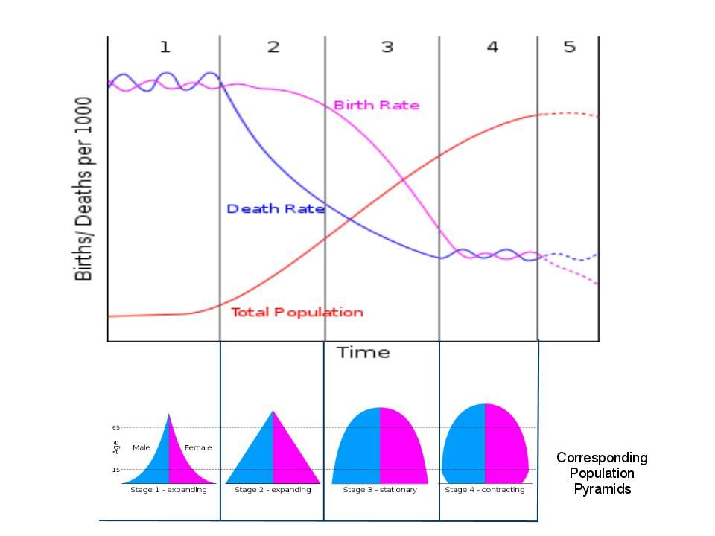

Slide 54
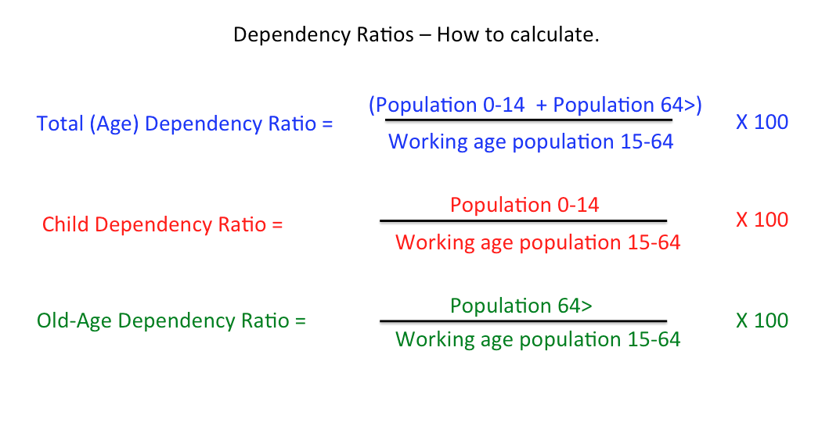

Slide 58
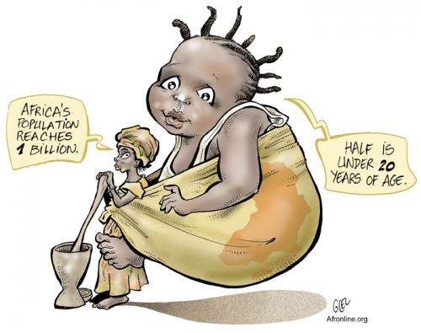

Slide 59
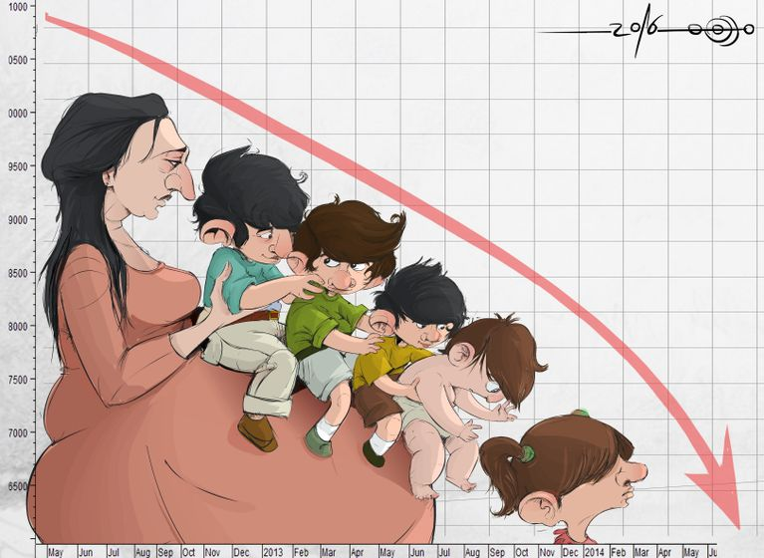
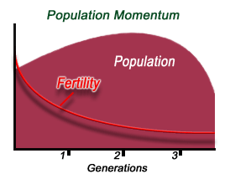

Slide 60
Population momentum
The tendency for a population to grow despite a
fall in fertility levels because of a relatively high
concentration of people of childbearing or pre-
childbearing age.
(It is also the tendency for a population to
continue to fall despite a rise in the birth rate).
(= the time lag between a change in birth/death
rates and the slowing of population growth or
rise in population).

Slide 62
Processes of population change and their effect on people and places
Policies associated with managing population change, focusing on:
policies related to ageing societies
pro-natalist or anti-natalist policies
gender equality policies and anti-trafficking policies

Slide 63
Processes of population change and their effect on people and places
The demographic dividend and the ways in which population could be considered a resource when contemplating possible futures
• One case study of a country benefiting from a demographic dividend

Slide 64
Processes of population change and their effect on people and places

Slide 65
Processes of population change and their effect on people and places
Synthesis, evaluation and skills opportunities
How population change may affect the power balance between groups of people at local, national and international scales

Slide 66
3. Challenges and opportunities

Slide 67
Population possibilities and power over the decision-making process
Global and regional/continental trends in family size, sex ratios, and ageing/greying

Slide 68
Population possibilities and power over the decision-making process
Policies associated with managing population change, focusing on:
policies related to ageing societies
pro-natalist or anti-natalist policies
gender equality policies and anti-trafficking policies

Slide 71
Successes:
The total fertility rate has decreased from nearly 6 to about 1.7
Population growth rate has fallen from a peak of 2.61% in the late 1960's to about 0.65% today
Birth rates have fallen from highs of 45 to about 13 today.
The availability of contraception has increased
Up to 250 million births have been prevented since 1979
China's population should peak in the first half of the 2030's (however, it might be as much as 1.45 billion)
Failures:
There have been criticisms about human rights, not only over freedom of choice, but forced abortions and sterilisations.
Female infanticde has taken place, where the boys fave been favoured.
There is now a sex imbalance in China (117:100).
Many children have been abandoned for adoption.
There is an ageing population and an increased dependency ratio
There has been shortage of workers in some areas.
The so called 'little emperors' syndrome where only children are spoilt
The policy has been open to corruption. Many people have paid bribes to have extra children.
The population is still 1.3 billion and growing

Slide 72
China's One-Child Policy, now Two-Child Policy (anti-natalist policy) – page 31 China currently has the largest population in the world, standing at about 1.3 billion. China is the third largest country in the world, but only about 10% of its area is good for arable farming. Much of the west is covered in mountains and much of the north is desert. China probably has the most famous population policy in the world. However, not everyone knows is that China actually had a pro-natalist policy after the end of World War II. During the war China was occupied by the Japanese. The Communist government never wanted this to happen again, so encouraged population growth to create a large army. This policy saw rapid population growth, but unfortunately the availability of resources was not growing at the same rate and in the early 1960's an estimated 20 million people died from famine. Because of the famine, in 1964 the government tried to promote birth control, but the birth rate still stood at 45 between 1966 and 1971. Because of the high birth rates the government promoted a new campaign 'Late, Sparse, Few'. However, the government didn't believe that this was having a significant enough effect and in 1979 introduced the one child policy. Demographers estimated that China's optimum population was 700 million and the aim was to meet this figure by 2080. The policy was strictly enforced and there were punishments for people who did not follow the policy including fines, loss of jobs, removal of education and health rights for children and for women caught to be pregnant with a second child forced abortion and sterilisation. At the same time as punishing offenders the government was also promoting the use of contraception and encouraging people to get married later. There are also some exceptions to the rule, families in rural areas were often allowed two children where people were needed to work on the land and ethnic groups were also allowed two children.

Slide 74
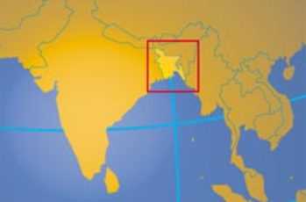
The Bangladeshi Miracle

Slide 75
Health Condition: In the mid-1970s, a Bangladeshi woman had more than six children on average. In combination with poor nutrition and lack of access to quality health services, this high fertility rate jeopardized the health of both the woman and her chil­dren. Beyond the health impact, high fertility and rapid population growth represented a major constraint to the country’s economic development and social progress. More than 150 million women in the developing world who would like to limit or space their pregnancies do not currently use a contraceptive method. So, for example, about 16 percent of mar­ried women in India have this “unmet need.” In sub-Saharan Africa, where services are in rela­tively short supply, the unmet need is the greatest.
Intervention or Program: The Bangladesh family planning program has depended on a large cadre of female outreach workers going door-to-door to provide information, motivate clients, and provide commodities; the program has used mass media to stimulate a change in attitudes about family size. The program both contributed to and benefited from improve­ments in women’s status in Bangladesh during the past 30 years.
Impact: As a result of the program, virtually all women in Bangladesh are aware of modern family planning methods. The current use of contraception among married women increased from 8 percent in the mid-1970s to about 60 percent in 2013, and fertility decreased from an average of more than six children per woman in 1975 to 2.4 in 2013. Although social and economic improvements have played a major role in increasing demand for contraception, the provision of services and information has been shown to have had an independent effect on attitudes and behavior.
Cost and Cost-Effectiveness: The program is estimated to cost between $100 million to $150 million per year, with about one-half to two-thirds of the funding coming from external donors. Cost-effectiveness has been estimated at about $13 to $18 per birth averted, a standard measure for family planning programs.

Slide 77
Germany's population currently stands at 81.3 million, (2016) compared with 80.2 million in 2011. In 2014 for example, there were 714 927 births and 868 373 deaths. With this trend expected to continue its population is projected to decline rapidly to 73.1 million by 2060, according to a report by the Guardian based on data from Destatis.
German's pro-natalist policy has not performed and modern attitudes and values towards fewer children and smaller family size is now the new norm. This is not to say that there isn't a generous family social security.
But…
People in Germany are having more children again.
Figures published on Wednesday by Federal Statistics Office showed that almost 800,000 children were born in Germany in 2016, up 7 percent from the year before.
The numbers placed the country's fertility rate — the average number of births per woman — at 1.59 in 2016, a marked upswing from 1.5 the year before and the highest in 43 years.
While the birth rate was significantly higher among mothers with foreign citizenship, German women also saw a notable increase, with the rate rising from 1.43 to 1.46.
Link

Slide 78
Generous Family Support
Germany is known to offer a generous package of pro-natal financial support. During the first 12-14 months following a birth a family qualifies for Elterngeld, which is a monthly payment to cover the period of time parents may choose to stay off work or work part time.
The Elterngeld amount is 67% of the applying parent's after tax earnings, averaged over 12 months before the child's birth
Maximum amount monthly is Euro 1,800
Minimum amount issued to eligible applicants is Euro 300 (even for unemployed parents)
For each multiple birth, 300 EURO per child issued.
In addition, to the Eltergeld the German government has introduced Parent Allowance Plus, a second payment totally up to half of the Eltergeld again.
Finally, a family also receives a family allowance payment which amounts to a monthly payment of Euro 190 per child for the first two children, EUR 196 for the third child and EUR 221 for every subsequent child. This increases by Euro 2 each year per child.
The aim of these allowances is to provide a package of support for the modern family, including a combination of targeted financial benefits, a good well subsidised childcare infrastructure, including affordable income based pricing structure for creches and a new policy that provides maximum support in modern families where the mother seeks to develop her career and the father wishes to spend more time off work with the baby.

Slide 79
According to data published by Germany's federal office for migration and refugees net migration has exceeded 300,000 every year since 2011, hitting 676,730 in 2014. Furthermore, with Germany's humanitarian intervention in 2015 a further 1.1 million refugees and asylum seekers were welcomed. The vast majority of whom are of working age and young adults.
A study by the Bertelsmann Foundation found that immigrants in Germany are net contributors to the public finances. The study found that, on average, foreign citizens living in Germany pay €3,300 more in tax each year than they receive in benefits. In 2014 this amounted to a contribution of nearly €22 billion. In addition these immigrants bring with them more conservative values towards to children and have the potential to improve natural increase.

Slide 80
Discuss the extent to which the migration policy (of asylum seekers) in Germany is the answer to Germany's population problem.
Despite the huge numbers e.g. >300000 immigrants per year since 2011 and 1.1 million asylum seekers in 2015 immigration is not expected to impact long term trends in falling population size. The reality seems to suggest that modern German values towards family size has significantly changed, favouring smaller families and careers for both parents. This will inevitably have a big impact on the German economy and is most likely to affect its position both within Europe and at the global scale.
However, immigrants do make net positive contributions to the German economy and attracting migrants from abroad with more conservative values in regard to family is likely to help in slowing down the fall.

Slide 82
Population possibilities and power over the decision-making process
The demographic dividend and the ways in which population could be considered a resource when contemplating possible futures
One case study of a country benefiting from a demographic dividend

Slide 83
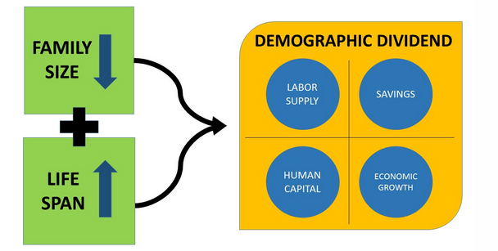

Slide 84
Population possibilities and power over the decision-making process
The demographic dividend (DD) and the ways in which population could be considered a resource when contemplating possible futures
The short-term demographic benefit that is »cashed in» by a country when it moves from Stage 2 to Stage 3 of the DTM. Demographic dividend refers to the growth in an economy that is the resultant effect of a change in the age structure of a country's population. The change in age structure is typically brought on by a decline in fertility and mortality rates.
Harnessing the Demographic Dividend
• One case study of a country benefiting from a demographic dividend
India (page 35)

Slide 85
...but as GDP growth slows, India’s DD could turn into disaster...

Slide 86
Population possibilities and power over the decision-making process
Synthesis, evaluation and skills opportunities
How population change may affect the power balance between groups of people at local, national and international scales

Slide 87
