Slide 1
Exam techniques

Slide 2
Examination guidance

Slide 3
Syllabus guidance

Slide 4
Command terms

Slide 5
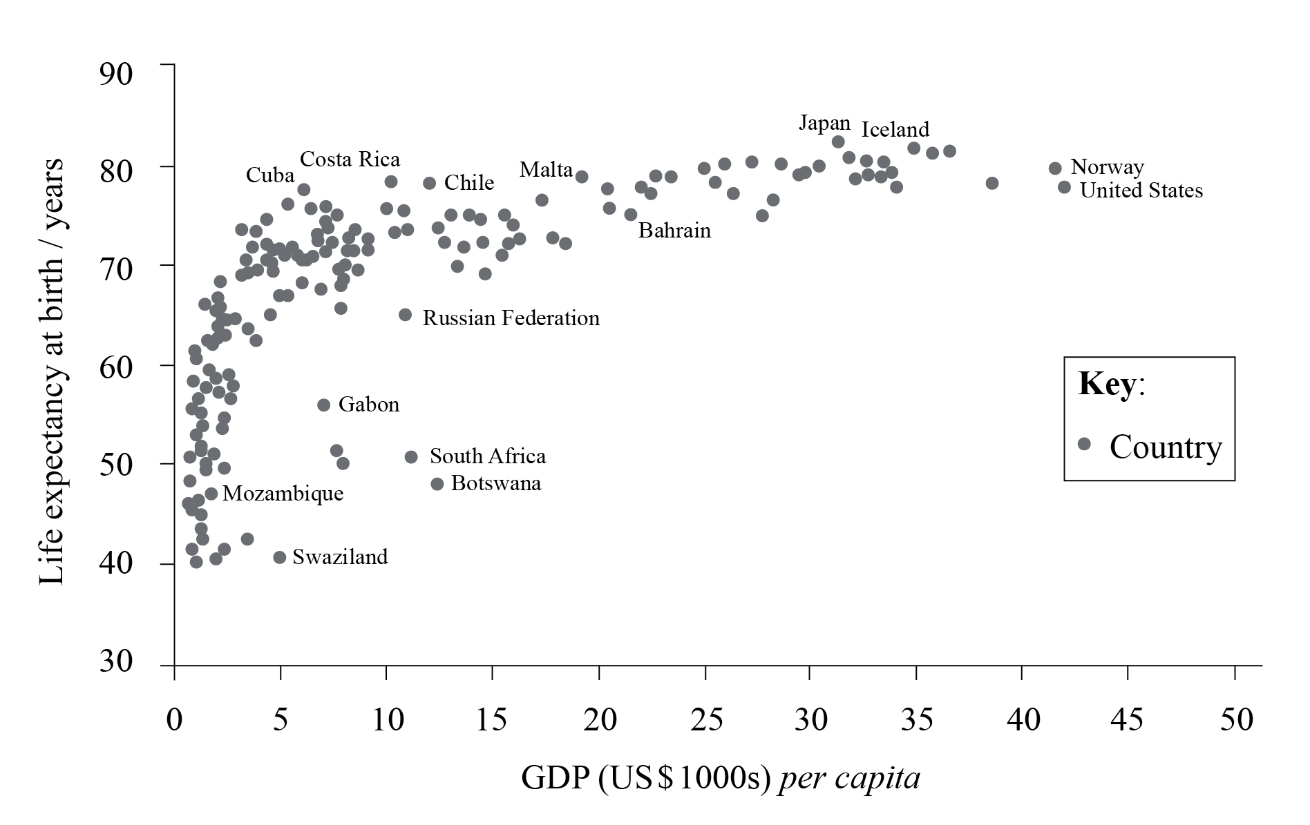
The graph below shows the relationship between GDP per capita and life expectancy at birth for a number of countries in 2010.
(2+2 marks)
(a) Describe the relationship shown on the graph.
(b) Suggest two possible reasons for the relationship described in (a).
Markscheme
(a) There is a positive relationship/life expectancy at birth increases as GDP per capita increases [1 mark], but it is non-linear/levels off [1 mark]. Award 1 mark for identification of an anomaly. Reserve 1 mark for quantification.
(b) Award 1 mark for identifying a valid reason and 1 mark for further development and/or exemplification. For example, higher GDP per capita implies a higher standard of living – this will impact upon diet/hygiene/sanitation/water supply/access to health care etc. which will impact upon longevity [1+1 marks].

Slide 6
Pattern versus trend

Slide 7
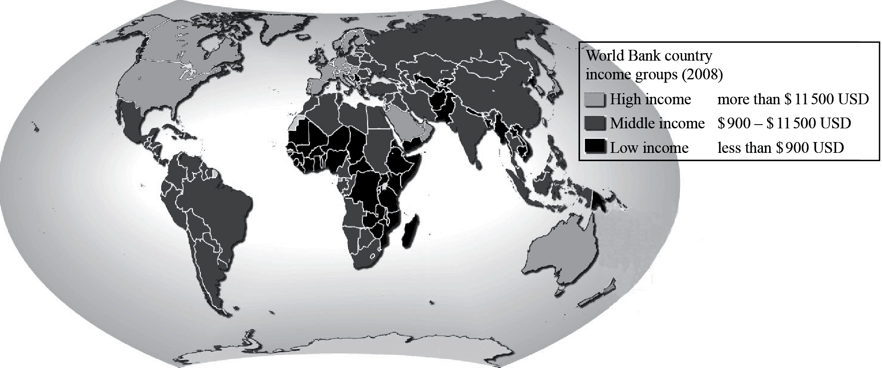
Describe the global pattern of GNI per person shown on the map. [3]
The map shows that most low income countries are in Africa and Central and South Asia [1 mark]; high income countries are in North America, Western Europe, and Australia [1 mark]. The rest of the world is classified as middle income [1 mark]. For full marks some quantification should be included or anomalies identified.

Slide 8
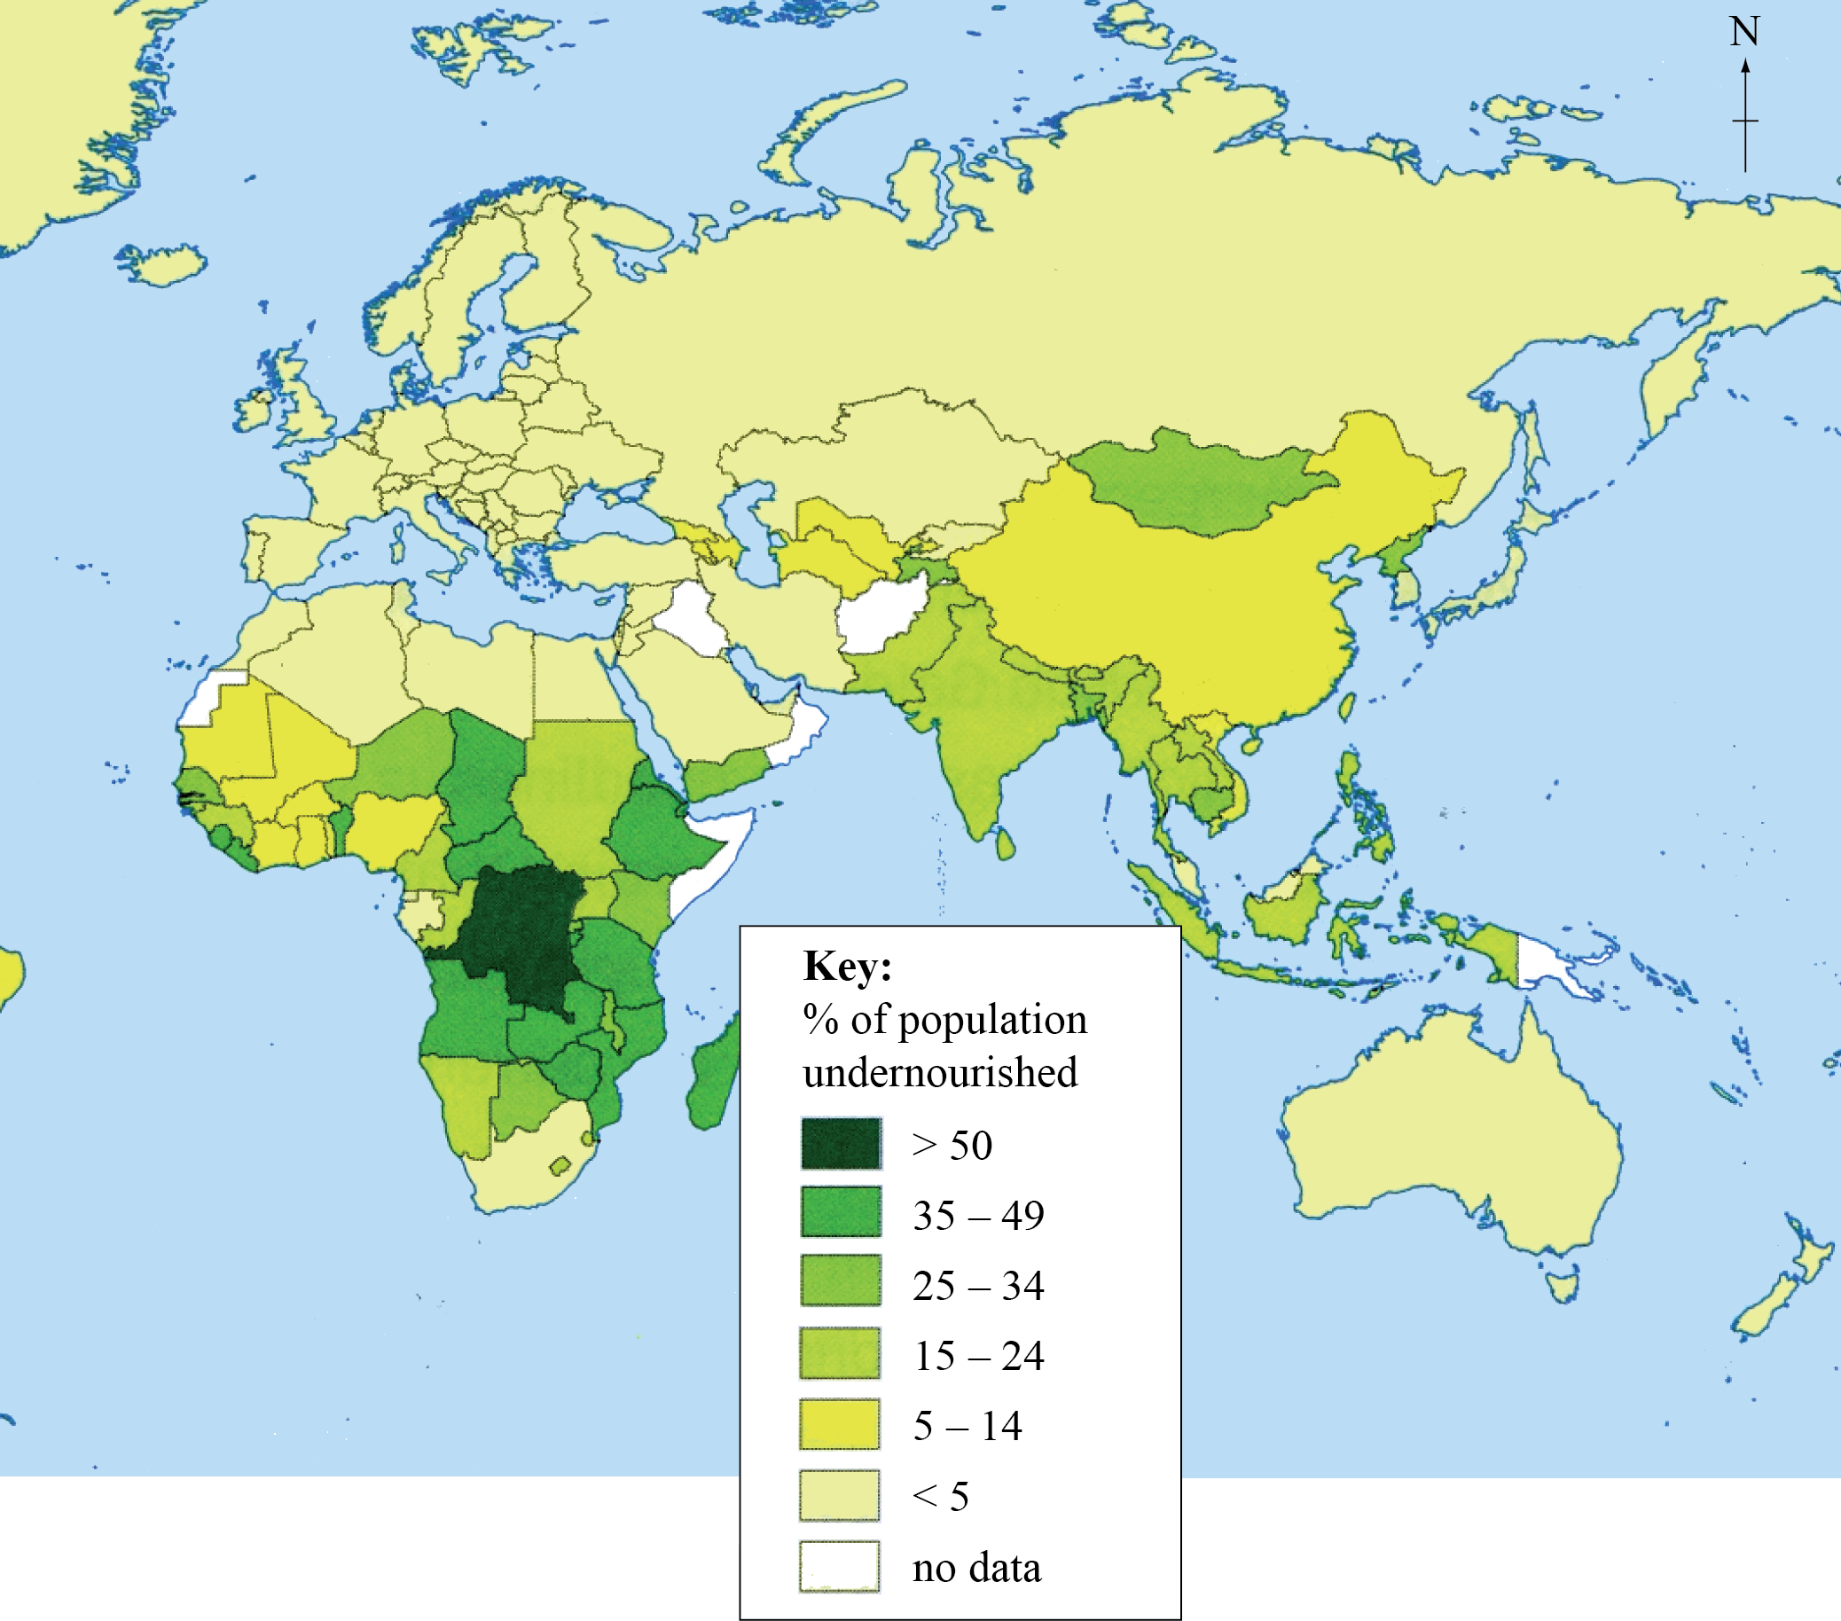
Describe the pattern of undernourishment shown on the map. [4]
The highest rate/prevalence of undernourishment (over 50%) is in central Africa [1 mark], especially the DRC [1 mark]. South/south-east Asia is generally lower than Africa but higher than Europe/Russia/Australia [1 mark].
Other important features that may be awarded [1 mark] include: low levels in north Africa and south Africa; lower levels in the Middle East; higher value (may describe as anomaly) in Mongolia/central Asia.
For the award of full marks some quantification is necessary.
N.B. country names are not essential for the award of the full [4 marks].

Slide 9
World regions map quiz

Slide 10
Why Some Countries Are Poor and Others Rich

Slide 11
Define ecological footprint. [2]
This can be broadly defined as the theoretical measurement of the amount of land and water a population requires to produce the resources it consumes [1 mark] (and to absorb its waste) under prevailing technology [1 mark].

Slide 12
“Environmental sustainability will never be achieved without population control.” Discuss this statement. (15)
There are many possible approaches to this question.
“Environmental sustainability” is treating the environment in such a way that it meets the needs of the present generation without limiting the ability of future generations to meet their own needs. It includes not only a concern for resource use (for example, preferring renewable resources to non-renewable resources) but also a determination to avoid contamination (soil, water, air) and to prevent adverse human-induced impacts on the environment.
Population control is not limited to policies designed to limit birth rates, but may also be interpreted to include policies of migration, and even policies designed to influence where people are permitted to live (zoning, national parks) and, increasingly, how they live / how much they consume.
In general, the successful implementation of population control is likely to reduce demand for resources, and decrease the likelihood of adverse human-induced environmental impacts. Successful population control is therefore normally associated with an improvement in the degree of sustainability.
However, population control alone is insufficient to ensure environmental sustainability, so a number of other factors such as political will, society’s sense of its relationship with the natural environment, public awareness, and desire to see progress only in terms of economic growth, will also be important. Equally, continued population growth may not be an obstacle to long-term sustainability if new technologies are developed and recycling, substitution, and conservation are embraced.
Stronger responses are likely to consider more than one scale (local, national, regional, global), but this is not a requirement for full marks. It is possible to gain full marks if the response focuses on only one or two points, such as over-consumption in some societies, so long as it is done in a well-argued and well-supported way.
Answers that do not show an understanding of environmental sustainability should not move beyond band D.
Responses based on appropriate, well-supported ideas and examples, and which arrive at some conclusion about the statement are likely to be credited at bands E/F.
Marks should be allocated according to the markbands.

Slide 13
Essay structure

Slide 14
“It is impossible to eliminate disparities in wealth and development.” Discuss this statement. (15)
This question may be considered from any scale: global, regional or national. It is possible to gain full marks looking at a single scale (it is also possible to score highly with a mainly social rather than spatial analysis).
Candidates are expected to demonstrate a clear understanding of the three key terms – disparities, wealth and development – in their answers, though they may choose to take as wide a view as they like of such concepts by including, for example, non-economic wealth, or social rather than economic development.
It is expected that answers will include a variety of different strategies designed to help reduce disparities, both in favour of, and against, the statement and will offer substantiation by means of detail or examples for the ideas presented.
Responses that arrive at a clear conclusion either agreeing or disagreeing with the statement, after a sound discussion including both sides of the issues, are likely to be awarded band E or above.
Marks should be allocated according to the markbands.

Slide 15
Mark bands

Slide 17
Guidelines for writing Geography IB essays
Interpreting the title
Look carefully at the essay title and carry out the following:
• Underline the key words in the title.
• Use the L.I.S.T. checklist below to ensure that you give the essay title its broadest interpretation.
LOCATION (spatial context): poor/rich countries; rural/urban areas; tropical/temperate; land/air/sea; marine/terrestrial/atmospheric
ISSUES (factors): positive/negative, advantages/disadvantages, costs/benefits, human/physical, environmental, social, cultural, demographic, political, economic, geographic
SCALE: global, regional, international, national, sub-national, local
TIME: long-term/medium-term/short-term; past/present/future; contemporary/recent/current
Some of the items in the L.I.S.T. may not be relevant to the essay.
Planning
Planning ensures that:
•ideas can be presented in a logical sequence
•new points can be added to the plan while writing the essay

Slide 18
When we talk about geographic factors, we generally refer to social, economic, environmental and political (SEEP).
Good for structuring your essay.

Slide 19
Mock exam

Slide 20
Anthony barnes video blogs

Slide 21
Geographical skills

