Slide 1
Extended Essays

Slide 2
In working on the extended essay, students are expected to:
plan and pursue a research project with intellectual initiative and insight
2. formulate a precise research question
3. gather and interpret material from sources appropriate to the research
question
4. structure a reasoned argument in response to the research question on the
basis of the material gathered
5. present their extended essay in a format appropriate to the subject,
acknowledging sources in one of the established academic ways
6. use the terminology and language appropriate to the subject with skill and
understanding
7. apply analytical and evaluative skills appropriate to the subject, with
an understanding of the implications and the context of their research.

Slide 3
Responsibilities of the student
It is required that students:
· choose a topic that fits into one of the subjects on the approved
extended essay list (in the Vade
Mecum)
· observe the regulations relating to the extended essay
· meet deadlines
· acknowledge all sources of information and ideas in an approved
academic manner.

Slide 4
It is strongly recommended that students:
· start work early
· think very carefully about the research question for their essay
· plan how, when and where they will find material for their essay
· plan a schedule for both researching and writing the essay, including extra time for delays and unforeseen problems
· record sources as their research progresses (rather than trying to reconstruct a list at the end)
· have a clear structure for the essay itself before beginning to write
· check and proofread the final version carefully
· make sure that all basic requirements are met (for example, all students should get full marks for the abstract).

Slide 5
Advice to students from examiners
Examiners’ reports frequently emphasize the following positive steps.
Before starting work on the extended essay, students should:
· read the assessment criteria
· read previous essays to identify strengths and possible pitfalls
· spend time working out the research question (imagine the finished essay)
· work out a structure for the essay.

Slide 6
During the research process, and while writing the essay, students should:
· start work early and stick to deadlines
· maintain a good working relationship with their supervisor
· construct an argument that relates to the research question
· use the library and consult librarians for advice
· record sources as they go along (rather than trying to reconstruct a list at the end)
· choose a new topic and a research question that can be answered if there is a problem with the original topic
· use the appropriate language for the subject
· let their interest and enthusiasm show

Slide 7
After completing the essay, students should:
· write the abstract
· check and proofread the final version carefully.

Slide 8
Recommended: things to avoid
Examiners’ reports also mention these things to be avoided at all costs.
Students should not work with a research question that is too broad or too vague, too narrow, too difficult or inappropriate.
A good research question is one that asks something worth asking and that is answerable within 40 hours/4,000 words. It should be clear what would count as evidence in relation to the question, and it must be possible to acquire such evidence in the course of the investigation.
If a student does not know what evidence is needed, or cannot collect such evidence, it will not be possible to answer the research question.

Slide 9
In addition, students should not:
· forget to analyse the research question
· ignore the assessment criteria
· collect material that is irrelevant to the research question
· use the Internet uncritically
· plagiarize
· merely describe or report (evidence must be used to support the argument)
· repeat the introduction in the conclusion
· cite sources that are not used.

Slide 10
One further piece of advice is as follows: the more background a student has in the subject, the better the chance he or she has of writing a good extended essay.
Choosing to write the extended essay in a subject that is not being studied as part of the Diploma Programme often leads to lower marks.
12

Slide 11
Researching and writing the extended essay
The research process
When researching the extended essay, students should do the following.
Choose the approved Diploma Programme subject for the extended essay.
· Read the assessment criteria and the relevant subject guidance.

Slide 12
2. Choose a topic.
3. Formulate a well-focused research question.
4. Plan the investigation and writing process.
· Identify how and where they will gather material.
· Identify which system of academic referencing they will use, appropriate to the subject of the essay.
· Set deadlines for themselves that will allow them to meet the school’s requirements.

Slide 13
5. Plan a structure (outline headings) for the essay.
This may change as the investigation develops but it is useful to have a sense of direction.
6. Undertake some preparatory reading.
· If students discover that it will not be possible to obtain the evidence needed in the time available,
the research question should be changed. This should be done sooner rather than later: students
should not lose time waiting and hoping that something will turn up. Students should go back
to stage 3, 2 or 1, and choose a new research question that can be answered.

Slide 14
7. Carry out the investigation.
· The material gathered should be assembled in a logical order, linked to the structure of the essay.
Only then will students know whether they have enough evidence for each stage of the argument
so that they can proceed to the next.
· Students should be prepared for things to go wrong. Sometimes they may discover something
later in the investigation that undermines what they thought had been established earlier on. If
that happens, the investigation plan needs to be revised.

Slide 15
Writing the extended essay
(Please note that the order in which they are presented here is not necessarily the order in which they should be written).
· Title page
· Abstract
· Contents page
· Introduction
· Body (development/methods/results)
· Conclusion
· References and bibliography
· Appendices

Slide 17
Students should use the chosen system of academic referencing as soon as they start writing. That way,
they are less likely to forget to include a citation. It is also easier than trying to add references at a later
stage.
Some students draft the introduction first. If students do that, they must be prepared to revise it once
the essay is complete.

Slide 18
The main task is writing the body of the essay, which should be presented in the form of a reasoned argument.
The form of this varies with the subject of the essay but, as the argument develops, it should
be clear to the reader what relevant evidence has been discovered, where/how it has been discovered
and how it supports the argument.
In most subjects, sub-headings within the main body of the essay will help the reader to understand the argument (and will also help the student to keep on track).

Slide 19
Once the main body of the essay is complete, it is possible to finalize the introduction (which tells the reader what to expect) and the conclusion (which says what has been achieved, including notes of any
limitations and any questions that have not been resolved).
Any information that is important to the argument should not be included in appendices or footnotes/endnotes. The examiner is not bound to read notes or appendices, so an essay that is not
complete in itself will lose marks.

Slide 20
The remaining stages in writing the essay take time but are not difficult.
Students need to check that
they have cited sources for all material that is not their own, and that the citations are complete and
consistent with the chosen referencing system.
The bibliography should list only the sources used in the
essay. The whole essay needs to be proofread carefully (computer spelling and grammar checkers are
useful but will not do everything).
Pages must be numbered and the contents page must be completed.
The abstract is normally written last.

Slide 21
Formal presentation of the extended essay
The extended essay should be written in a clear, correct and formal academic style, appropriate to the subject from which the topic is drawn.

Slide 22
The length of the extended essay
The upper limit is 4,000 words for all extended essays. This upper limit includes the introduction, the
body, the conclusion and any quotations, but does not include:
· the abstract
· acknowledgments
· the contents page
· maps, charts, diagrams, annotated illustrations and tables
· equations, formulas and calculations
· citations/references (whether parenthetical or numbered)
· footnotes or endnotes
· the bibliography
· appendices.

Slide 23
Essays containing more than 4,000 words are subject to penalties and examiners are not required to read
material in excess of the word limit.

Slide 24
Title
The title should provide a clear indication of the focus of the essay. It should be precise and not necessarily
phrased in the form of a question.

Slide 25
Abstract
An abstract not exceeding 300 words must be included with the essay submitted. It does not serve as an
introduction, but presents an overview of the extended essay, and should, therefore, be written last.

Slide 26
The inclusion of an abstract is intended to encourage students to examine closely the development of
an argument within the extended essay and the pertinence of any conclusions that are reached. It is also designed to allow readers to understand quickly the contents of the extended essay.
The minimum requirements for the abstract are for it to state clearly:
· the research question being investigated
· the scope of the investigation
· the conclusion(s) of the extended essay.
The abstract should be typed or word processed on one side of a sheet of paper, and placed immediately
after the title page.

Slide 27
Contents page
A contents page must be provided at the beginning of the extended essay and all pages should be numbered. An index is not required.

Slide 28
Illustrations
Presentation and overall neatness are important, and it is essential that illustrative material, if included, is well set out and used effectively. Graphs, diagrams, tables and maps are effective only if they are clearly
labelled and can be interpreted with ease. All such material that is incorporated into the extended essay must be directly related to the text and acknowledged where appropriate. The use of photographs and other images is acceptable only if they are captioned and/or annotated and are used to illustrate a specific
point made in the extended essay.

Slide 29
Bibliographies, references and citations
An extended essay must reflect intellectual honesty in research practices and provide the reader with the exact sources of quotations, ideas and points of view through accurate bibliographies and referencing.
Producing accurate citations, referencing and a bibliography is a skill that students should be seeking to perfect.
Documenting the research in this way is vital: it allows readers to evaluate the evidence for themselves and it shows the student’s understanding of the importance of the sources used.
Failure to comply with this requirement will be viewed as plagiarism and will, therefore, be treated as a case of malpractice.

Slide 31
Appendices, footnotes and endnotes
Appendices, footnotes and endnotes are not an essential section of the extended essay and examiners are not required to read them, so care should be taken to include all information of direct relevance to the analysis and argument in the main body of the essay.
An essay that attempts to evade the word limit by including important material in notes or appendices risks losing marks under several criteria.
Unless considered essential, complete lists of raw data should not be included in the extended essay.
Students should not constantly refer to material presented in an appendix as this may disrupt the continuity of the essay.

Slide 33
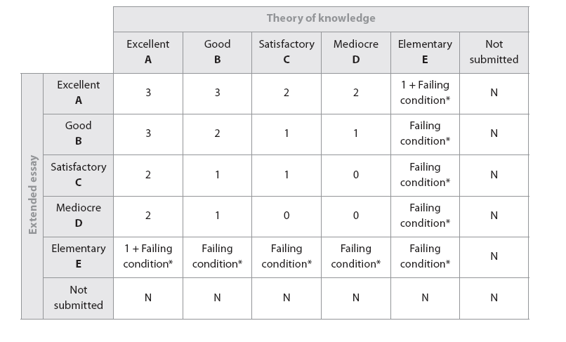
The diploma points matrix

Slide 34
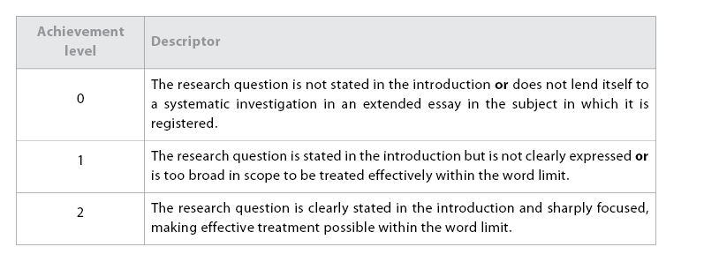
A: research question
(Objectives 1 and 2)
This criterion assesses the extent to which the purpose of the essay is specified. In many subjects, the aim of the essay will normally be expressed as a question and, therefore, this criterion is called the “research question”. However, certain disciplines may permit or encourage different ways of formulating
the research task.

Slide 35
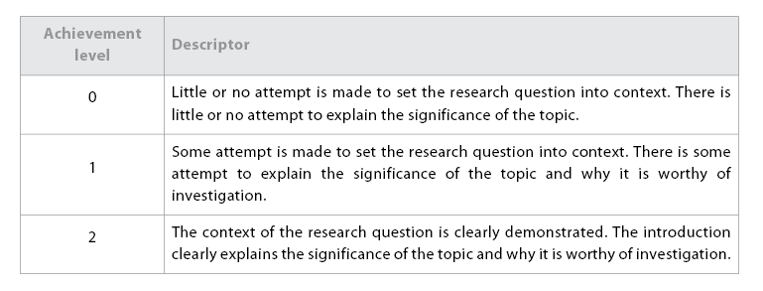
B: introduction
(Objectives 1 and 5)
This criterion assesses the extent to which the introduction makes clear how the research question relates to existing knowledge on the topic and explains how the topic chosen is significant and worthy of investigation.

Slide 36
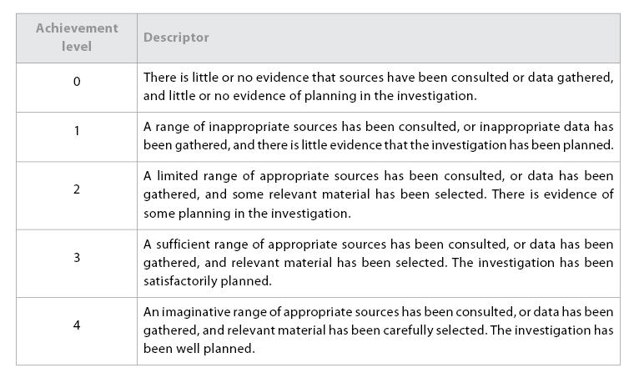
C: investigation
(Objectives 1 and 3)
This criterion assesses the extent to which the investigation is planned and an appropriate range of sources has been consulted, or data has been gathered, that is relevant to the research question. Where the research question does not lend itself to a systematic investigation in the subject in which the essay is registered, the maximum level that can be awarded for this criterion is 2.

Slide 37
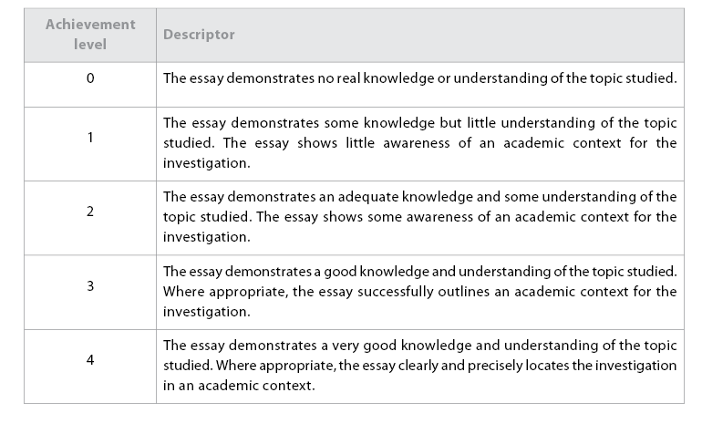
D: knowledge and understanding of the topic studied
(Objectives 3 and 7)
Where the research question does not lend itself to a systematic investigation in the subject in which
the essay is registered, the maximum level that can be awarded for this criterion is 2. “Academic context”,
as used in this guide, can be defined as the current state of the field of study under investigation. However,
this is to be understood in relation to what can reasonably be expected of a pre-university student. For
example, to obtain a level 4, it would be sufficient to relate the investigation to the principal lines of
inquiry in the relevant field; detailed, comprehensive knowledge is not required.

Slide 38
E: reasoned argument
(Objectives 1 and 4)
This criterion assesses the extent to which the essay uses the material collected to present ideas in alogical and coherent manner, and develops a reasoned argument in relation to the research question.
Where the research question does not lend itself to a systematic investigation in the subject in which
the essay is registered, the maximum level that can be awarded for this criterion is 2.

Slide 39
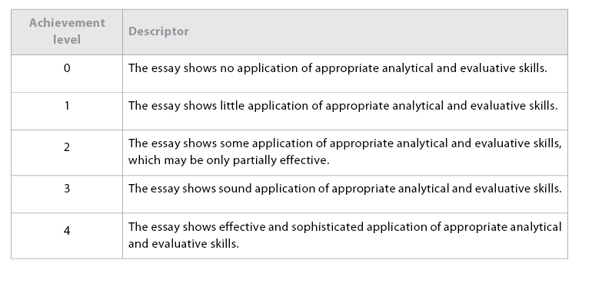
F: application of analytical and evaluative skills appropriate to the subject
(Objective 7)

Slide 40
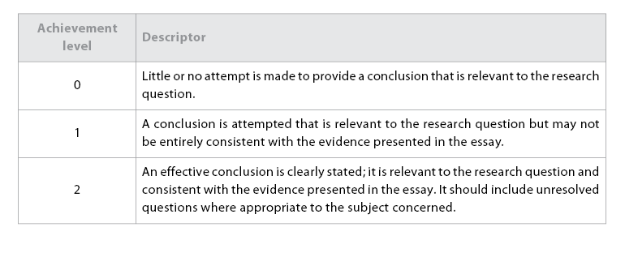
H: conclusion
(Objectives 1, 4 and 5)
This criterion assesses the extent to which the essay incorporates a conclusion that is relevant to the
research question and is consistent with the evidence presented in the essay.

Slide 41
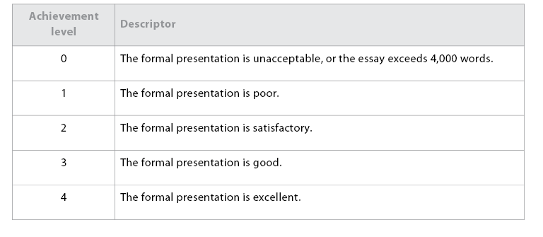
I: formal presentation
(Objective 5)
This criterion assesses the extent to which the layout, organization, appearance and formal elements of the essay consistently follow a standard format. The formal elements are: title page, table of contents, page numbers, illustrative material, quotations, documentation (including references, citations and
bibliography) and appendices (if used).

Slide 42
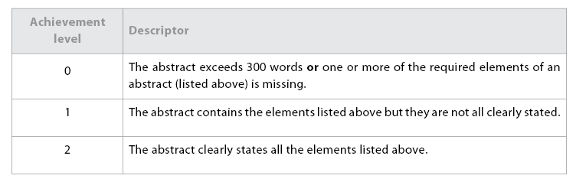
J: abstract
(Objective 5)
The requirements for the abstract are for it to state clearly the research question that was investigated,
how the investigation was undertaken and the conclusion(s) of the essay.

Slide 43
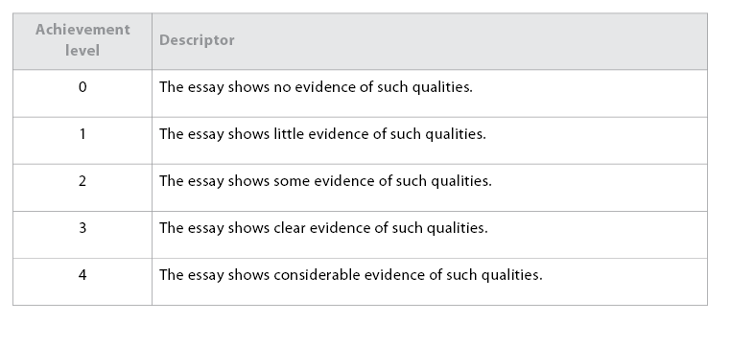
K: holistic judgment
(Objective 1)
The purpose of this criterion is to assess the qualities that distinguish an essay from the average, such as intellectual initiative, depth of understanding and insight. While these qualities will be clearly present in the best work, less successful essays may also show some evidence of them and should be rewarded
under this criterion.

Slide 44
Academic honesty
The student is ultimately responsible for ensuring that his or her extended essay is authentic, with the work or ideas of others fully and correctly acknowledged. Additionally, it is the responsibility of a supervisor to confirm that, for each student he or she has supervised, to the best of his or her knowledge, the version of the extended essay submitted for assessment is the authentic work of the student.
Both plagiarism and collusion are forms of malpractice that incur a penalty. The same piece of work, or two versions of the same work, cannot be submitted to meet the requirements of both the extended essay and another assessment component of a subject contributing to the diploma or an additional
certificate.

Slide 45
Geography

Slide 46
Make sure that you are using the Diploma Programme Extended Essay Guide for first examination in 2009. The EE requirements for Geography have recently changed.
“care maybe needed to ensure that the research question is not too broad to be satisfactorily answered within the word limit”
“narrow area of research in depth”
“spatial component”
“at a local scale”
“as the data collected in the field is not required for extended essays, the research questions can be more broadly based than those used for fieldwork and can rely on information derived from sources other than direct fieldwork”

Slide 47
Ecumene Extended Essay Samples

Slide 48
An EE that relies on secondary data only is possible, but there must be a degree of originality in how the data is analyzed - so for example, data used for a map in the original source might be susceptible to a statistical correlation with data from elsewhere, etc.
Originality here is the key point. An essay that analysed secondary material fully is equally valid to one where fieldwork is included and could in fact be better than EEs based on fieldwork.
This was because many EEs based on fieldwork tended to be more like long fieldwork reports not discursive essays. Student must go beyond referring to or describing the secondary data both to analyse it and to try to bring in their own ideas, thus the reference about originality.

Slide 49
Research question not too broad.
Can be satisfactorily answered within the word limit.
Requirement to focus on a narrow area of research in depth
Must have a spatial component.
Area of research at a local scale.
Data collection in the field not required.

Slide 50
Overview
An extended essay in geography provides students with an opportunity to apply a range of skills to
produce an independent and in-depth geographical study.
The nature of an extended essay in geography
is characterized by a spatial emphasis and the application of geographical theory and methodology.

Slide 51
Choice of topic
It is important that the topic of the essay has a geographical emphasis and is not more closely related to another discipline.
It is the task of the supervisor to ensure that the research question leads the student along a path that utilizes appropriate geographical sources, and that encourages the application of relevant geographical concepts, theories or ideas.
The essay topic may well relate to an area of the Diploma Programme geography course but this is not a requirement and other areas of the subject may
be explored.
The scope of the essay should not be too broad: such essays are rarely successful.
The best research questions are well focused, thus encouraging analysis in depth rather than breadth.
It is also important that the geographical context of the essay is well established early in the essay.

Slide 52
Investigations carried out at a local scale usually score the highest marks. This narrow focus discourages an over-reliance on published materials and encourages original research.
Essays conducted in an area that is familiar and accessible to the student have a much greater chance of achieving success through a more personal involvement, which, in turn, encourages a greater in-depth study.
A sound methodology including the collection of high-quality data is the foundation of a good geography
essay.
Good data gives the student the scope for the type of in-depth analysis that characterizes the very best pieces of work.
It is rare for an essay that is based entirely on published textbooks to score highly.

Slide 53
Treatment of the topic
It is important that an extended essay in geography is not seen as just an extended piece of fieldwork.
Although there may be some similarities in approach, the extended essay need not place so strong an emphasis on primary field data. In fact, many successful research topics are based on published data.
The emphasis, therefore, should be more on written analysis, interpretation, evaluation and the development of an argument than on the techniques of data collection and processing.
It is vital that the methodology of the essay is tailored to the research question and allows for an in-depth investigation.

Slide 54
Appropriate resources for an extended essay in geography could include both primary and secondary data—books, newspapers and magazines, interviews, the Internet, maps, aerial photographs and satellite images, digital landscape simulations, video, CD, DVD, GIS, diagrams and models.
The geographical context in which the research is being conducted should be clearly outlined, usually
with the aid of one or more maps and, where relevant, photographs or satellite images.
Geographical data is of little value unless it is analysed, using appropriate geographical, statistical,
graphical or qualitative techniques, and then critically evaluated.

Slide 55
Illustrations and maps
It is essential that a geography extended essay is supported by appropriate methods for illustrating information/data, such as diagrams, sketch maps, tables and graphs. Wherever these are derived from other sources, these sources must be acknowledged.
Good essays usually have maps near the start to place the investigation in a clear geographical context.
All maps should give an indication of orientation and scale, and include a key.
Any maps derived from other sources should be clearly marked with the map reference number and the publisher, and the source of any base maps that have not been constructed by the student should be given. Using only photocopied maps, or those printed from commercial computer software, is rarely effective and provides little evidence of map skills.

Slide 56
The use of sketch maps and labelled or annotated diagrams as support information is highly encouraged.
Maps constructed by the student on a computer are to be encouraged and it is a good idea to state the
software program used. Hand-drawn maps should be neat and clear, and employ the use of colour
shading, a scale and a key where appropriate.
Photographs, if included, should be essential to the essay and not included merely for decoration. As
such, they should be labelled or carry a written explanation of the points they are intended to illustrate.

Slide 57
Interpreting the assessment criteria

Slide 58
Criterion A: research question
The research question must be focused, appropriate to the subject of geography, give the essay a spatial
context and encourage an investigative approach. In geography, many successful essays develop the
research question through the formulation of a hypothesis or hypotheses. If students do this, it is important
to ensure that hypotheses are well constructed, testable, have a basis in geographical theory and involve
appropriate investigative channels. The best essays have a limited number of hypotheses. Too many
hypotheses can result in an essay that is unfocused or fragmented.
It is equally acceptable for the research question to examine a geographical issue, conflict or problem,
which may be formulated as a proposition or statement for discussion.
The research question must be clearly stated in the abstract and in the introduction. It must be framed
in a way that discourages a descriptive or narrative approach, and that encourages argument and
discussion.

Slide 59
Criterion B: introduction
It is important to put the research question into a locational and theoretical context. The introduction
should, therefore, clearly outline the scale and location of the investigation, and demonstrate how the
topic relates to current geographical knowledge and theory. An indication should be given as to why
the topic was chosen and why it warrants investigation. The introduction should be clear and concise.
Care must be taken to avoid over-lengthy discourses on theoretical background.

Slide 60
Criterion C: investigation
It is important that the investigation uses a range of sources of information that may include data such
as those listed in the “Treatment of the topic” section. The information selected must be relevant to the
topic and should provide the evidence that will be used to support the argument. The essay must use
data/information that is sufficient (in quality and quantity), for example, questionnaires must have enough
respondents to make the findings valid. It is not essential, however, that fieldwork data forms the basis
of the investigation: published data sources are also valid.
The proper planning of the essay involves the adoption of a methodology that begins with the collection
and selection of appropriate information, leads to a systematic analysis with valid results, interpretation
and conclusions, and ends with a critical evaluation of the evidence and the approach adopted.

Slide 61
Criterion D: knowledge and understanding of the topic studied
Knowledge and understanding of the theoretical background and an awareness of the academic context
are essential to a good essay. This should be achieved through the integration of the student’s own ideas
with current geographical thought, using both primary and secondary sources.

Slide 62
Criterion E: reasoned argument
Essays that are largely narrative or descriptive cannot score highly on this criterion. The best essays
develop an argument, backed up with evidence, to convince the reader of the validity of their findings.
The argument may be personal, but at the same time must remain logical and balanced. In geography,
evidence may be presented in graphic as well as written form, using appropriate maps, diagrams, sketches,
photographs and charts/graphs.
Where relevant, the argument should present evidence that leads towards the acceptance or rejection
of the original hypotheses. In the context of the investigation of an issue, conflict or problem, bias should
be avoided.

Slide 63
Criterion F: application of analytical and evaluative skills appropriate to the subject
Much of the evidence presented in support of an argument in a geography essay comes from the analysis
of data. This involves the use of appropriate analytical techniques and the application of relevant tests
of significance. Among the valid techniques characteristic of geographical inquiry are the use of interaction
and gravity models, network analysis, correlation techniques, measures of dispersion, sampling techniques
and standard error calculations. Where the data is qualitative, appropriate analytical techniques should
be employed. The element of personal evaluation is important when interpreting the results of data
analysis. The investigation should show some awareness of the authenticity, validity, and limitations of
the data and the methods used.
Where data has not been used, the essay must still incorporate a critical analysis and evaluation of the
information.

Slide 64
It may be that the results of the analysis are unexpected or do not seem to fit established patterns.
Students should not be discouraged by this. Some of the best essays have emerged when students have
had to reconsider and re-evaluate their original ideas, and modify their argument accordingly. Such an
awareness of the need to make constant adjustments and corrections, and to recognize shortcomings,
is an essential element of research.

Slide 65
Criterion G: use of language appropriate to the subject
Geographical terminology and vocabulary must be used accurately and appropriately throughout the
essay. It is important to adopt an objective style that avoids lengthy personal statements and opinions,
and that communicates geographical information and ideas in a clear and precise manner.

Slide 66
Criterion H: conclusion
The conclusion should synthesize the findings of the investigation and briefly reiterate the evidence
relevant to the research question. The essay should state, where relevant, which hypotheses have been
accepted or rejected and why. Hypotheses that have been rejected may be modified or replaced,
suggesting new avenues of investigation.
The conclusion should critically evaluate the appropriateness of the methodology and acknowledge any
flaws or limitations in the investigative process. Any unresolved questions that have arisen from the
research should be introduced at this stage.
The conclusion should not be an emotive personal statement relating to an issue, conflict or problem,
nor should it introduce new information that has not been discussed in the argument.

Slide 67
Criterion J: abstract
The abstract should clearly state the research question; give a brief account of how the investigation was
carried out, the methods that were used and the types of information that were gathered; and summarize
the findings as stated in the conclusion.

Slide 68
Criterion K: holistic judgment
Qualities that are rewarded under this criterion include the following.
· Intellectual initiative: Ways of demonstrating this in geography essays include formulating a challenging research question, employing innovative or inventive methods of data collection and data analysis, and producing a work of originality.
· Depth of understanding and insight: These are most likely to be demonstrated through the ability of the student to:
grasp the theoretical background to the topic and keep it central to the investigation
use reflection in the development of the argument and critical evaluation of the essay
select and use imaginative illustrative techniques
overcome problems that arise
- modify ideas in light of new evidence.

