Slide 1
Global interaction at the local level
McDonald’s Norwegian Salmon Wrap

Slide 2
definitions

Slide 3
Cross-border transactions
Sales of goods or services
between different countries.

Slide 4
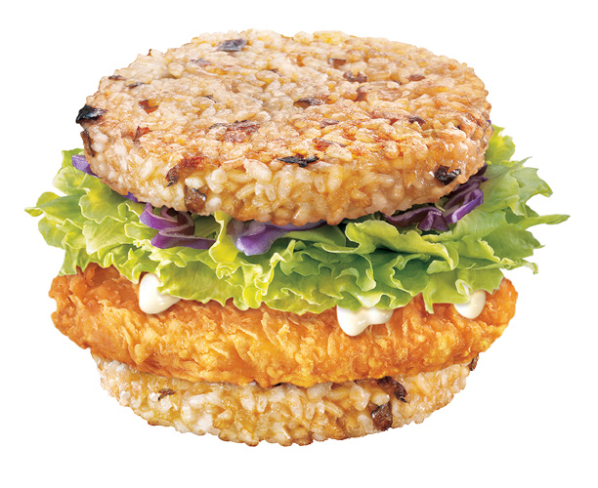
Glocalization
A term that was invented to emphasize that the globalization of a product is more likely to succeed when the product or service is adapted specifically to each locality or culture in which it is marketed. The increasing presence of McDonald’s restaurants worldwide is an example of globalization, while changes made to the menus of the restaurant chain, in an attempt to appeal to local tastes, are an example of glocalization.

Slide 5
You should be able to:
Distinguish between the terms globalization and glocalization.
Globalization is “the growing interdependence of countries through the increasing volume and variety of cross-border transactions in goods and services and of international capital flows, and through the more rapid and widespread diffusion of technology” (source IMF).
Glocalization is the adaptation of a good for a local market. The adaptation of McDonald’s to the Indian market (with the chicken maharaja mac) is a good example, as is the example of small Japanese cars for the European market and sports vehicles (SUVs) for the North American market.

Slide 6
You should be able to:
Examine the extent to which commercial activities at a local scale have become globalized.
Examine the reasons why the level and rate of adoption varies from place to place.
In many parts of the world, commercial activities have become globalized. Barclays, Tesco, Marks and Spencer, McDonalds and Starbucks, for example, have all become globalized.
The rate of adoption varies with
affordability and acceptibility –
some countries may resist globalization,
for example Myanmar and North Korea.

Slide 7
You should be able to:
Discuss civil society responses to globalization, the adoption, adaptation (glocalization) or rejection of globalized goods, services and cultural traits.
Evaluate the relative costs and benefits of local commercial production to the producer, the consumer and the local economy, compared with the costs and benefits of globalized production.
Local responses can lead to a product being adapted, for example, Wal-Mart varied its style to fit the Chinese market and the German market.
Costs and benefits can be seen with regard to the food industry. Mass-produced foods may be cheap, but they can be environmentally damaging. Local farmers’ products produce may be more environmentally friendly – although this is not always the case – but generally costs more.

Slide 8
You should be able to:
describe the role of civil society in raising awareness of local and global environmental, social and cultural issues.
examine the role of civil society in supporting local economic activity and strengthening local cultural values.
discuss the position held by anti-globalization groups.
evaluate the quality of life of a contemporary non-globalized society.
A good example is the role of Greenpeace, the Body Shop and Friends of the Earth in raising awareness over Shell’s involvement in the Niger delta with the Ogoni population.
Avaaz is an NGO that is involved in political campaigns largely via the Internet. Survival International is an NGO that helps raise awareness about indigenous groups.
For some non-globalized societies, such as the Popaluca Indians of Mexico, their traditional ways provide a high quality of life, but this being threatened as their forests are destroyed (the same with the Cofáns in Ecuador).

Slide 9
