Slide 1
Transnational Corporations
Transnational corporations -- those corporations which operate in more than one country or nation at a time -- have become some of the most powerful economic and political entities in the world today.

Slide 2
Many of these companies have far more power than the nation-states across whose borders they operate
For example, the combined revenues of just General Motors and Ford -- the two largest automobile corporations in the world -- exceed the combined Gross Domestic Product (GDP) for all of sub-Saharan Africa.

Slide 3
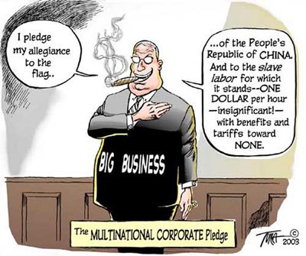

Slide 4
The combined sales of only 6 Japanese trading companies are nearly equivalent to the combined GDP of all of South America.

Slide 5
Transnational corporations hold ninety percent of all technology and product patents worldwide, and are involved in 70 percent of world trade.

Slide 6
The number of transnational corporations in the world has jumped from 7,000 in 1970 to 40,000 in 1995.
While global in reach, these corporations’ home bases are concentrated in the Northern industrialized countries,
where ninety percent of all transnationals are based.
More than half come from just five nations:
France, Germany, the Netherlands, Japan and the United States.

Slide 7
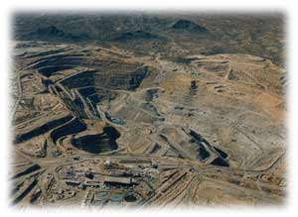
Given their dominance of politics, economics and technology, it is not surprising to find the big transnationals deeply involved in most of the world’s serious environmental crises.

Slide 8
Transnational corporations exert significant influence over the domestic and foreign policies of the Northern industrialized government that host them. Surprise! Indeed, the interests of the most powerful governments in the world are often intimately intertwined with the expanding pursuits of the transnationals that they charter.
At the same time, transnational corporations are moving to circumvent national governments.
The borders and regulatory agencies of most governments are caving in (or being paid off) to the New World Order of globalization, allowing corporations to assume an ever more stateless quality, leaving them less and less accountable to any government anywhere.

Slide 9
Two reasons for choosing developing countries as place of production
Cheap labour
Increasing wealth and spending power of the population as the economy grows and develops.

Slide 10
Because of the widening gap between the rich and poor in many developing countries, it is seldom the same people who would, for example, eat in an American fast food outlet as would work in an American shoe factory in China.

Slide 11
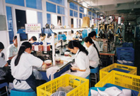

Slide 12
McDonald's in Egypt

Slide 13
Prices that are similar to those charged in the United States.
Establish a fashionable image of exotic “foreign” American.
Clean and safe.

Slide 14
Supersize Me

Slide 15
The local place adapts to the TNCs’ production methods
The operations of the TNCs also adapt to local conditions
For instance: Pizza Hut’s use of delivery bicycles in Shenzen.

Slide 16
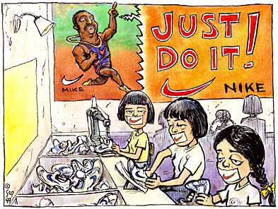
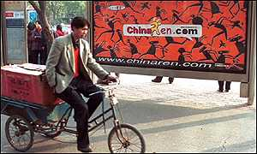

Slide 17
Global media networks

Slide 18
1960s: Marshall McLuhan
The world would become a “global village”

Slide 19
Global village Global communications would improve so much that exchanging information with other people would become as easy as communicating to another person in the same village.

Slide 20
International telephone calls
Undersea cable
Communications satellites
Internet

Slide 21
Internet
US Department of Defence
United States
English as their first language
New parts of the world

Slide 22
Internet continued
Capacity to influence local cultures and ways of thinking by introducing new ideas very quickly
Communicate quickly and cheaply through chat sessions
Has the potential to reach maaaaaaaaaaaaaaaany users

Slide 23
Television

Slide 24
Information and entertainment can reach most parts of the world almost instantly
May come to suppress the local culture

Slide 25
Movies change cultural attitudes and perspectives
Many people believe that foreign movies appearing in China in the 1980s caused large numbers of locals to support economic development that would enable China to catch up with the rest of the world.

Slide 26
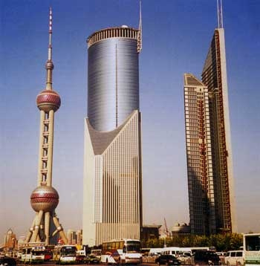
Shanghai’s skyline

