Slide 1
Patterns in environmental quality and sustainability
The syllabus says:
Atmosphere and change
Describe the functioning of the atmospheric system in terms of the energy balance between solar and long-wave radiation. Explain the changes in this balance due to external forcings (changes in solar radiation, changes in the albedo of the atmosphere and changes in the long-wave radiation returned to space).
Discuss the causes and environmental consequences of global climate change.

Slide 2
Diurnal variations occur because the Earth rotates approximately once every 24 hours.

Slide 3
Seasons are a result of the fact that the Earth´s axis is tilted.

Slide 4
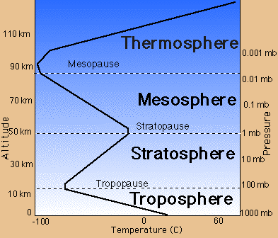

Slide 5
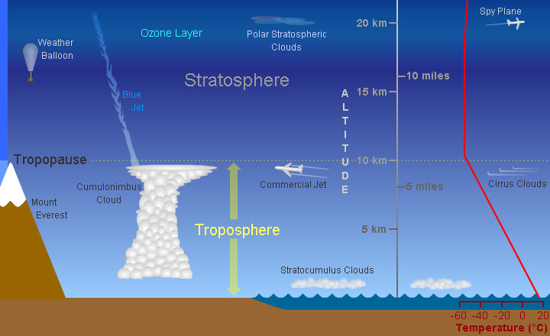
This picture shows the troposphere. The troposphere is a layer of Earth's atmosphere. It starts at the ground and goes up to 10 km high. We live in the troposphere. Weather happens in this layer. Most clouds are found in the troposphere. The higher you go in the troposphere, the colder it gets. The next layer up is the stratosphere

Slide 6
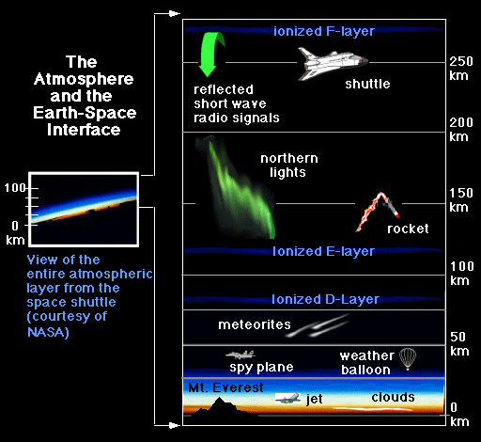

Slide 7
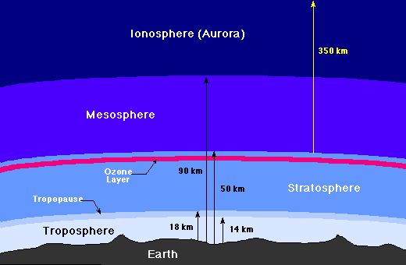

Slide 8
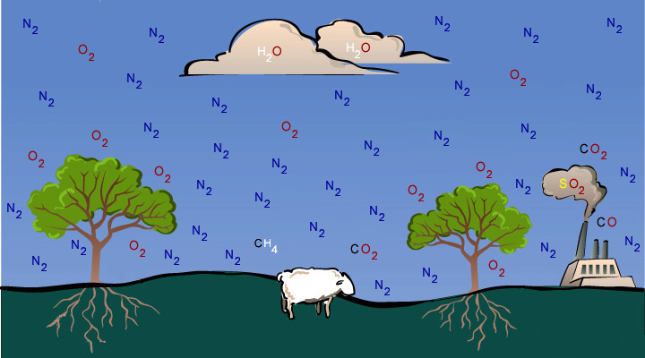
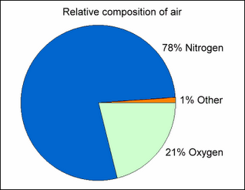
This cartoon shows some of the gases in Earth's troposphere. There is
more nitrogen (N₂) than anything else. There is also a lot of oxygen (O₂).
The cartoon also shows carbon dioxide (CO₂), water vapor (H₂O),
methane (CH₄), sulfur dioxide (SO₂), and carbon monoxide (CO).

Slide 9
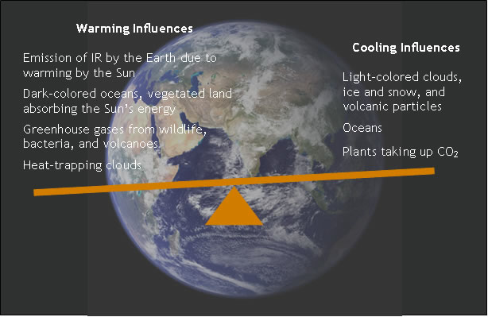

Slide 10
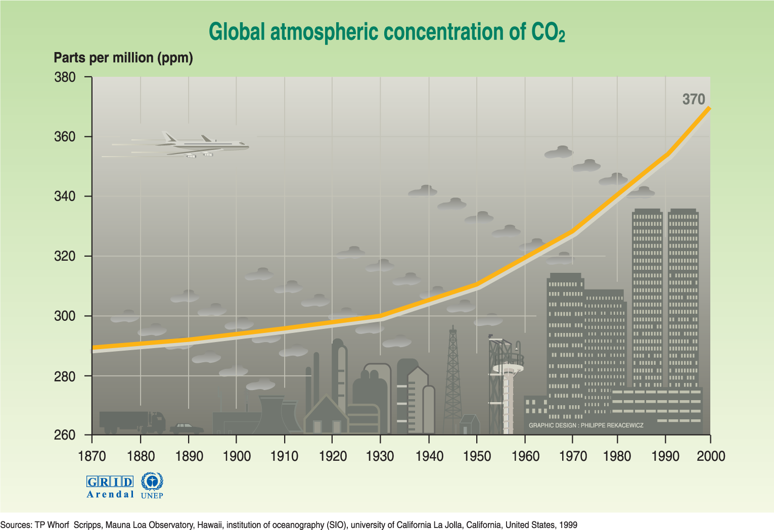

Slide 11
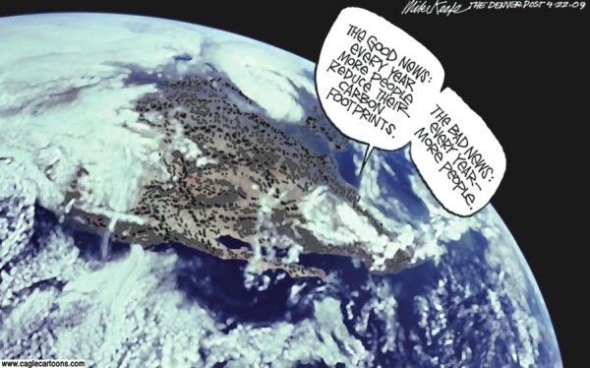

Slide 12
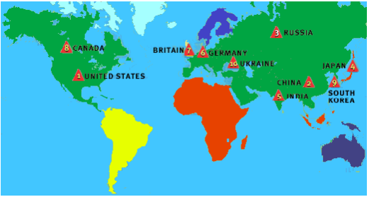
Top Ten CO2 Producing Nations

Slide 13
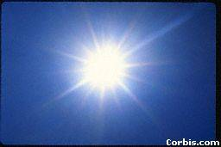
SOLAR ENERGY - VARIATIONS
INSOLATION is the energy which drives the atmospheric weather system. All winds, humidity and weather systems are driven by variations in temperature.

Slide 14
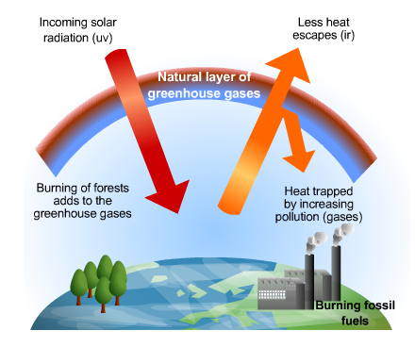

Slide 15
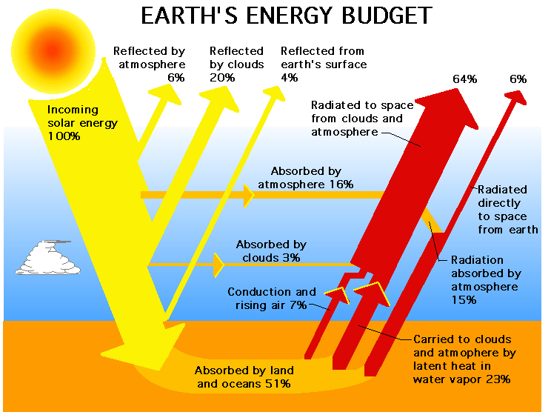

Slide 16
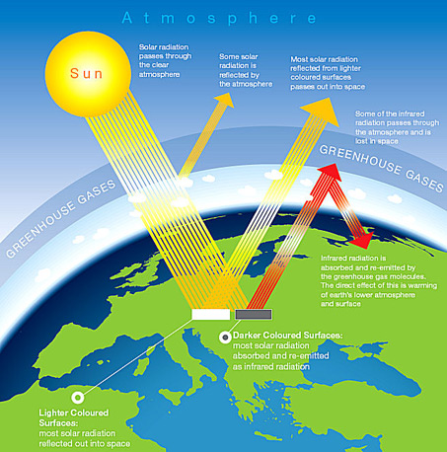

Slide 17
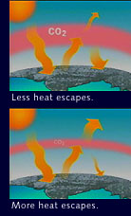

Slide 18
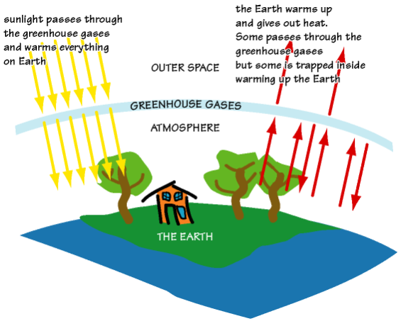

Slide 19
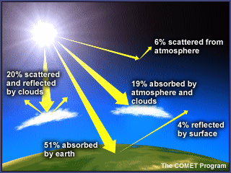

Slide 20
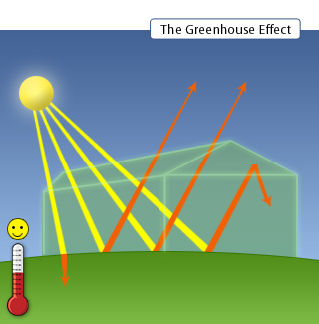

Slide 21
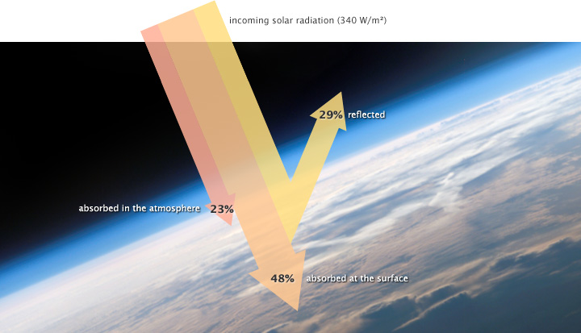

Slide 22
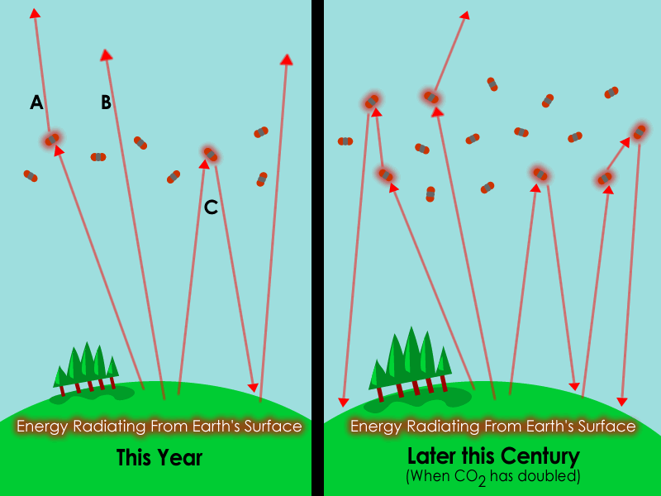

Slide 23
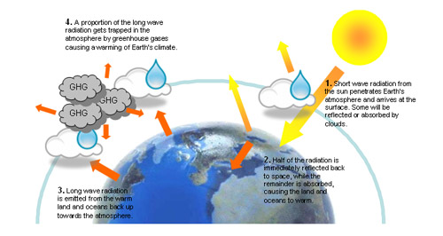

Slide 24
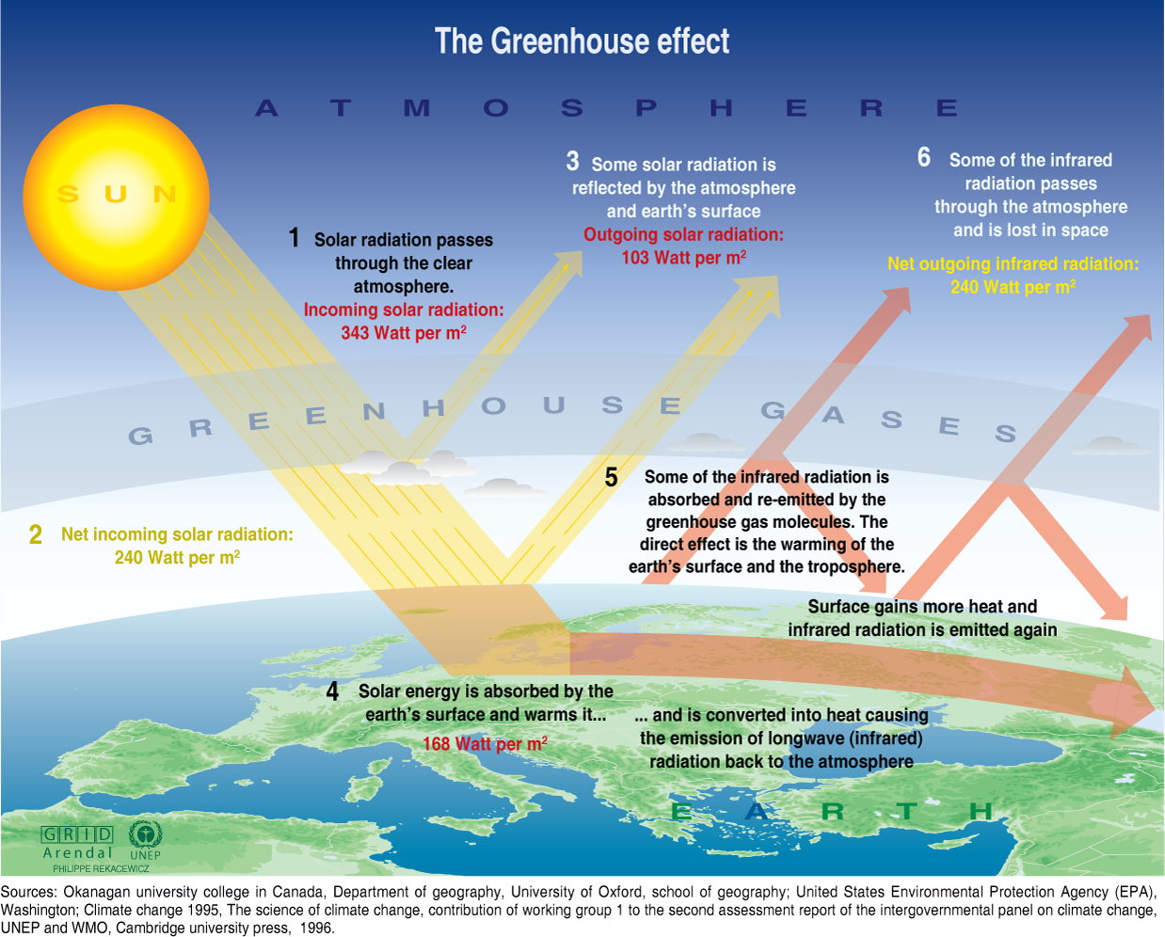

Slide 25
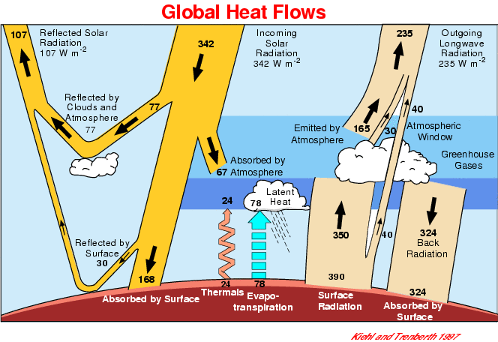

Slide 26
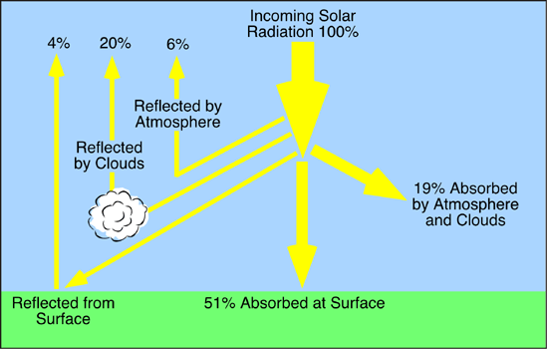

Slide 27
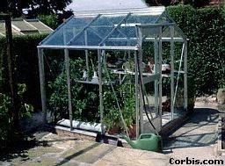
The GREENHOUSE EFFECT, like a real greenhouse (below) is to allow heat in, but not out. Gases in the atmosphere (CO2, Methane) naturally trap outgoing LW radiation more effectively than they do incoming SW radiation. This retains heat, warming the earth’s atmosphere.

Slide 28
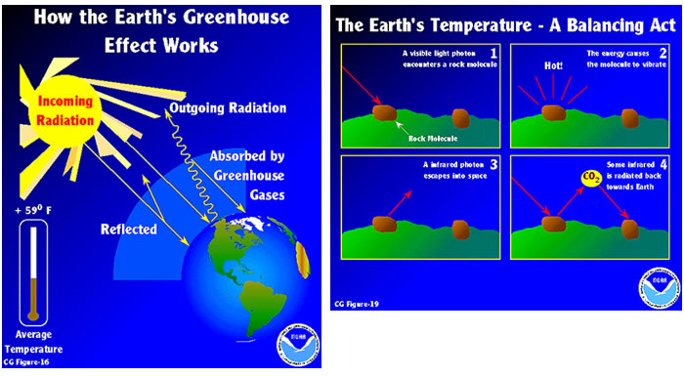

Slide 29
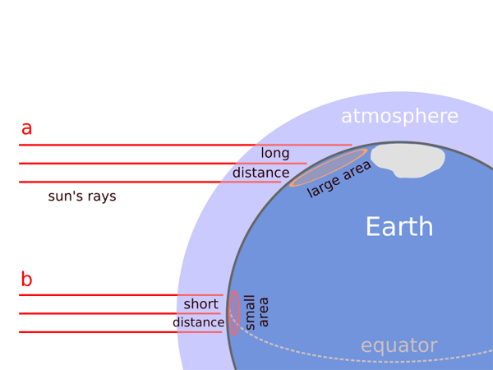

Slide 30
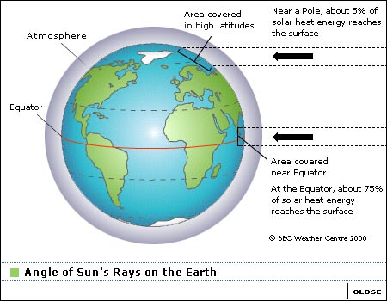
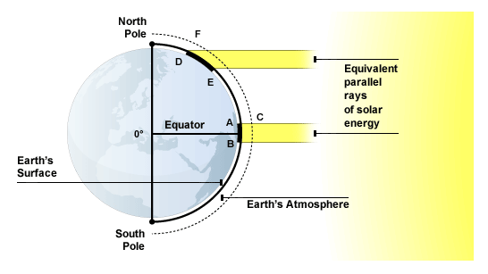

Slide 31
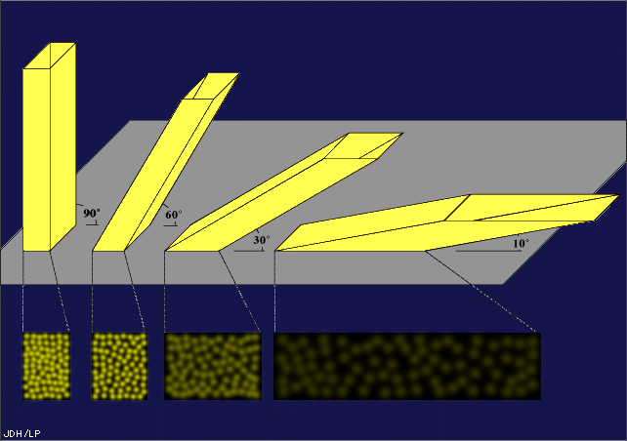

Slide 32
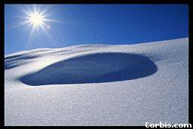
Albedo is the reflection and scattering of light from a surface.

Slide 33
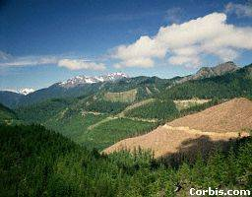
ALBEDO is the reflectivity of the earth’s surface. Darker colours have a lower albedo; it absorbs more incident radiation than lighter colours. On the photo, the snowcapped mountains have the highest albedo, the forest the lowest. Ice cover at the poles has a high albedo, further reducing temperature.

Slide 34
The Albedo Effect
Scientists believe that global warming will trigger new processes. Some will lead to further warming, and others will mitigate it. The impact of these positive and negative feedbacks is a major cause of uncertainty in climate predictions.

Slide 35
Exposed land is darker coloured and absorbs more energy. As the ice melts, more land is exposed. This absorbs more heat, melting more ice.
3) Light coloured ice reflects back the Sun’s energy efficiently.
3) The altitude of the melting ice is reduced so it becomes harder for new ice to form.

Slide 36
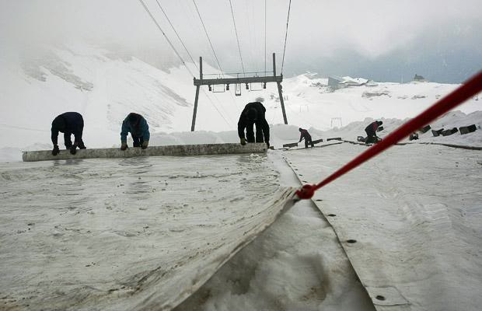
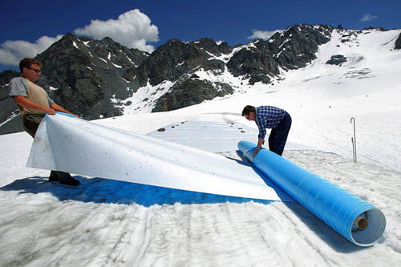

Slide 37
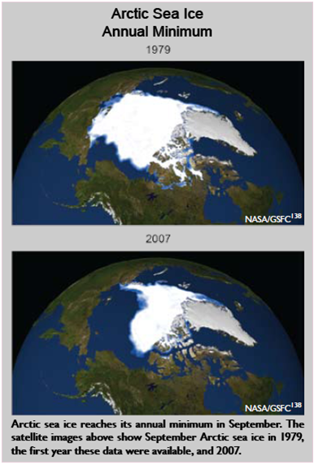

Slide 38
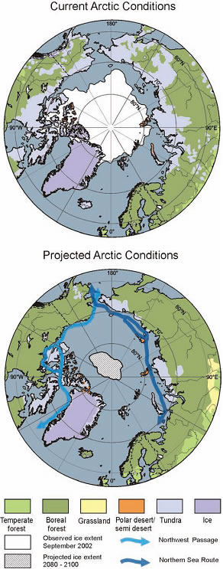

Slide 39
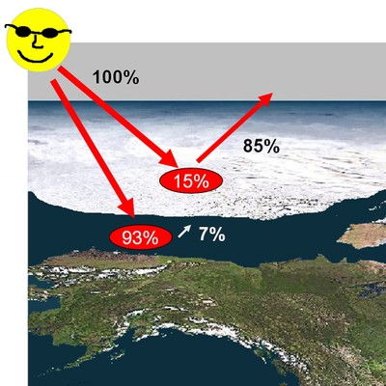

Slide 40
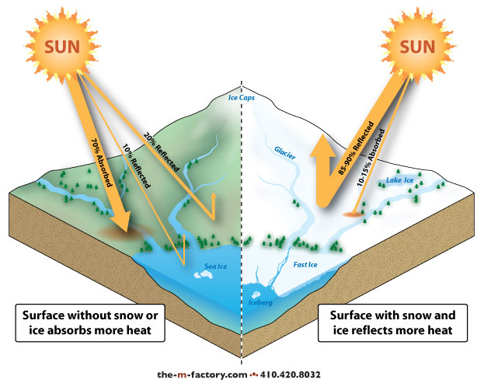

Slide 42
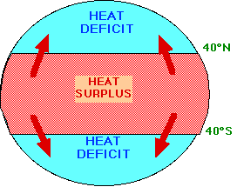
GLOBAL HEAT FLUX

Slide 43
This heat transfer (flux) occurs by:
Ocean currents; cold polar water flows towards the equator while warm water flows from equator to pole.
Winds which blow warm air to towards the poles and cold to the equator.

Slide 44
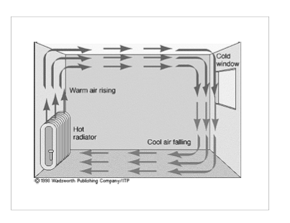

Slide 45
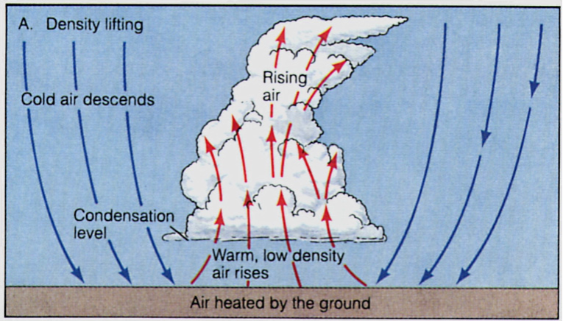

Slide 46
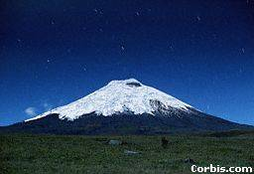
ALTITUDE causes temperature to decrease (by about 0.6°C per 100m). Air is warmed mainly by contact with the ground, so air at altitude is colder. It is also at lower pressure (less dense) so absorbs insolation less effectively. Hence snowcapped peaks.

Slide 47
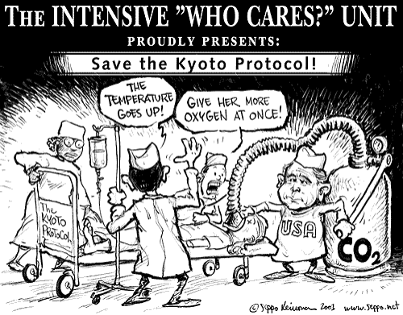

Slide 48
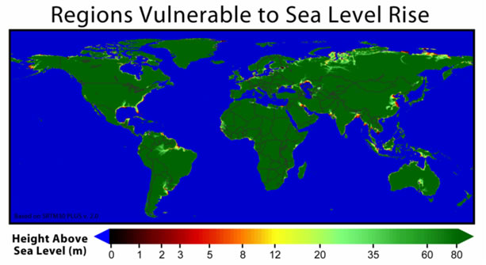

Slide 49
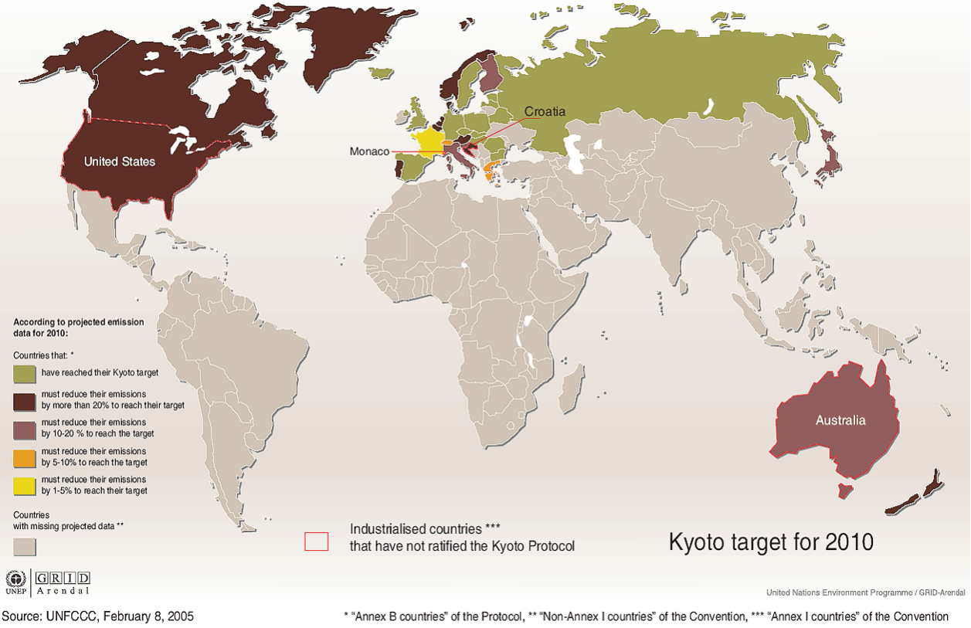

Slide 50
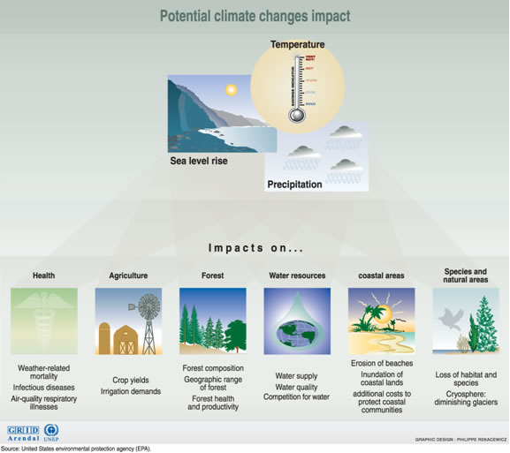

Slide 51
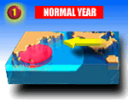
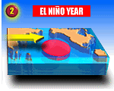
Starting up an El Niño event
The western Pacific Ocean warms and cools in cycles.
Normally, east-to-west winds pile up warm water in the western Pacific, while cold water from deep in the ocean rises to the surface along the South American Coast.
Every few years, the trade winds change, allowing the pool of warm water to move to the east where it blocks the rising cold.

Slide 52
