Slide 1
Tourism as a Development Strategy
Planet Geography

Slide 2
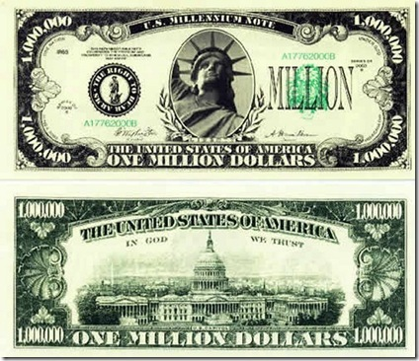
Income of foreign exchange

Slide 3
LEDCs reliant on tourism

Slide 4
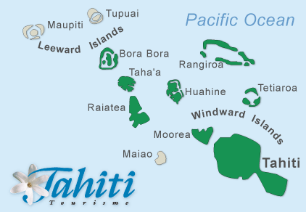
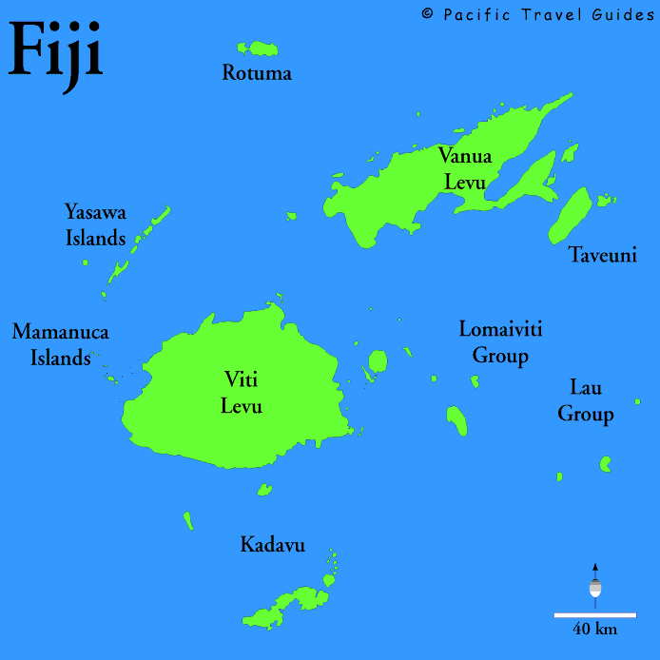
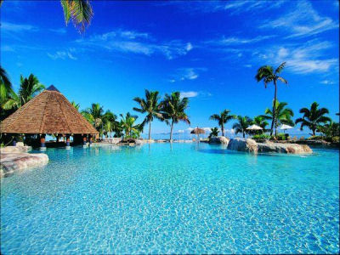
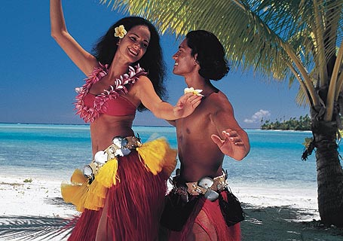
Pacific

Slide 5
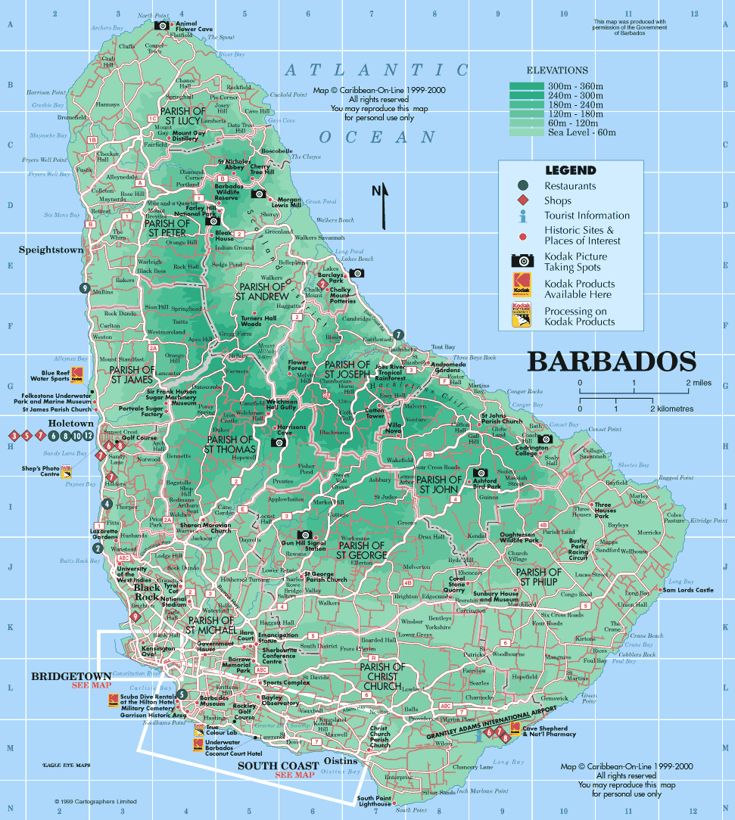
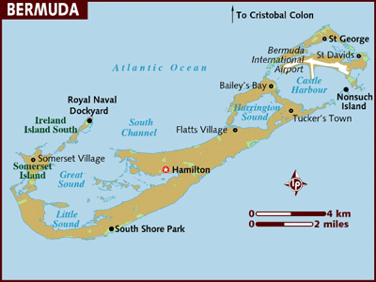
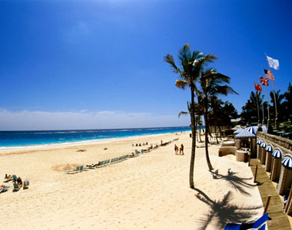
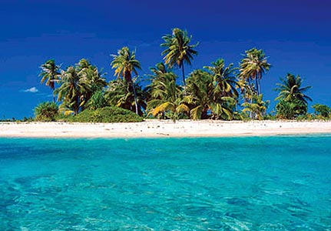
Caribbean

Slide 6
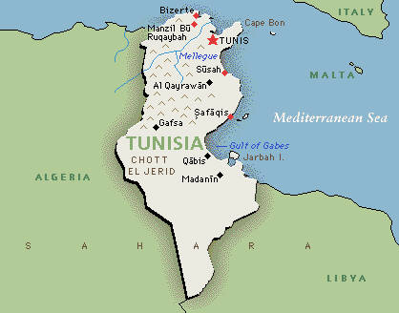
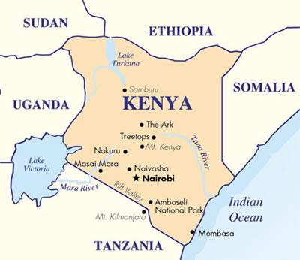
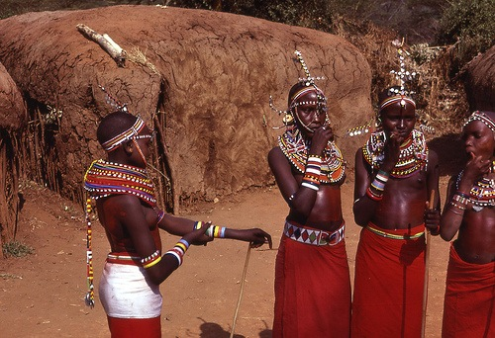
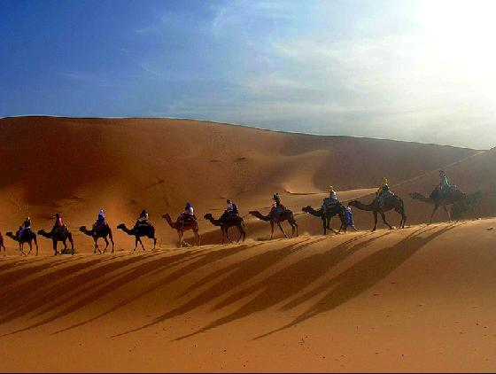
Africa

Slide 7
Positive economic benefits
Income (local economy, investment in other economic sectors, amount that has to be spent each day)
Government revenues (departure tax, other tourism tax, tax on goods and services)
Employment (hotels, restaurants, nightclubs, taxis and souvenir sales)
Improvements in infrastructure (better water and sewage systems, roads, electricity, telephone and public transport networks)
Informal employment (street vendors, rickshaw drivers, informal guides – big multiplier effect)

Slide 8
Positive impact on culture
Impact on culture (brings people from different cultures and backgrounds together: foster understanding, greater tolerance and mutual respect)
Adds to the vitality of communities (events, festivals preserve local identity, renewal of indigenous cultures, cultural arts and crafts, reduce emigration from rural areas)

Slide 9
Negative economic impacts
Leakage (export leakage: to international airlines, hotels and other companies, import leakage: imported food and drinks)
Infrastructure costs (at the expense of education and health)
Drives up the prices (rise in real estate demand, basic goods and services, outsiders gain control over land and property)
Over-dependence of tourism (economic recession in MEDCs, fear of terrorism, natural disasters, might neglect education of children or the production of food)

Slide 10
Negative cultural impact
Negative cultural impact (creates hostility among local people, fail to respect local customs and moral values, making people a spectacle for tourists, spending attitudes, loud behaviour, in a role of servitude, cultural bastardisation and trinketisation = people are assimilated into the materialistic attitudes of the developed world)
Highlighting the stark contrast in lifestyles (hotels towering over modest buildings, wearing minimal clothing for swimming)
Cultural imperialism (where people such as tourists insensitively impose their own ideas, traditions and culture on others who are in a less powerful situation)

Slide 11
Transculturation
People in a traditional culture are exposed to new and alien ideas by outsiders

Slide 12
Adaptation (reject some, accept some)
Can cause resentment (resent the dilution of culture, resent the convergence with the “mainstream western” culture that results)

Slide 13
Commodify the local culture
Preserving a culture to make it a commodity with an economic value.
Zooification (preserving of traditional cultures as a curiosity for others to see and observe)

Slide 14
Positive environmental impact
Positive pressure to improve the environment
Can be sustainable in the long-term

Slide 15
Sustainable tourism
The local population should remain prosperous and retain its cultural identity.
The landscape should remain attractive to tourists.
Any impact on the ecology of the tourist destination should be minimal.

Slide 16
Sustainable Management of Tourism

Slide 17
Ecotourism encourages
interaction between local people and tourists on an equal basis
preservation of environmental quality
preservation of traditional cultures
education of the tourists
participation by local people

Slide 18
Operates under many labels
Adventure tourism
Contact tourism
Green tourism
Low-impact tourism
Sustainable tourism
Wilderness tourism

Slide 19
Management
Visitor management techniques
Carrying capacity calculations
Consultation and participation with local people

Slide 20
Against ecotourism
Reduces profits
Reduces the speed with which money can be made

Slide 21
So most of the growth in tourism in LEDCs is mass-tourism

Slide 22
Sustainability has 4 facets:
Environmental sustainability
Social sustainability
Cultural sustainability
Economic sustainability

Slide 23
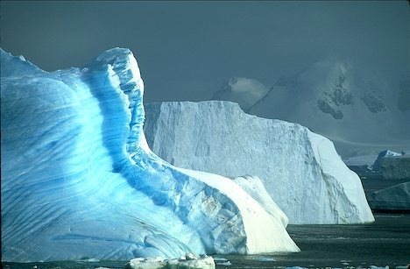
Antarctica
Largest and most pristine wilderness (14 million square kms)
New industry
Small in scale (14700 visitors in 2000)
“Off the beaten track”
Environmental rather than restful
Only possible in summer time
Health risks
High cost ($ US 5000 for 14 days)
Cold, fragile environment

Slide 24
Annual hole in the ozone layer
1991 Protocol on Environmental Protection to the Antarctic Treaty (aims to protect the Antarctic environment)

Slide 25
Negative environmental impact
Soil erosion, increased pollution, loss of wildlife habitats, pressure on endangered species, greater vulnerability to forest fires, pressure on water resources, force the local population to compete for the use of critical resources

